Slide 1
Supplemental Figure S1.
Symptom severity summary score (SYMSUM) by treatment group and timepoint
Worse symptoms

Slide 2
Supplemental Figure S2.
Average symptom score among patients without symptoms at baseline
(“not at all”/“a little bit”)
– Hot Flashes –
Worse symptoms

Slide 3
Supplemental Figure S3.
Average symptom score among patients without symptoms at baseline
(“not at all”/“a little bit”)
– Joint Pains –
Worse symptoms

Slide 4
Supplemental Figure S4.
Average symptom score among patients without symptoms at baseline
(“not at all”/“a little bit”)
– Weight Gain –
Worse symptoms

Slide 5
Supplemental Figure S5.
Average symptom score among patients without symptoms at baseline
(“not at all”/“a little bit”)
– General Aches and Pains –
Worse symptoms

Slide 6
Supplemental Figure S6.
Average symptom score among patients without symptoms at baseline
(“not at all”/“a little bit”)
– Muscle Stiffness –
Worse symptoms

Slide 7
Supplemental Figure S7.
Average symptom score among patients without symptoms at baseline
(“not at all”/“a little bit”)
– Forgetfulness –
Worse symptoms

Slide 8
Supplemental Figure S8.
Relationship between age, treatment, and amenorrhea
 | n (% with amenorrhea)
Age | AC | FEC-100
≤40 | 102 (8.8) | 101 (18.8)
41-45 | 127 (40.2) | 126 (65.9)
46-50 | 162 (88.9) | 150 (88.7)
>50 | 83 (91.6) | 74 (93.2)
Odds ratio for amenorrhea FEC-100 vs AC
FEC-100 is worse

Slide 9
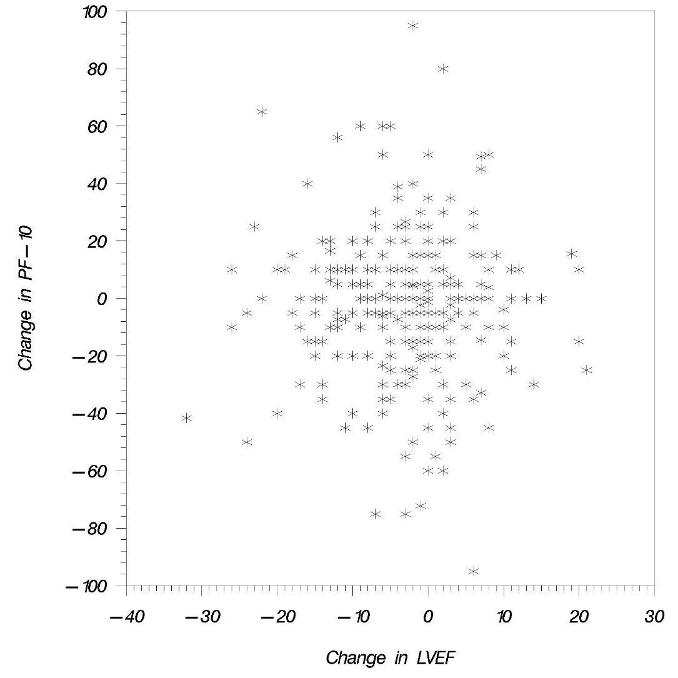
Supplemental Figure S9. Association between change in PF score and change in LVEF (from baseline to 12 months) among women participating in B-36 cardiac sub-study

