Slide 1
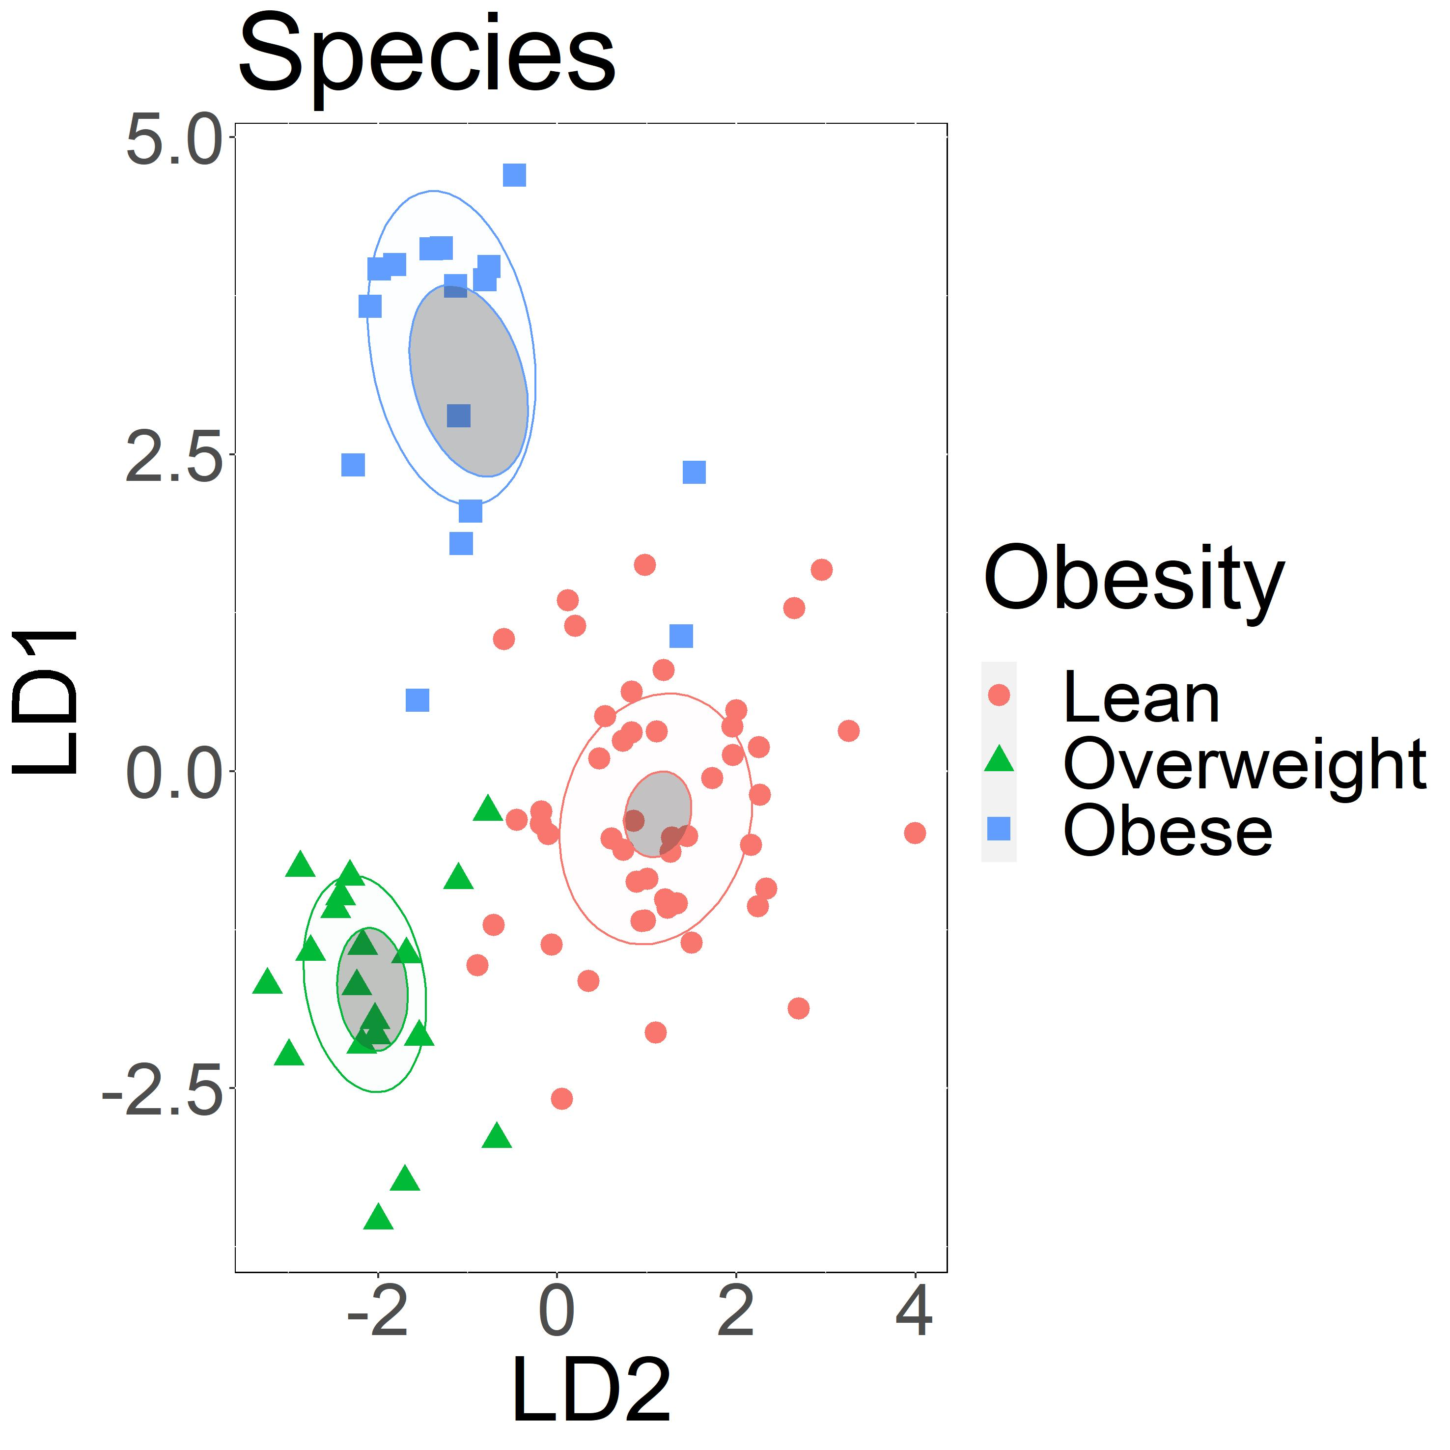
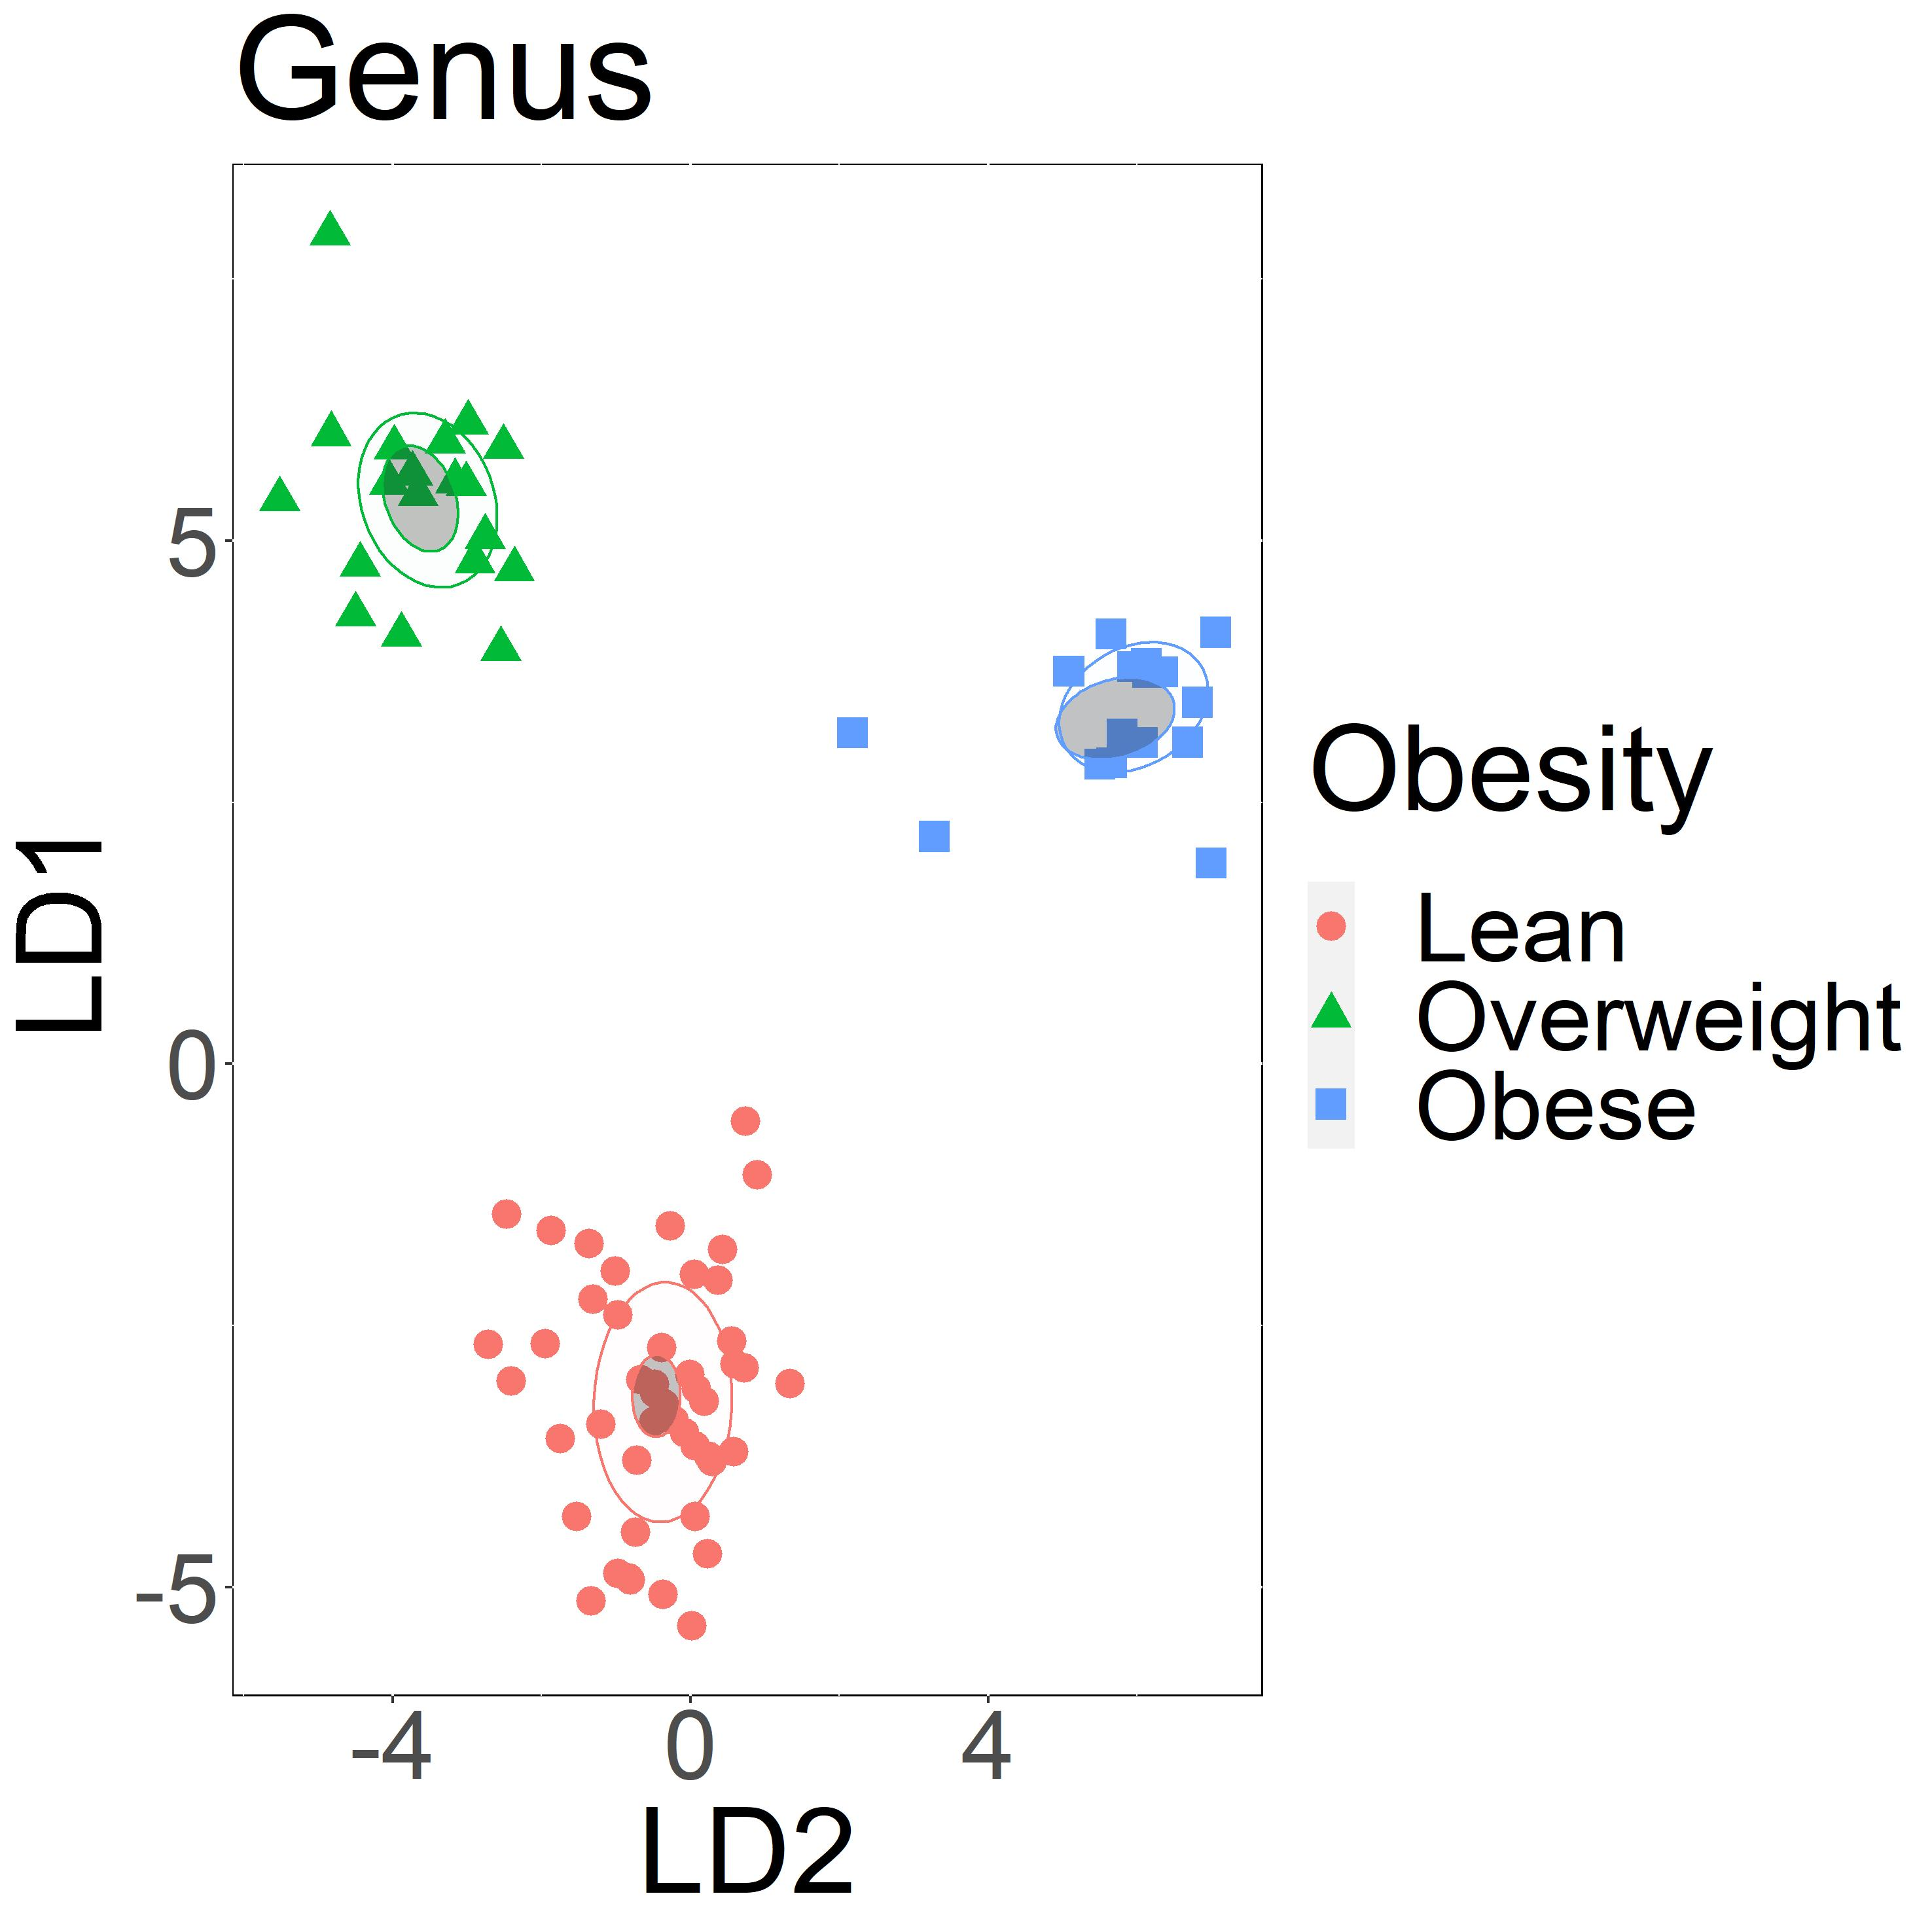
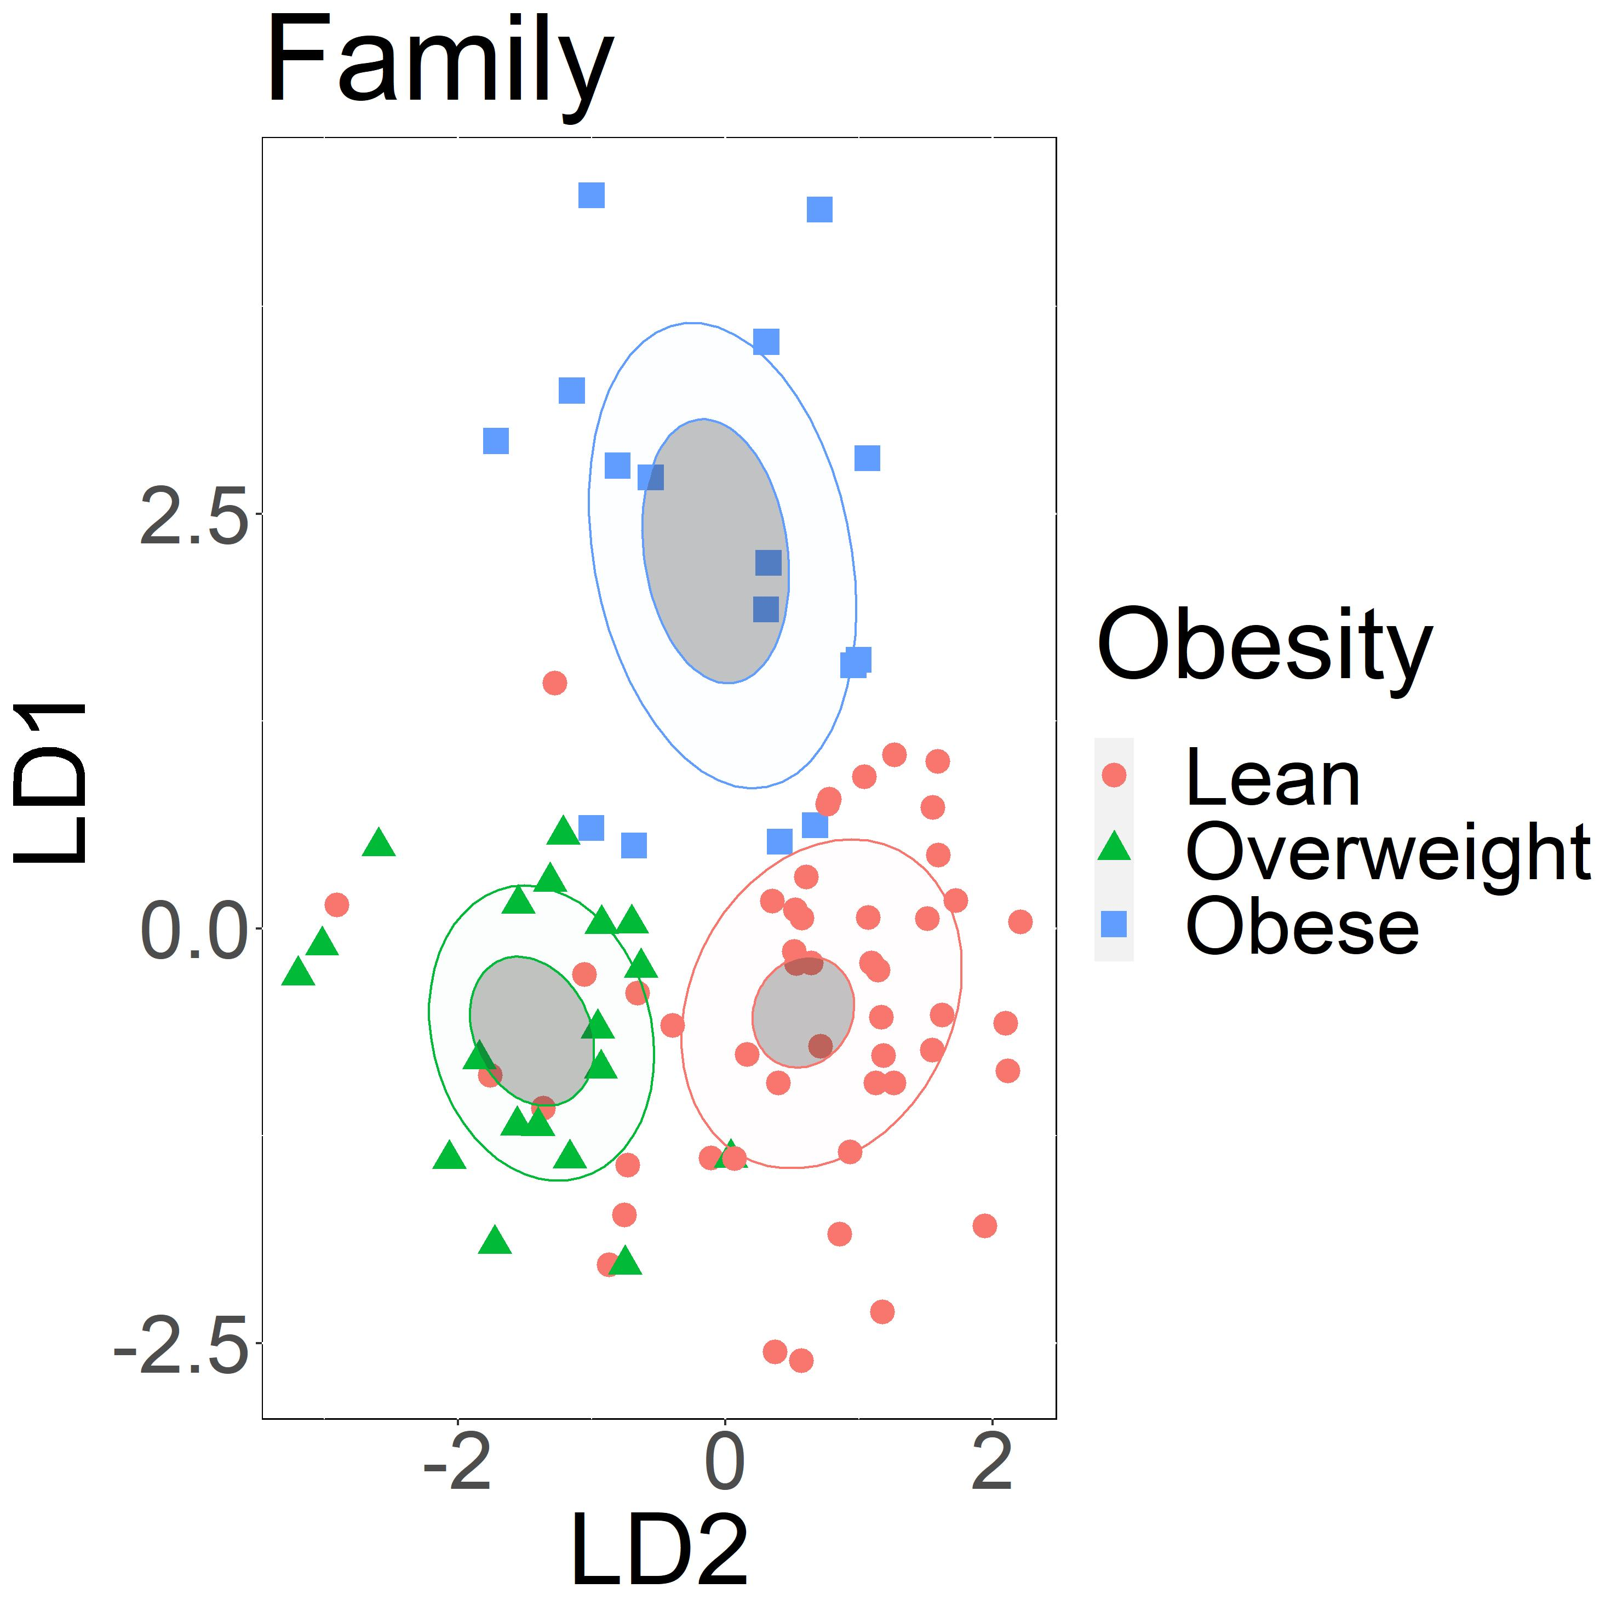
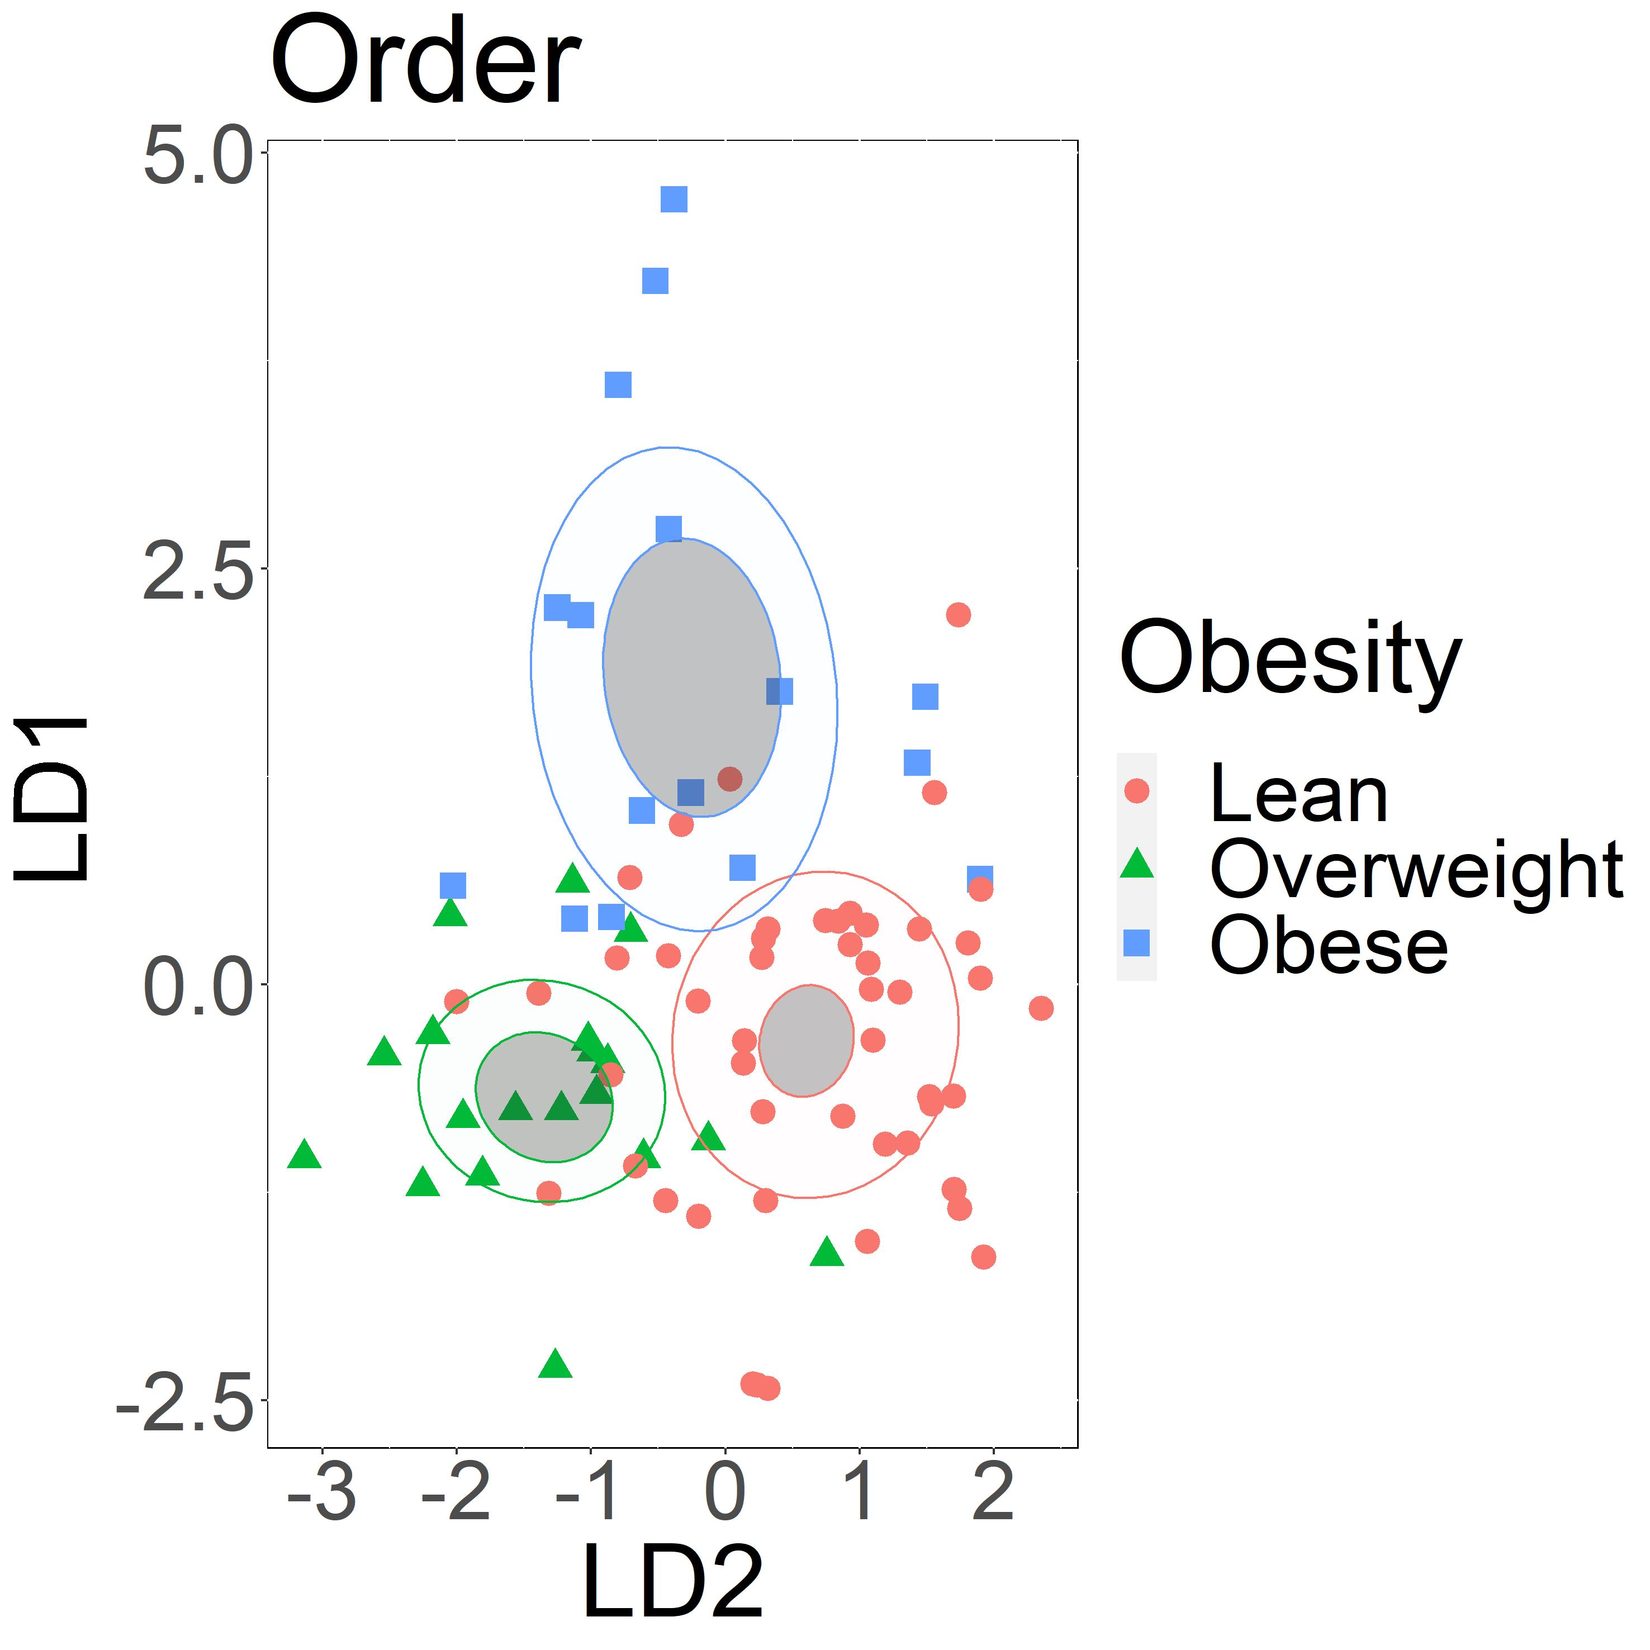
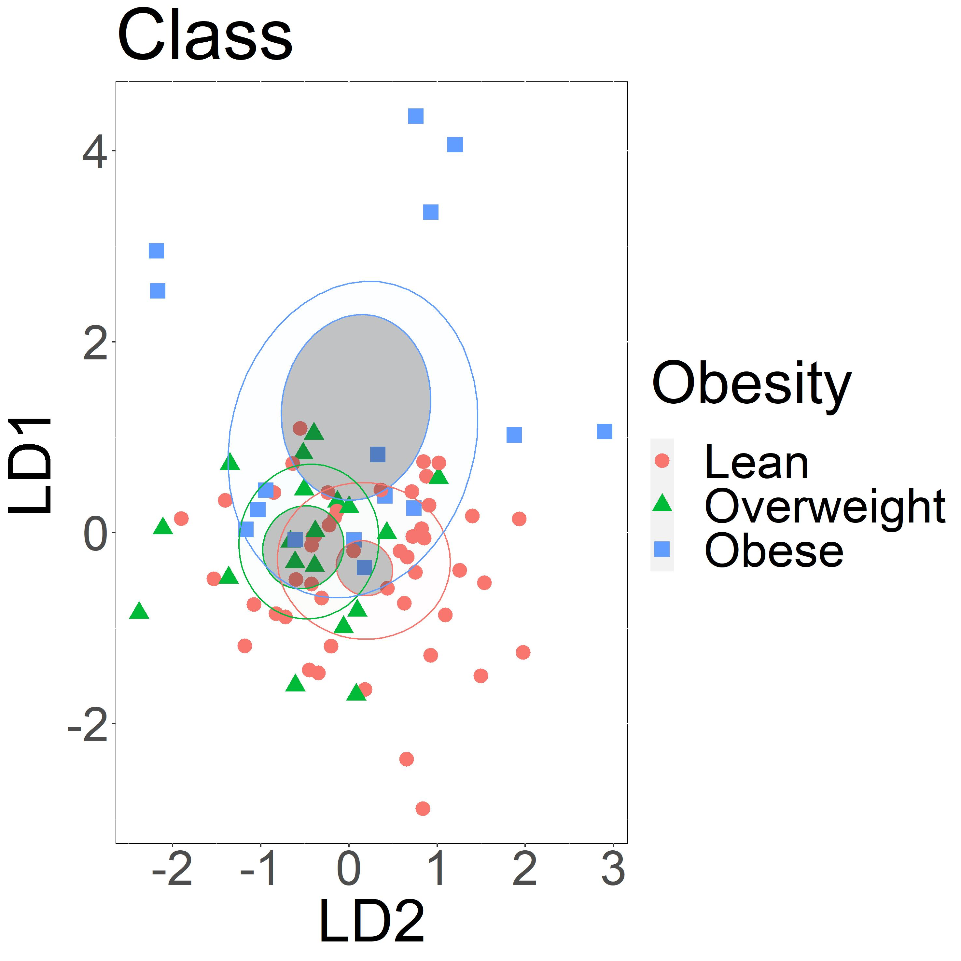
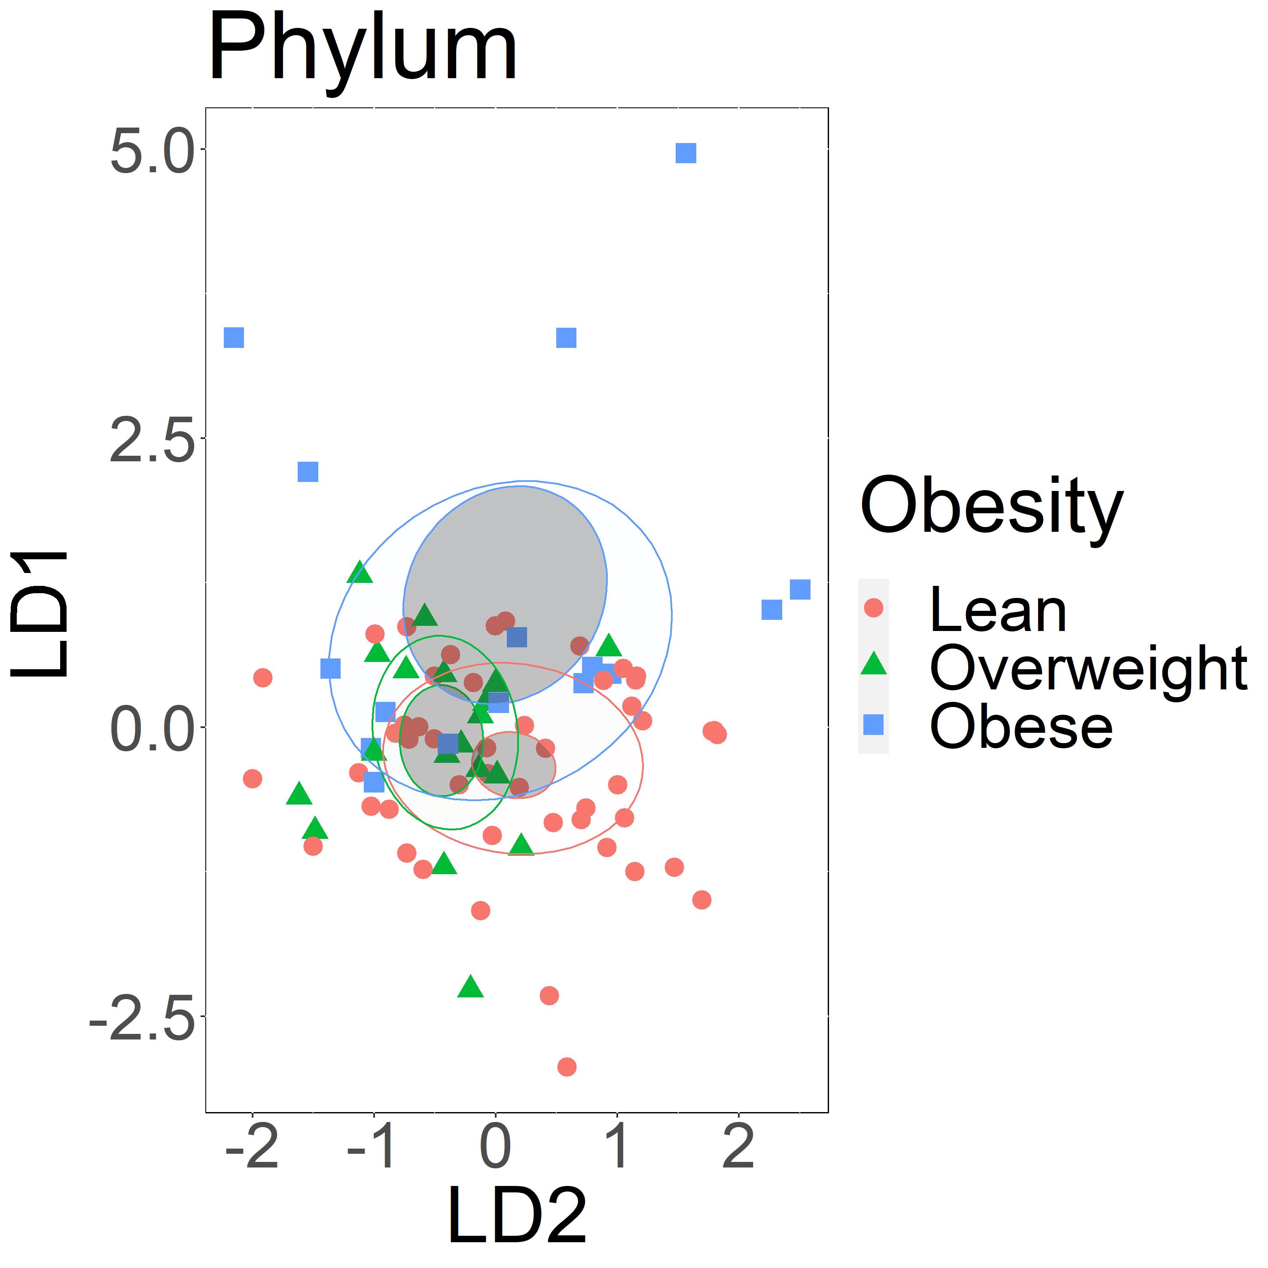
A
B
C
D
E
F
Supplement figure 1: Obesity groups could be characterized based on abundance of salivary bacterial taxa, especially at lower taxonomic ranks. Linear discriminant analysis of A) bacterial species, B) bacterial families, C) bacterial families, D) bacterial orders, E) bacterial classes F) bacterial phyla. Taxa with differential abundance of less than 20 sequences were filtered out. Confidence ellipses are shaded. Normal data ellipses are unfilled and leveled to include 50% of the samples.
Notes:
Supplement figure 1: Obesity groups could be characterized based on abundance of salivary bacterial taxa, especially at lower taxonomic ranks. Linear discriminant analysis of A) bacterial species, B) bacterial families, C) bacterial families, D) bacterial orders, E) bacterial classes F) bacterial phyla. Taxa with abundance of less than 20 were filtered out. Obesity groups are represented by color, lean group by red, overweight group by green, and obese group by blue. Confidence ellipses are shaded. Normal data ellipses are unfilled and leveled to include 50% of the samples.

Slide 2
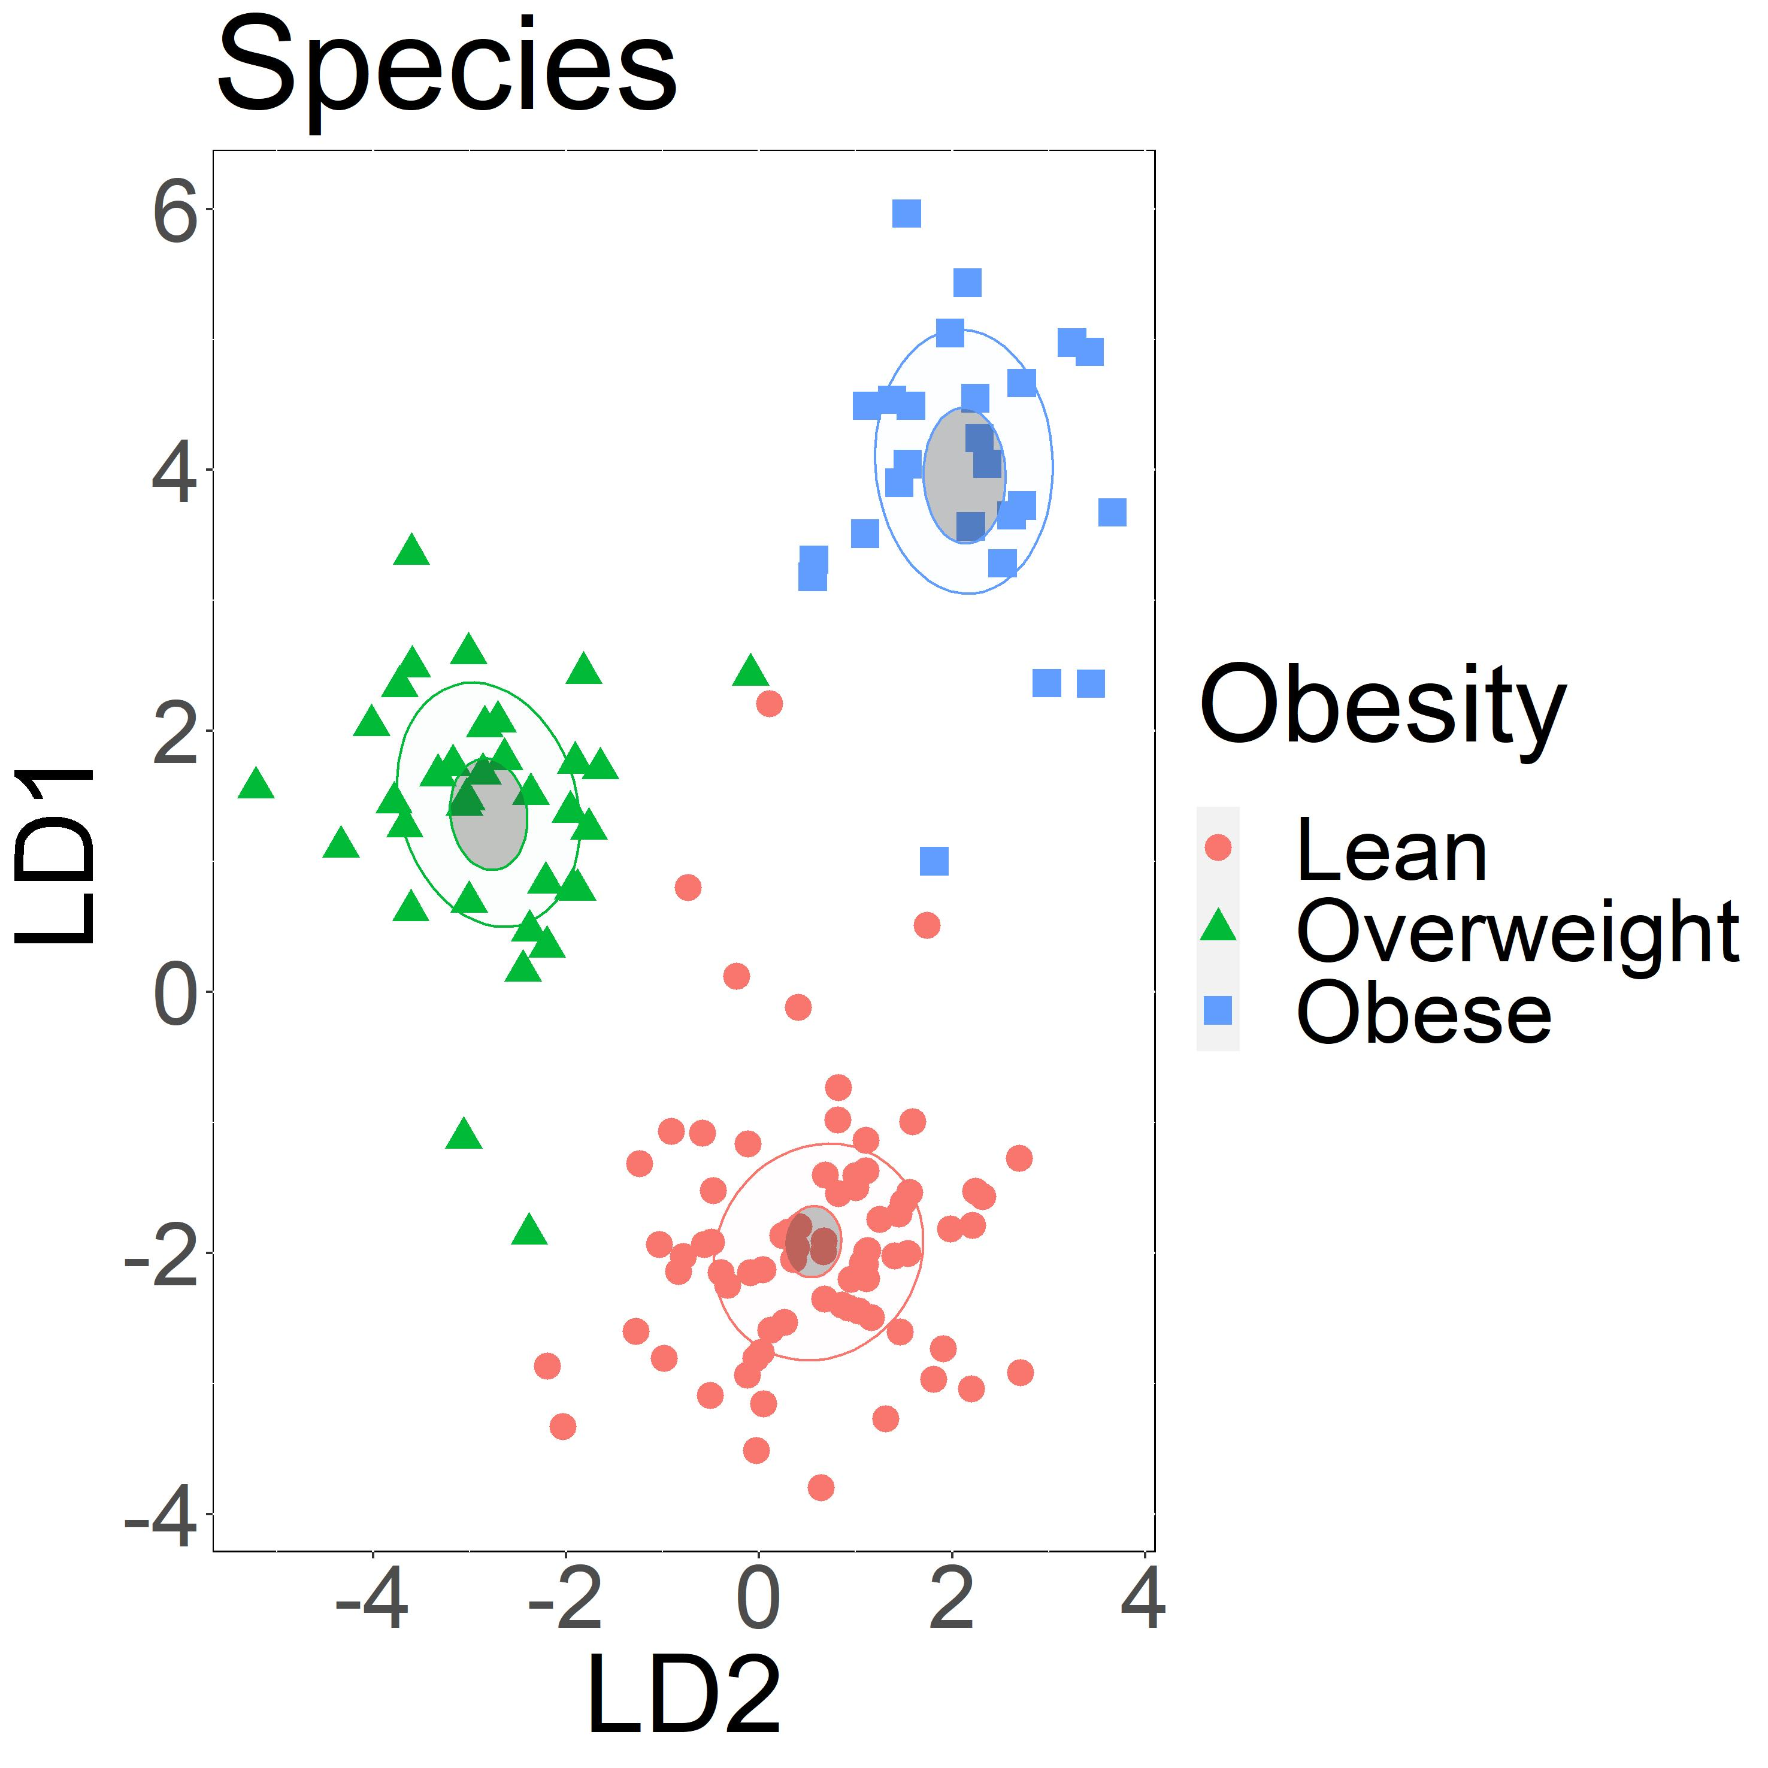
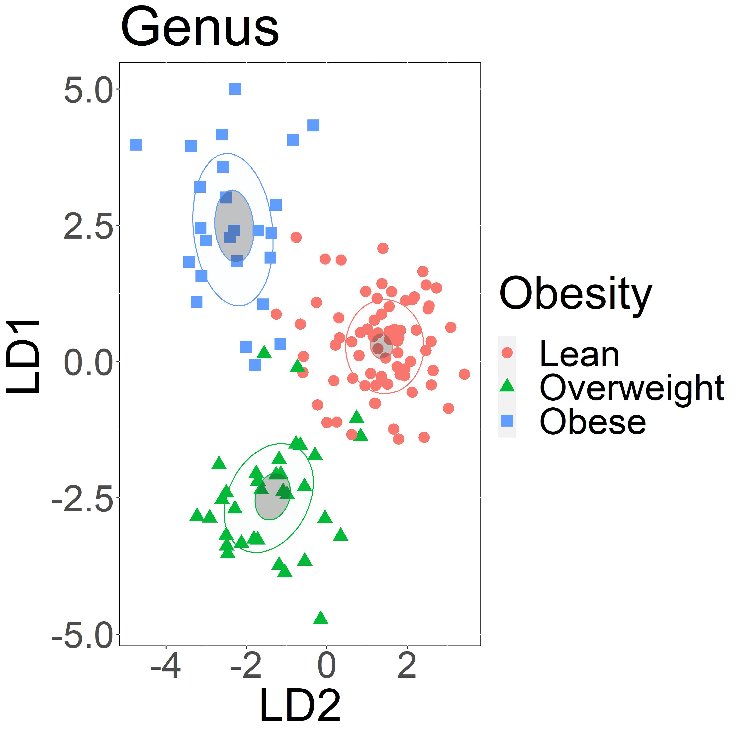
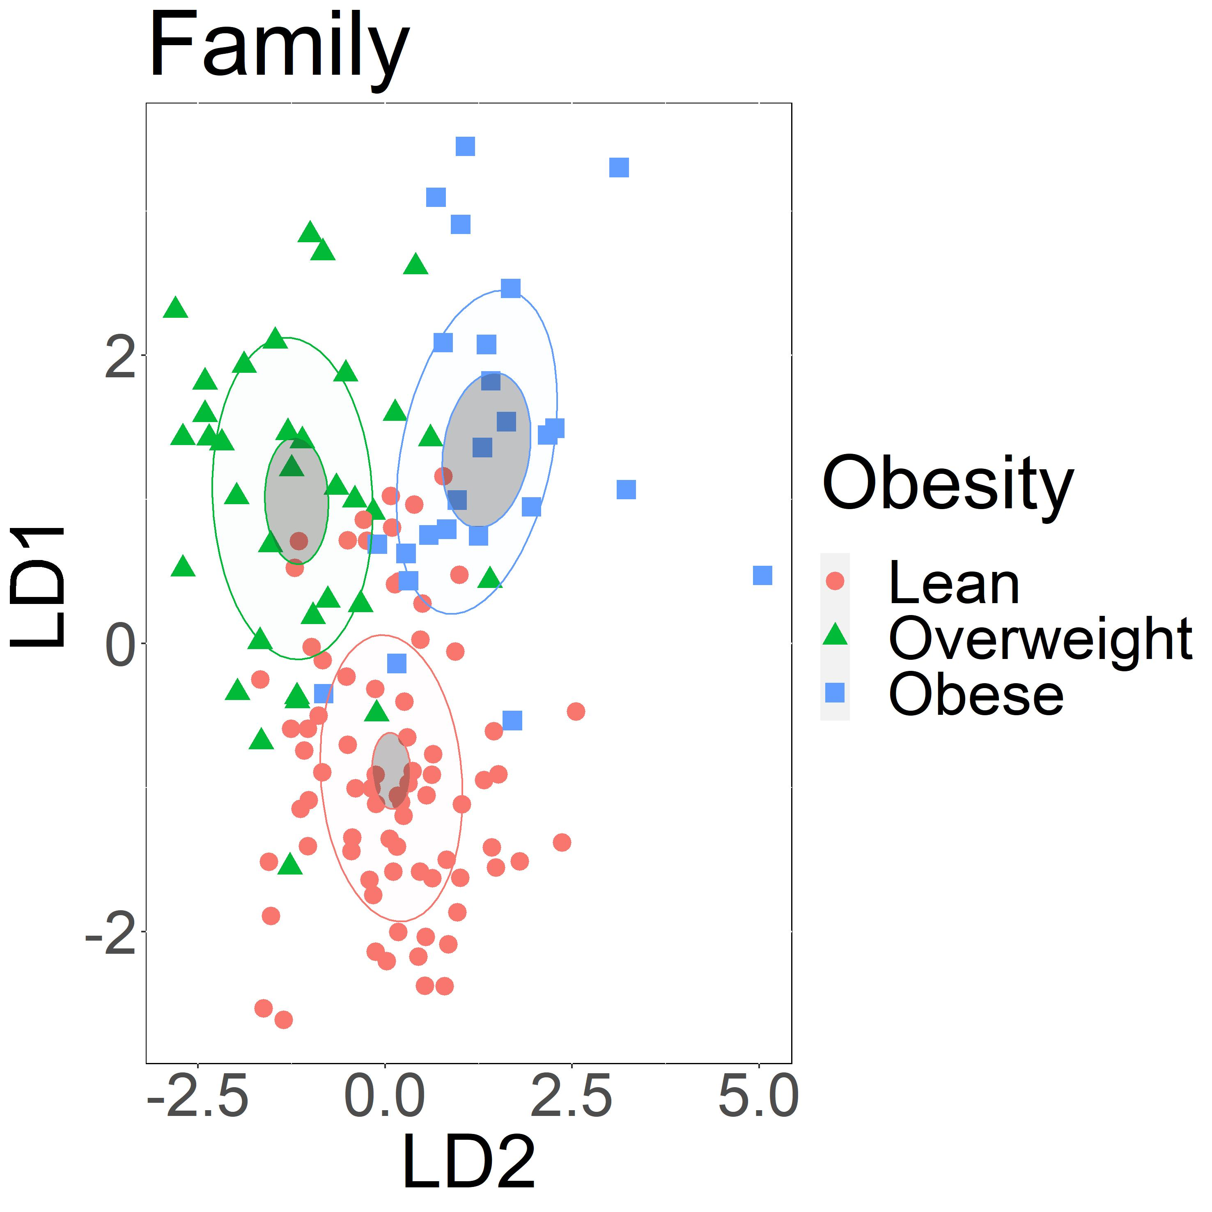
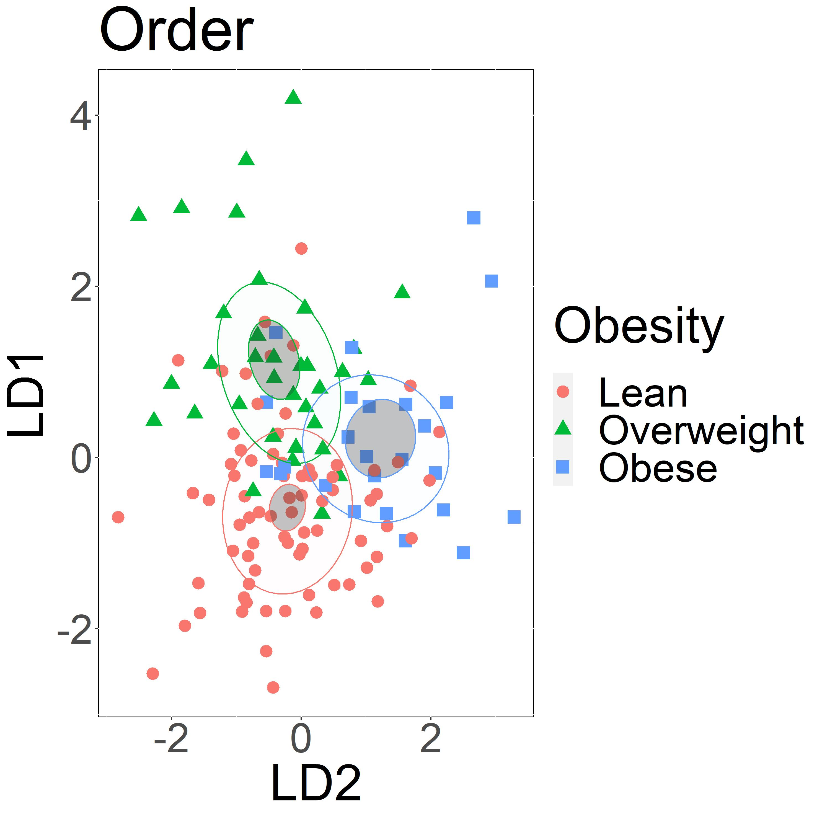
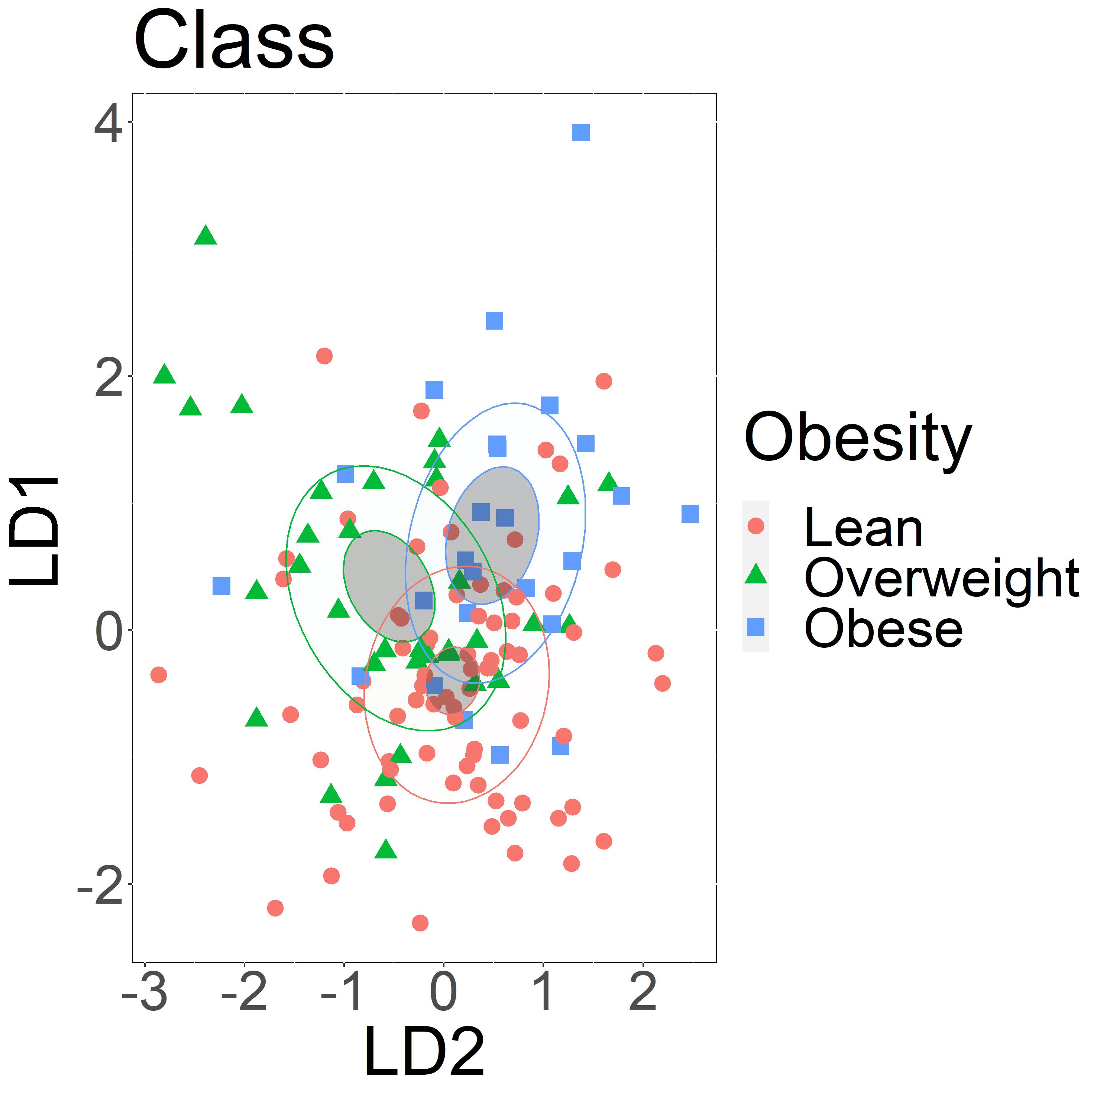
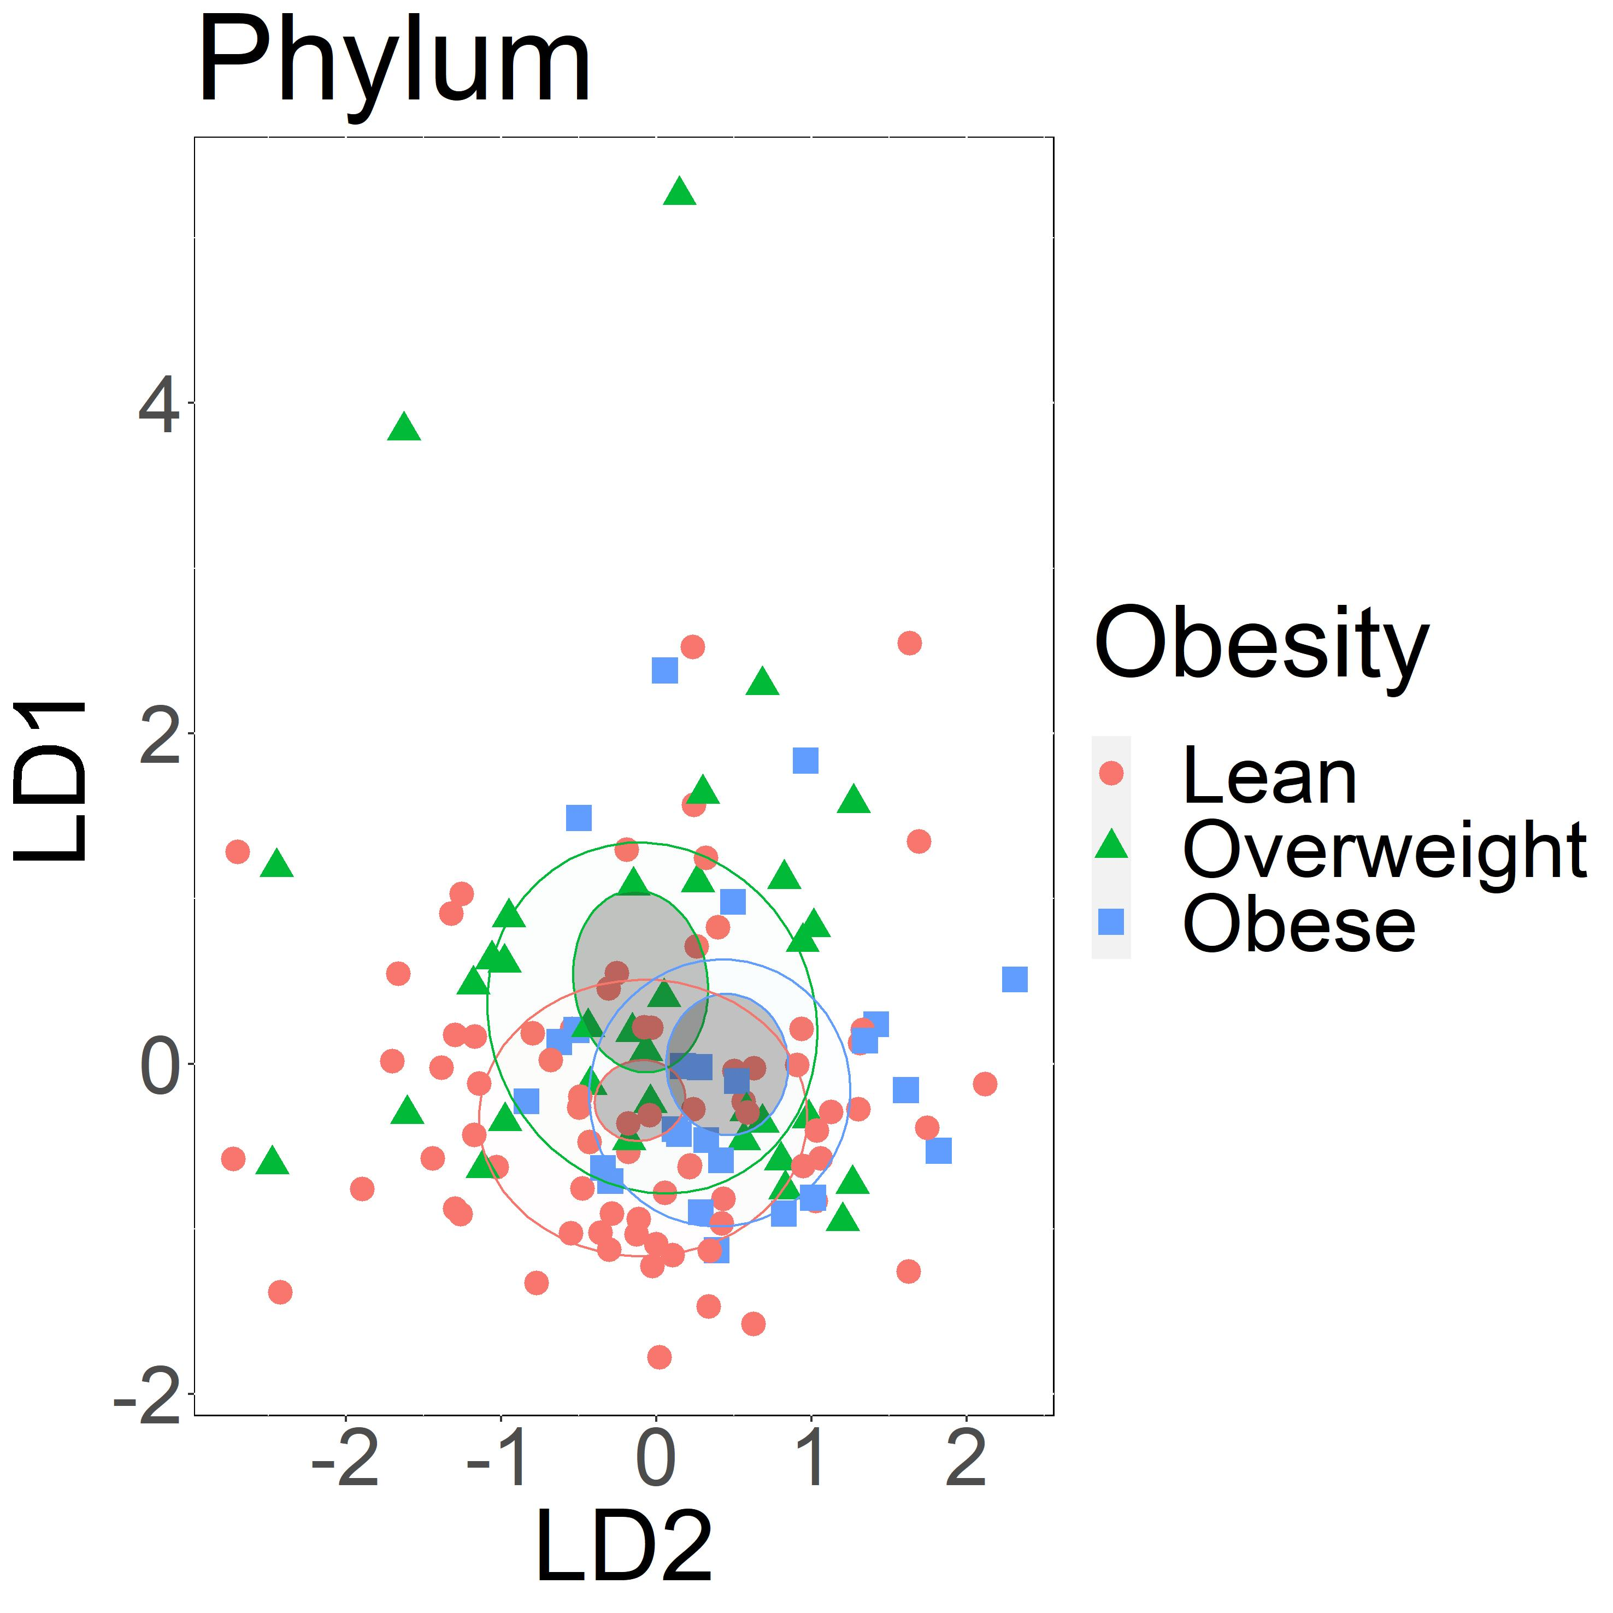
A
B
C
D
E
F
Supplement figure 2: Obesity groups could be characterized based on abundance of fecal bacterial taxa, especially at lower taxonomic ranks. Linear discriminant analysis of A) bacterial species, B) bacterial genera, C) bacterial families, D) bacterial orders, E) bacterial classes F) bacterial phyla. Taxa with abundance of less than 20 sequences were filtered out. Confidence ellipses are shaded. Normal data ellipses are unfilled and leveled to include 50% of the samples.
Notes:
Supplement figure 2: Obesity groups could be characterized based on abundance of fecal bacterial taxa, especially at lower taxonomic ranks. Linear discriminant analysis of A) bacterial species, B) bacterial families, C) bacterial families, D) bacterial orders, E) bacterial classes F) bacterial phyla. Taxa with abundance of less than 20 were filtered out. Obesity groups are represented by color, lean group by red, overweight group by green, and obese group by blue. Confidence ellipses are shaded. Normal data ellipses are unfilled and leveled to include 50% of the samples.

Slide 3
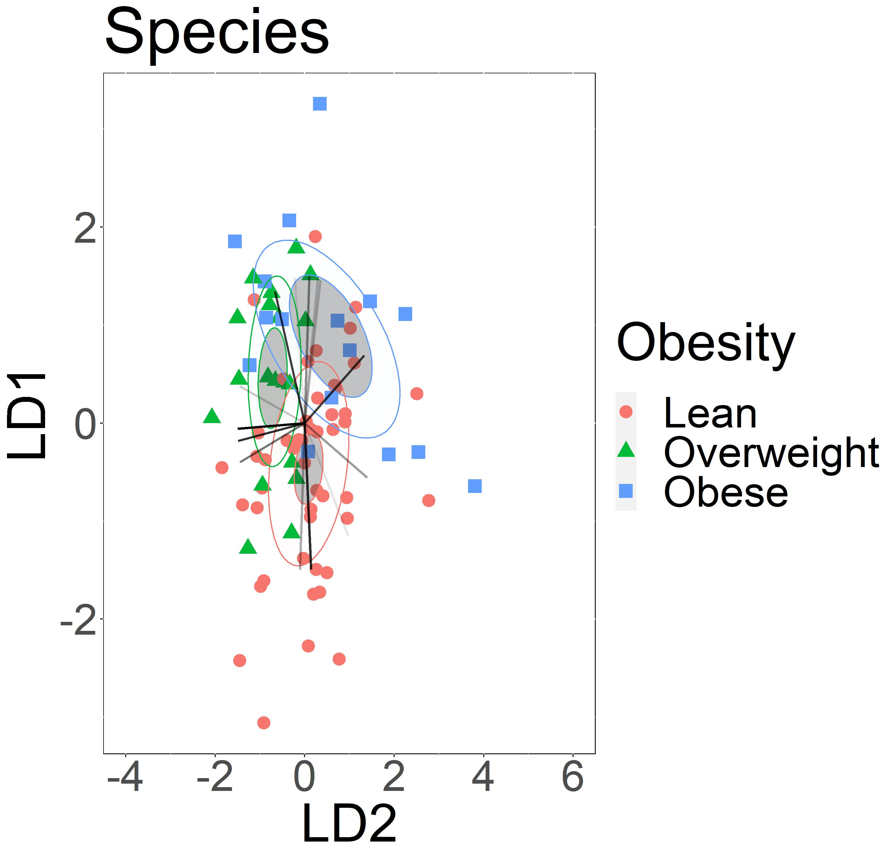
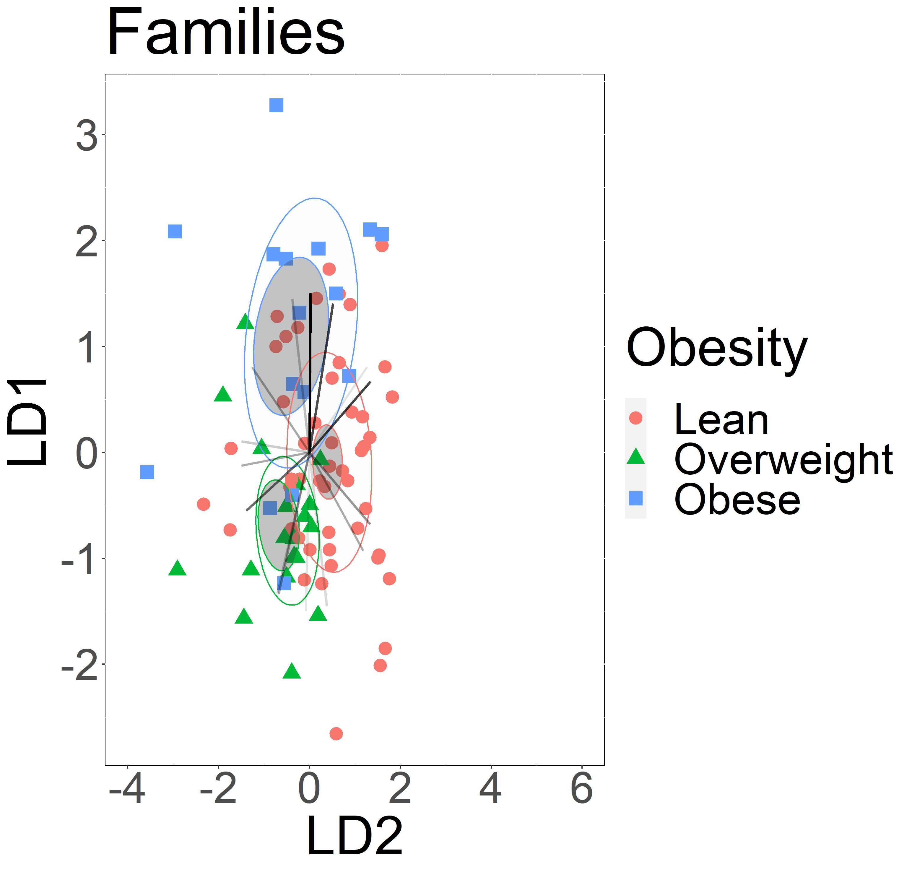
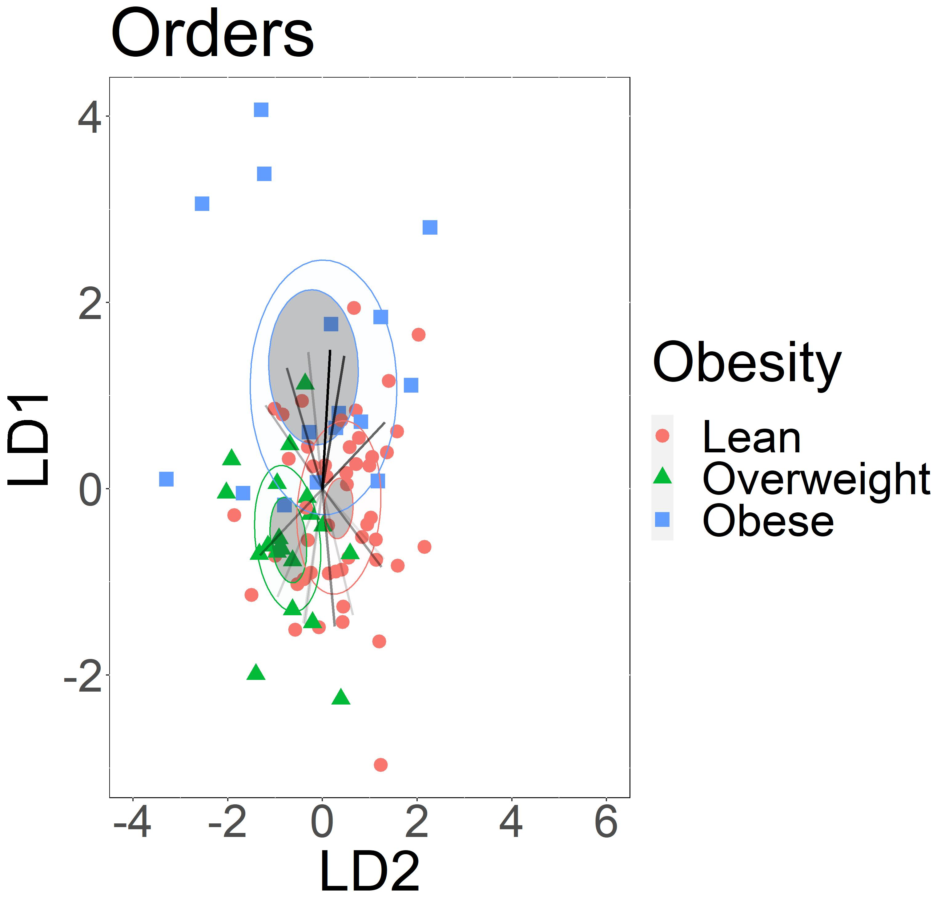
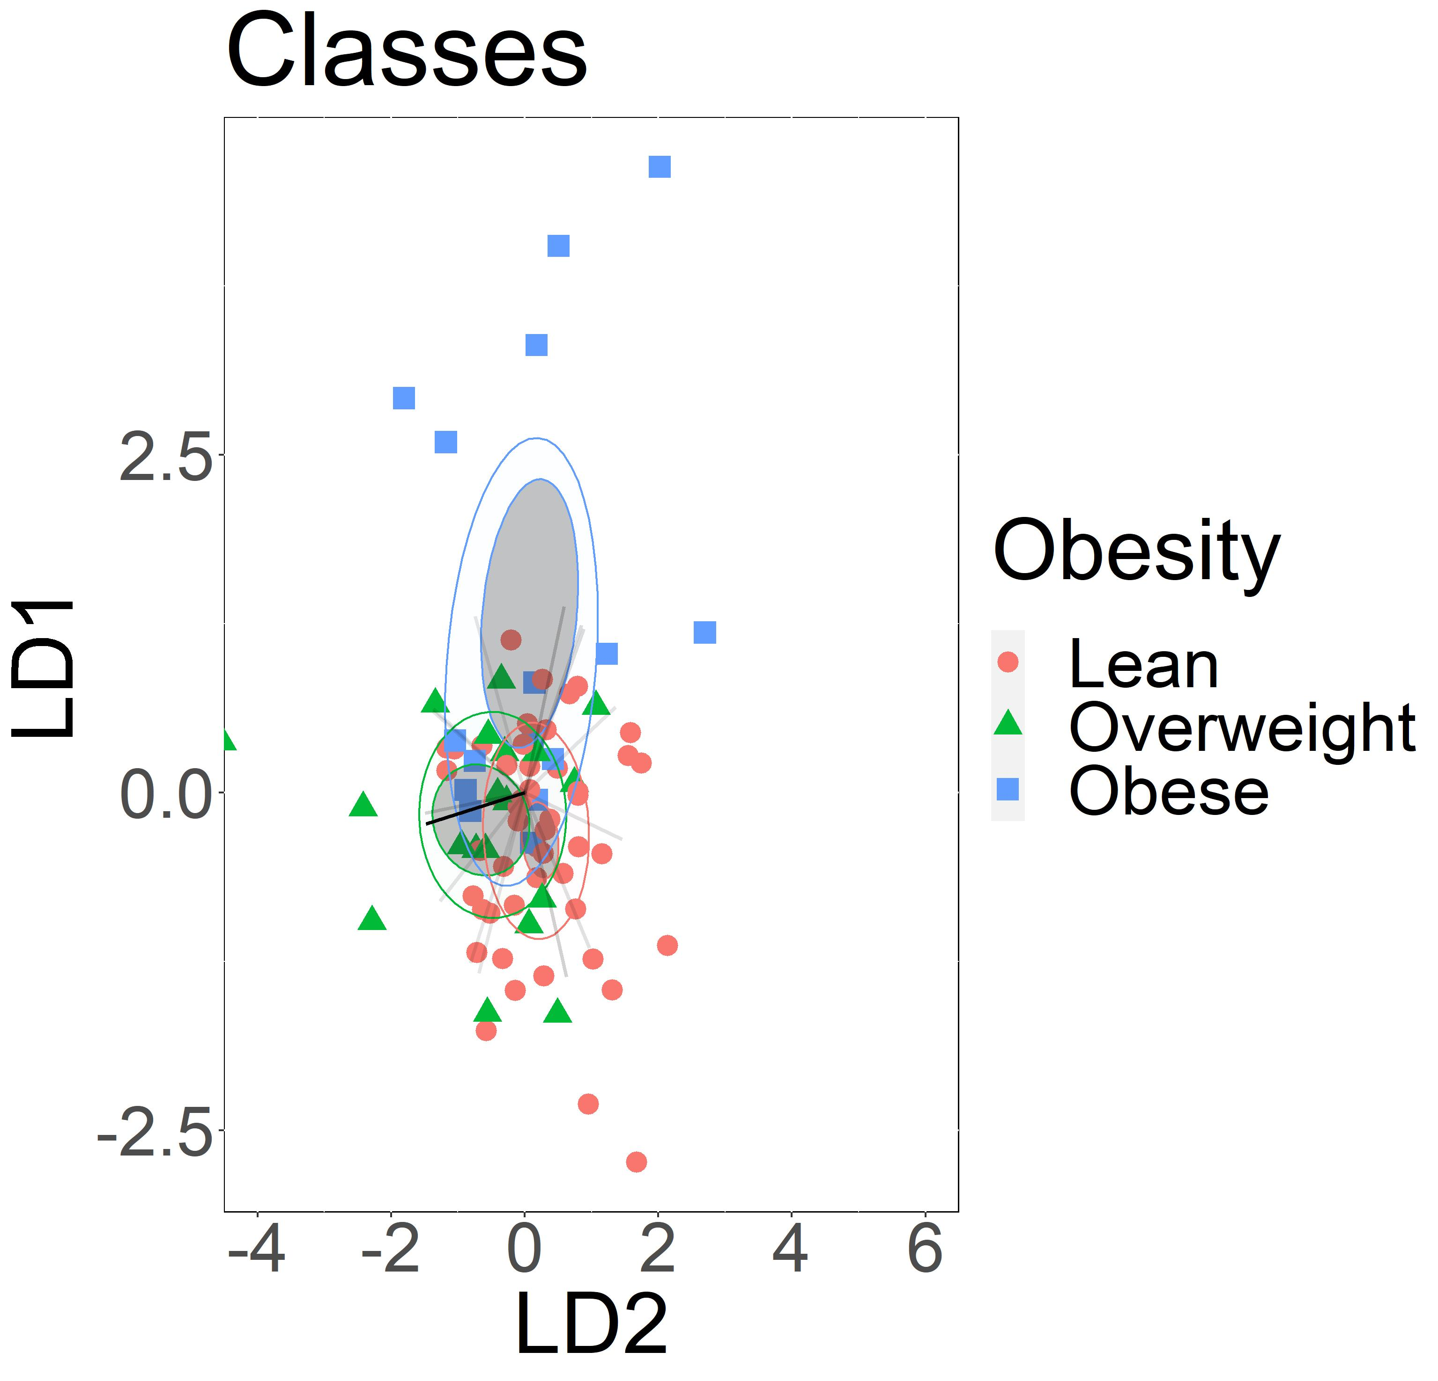
A
B
S.or
V.pa
Cam
F.nu
Vei
H.pa
Ana
P.pal
Str
Lac
V.di
P.je
Fla
P.pas
Fus
P.ve
P.me
Por
P.se
N.pe
Sel
Mic
P.na
Pas
Lep
F.pe
Nei
R.mu
Act
Pre
C
D
Cam
Vei
Pep
Alp
Cor
Spi
Cam
Lact
Fla
Neg
Spi
Bac
Fus
Clo
Sac
Ent
Cor
Act
Act
Mic
Des
Lach
Gam
Gra
Bur
Fus
Bac
Abs
Syn
Bac
Supplement figure 3: Lean and obese groups can be characterized by the abundance of dominant salivary bacterial taxa, across most taxonomic ranks. The results also indicate that the most abundant bacteria taxa are not the most influential for characterization of obesity groups. Linear discriminant analysis of 15 most abundant salivary bacterial A) Species F.pe: Fusobacterium periodonticum, R.mu: Rothia mucilaginosa, P.na: Prevotella nanceiensis, N.pe: Neisseria perflava, P.me: Prevotella 7 melaninogenica, P.je: Prevotella 7 jejuni, H.pa: Haemophilus parainfluenzae, V.pa: Veillonella parvula, S.or: Streptococcus oralis, F.nu: Fusobacterium nucleatum, P.pal: Prevotella pallens, P.pas: Porphyromonas_pasteri, V.di: Veillonella_dispar, P.ve: Prevotella 7 veroralis, P.se: Prevotella_salivae , B) Families, Cam: Campylobacteraceae, Ana: Anaerovoracaceae, Vei: Veillonellaceae, Str: Streptococcaceae, Lac: Lachnospiraceae, Fla: Flavobacteriaceae, Mic: Micrococcaceae, Lep: Leptotrichiaceae, Nei: Neisseriaceae, Pas: Pasteurellaceae, Act: Actinomycetaceae, Pre: Prevotellaceae, Sel: Selenomonadaceae, Por: Porphyromonadaceae, Fus: Fusobacteriaceae, C) Orders, Cam: Campylobacterales, Pep: Peptostreptococcales-Tissierellales, Vei: Veillonellales-Selenomonadales, Cor: Coriobacteriales, Fla: Flavobacteriales, Lact: Lactobacillales, Spi: Spirochaetales, Ent: Enterobacterales, Act: Actinomycetales, Bur: Burkholderiales, Bac: Bacteroidales, Abs: Absconditabacteriales (SR1), Lach: Lachnospirales, Mic: Micrococcales, Fus: Fusobacteriales D) Classes, Neg: Negativicutes, Alp: Alphaproteobacteria, Cam: Campylobacteria, Spi: Spirochaetia, Sac: Saccharimonadia, Bac: Bacilli, Clo: Clostridia, Cor: Coriobacteriia Des: Desulfobulbia, Gam: Gammaproteobacteria, Fus: Fusobacteriia, Bac: Bacteroidia, Syn: Synergistia, Gra: Gracilibacteria, Act: Actinobacteria . The intensity of vector rays’ color corresponds to the strength of the impact. Confidence ellipses are shaded. Normal data ellipses are unfilled and leveled to include 50% of the samples.
Notes:
Supplement figure 3: Lean and obese groups can be characterized by the abundance of dominant salivary bacterial taxa, across most taxonomic ranks. The results indicate that the most abundant bacteria taxa are not the most influential for characterization of obesity groups. Linear discriminant analysis of 15 most abundant oral bacteria A) Species, B) Families, C) Orders, D) Classes . Obesity groups are represented by color, lean group by red, overweight group by green, and obese group by blue. The intensity of vector rays’ color corresponds to the strength of the impact. Confidence ellipses are shaded. Normal data ellipses are unfilled and leveled to include 50% of the samples.
Names:
Species F.pe: Fusobacterium_periodonticum, R.mu: Rothia mucilaginosa, P.na: Prevotella nanceiensis, N.pe: Neisseria perflava, P.me: Prevotella_7_melaninogenica, P.je: Prevotella_7_jejuni, H.pa: Haemophilus_parainfluenzae, V.pa: Veillonella_parvula, S.or: Streptococcus_oralis, F.nu: Fusobacterium_nucleatum, P.pal: Prevotella_pallens, P.pas: Porphyromonas_pasteri, V.di: Veillonella_dispar, P.ve: Prevotella_7_veroralis, P.se: Prevotella_salivae.
Families: Cam: Campylobacteraceae, Ana: Anaerovoracaceae, Vei: Veillonellaceae, Str: Streptococcaceae, Lac: Lachnospiraceae, Fla: Flavobacteriaceae, Mic: Micrococcaceae, Lep: Leptotrichiaceae, Nei: Neisseriaceae, Pas: Pasteurellaceae, Act: Actinomycetaceae, Pre: Prevotellaceae, Sel: Selenomonadaceae, Por: Porphyromonadaceae, Fus: Fusobacteriaceae.
Orders: Cam: Campylobacterales, Pep: Peptostreptococcales-Tissierellales, Vei: Veillonellales-Selenomonadales, Cor: Coriobacteriales, Fla: Flavobacteriales, Lact: Lactobacillales, Spi: Spirochaetales, Ent: Enterobacterales, Act: Actinomycetales, Bur: Burkholderiales, Bac: Bacteroidales, Abs: Absconditabacteriales (SR1), Lach: Lachnospirales, Mic: Micrococcales, Fus: Fusobacteriales
Class: Neg: Negativicutes, Alp: Alphaproteobacteria, Cam: Campylobacteria, Spi: Spirochaetia, Sac: Saccharimonadia, Bac: Bacilli, Clo: Clostridia, Cor: Coriobacteriia Des: Desulfobulbia, Gam: Gammaproteobacteria, Fus: Fusobacteriia, Bac: Bacteroidia, Syn: Synergistia, Gra: Gracilibacteria, Act:

Slide 4
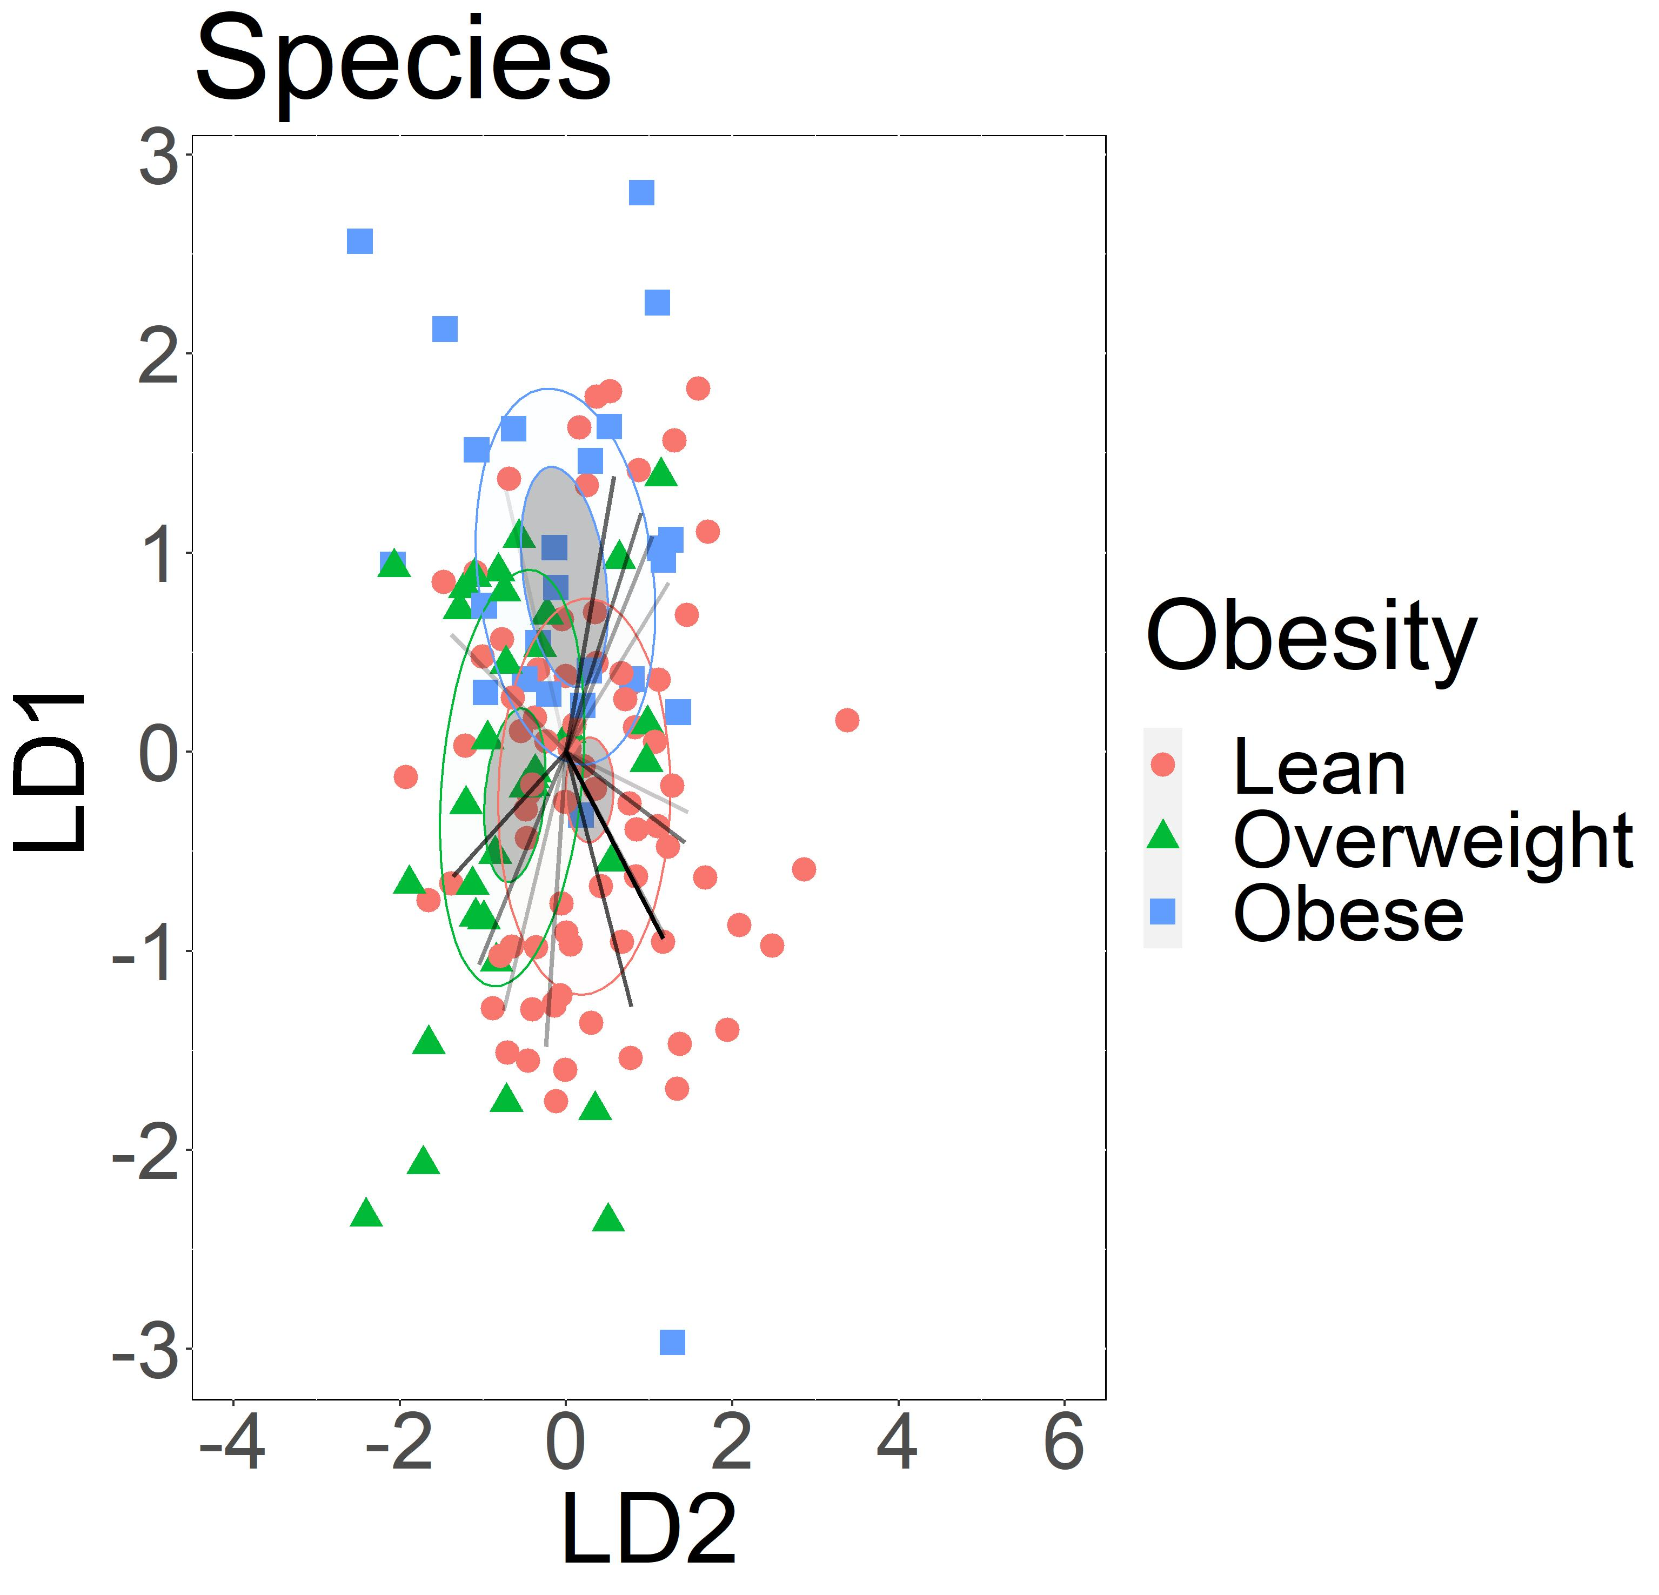
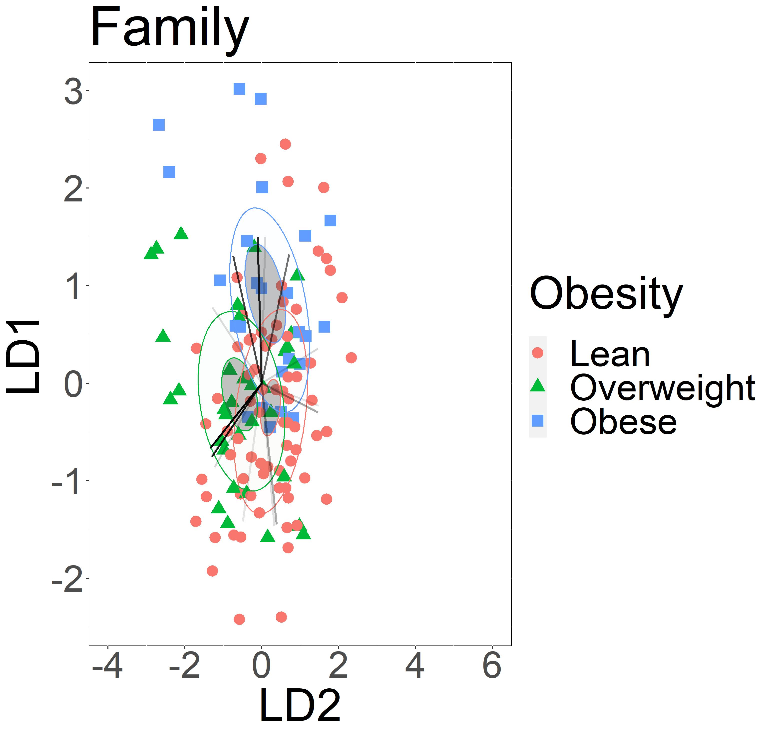
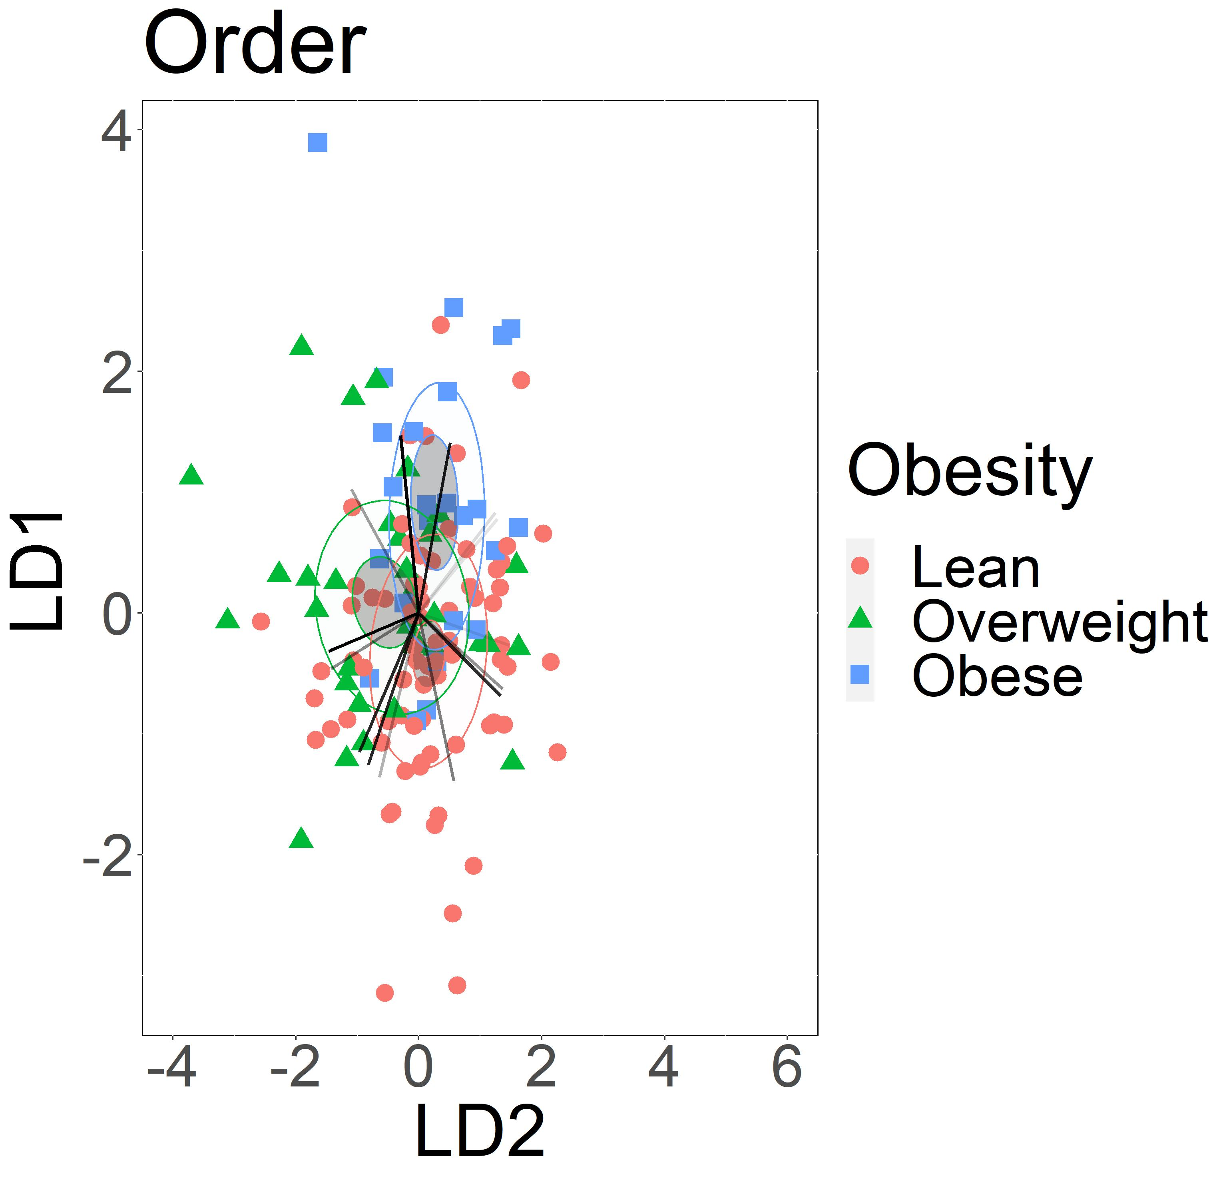
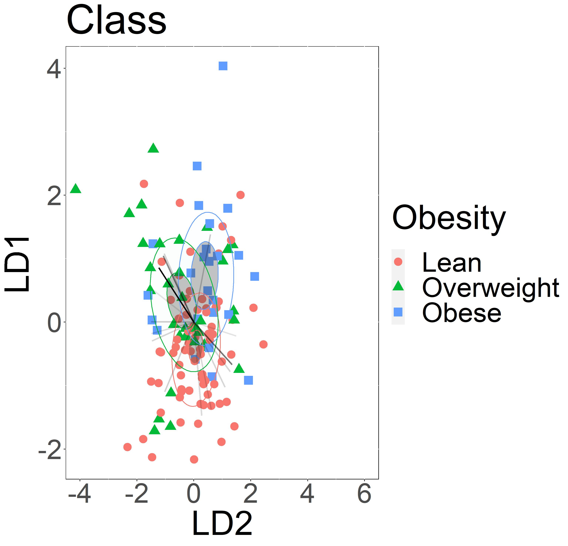
A
B
B.uni
P.di
E.ha
Aci
P.me
Pre
P.fa
B.vu
Vei
Tan
F.pr
Mar
Osc
B.ob
L.nk
Rum
B.ste
A.ha
Eco
Bif
B.ov
B.wa
Sut
B.the
Chi
Des
L.pe
Rik
Bac
C
D
Vei
Pep
Aci
Len
Osc
Met
Neg
Bur
Des
Fus
Bac
Clo
Chi
Bif
Cor
Bact
Ery
Ent
Des
Inc
Ver
Clo
Gam
Act
Cor
Ver
Vam
Bac
Alp
Supplement figure 4: Lean and obese groups can be characterized by the abundance of dominant fecal bacterial taxa across most taxonomic ranks. The results also indicate that most abundant bacteria taxa are not the most influential for characterization of obesity groups. Linear discriminant analysis of 15 most abundant fecal bacteria A) Species, B.uni: Bacteroides uniformis, E.ha: Eubacterium hallii group hallii, P.me: Parabacteroides merdae, B.vu: Bacteroides vulgatus, P.di: Parabacteroides distasonis, P.fa: Phascolarctobacterium faecium, F.pr: Faecalibacterium prausnitzii, L. nk: Lachnospiraceae NK4A136 group bacterium, B.wa: Bilophila wadsworthia, B.the: Bacteroides thetaiotaomicron, A.ha: Anaerostipes hadrus, L.pe: Lachnospira pectinoschiza, B.ov: Bacteroides ovatus, B.ste: Bacteroides stercoris, B.ob: Blautia obeum B) Families, Aci: Acidaminococcaceae, Pre: Prevotellaceae, Vei: Veillonellaceae, Tan: Tannerellaceae, Osc: Oscillospiraceae, Rum: Ruminococcaceae, Bif: Bifidobacteriaceae, Des: Desulfovibrionaceae, Bac: Bacteroidaceae, Chi: Christensenellaceae, Sut: Sutterellaceae, Eco: Eubacterium coprostanoligenes group, Mar: Marinifilaceae, C) Orders, Vei: Veillonellales-Selenomonadales, Aci: Acidaminococcales, Pep: Peptostreptococcales-Tissierellales, Osc: Oscillospirales, Des: Desulfovibrionales, Bac: Bacteroidales, Bif: Bifidobacteriales, Ent: Enterobacterales, Clo: Clostridia UCG-014, Cor: Coriobacteriales, Ver: Verrucomicrobiales, Ery: Erysipelotrichales, Chi: Christensenellales, Bur: Burkholderiales , D) Classes, Neg: Negativicutes, Met: Methanobacteria, Len: Lentisphaeria, Fus: Fusobacteriia, Clo: Clostridia, Cor: Coriobacteriia, Des: Desulfovibrionia, Gam: Gammaproteobacteria, Ver: Verrucomicrobiae, Bac: Bacilli, Alp: Alphaproteobacteria, Vam: Vampirivibrionia, Act: Actinobacteria, Inc: Incertae Sedis, Bact: Bacteroidia. The intensity of vector rays’ color corresponds to the strength of the impact. Confidence ellipses are shaded. Normal data ellipses are unfilled and leveled to include 50% of the samples.
Notes:
Supplement figure 4: Lean and obese groups can be characterized by the abundance of dominant fecal bacterial taxa across most taxonomic ranks. The results indicate that most abundant bacteria taxa are not the most influential for characterization of obesity groups. Linear discriminant analysis of 15 most abundant intestinal bacteria A) Species, B) Families, C) Orders, D) Classes . Obesity groups are represented by color, lean group by red, overweight group by green, and obese group by blue. The intensity of vector rays’ color corresponds to the strength of the impact. Confidence ellipses are shaded. Normal data ellipses are unfilled and leveled to include 50% of the samples.
Names:
Species: B.uni: Bacteroides_uniformis, E.ha: [Eubacterium] hallii group_hallii, P.me: Parabacteroides_merdae, B.vu: Bacteroides_vulgatus, P.di: Parabacteroides_distasonis, P.fa: Phascolarctobacterium_faecium, F.pr: Faecalibacterium_prausnitzii, L. nk: Lachnospiraceae NK4A136 group_bacterium, B.wa: Bilophila_wadsworthia, B.the: Bacteroides_thetaiotaomicron, A.ha: Anaerostipes_hadrus, L.pe: Lachnospira_pectinoschiza, B.ov: Bacteroides_ovatus, B.ste: Bacteroides_stercoris, B.ob: Blautia_obeum
Families: Aci: Acidaminococcaceae, Pre: Prevotellaceae, Vei: Veillonellaceae, Tan: Tannerellaceae, Osc: Oscillospiraceae, Rum: Ruminococcaceae, Bif: Bifidobacteriaceae, Des: Desulfovibrionaceae, Bac: Bacteroidaceae, Chi: Christensenellaceae, Sut: Sutterellaceae, Eco: [Eubacterium] coprostanoligenes group, Mar: Marinifilaceae
Orders: Vei: Veillonellales-Selenomonadales, Aci: Acidaminococcales, Pep: Peptostreptococcales-Tissierellales, Osc: Oscillospirales, Des: Desulfovibrionales, Bac: Bacteroidales, Bif: Bifidobacteriales, Ent: Enterobacterales, Clo: Clostridia UCG-014, Cor: Coriobacteriales, Ver: Verrucomicrobiales, Ery: Erysipelotrichales, Chi: Christensenellales, Bur: Burkholderiales.
Classes: Neg: Negativicutes, Met: Methanobacteria, Len: Lentisphaeria, Fus: Fusobacteriia, Clo: Clostridia, Cor: Coriobacteriia, Des: Desulfovibrionia, Gam: Gammaproteobacteria, Ver: Verrucomicrobiae, Bac: Bacilli, Alp: Alphaproteobacteria, Vam: Vampirivibrionia, Act: Actinobacteria, Inc: Incertae Sedis, Bact: Bacteroidia

