Slide 1
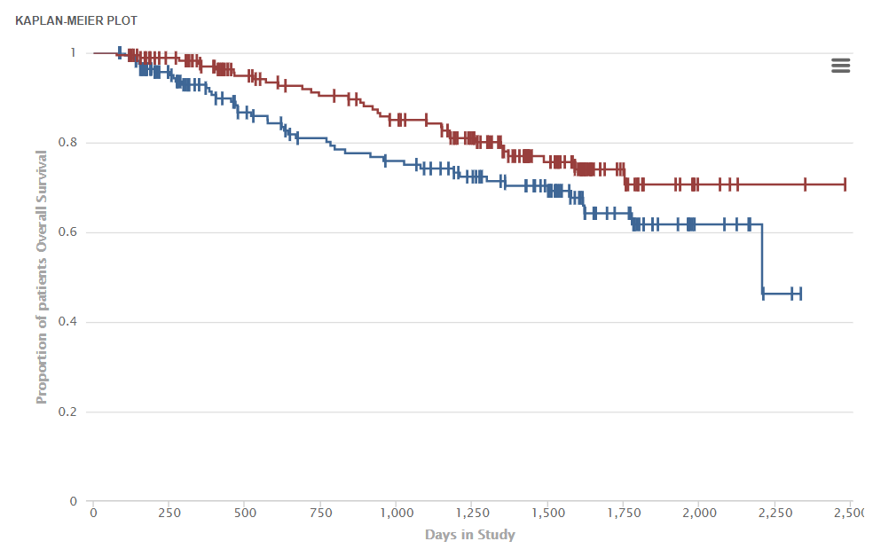
A)
 | Normal | MGUS | smoldering | MM @ dx | @ relapse
Normal |  | 0.9433 | 0.0094 | <0.0001 | 0.0017
MGUS | 0.9433 |  | 0.00425 | 0.0002 | 0.0083
smoldering | 0.0094 | 0.0425 |  | 0.8403 | 0.9926
MM @ dx | <0.0001 | 0.0002 | 0.8403 |  | 0.9805
@ relapse | 0.0017 | 0.0083 | 0.9926 | 0.9805
Statistically significant p values
shown in BOLD
B)
Lowest quartile
p=0.0022
Proportion of patients alive
Highest quartile
DAYS in study
Suppl fig 1: A) Post-hoc analysis (method of Tukey-Kramer) of hnRNPA1 expression, shown as p values for multiple comparisons between groups; B) Survival from dx of
symptomatic patients with multiple myeloma comparing those in highest quartile for hnRNP A1 expression vs those in lowest quartile.
Supplemental fig 1

Slide 2





C 1 2 3 4 5 6 7
C 1 2 3 4 5 6 7
A)
hnRNP A1
hnRNP A1
C-myc
C-myc
GAPDH
GAPDH
Targeted sequence 1
Targeted sequence 2
B)
WT tumors 125 tumors
WT tumors
111 tumors
hnRNP A1
hnRNP A1
GAPDH
GAPDH
Supplemental fig 2: A) Immunoblot analysis of hnRNP A1 and c-myc expression in clones (1-7) generated after CRISPR deletion of A1 by targeting 2 separate
sequences in exon 1; B) Examples of immunoblot assays of control (WT) tumors or A1-deleted 125 and 111 tumors.
Supplemental fig 2

Slide 3
100
90
o
x
80
x
x
Control (DMSO)
70
o
o
J007 (250 nM)
60
% myc remaining
50
o
o
40
x
x
30
x
20
o
x
x
o
o
10
15 30 45 60 75 90 105 120 135
Minutes after adding cycloheximide
Supplemental figure 3: Pulse chase analysis of myc half-life in MM cells after treatment with J007 (250nM) vs DMSO for 18 hours
SUPPLEMENTAL FIGURE 3

Slide 4
A)
B)
Subcutaneous challenge
Intravenous challenge
Supplemental fig 4: A) Weights (mean+/-SEM, n= 8 mice/group) of mice during J007 treatment (20mg/kg) after subcutaneous challenge; B) Weights (mean+/-SEM,
n=6 mice/group) of mice during J007 treatment after IV challenge
Supplemental fig 4

Slide 5
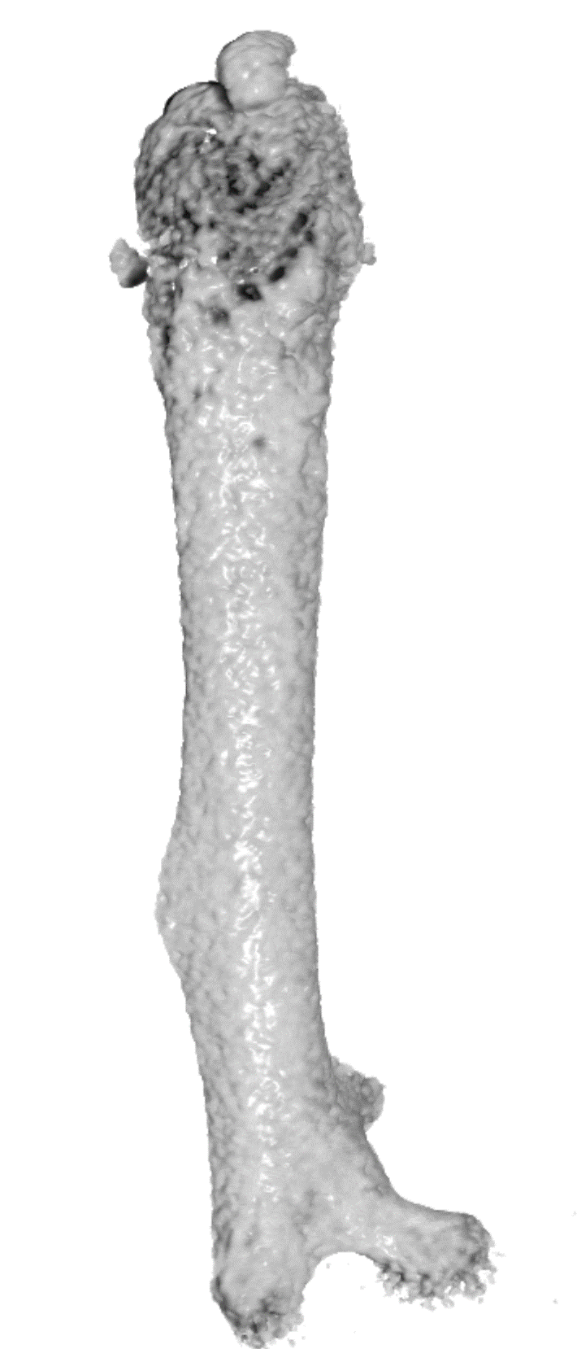
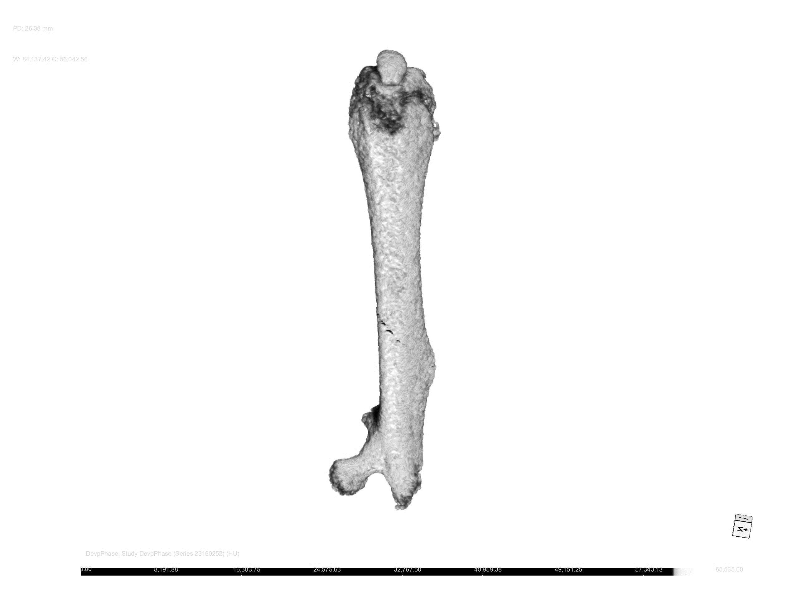
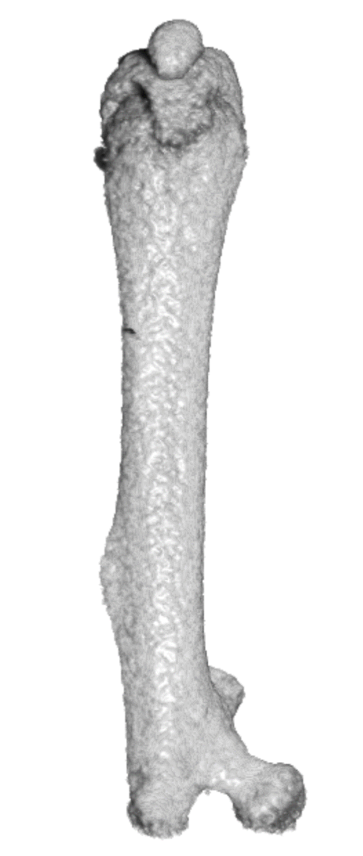
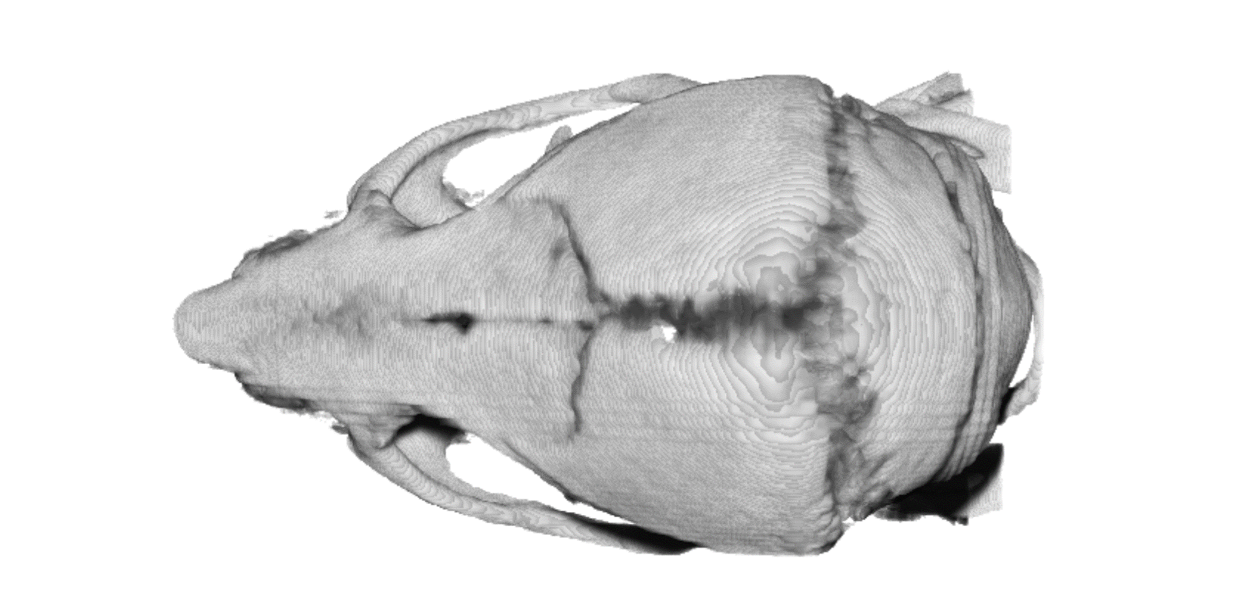
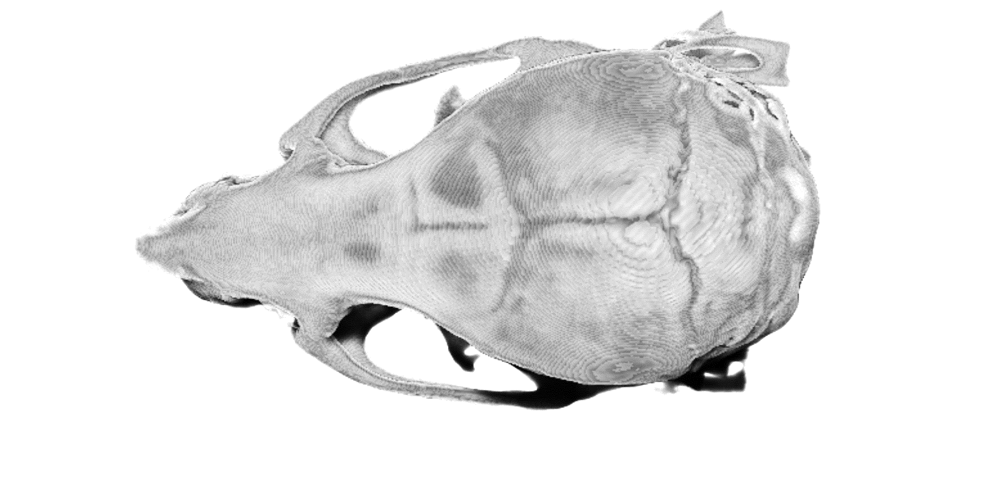
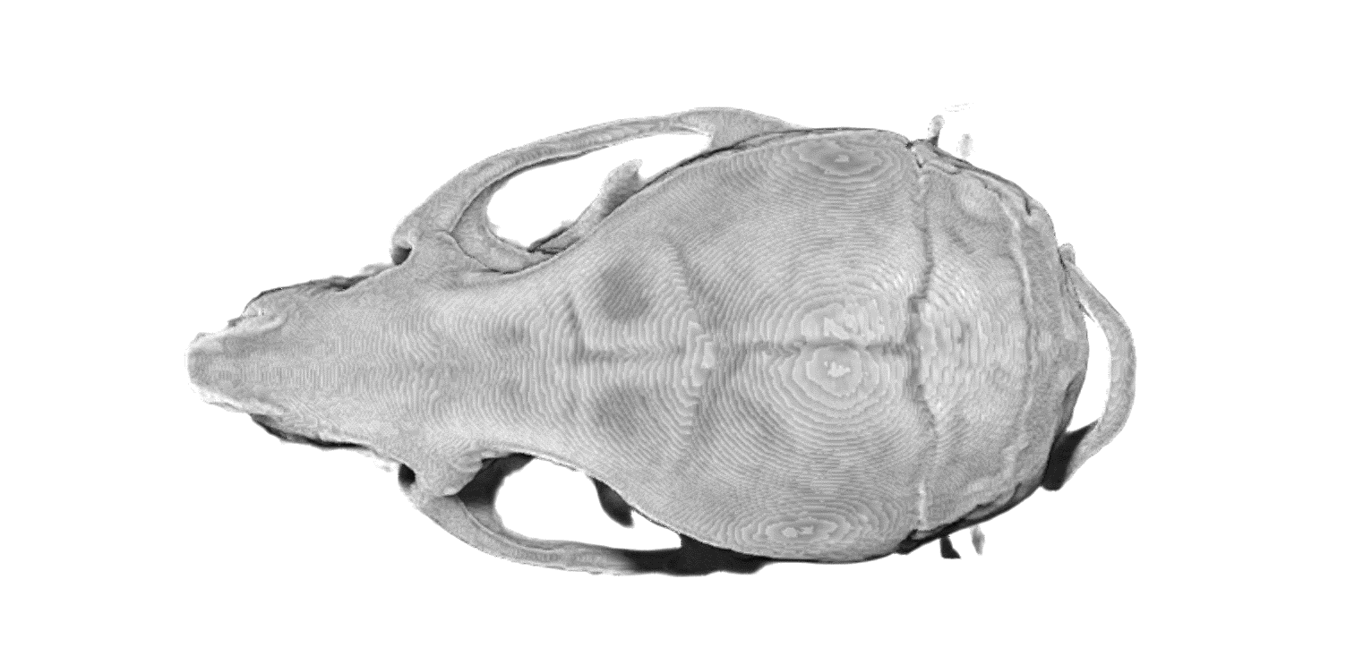
A)
Vehicle
J007 20mg/kg/d
J007 40mg/kg/d
B)
Humerus
C）
Vehicle
J007 20mg/kg/d
J007 40mg/kg/d
Skull
J007 ameliorates bone loss in tumor-bearing mice: A) Representative 3D μCT images of humeri from mice treated with 20 mg or 40 mg of compound per kg bodyweight and day (center and right panels) or left untreated (left panel). Humerus head and neck (indicated by red rectangle) were used for determination of bone volume (BV) shown in adjacent panel. B) Ratio of BV to total volume (TV). Mean values (black bars) and SDs (short horizontal lines) are plotted. Results of t test comparisons are indicated at top. C) Representative 3D μCT images of the cranium of mice from the 3 study groups. The pronounced separation of the coronal, sagittal and lambdoid sutures seen in untreated mice (red arrows) was prevented by treatment using J007.
Supplemental fig 5

Slide 6
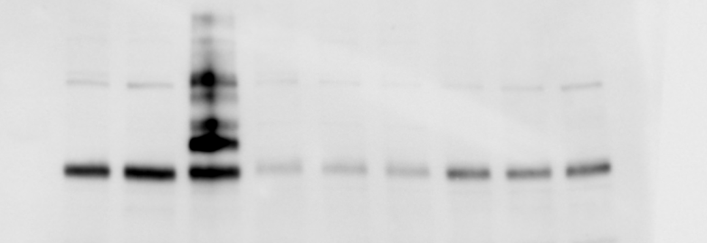

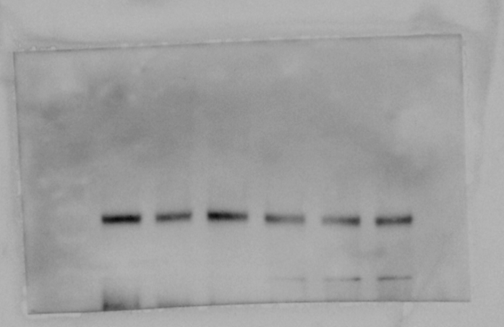



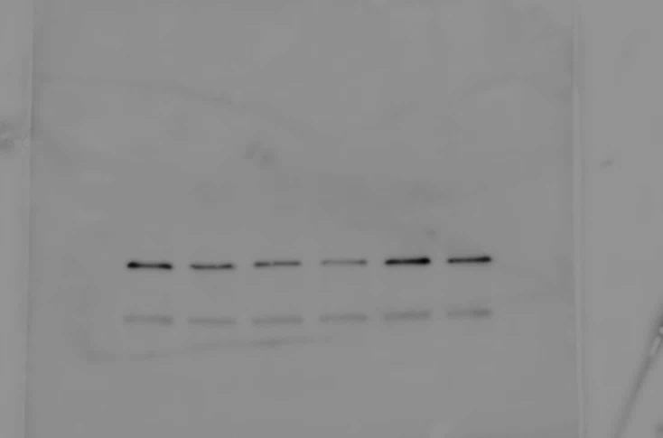

A)
B)
Pp242 (nM ) 0 100 250
DMSO PP242
J007 (nM) 0 50 0 50 50
C-myc
P70-phos
Pp242 (nM) 0 0 250 100 250
S6-phos
C-myc
GAPDH
phosphorylated
4EBP-1
GAPDH
GAPDH
1 .55 1.2 .4 .2
p<0.05
C)
5
4
P<0.05 (t-test)
3
P=0.08 (Anova)
Tumor weight (g)
2
1
0
control
J007
pp242
combination
Supplemental figure 6: A) Immunoblot assay for c-myc expression (left panel) and TORC1 substrates (right panel) following exposure to pp242 for 24 hrs; Right panel
shows data after 250 nM of pp242; B) Immunoblot assay for myc expression after exposure to pp242 or J007 or the combination of both compounds; Below the gel
is shown relative myc expression (myc/GAPDH ratio where control is set at ‘1’), mean+/-SD, n=3 and p value for difference in expression comparing J007 alone at
50nM to J007 combined with pp242 at 250 nM; C) Tumor weights in SQ-challenged mice treated with either J007 alone (20mg/kg/d, pp242 alone (50mg/kg/d) or the
combination of both compounds.
Suppl fig 6

Slide 7
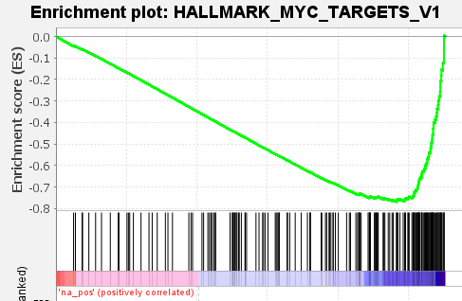
category | Genes in category | P value | Q value
Hallmark Myc Targets | 181 | 0.000001 | 0.007
Hallmark Angiogenesis | 16 | 0.018 | 0.042
Hallmark E2F Targets | 186 | 0.00001 | 0.041
Hallmark mTORC1 Targets | 178 | 0.00004 | 0.042
Hallmark Protein Secretion | 83 | 0.004 | 0.044
Hallmark Mitotic Spindle | 181 | 0.00003 | 0.054
Hallmark G2M Checkpoint | 187 | 0.005 | 0.095
Hallmark Peroxisome | 74 | 0.02 | 0.08
Hallmark Unfolded Protein Response | 104 | 0.044 | 0.12
Hallmark Fatty Acid Metabolism | 116 | 0.036 | 0.16
A)
B)
Supplemental figure 7: A) Gene set enrichment identification of pathway categories significantly and negatively impacted by exposure of IL6/Myc1 MM cells to J007 (1 uM for 72 hrs) B) Enrichment plot for myc target activation genes..

Slide 8
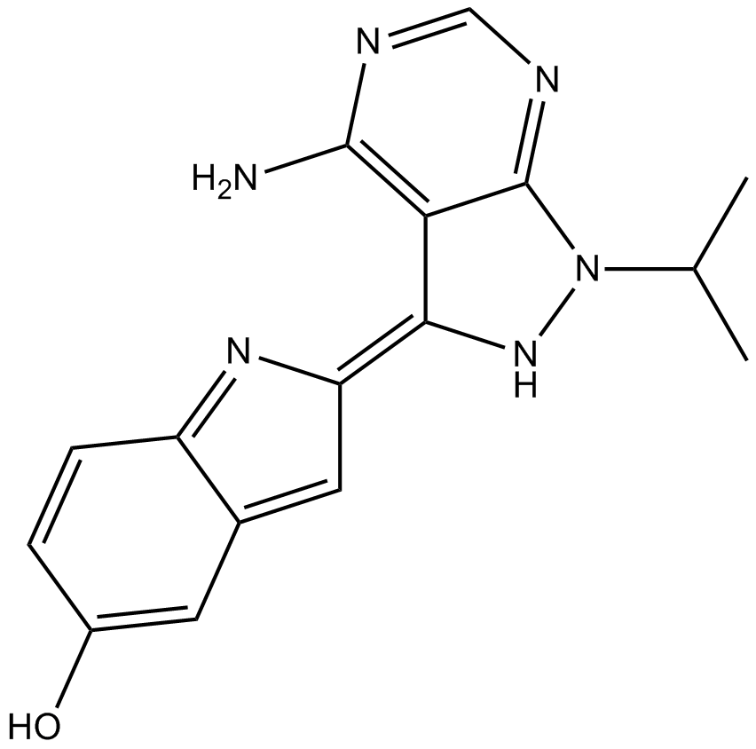
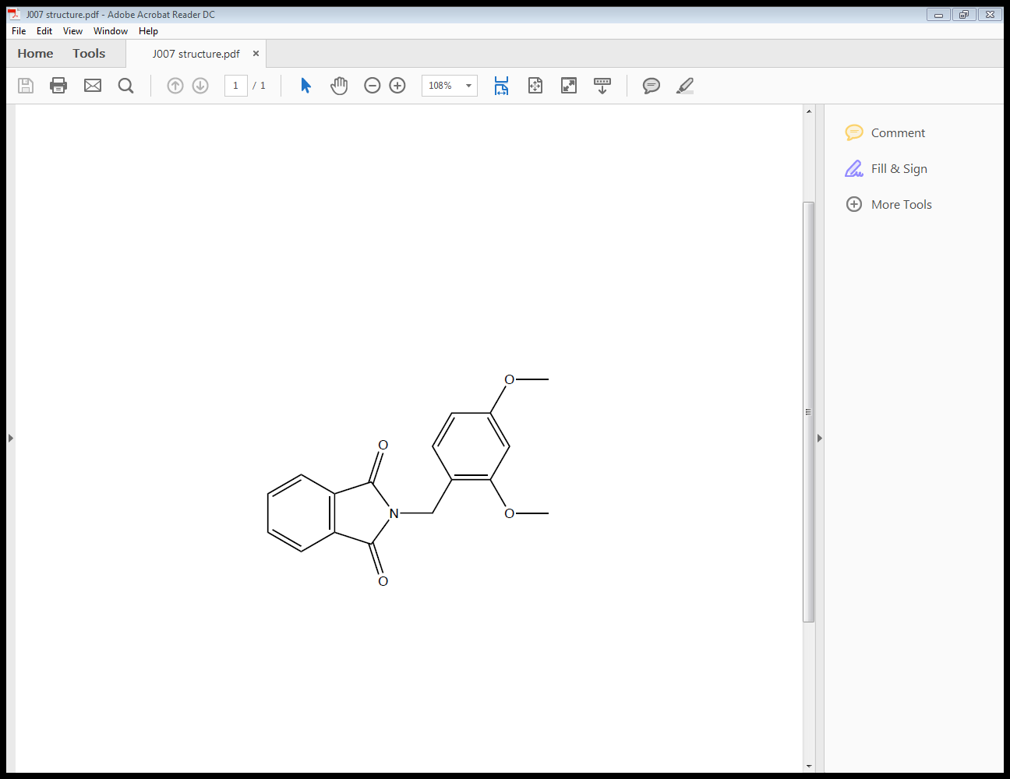
MM cells
mTORC1
ER STRESS
p70
S6
P
PP242
Multiple Myeloma
Progression
4EBP-1
P
hnRNP A1
eIF-4E
YB-1
J007
c-MYC
MYC
RNA
cap
IRES
cap-dependent translation
5’UTR
cap-independent translation
Model describing roles of hnRNP A1 and the myc IRES in promoting c-myc translation and MM progression. Myc translation can occur via a cap-dependent mechanism which is promoted by mTORC1 activity and prevented by pp242 or via a cap-independent mechanism through an IRES sequence within the 5’UTR of the myc RNA, which is promoted by hnRNP A1 and prevented by J007. The ongoing ER stress within MM cells inhibits mTORC1 activity and renders the cell highly dependent on the fail-safe IRES-dependent myc translation, thus explaining its sensitivity to J007 alone. In a positive feedback loop, hnRNP A1-dependent myc translation and myc expression drives hnRNP A1 expression.
Suppl fig 8

