Slide 1
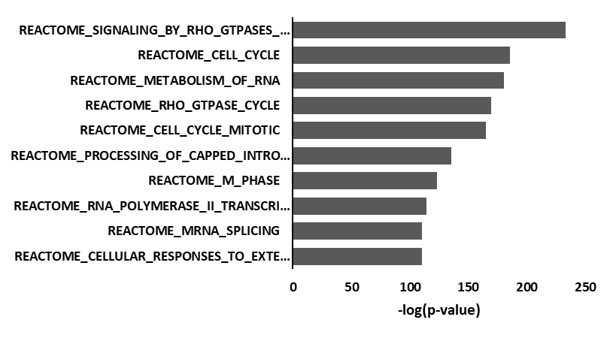
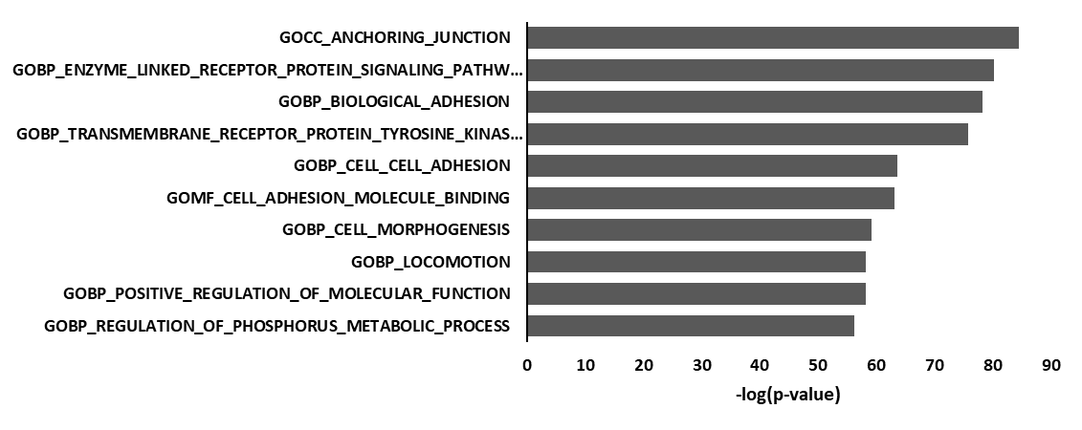
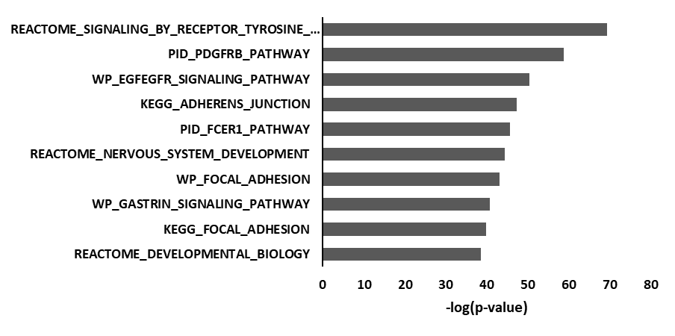
A.
UT
B.
Figure S1: (A) Literature consistent network (METACORE) and MsigDB canonical pathways (CP) analysis of RXDX106 modulated phosphoproteins (pSTY). (B) Top enriched functional modules from MsigDB gene ontology (GO) and canonical pathways (CP) analyses of phosphotyrosine (pY) peptides altered by RXDX106.
Notes:
For B, find original, add scale bars and reexport if necessary. Make figure in Illustrator.
For A, add RXDX106 before min
Add Eric Welsh figure and make changes necessary to C to make them match and consistent.
Make D, E and F consistent in colors, fonts, axes, legends and general presentation. Add 3D data?

Slide 2
PC9
S1-34
S2-17
S2-30
S2-10
Figure S2: Oncoprint of probably damaging variants between parental PC9 cells and each derived resistant clone. Top graph shows number of variants for each sample with the color indicating variant type. Bottom graph is the distribution of variants by the type of base substitution. The graph on the right indicates number of samples in which the gene is mutated.

Slide 3
Figure S3: RNA sequencing data from PC9 and each resistant clone was subject to single sample gene set enrichment analysis (ssGSEA) using cancer hallmarks. Shown here are the top 50 modulated hallmarks, where each hallmark was converted to a Z-score for both the parental and the resistant clones. Each resistant clone’s Z-score was then subtracted from the parental’s score to highlight clones’ difference from PC9. Gene sets with an FDR >0.05 are denoted using an “X.”

