Slide 1
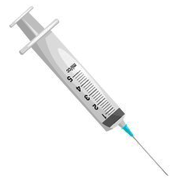
Figure S2
a
PDX engraftment
Drug administration
End point
c
Isotype (n = 10)
Spleen
Liver
BM
PB
LN
etc.
i.v.
Rit + LEN (n = 10)
p = 0.032
BI-1206 (n = 10)
p = 0.0016
p = 0.00017
p = 0.00004
p = 0.0013
p = 0.000006
Blood collection
% tumor cells in PB
Serum β2M level
b
d
p = 0.0006
p = 0.0063
p = 0.00002
p = 4.8e-8
p = 0.0014
p = 1.07e-9
p = 0.043
p = 0.041
e
f
g

