Slide 1
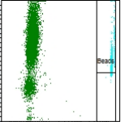
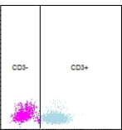
CD3⁺/CD4⁺/CD8⁺/CD19⁺/CD(16+56)⁺ Gating
(CANTO)
SCC
SCC
SCC
FSC
CD19-APC
CD3-FITC
CD4-PE-CY7
CD19-APC
CD8-APC-CY7
CD16+56-PE

Slide 2
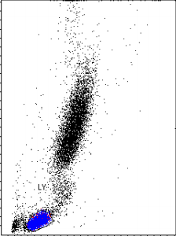
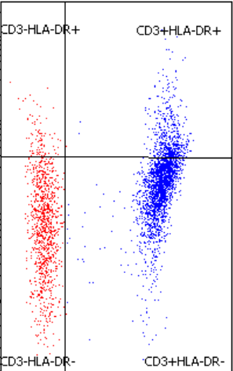
CD3⁺HLA-DR⁺ Gating (DIVA)
HLA-DR-PerCP-CY5.5
SCC
FSC
CD3-APC

Slide 3
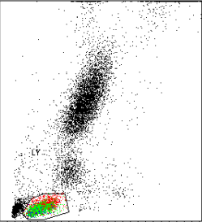
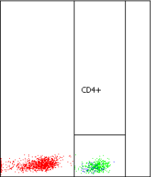
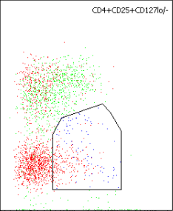
CD4⁺CD25⁺CD127^{low/-} Treg Gating (DIVA)
CD127-PE
SCC
SCC
FSC
CD4-FITC
CD25-APC

Slide 4
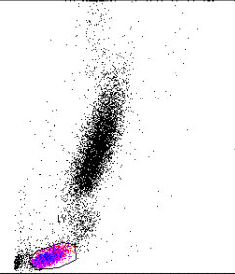
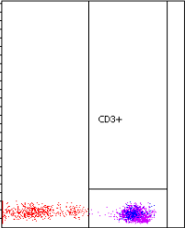
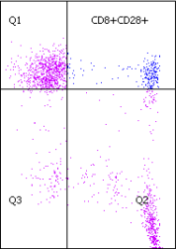
CD8⁺CD28⁺ Gating (DIVA)
CD28-PE
SCC
SCC
FSC
CD3-APC
CD8-FITC

Slide 5
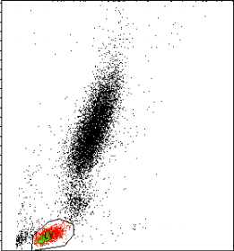
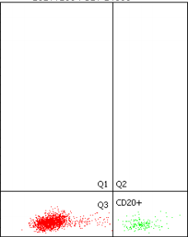
CD20⁺ Gating (DIVA)
SCC
SCC
FSC
CD20-FITC

