Slide 1

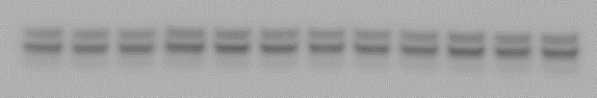

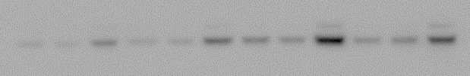
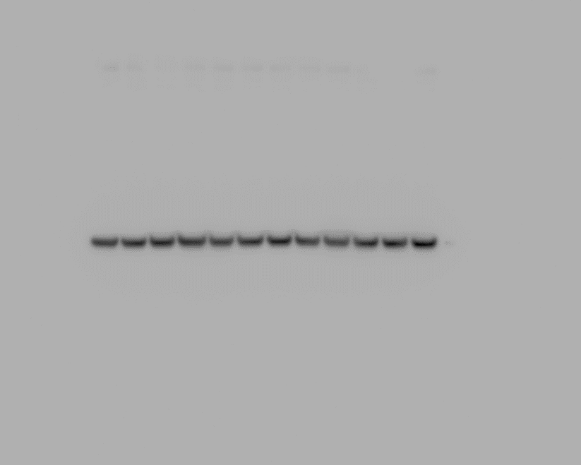
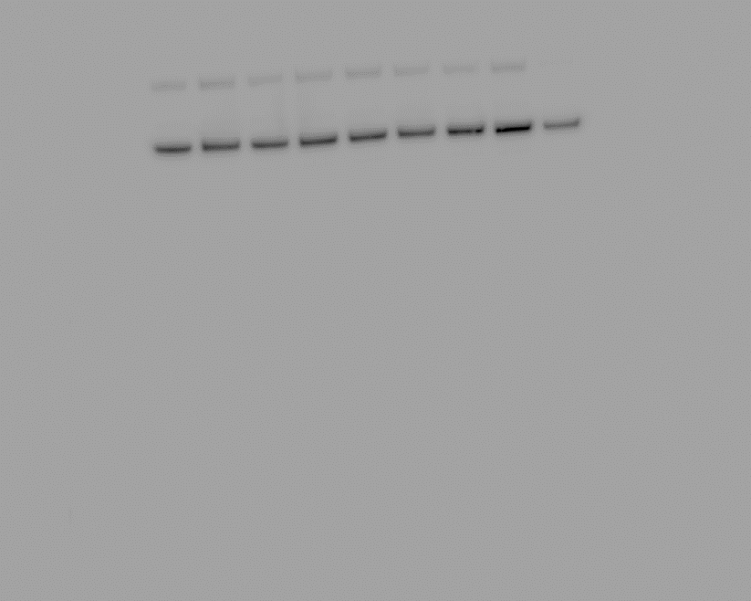
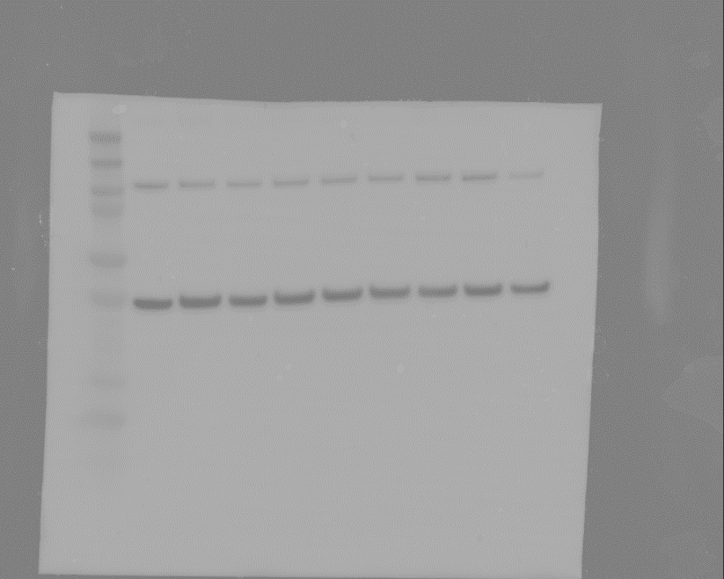
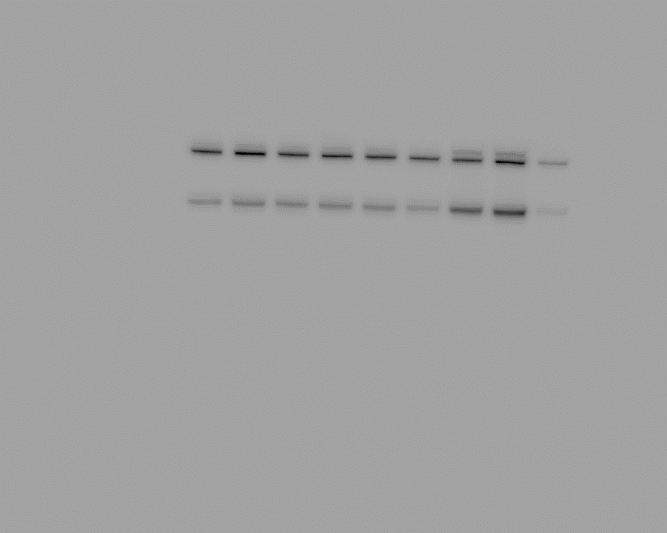
Supplementary fig 2. The effects of PFBS exposure on signaling pathways governing trophoblast invasion
A
Exp 1 Exp 2 Exp 3 Exp 4
B
C
D
C P0.1 P10 C P0.1 P10 C P0.1 P10 C P0.1 P10
Phospho-AKT
P=0.04
*
Phospho-ERK
GAPDH
Phospho-p38
GAPDH
E
2 hours 6 hours 18 hours
F
G
C P0.1 P10 C P0.1 P10 C P0.1 P10
Full length Notch2
Cleaved-Notch2
GAPDH
*
P=0.05
Full length Notch3
P=0.005
**
Cleaved-Notch3
GAPDH

