Slide 1
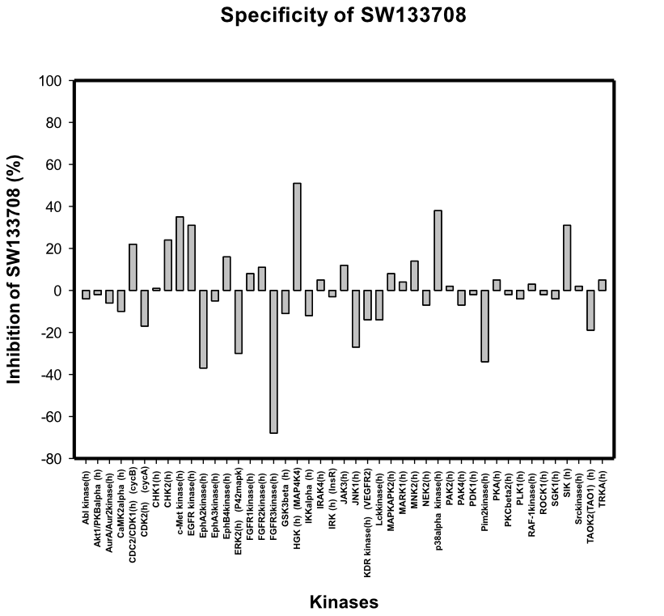
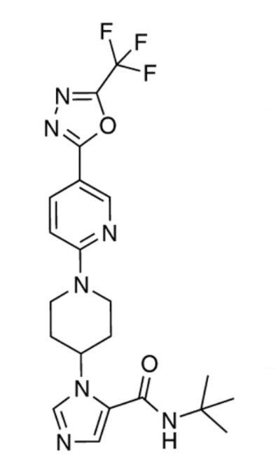
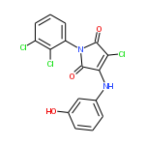
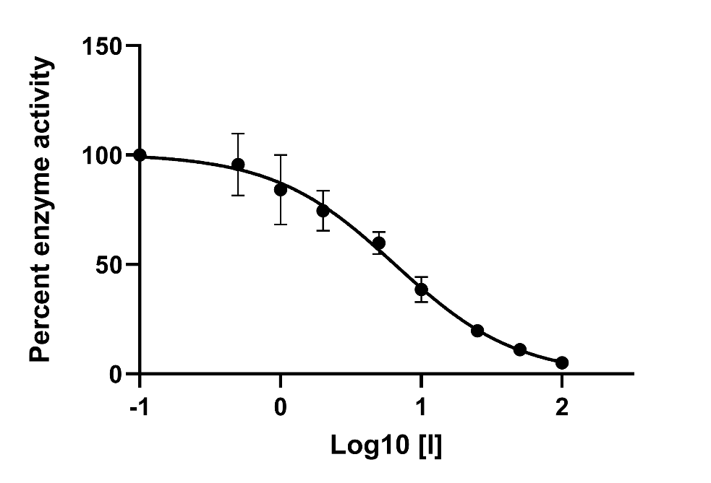
Figure S1
A
C
B
D
Supplementary Figure 1. Identification of a WNK1 inhibitor from a chemical screen. A. Structure of WNK463 (ref 28). B. A 3500 compound library, chosen by Bruce Posner, Director of the HTS core, to be representative of the UT Southwestern 230,000 compound library chemical space was screened for inhibitors of phosphorylated (pS382) WNK1 194-483 prepared as described (ref 59) using myelin basic protein as substrate with protocols generally as described in (Piala et al, Bioorg Med Chem Lett 26, 3923, 2016). Compound SW133708 (IUPAC name: 3-chloro-1-(2,3-dichlorophenyl)-4-[(3-hydroxyphenyl)amino]-1H-pyrrole-2,5-dione) (Chembridge compound #6505063) was identified as the top hit from the screen. C. A 45 human kinase panel was evaluated for inhibition by 10 μM SW133708 by the Eurofins commercial screening service (Celle-L’Evescault, France) which used HTRF (Homogeneous Time Resolved Fluorescence) to determine relative inhibition. Inhibition higher than 50% was considered significant. In addition to inhibiting WNK1, SW133708 shows inhibitory activity only toward fibroblast growth factor receptor-3 (FGFR3) of the kinases in the specificity screen. D. Dose response for inhibition of WNK1 activity with SW133708 measured using pS382 WNK1 kinase domain as above and GST-OSR1 314-344 as the substrate. The IC₅₀ was 6.5 µM. The IC₅₀ for WNK463 using this method was ~ 50 nM.

Slide 2
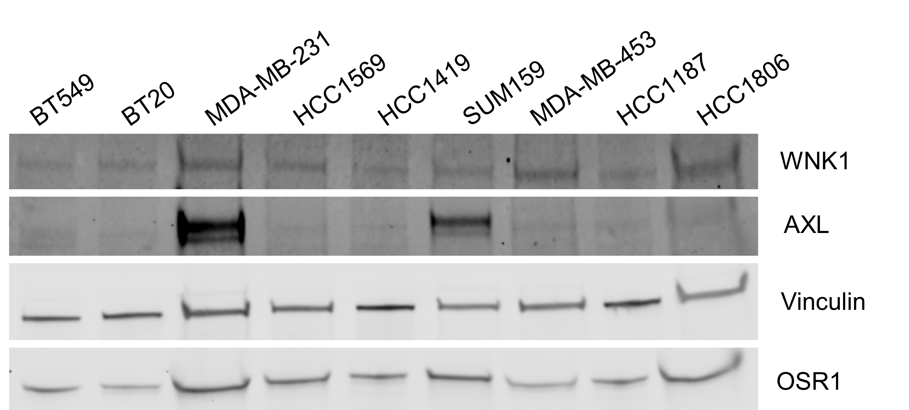
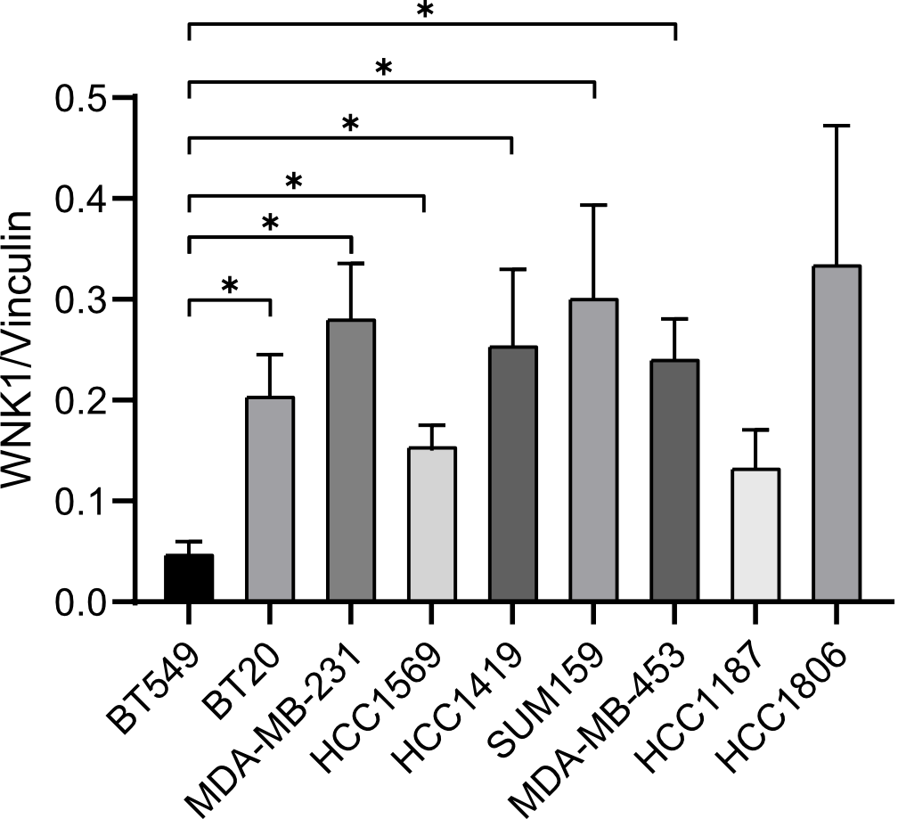
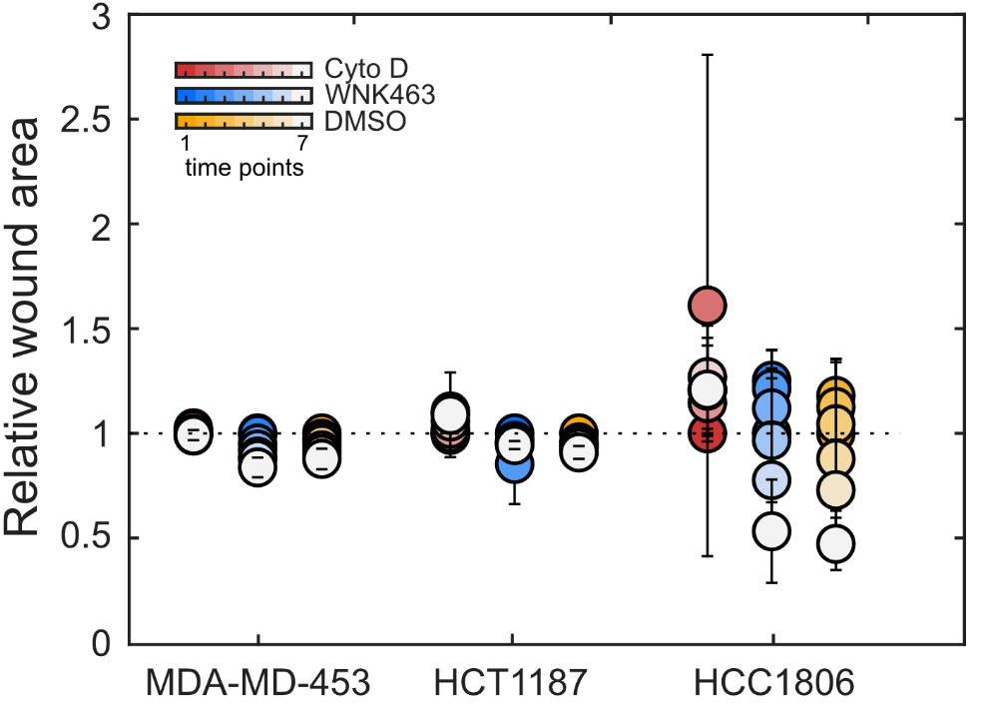
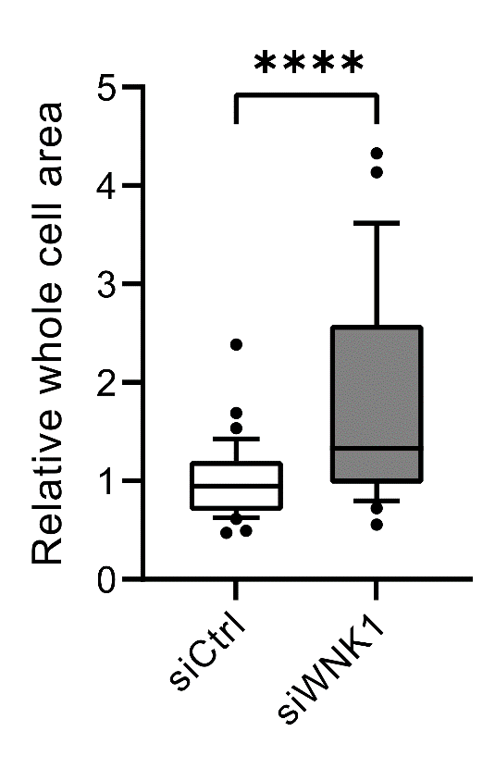
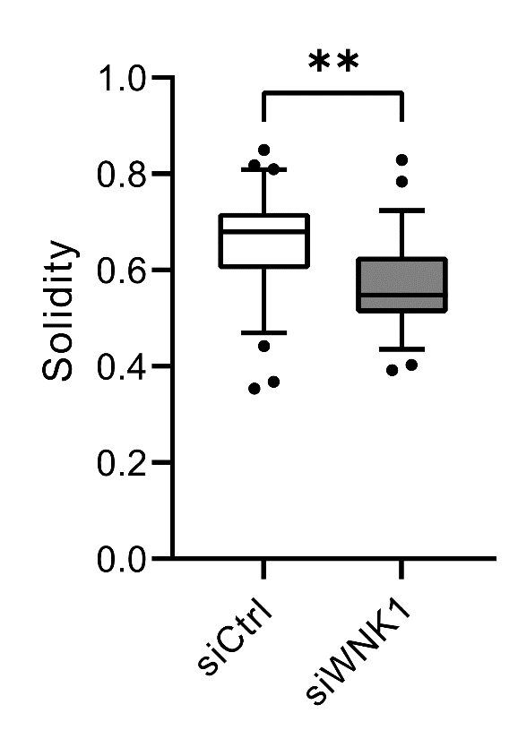
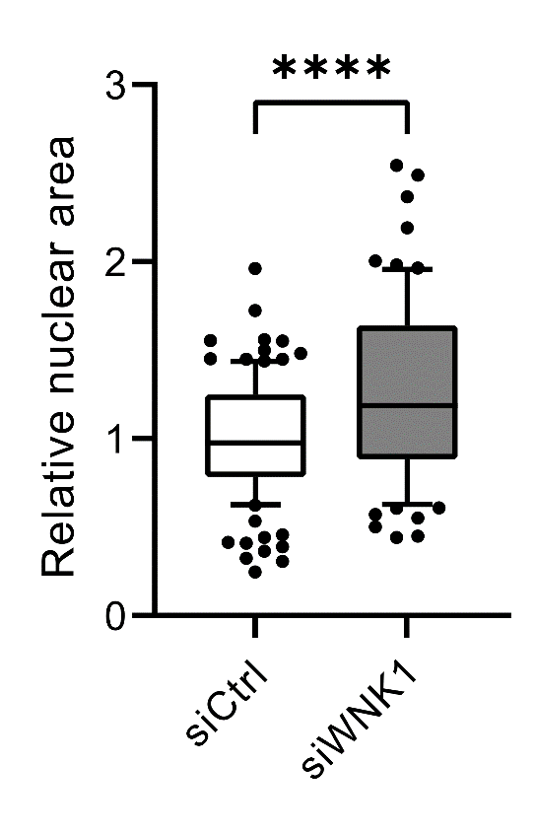
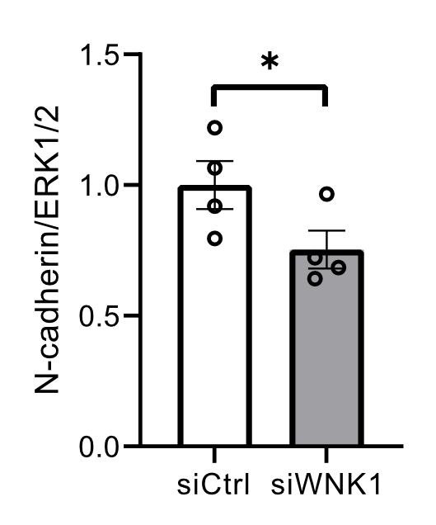
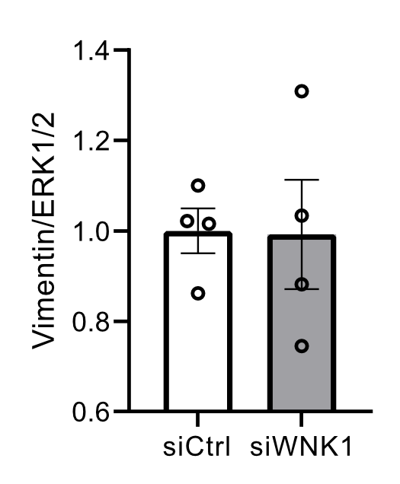
Figure S2
A
B
C
D
E
F
G
H
Supplementary Figure 2. Relationship among AXL, WNK1 and OSR1 expression and migration in breast cancer cells. A. Protein expression of WNK1, OSR1 and AXL in several breast cancer cell lines. B. Quantification of WNK1 expression levels in several breast cancer cells; n=3. C. Additional breast cancer cell lines were tested using the same protocol as in main Figure 1C. These lines showed little or no migration over the 48-hour time course. D. Effect of WNK1 knockdown on cell morphology and EMT-associated factors in MDA-MB-231 cells. Relative whole cell area was increased in cells treated with WNK1 siRNA. E. WNK1 siRNA decreased ‘solidity’ or roundness. siCtrl: n=37 and siWNK1: n=27. F. siWNK1 treated cells had increased relative nuclear area compared to siCtrl treated cells. siCtrl: n=111 and siWNK1: n=75. G. Knockdown of WNK1 decreased N-cadherin protein amount; n=4. H. WNK1 siRNA treatment had no effect on vimentin; n=4. Data represented as Mean±SEM, *p<0.05; 1-tailed Student’s t test. ** p<0.005 and ****p<0.0001; 2-tailed Student’s t test.

Slide 3
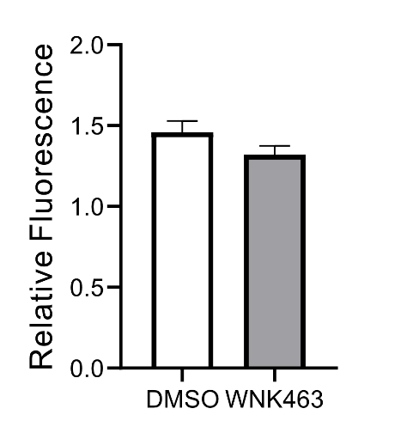
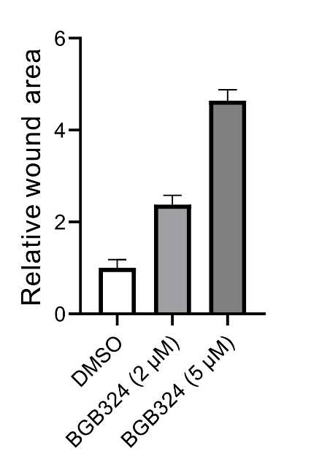
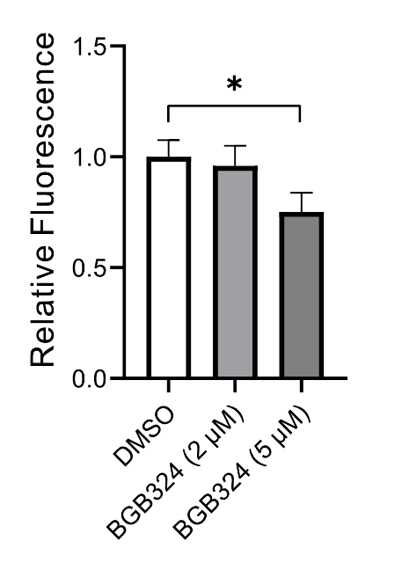
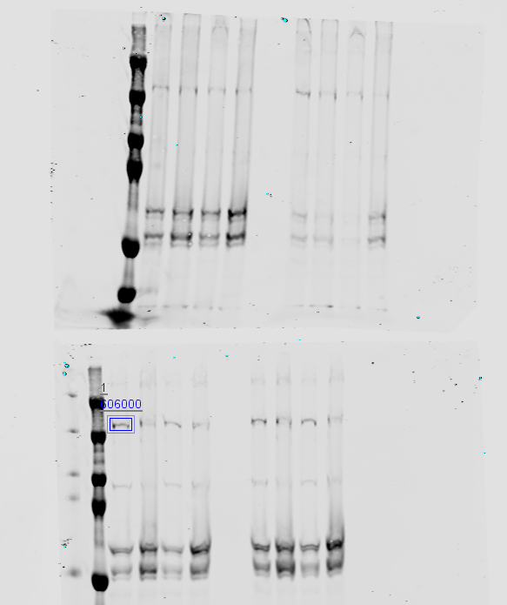
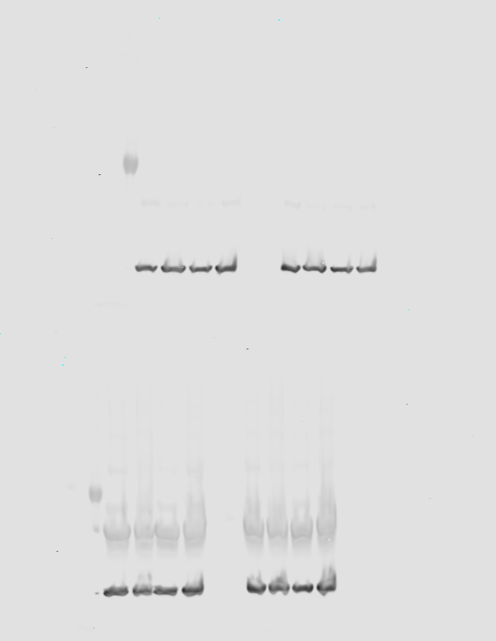
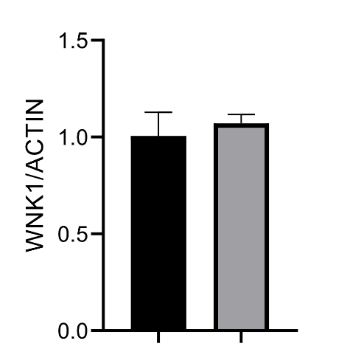
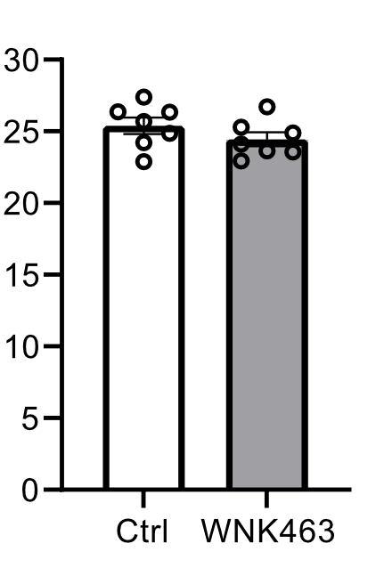
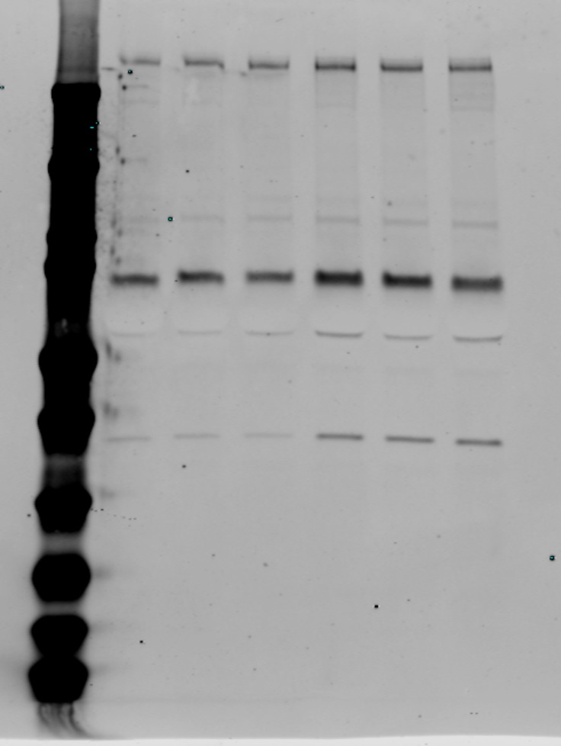
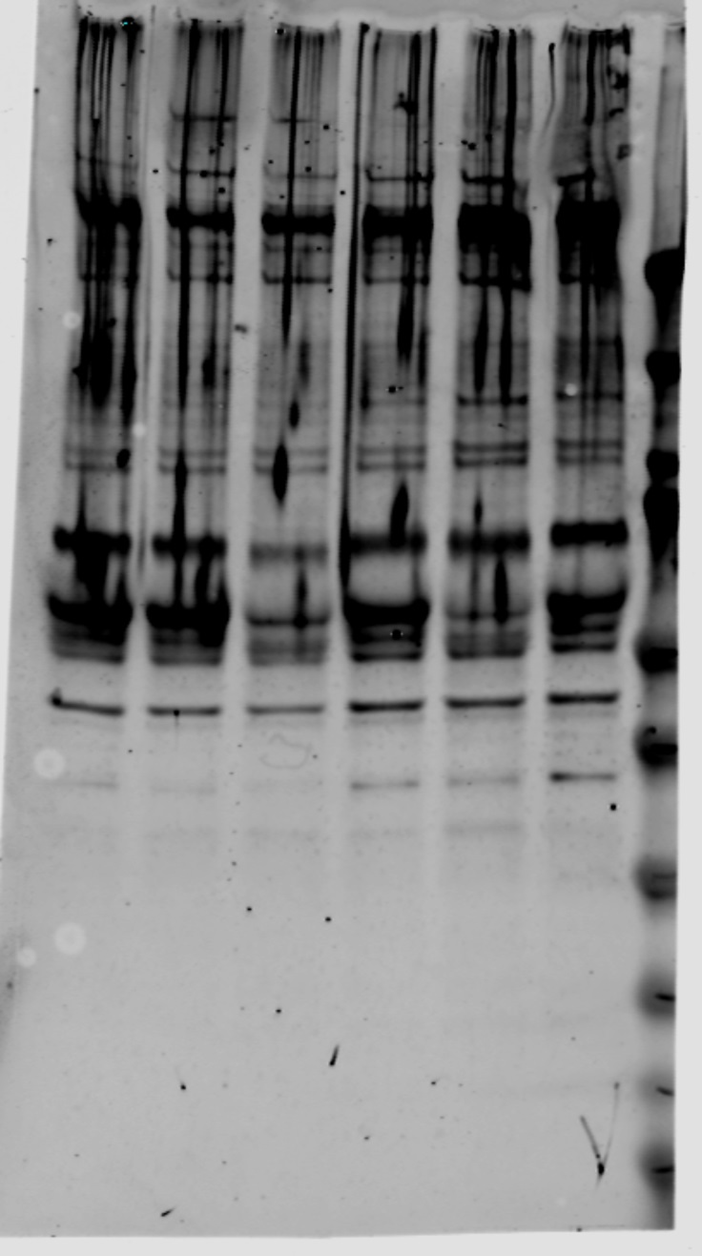
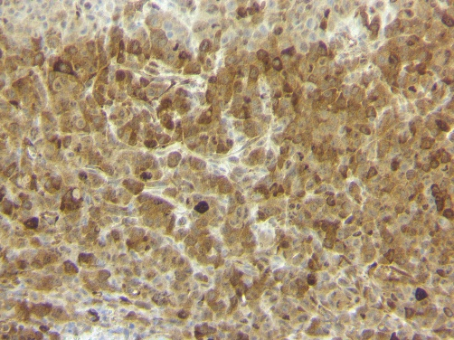

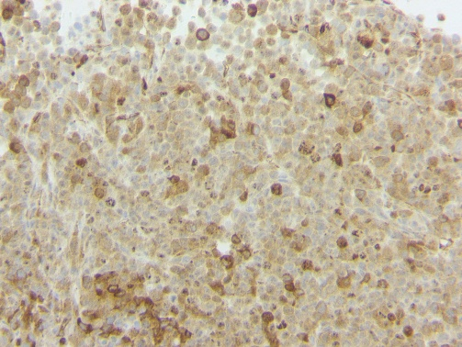

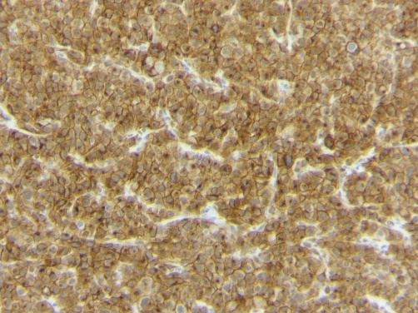

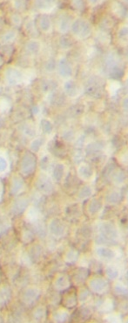
Figure S3
A
B
C
D
Lung-derived
metastatic
Parental
pOSR1
ACTIN
E
Bone-derived
Metastatic
F
G
Parental
WNK1
Body weight (g)
ACTIN
Parental
Bone-derived
Metastatic
H
Ctrl
WNK463
I
pOSR1
J
Ctrl
WNK463
K
AXL
Supplementary Figure 3. Cell viability and tumor IHC. A. Viability of MDA-MB-231 cells measured with CellTiter-Blue incubated with WNK463 (1 µM) for 24 hours. Paired t-test showed no difference between DMSO and WNK463 treatment groups; n=8. Mean±SD B. Migration of MDA-MB-231 cells was inhibited more by 5 µM than 2 µM BGB324 treated overnight, n=12. C. Overnight treatment with 5 µM BGB324 caused greater cell death than 2 µM BGB324. DMSO: n=11, BGB324: n=7. D. Representative Western blots for pOSR1 levels in Parental and Lung-derived metastatic MDA-MB-231 cells; n=2 in duplicates. E. WNK1 immunoblots from Parental and Bone-metastatic MDA-MB-231 cells. F. Quantification showed no differences in WNK1 protein between the groups. G. Body weights of NSG mice treated with DMSO vehicle (Ctrl) or WNK463 1.5 mg/kg for 2 weeks were not different; n=7. H. Representative images of immunohistochemical staining of pOSR1 or AXL (J) in orthotopic tumors from Bone metastatic MDA-MB-231 cells injected into NSG mice treated either with Ctrl (DMSO control) or WNK463 (1.5 mg/kg). I. Quantification of histoscores show decreased pOSR1 and AXL staining (K) in tumors treated with WNK463 compared to control, n=3. Mean±SEM. Scale=100 µm, *p<0.05; 1-tailed Student’s t test, **p<0.005 and ****p<0.0001; 2-tailed Student’s t test.

Slide 4
Figure S4
WNK1
OSR1
AXL
Slug
NKCC1
Cell migration, invasion and tumor metastasis
Supplementary Figure 4. Schematic representation of collaboration among WNK1, OSR1, and AXL in promoting breast cancer cell migration, invasion and tumor metastasis.

