Slide 1
Fig 1: CONSORT diagram
Pre-COVID-19 COVID-19
1st wave
Recruitment duration 7.5 months 2 months
N admission/month 180 201
-------------------------------------------------------------------------------------
Admissions (total) 1349 403
(including 121 with COVID-19)
ICU stay >10 days 170 (12.6%) 94 (23.3%)
Mech. Vent. >10 days 52 55
3 refused
N patients 52 52

Slide 2
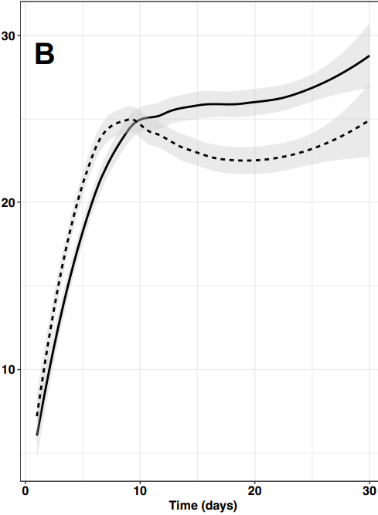
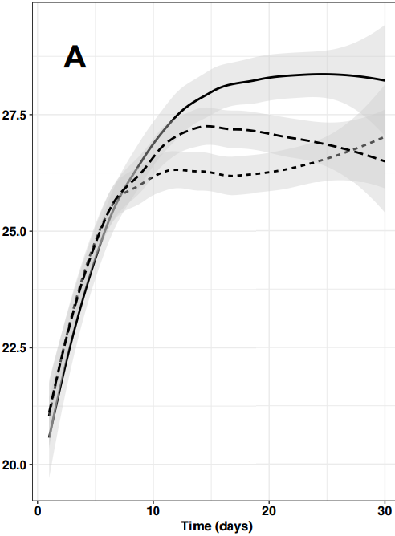
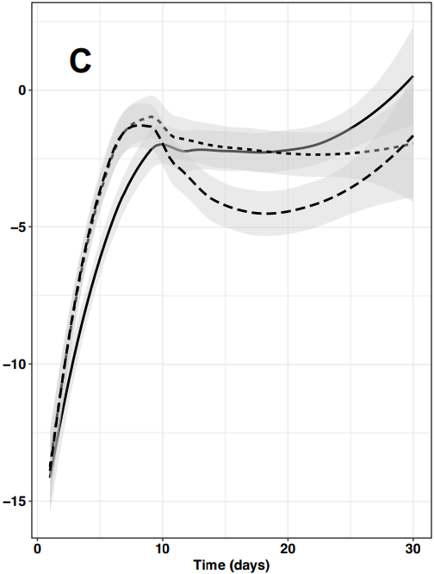




Fig 2
A. Energy delivery
(kcal/kg IBW)
B. Energy target
(kcal/kg IBW)
C. Energy balance
(kcal/kg IBW)
p<0.001
P < 0.001
non-CO
COVID-19
non-CO
COVID-19
COVID-19 protocol
CO-25 en bleu

Slide 3
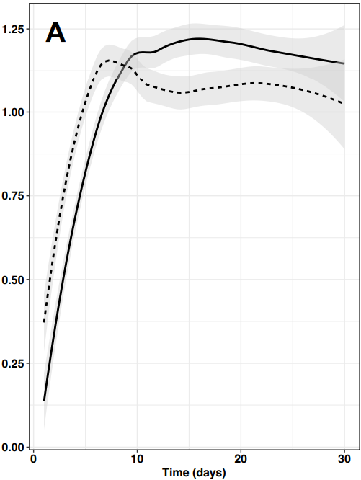
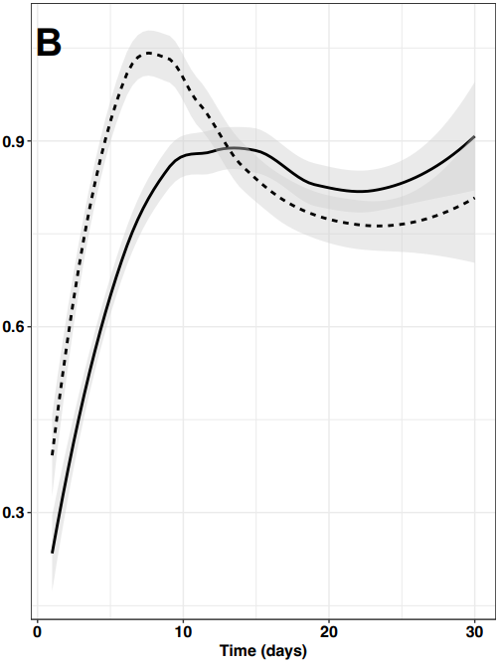
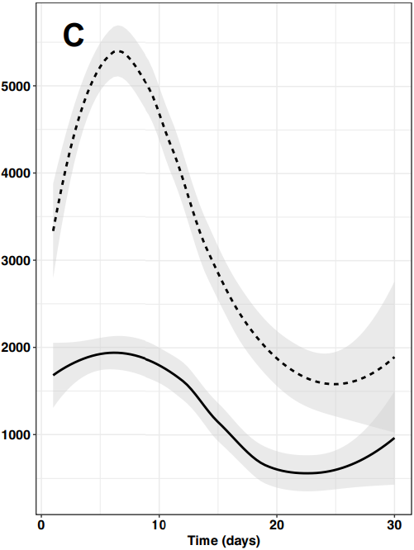
Fig 3:
Propofol
(mg/24h)
p<0.001
Protein intake
(g/kg IBW)
Lipid intake
(g/kg IBW)
p<0.001
non-CO
COVID-19

Slide 4
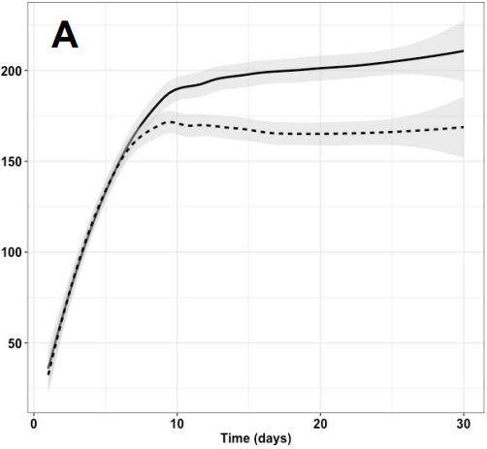
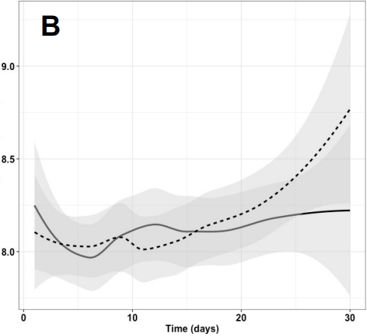
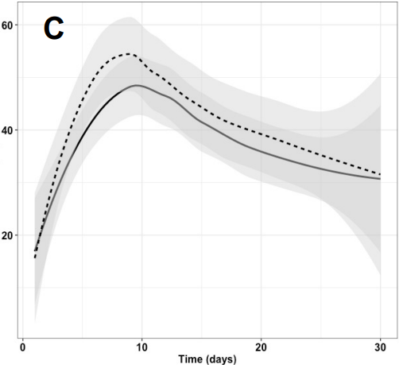
Fig. 4:
Glucose delivery (g/d)
Blood glucose (mmol/L)
Insulin (IU/24h)
non-CO
COVID-19

Slide 5
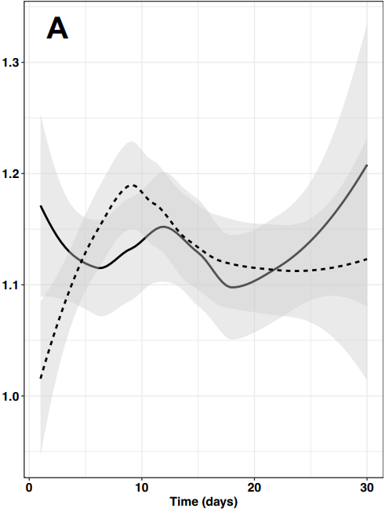
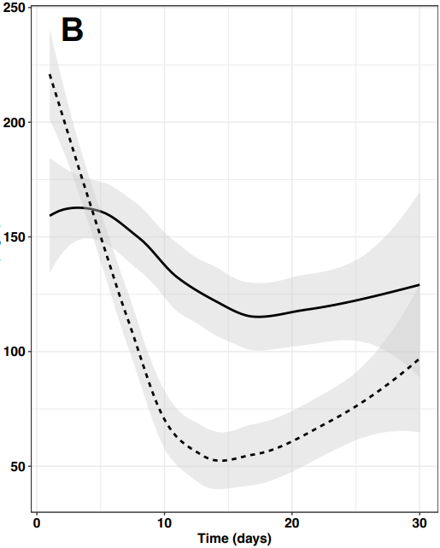
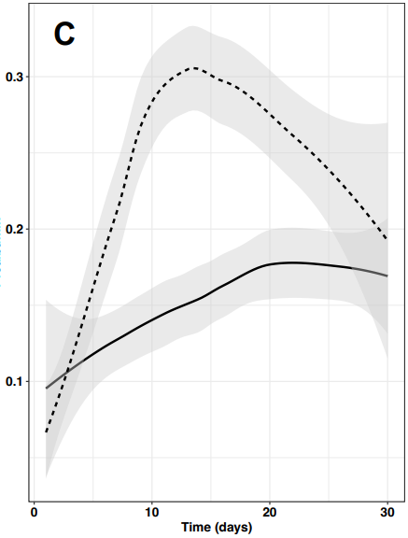
Fig. 5:
Blood phosphate (mmol/L)
C-reactive protein
(mg/L)
Prealbumin
(g/L)
non-CO
COVID-19

Slide 6
Supplement

Slide 7
Fig. 1-supplement:
Kaplan Meier survival curves according A to presence of COVID-19 or not, and B to a high or low NRS
A
B
Non-CO
COVID-19
NRS 3-4 (n=38)
Non-COVID
COVID
NRS > 5 (n=66: 32 COVID-19, 34 non-CO)
Time (days)
Time (days)

Slide 8
Fig. 2-Supplement: Evolution of feeding route over time in both groups
Percentage of days on each route
Days after ICU admission

Slide 9
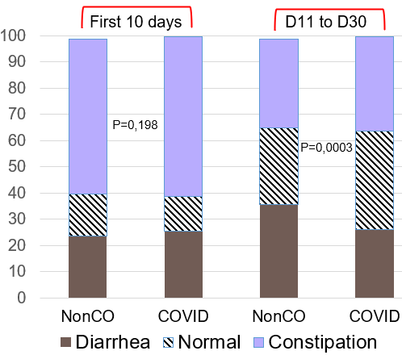
Fig 3 –supplement: Bowel activity in COVID-19 and non-CO patients as a percentage of days during the early phase (first 10 days) or later
Constipation predominates in the early phase in all (ns)
Diarrhoea in ≅ 30% of days
Not more frequent in COVID patients
Day 1 to 10: n=1035 days
Day 11 to 30: n=1341 days

Slide 10
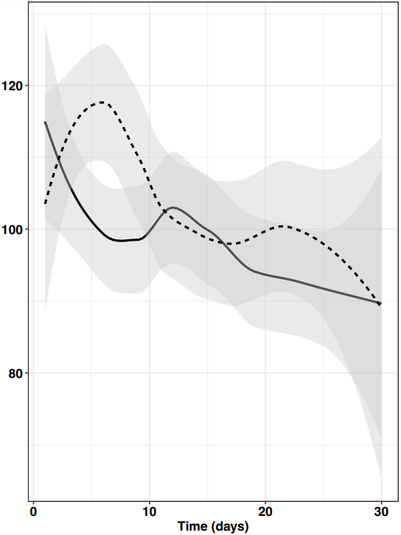
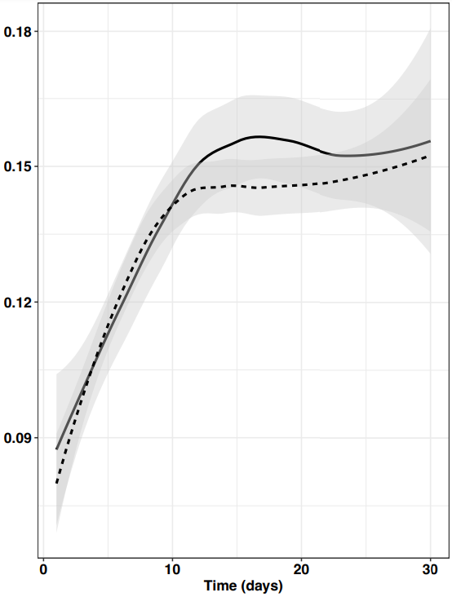
Fig. 4 Supplement: Evolution of blood creatinine and urea/creatinine ratio
Creatinine (μmol/l)
Urea/creatinine ratio
non-CO
COVID-19
non-CO
COVID-19

