Slide 1
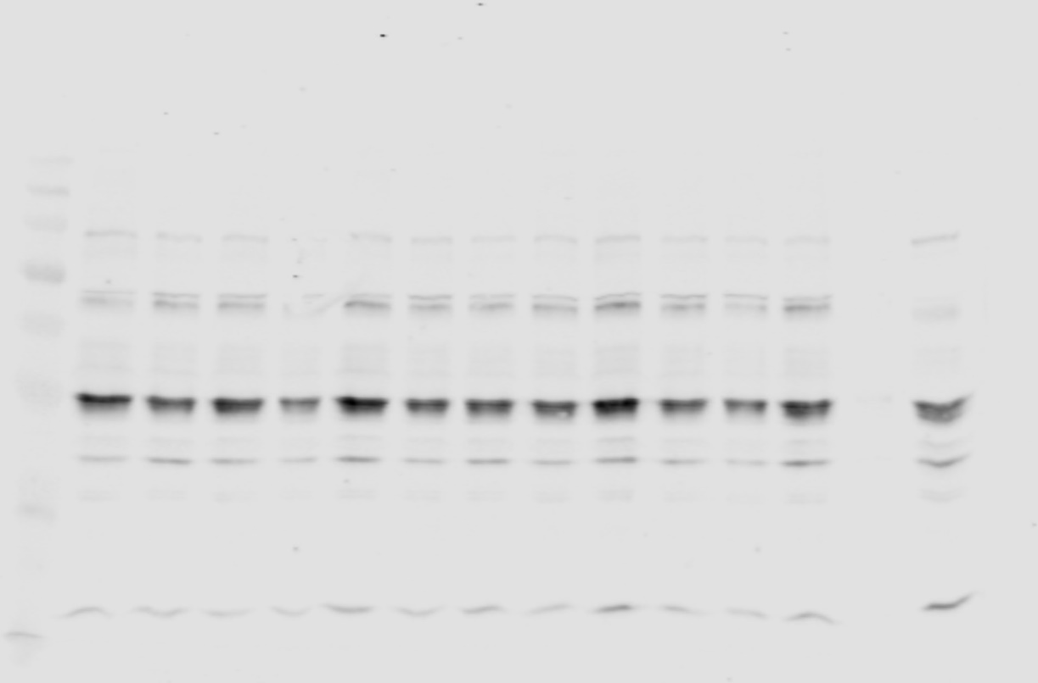
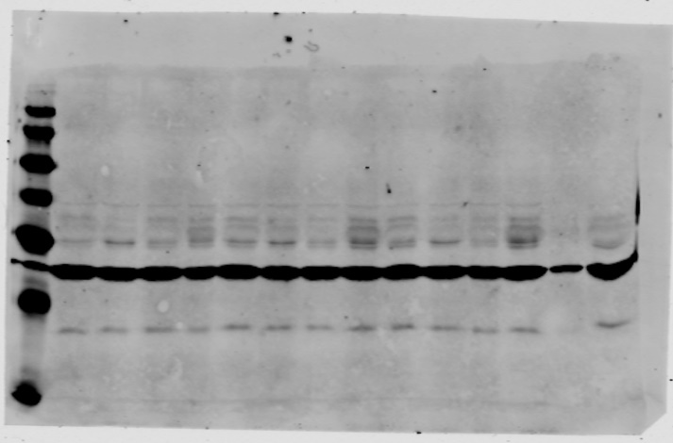
Figure 2a
α-Tau
α-E2F4 + α-Actin*
270
270
175
175
130
130
95
95
66
66
52
52
37
37
30
30
16
16
MW
WE
WD
FE
FD
WE
WD
FE
FD
WE
WD
FE
FD
MW
WE
WD
FE
FD
WE
WD
FE
FD
WE
WD
FE
FD
C57BL6
C57BL6
*Two primary antibodies recognizing bands of defined mobility (α-E2F4 and α-Actin) were used for the Oddisey protocol
MW: Molecular weight (kDa); WE: WT/EGFP; WD: WT/E2F4DN; FE: 5xFAD/EGFP; FD: 5xFAD/E2F4DN

Slide 2
Figure 2a
α-Actin
270
175
130
95
66
52
37
30
16
MW
WE
WD
FE
FD
WE
WD
FE
FD
WE
WD
FE
FD
C57BL6
MW: Molecular weight (kDa); WE: WT/EGFP; WD: WT/E2F4DN; FE: 5xFAD/EGFP; FD: 5xFAD/E2F4DN

Slide 3
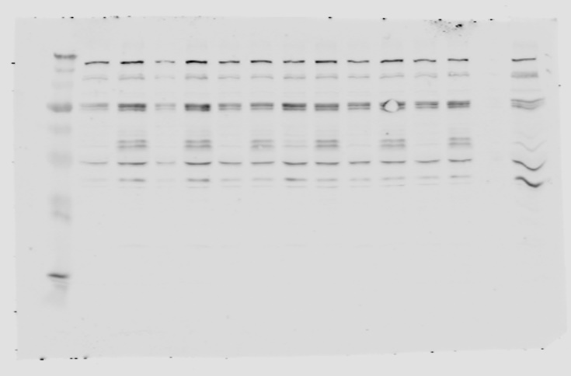
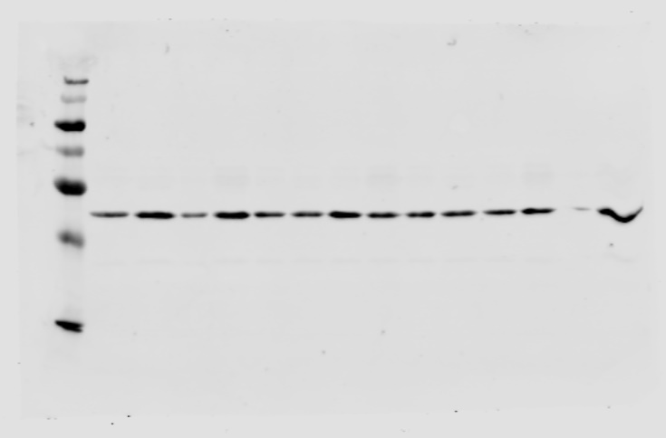
Figure 2a
α-Myc
α-Actin
270
270
175
175
130
130
95
95
66
66
52
52
37
37
30
30
16
16
MW
WE
WD
FE
FD
WE
WD
FE
FD
WE
WD
FE
FD
MW
WE
WD
FE
FD
WE
WD
FE
FD
WE
WD
FE
FD
C57BL6
C57BL6
MW: Molecular weight (kDa); WE: WT/EGFP; WD: WT/E2F4DN; FE: 5xFAD/EGFP; FD: 5xFAD/E2F4DN

Slide 4
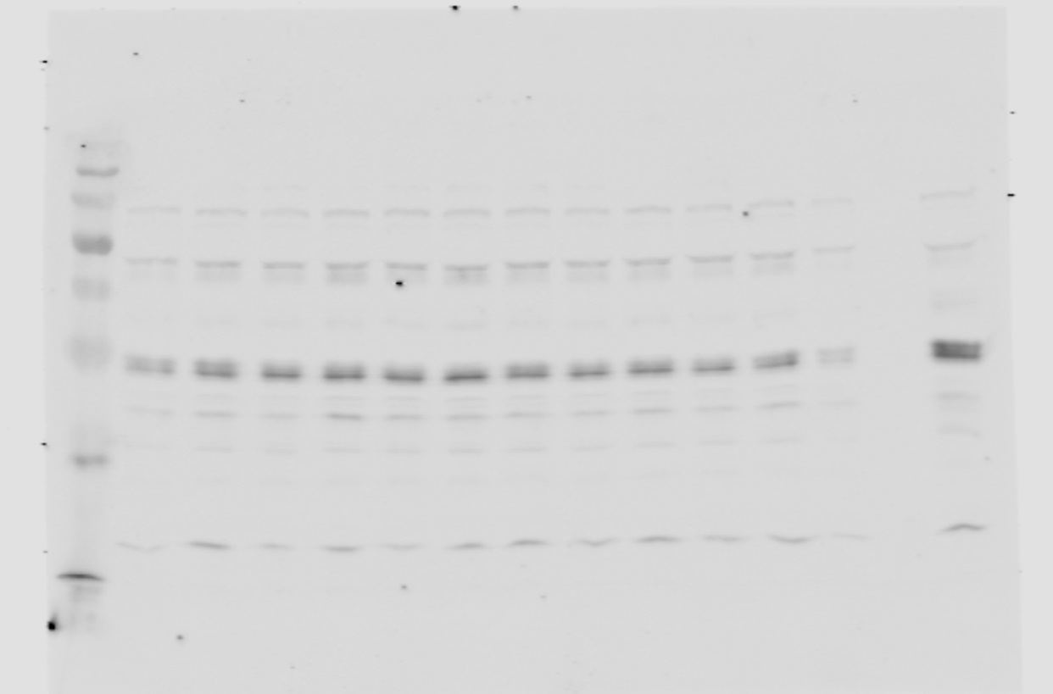
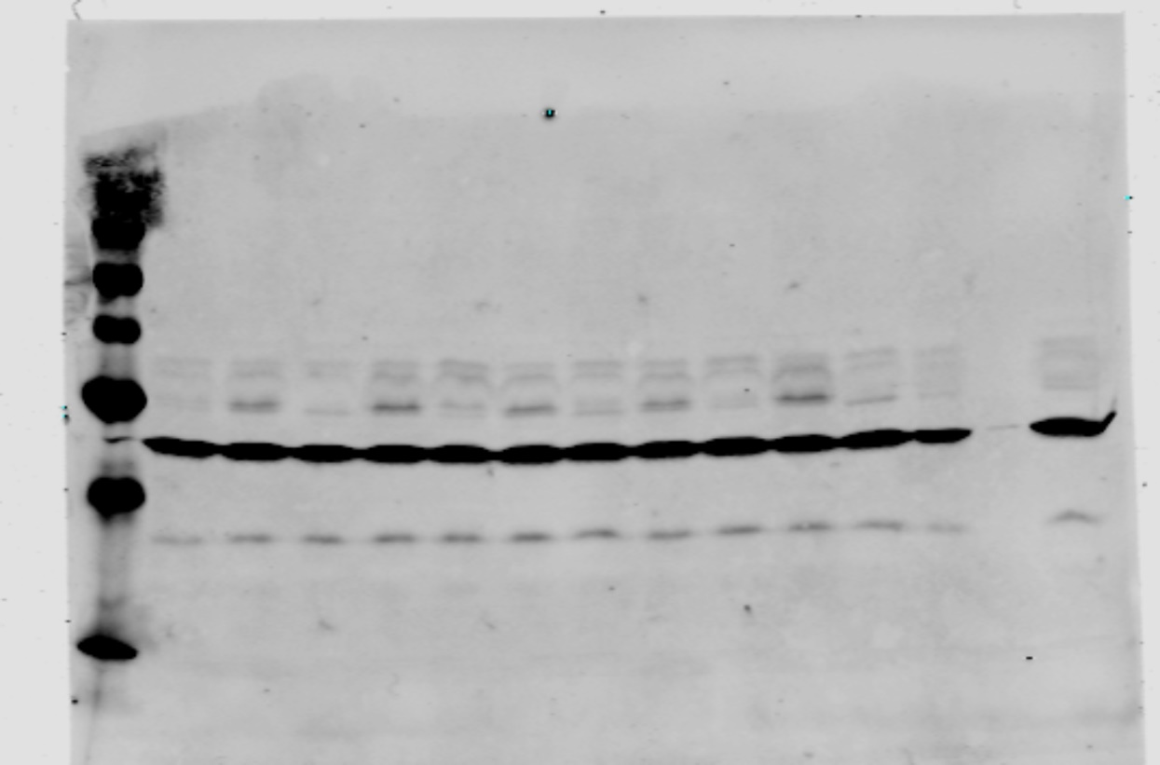
Figure 2b
α-Tau
α-E2F4 + α-Actin*
270
270
175
175
130
130
95
95
66
66
52
52
37
37
30
30
16
16
MW
WE
WD
FE
FD
WE
WD
FE
FD
WE
WD
FE
FD
MW
WE
WD
FE
FD
WE
WD
FE
FD
WE
WD
FE
FD
C57BL6
C57BL6
*Two primary antibodies recognizing bands of defined mobility (α-E2F4 and α-Actin) were used for the Oddisey protocol
MW: Molecular weight (kDa); WE: WT/EGFP; WD: WT/E2F4DN; FE: 5xFAD/EGFP; FD: 5xFAD/E2F4DN

Slide 5
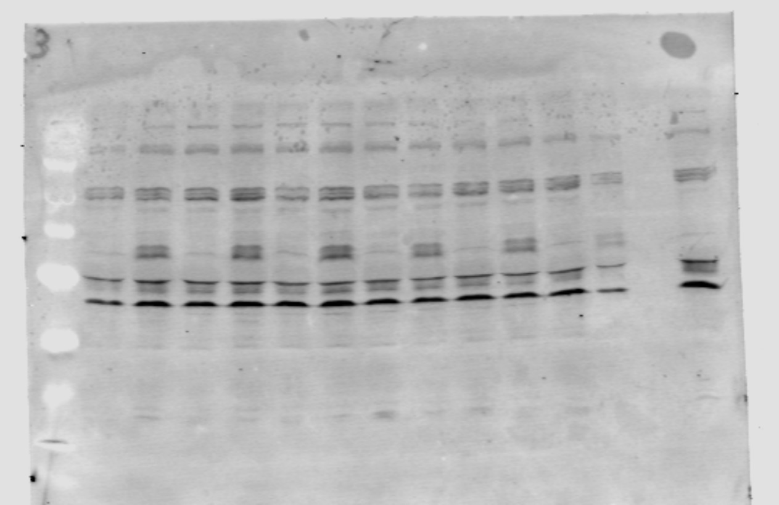
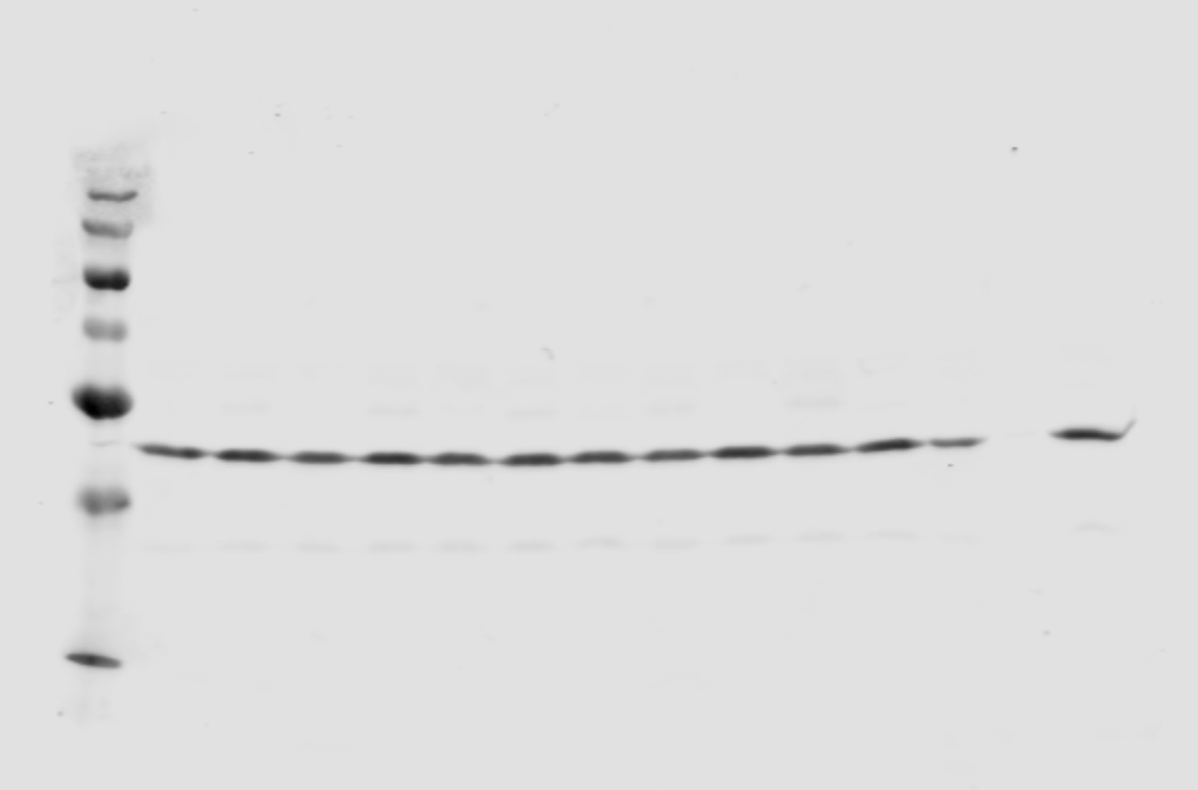
Figure 2b
α-Myc
α-Actin
270
270
175
175
130
130
95
95
66
66
52
52
37
37
30
30
16
16
MW
WE
WD
FE
FD
WE
WD
FE
FD
WE
WD
FE
FD
MW
WE
WD
FE
FD
WT
WD
FE
FD
WE
WD
FE
FD
C57BL6
C57BL6
MW: Molecular weight (kDa); WE: WT/EGFP; WD: WT/E2F4DN; FE: 5xFAD/EGFP; FD: 5xFAD/E2F4DN

Slide 6
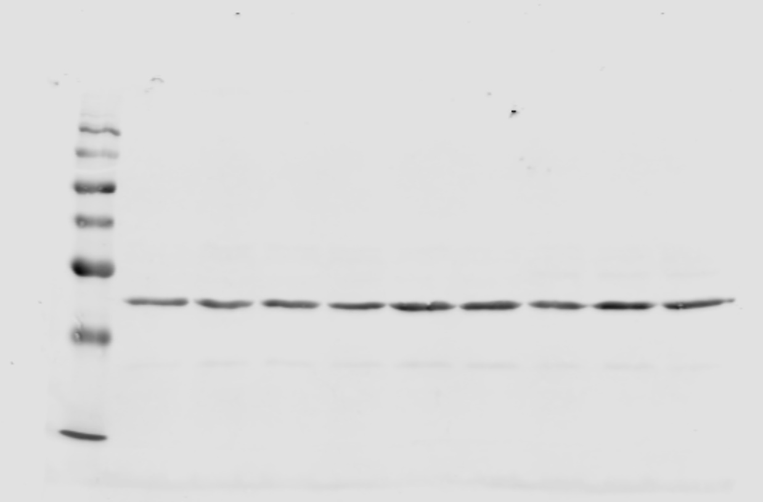
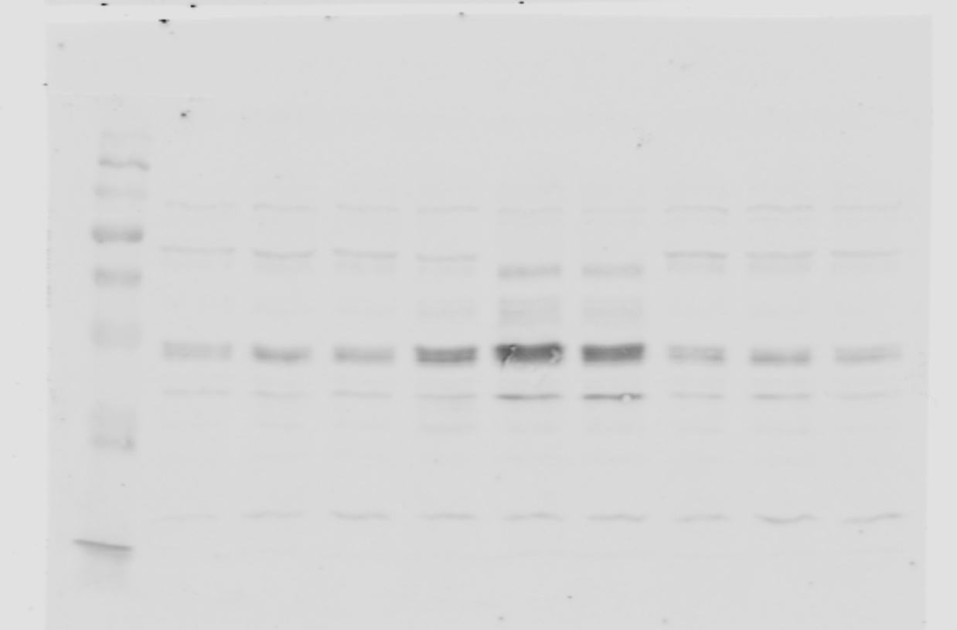
Supplementary Fig. 2
α-Actin
α-Tau
270
270
175
175
130
130
95
95
66
66
52
52
37
37
30
30
16
16
MW
WE
WE
WE
C57BL6
C57BL6
C57BL6
WD
WD
WD
MW
WE
WE
WE
WD
WD
WD
C57BL6
C57BL6
C57BL6
MW: Molecular weight (kDa); WE: WT/EGFP; WD: WT/E2F4DN

Slide 7
Supplementary Fig. 6
β-Amyloid
Lamin B1 + Actin*
95
66
52
37
130
30
95
66
16
52
37
6.5
30
16
MW
WE
FE
FE
FE
FD
FD
FD
MW2
MW
WE
FE
FE
FE
FD
FD
FD
MW
*Two primary antibodies recognizing bands of defined mobility (α-Lamin B1 and α-Actin) were used for the Oddisey protocol
MW: Molecular weight (kDa); WE: WT/EGFP; WD: WT/E2F4DN

Slide 8
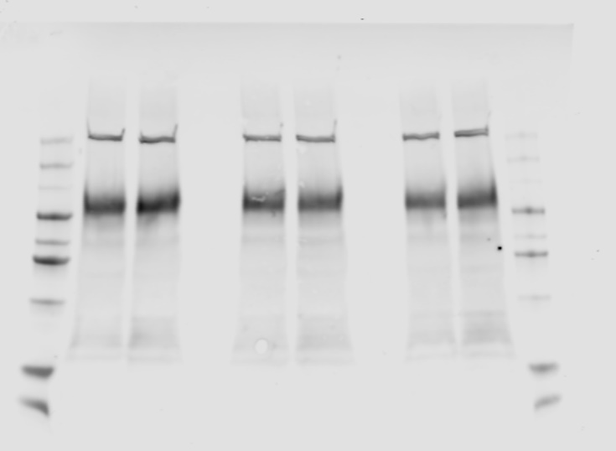
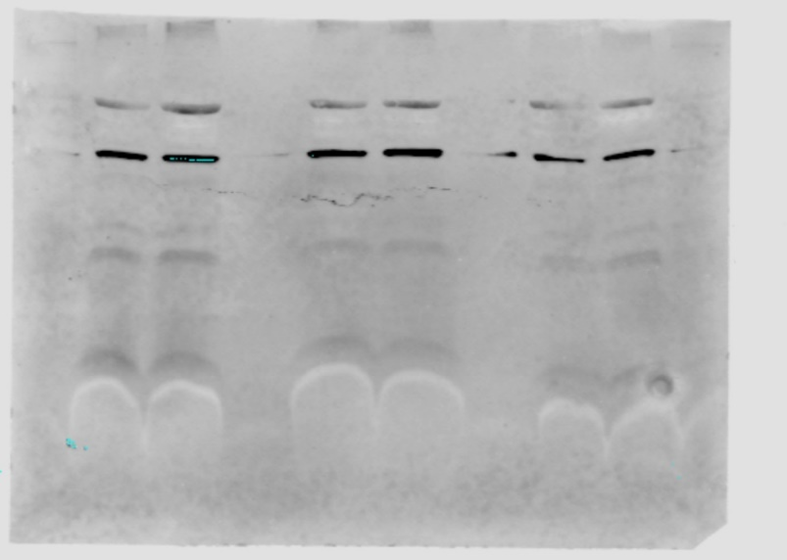
Supplementary Fig. 7
APP
Aβ
95
66
52
37
30
130
16
95
66
52
37
6.5
30
16
6.5
MW
FE
FD
FE
FD
FE
FD
MW
MW
FE
FD
FE
FD
FE
FD
MW
MW: Molecular weight (kDa); WE: WT/EGFP; WD: WT/E2F4DN

Slide 9
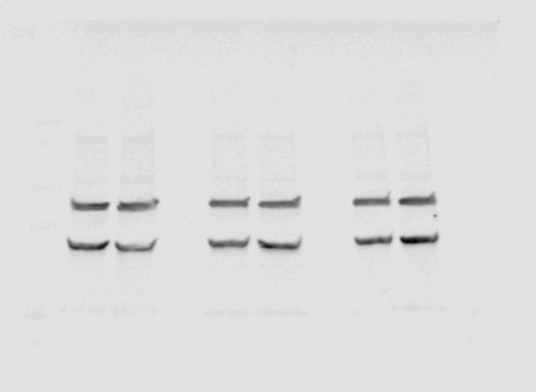
Supplementary Fig. 7
Lamin B1 + Actin*
*Two primary antibodies recognizing bands of defined mobility (α-Lamin B1 and α-Actin) were used for the Oddisey protocol
130
95
66
52
37
30
16
6.5
MW
FE
FD
FE
FD
FE
FD
MW: Molecular weight (kDa); WE: WT/EGFP; WD: WT/E2F4DN

Slide 10
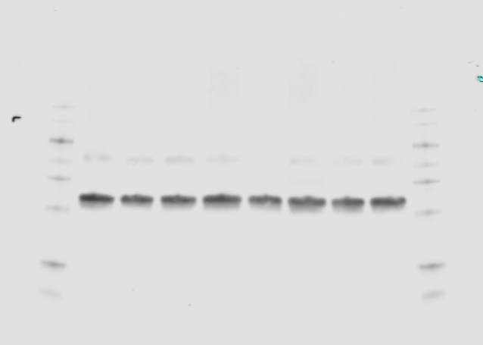
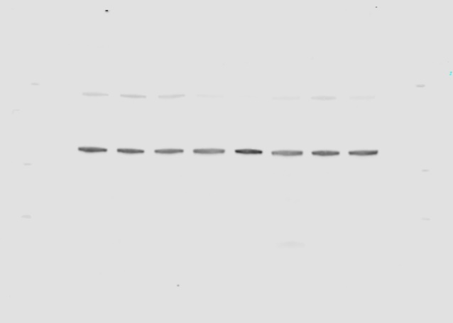
Supplementary Fig. 10
Synaptophysin
Lamin B1
130
130
95
95
66
66
52
52
37
37
30
30
16
16
6.5
6.5
MW
WE
WD
FE
FD
WE
WD
FE
FD
MW
MW
WE
WD
FE
FD
WE
WD
FE
FD
MW
MW: Molecular weight (kDa); WE: WT/EGFP; WD: WT/E2F4DN; FE: 5xFAD/EGFP; FD: 5xFAD/E2F4DN

