Slide 1
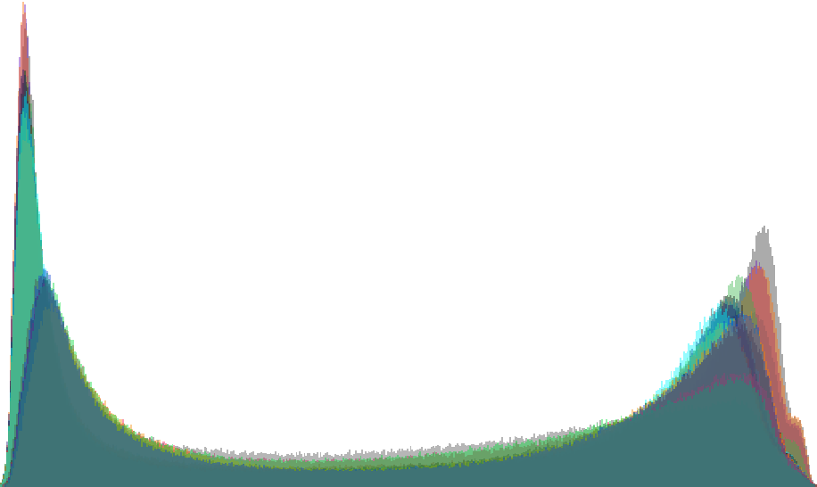
7000
6000
5000
Number of CpG probes
4000
3000
2000
1000
0.2
0.4
β value
0.6
0.8

