Slide 1


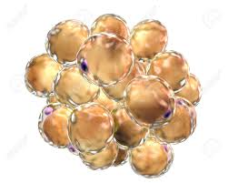
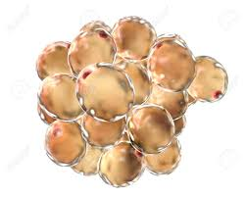
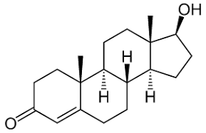
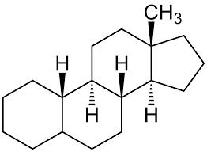
Adipose Tissue-
a steroidogenic organ
lean
obese
lean
Steroidogenic enzymes
BDP
FDP
FDP
BDP
AKR1c2 ↑
AKR1c3 ↑
Androstendione
Testosterone
DHT
androgens
androgens
Serum
CYP19 ↑
Estradiol
Estrone
estrogens
estrogens
Supplemental Figure 1: Model for steroidogenic machinery and capacity for testosterone biosynthesis in human AT. Differences for steroid production via the
frontdoor pathway (FDP) and the backdoor pathway (BDP) are depicted. That leads to different steroidogenic gene expression and a much higher androgen
production in AT of obese women.

