Slide 1
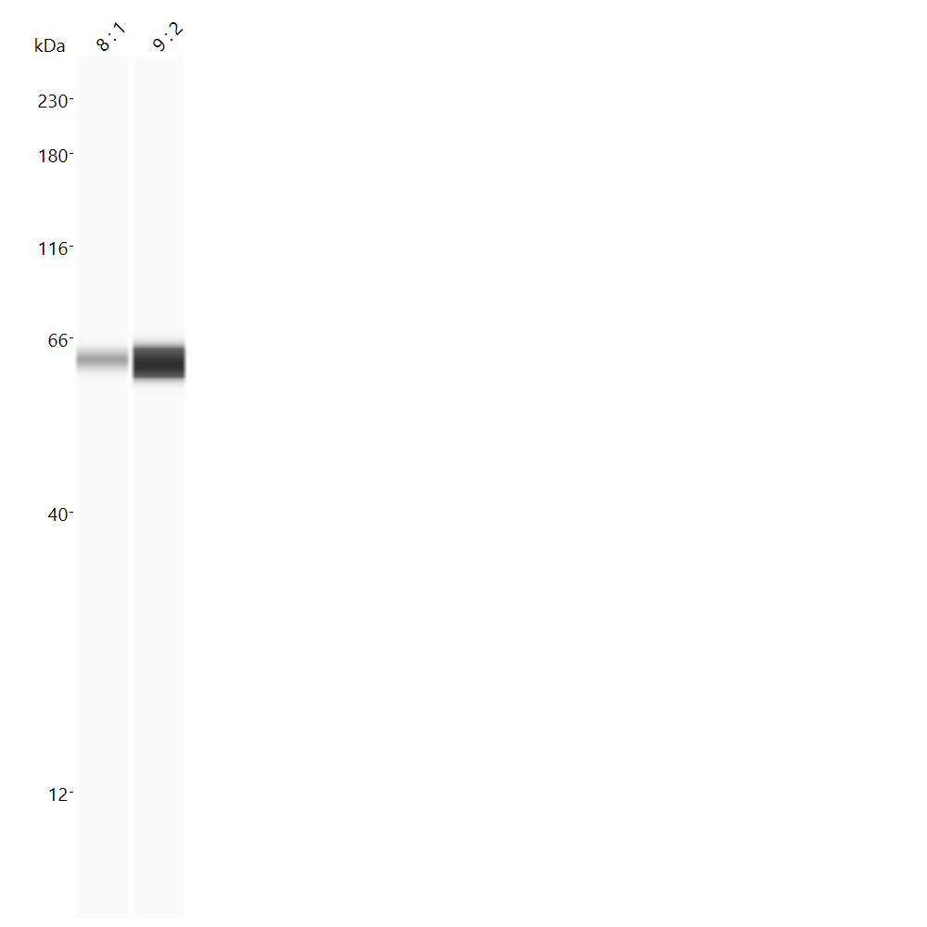
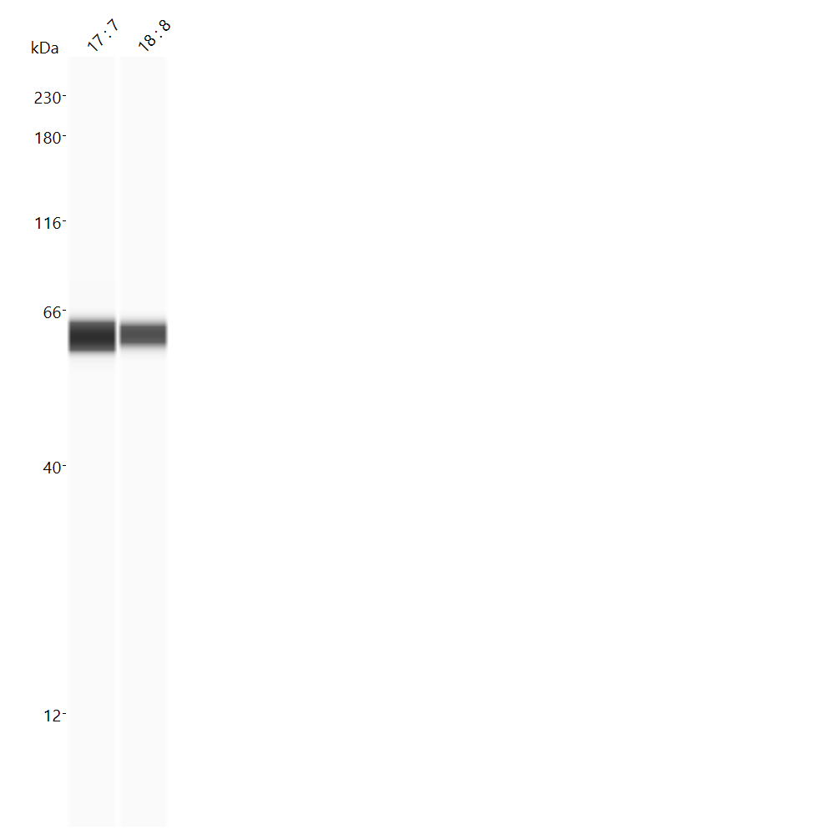
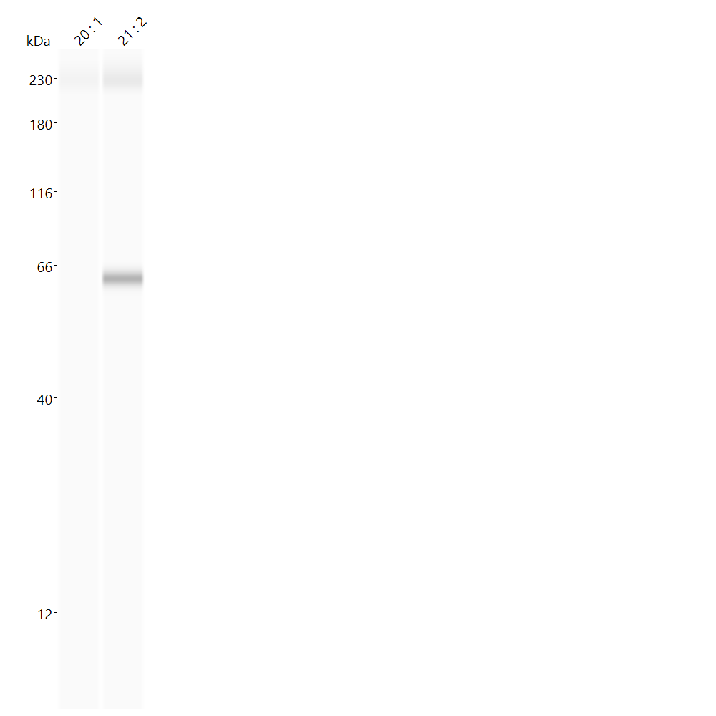
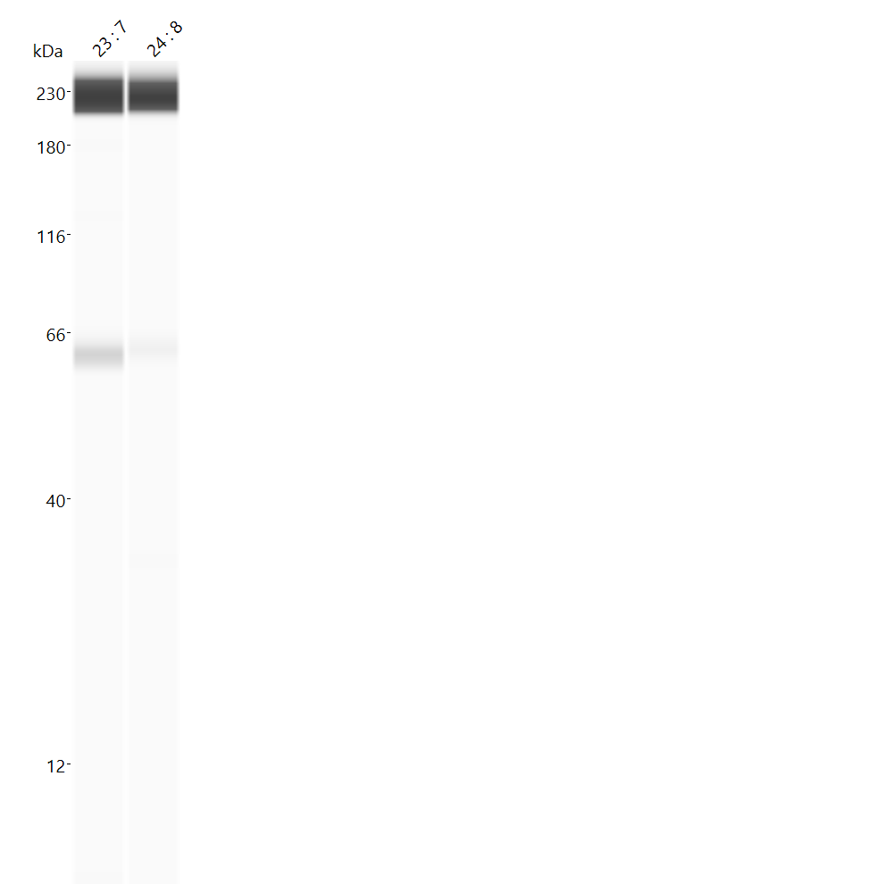
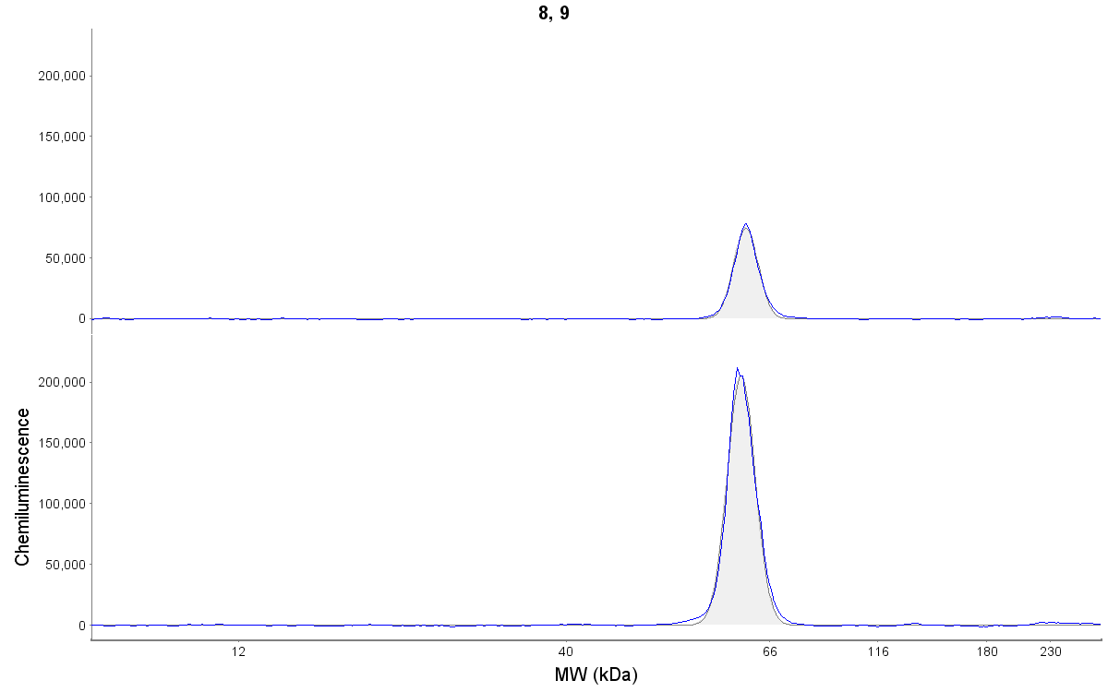
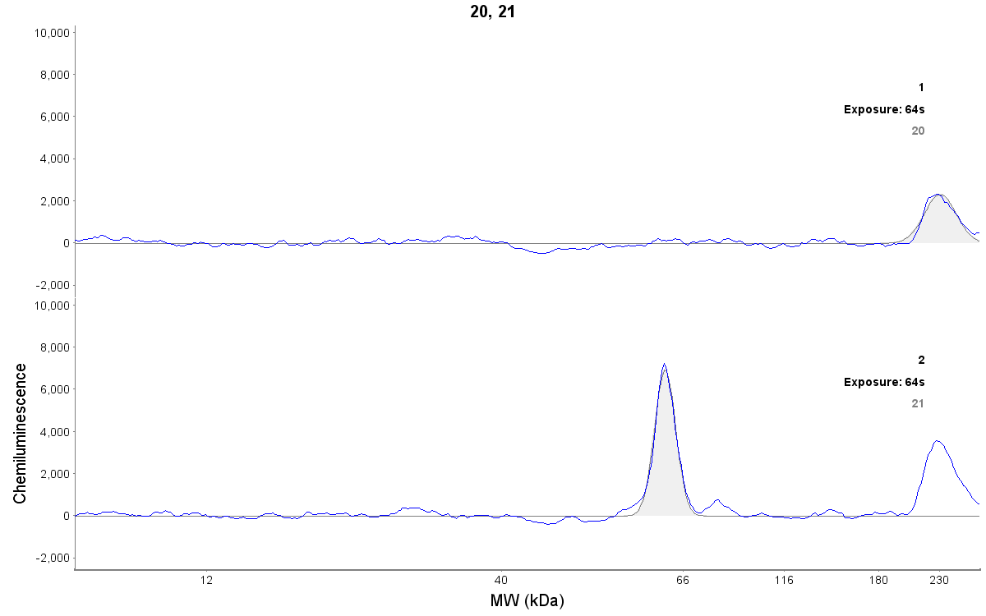
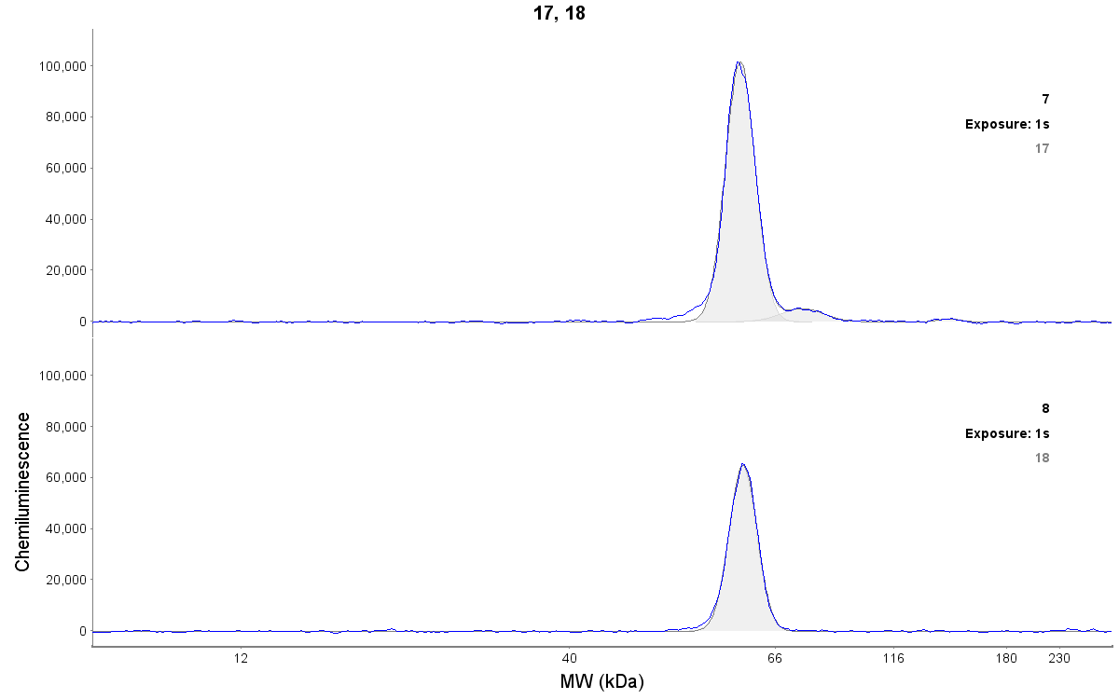
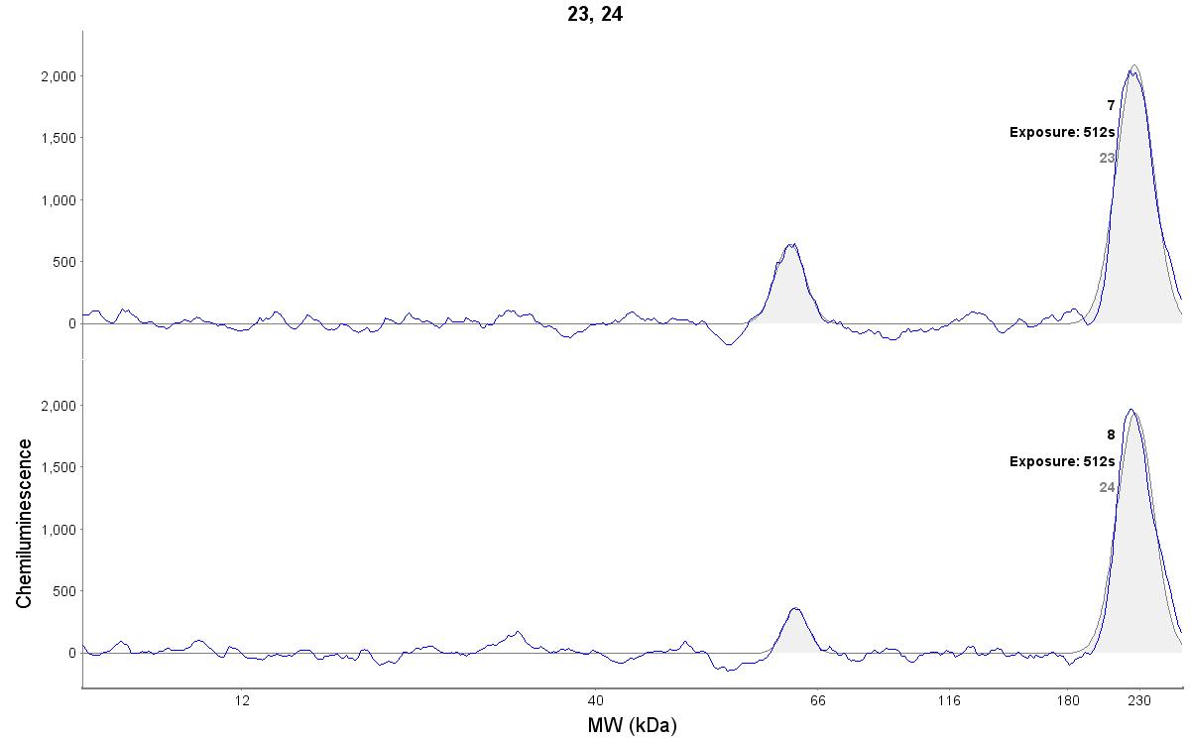
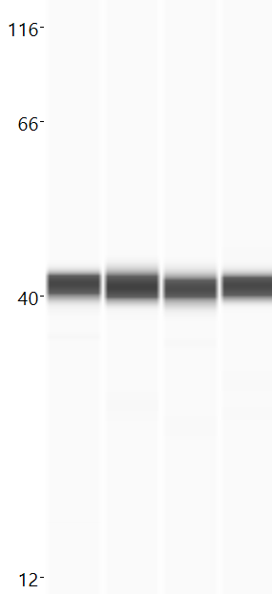
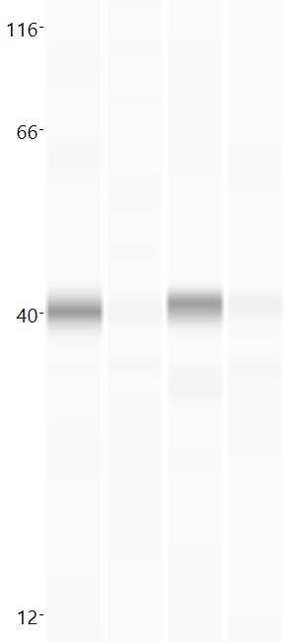
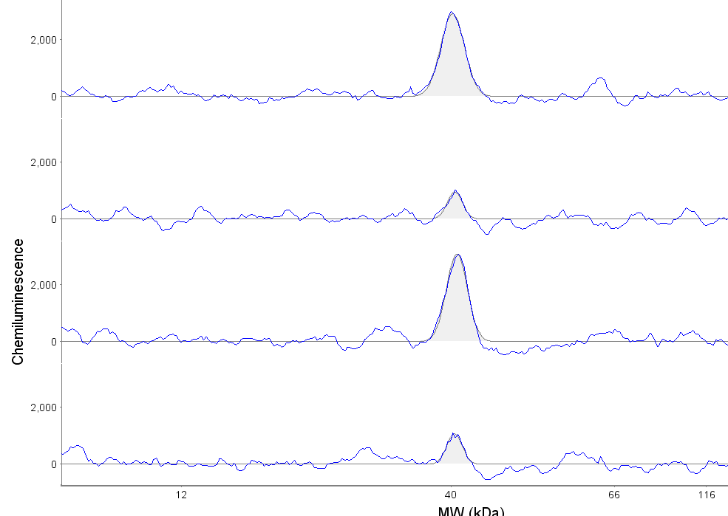
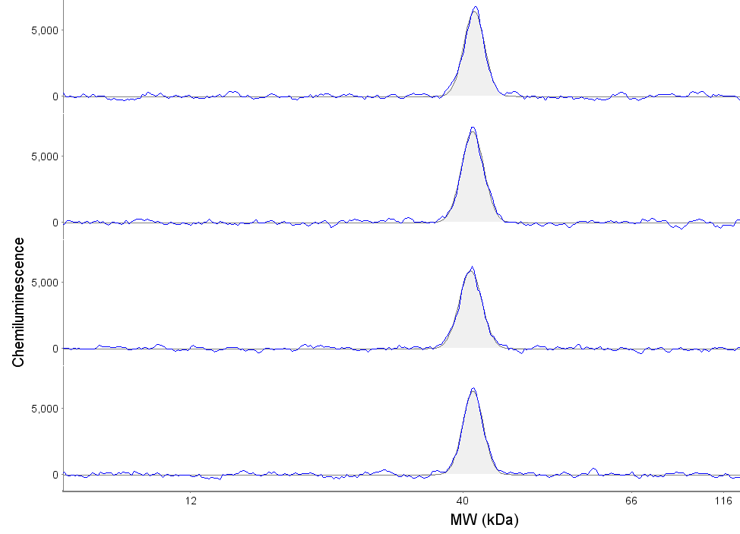
Lean
women
Obese
women
Lean
women
Obese
women
CYP11A1
3Beta-HSD2
SC
SC
Lean
women
VC
VC
SC
SC
Obese
women
VC
VC
GAPDH
AKR1C2
SC
SC
Lean
women
VC
VC
SC
SC
Obese
women
VC
VC
Supplemental Figure 2: protein expression of steroidogenic enzymes in sc and visc AT of lean and obese women. GAPDH was used as a reference protein.
Chemiluminescence curves of one representative N of a Western Blot are depicted.

