Slide 1
Reference
Ighmbp2^{+/D564N}
Supplemental Figure 1: No identified off-target editing by CRISPR/Cas9 in the generation of the D564N mice. Sequence from a predicted off-target CRISPR/Cas9 location within the heterozygous D564N founder animal genomic DNA indicating that D564N and wildtype (reference) sequences are identical.

Slide 2
A.
Rotarod
B.
Grip Strength
Ighmbp2^{+/+} Males (n=5)
Ighmbp2^{+/+} Females (n=9)
D564N/D564N +high dose Males (n=6)
D564N/D564N +high dose Females (n=8)
Supplemental Figure 2: D564N mutants do not differ in motor strength and coordination between sexes as assayed by rotarod and grip strength. (A) Motor strength and coordination assayed by rotarod in Ighmbp2^{+/+} and Ighmbp2^{D564N/D564N} mice ICV injected with a high dose (5x10¹¹ viral genomes) of ssAAV9-IGHMBP2 comparing male and female animals. Assay is measured in seconds. (B) Grip strength in Ighmbp2^{+/+} and Ighmbp2^{D564N/D564N} mice ICV injected with a high dose (5x10¹¹ viral genomes) of ssAAV9-IGHMBP2 comparing male and female animals. Assay is measured in grams. Statistical test used was a Two-way ANOVA with Tukey’s post-hoc test for multiple comparisons. Data bars expressed as mean ± SEM, ns= not significant.
.

Slide 3
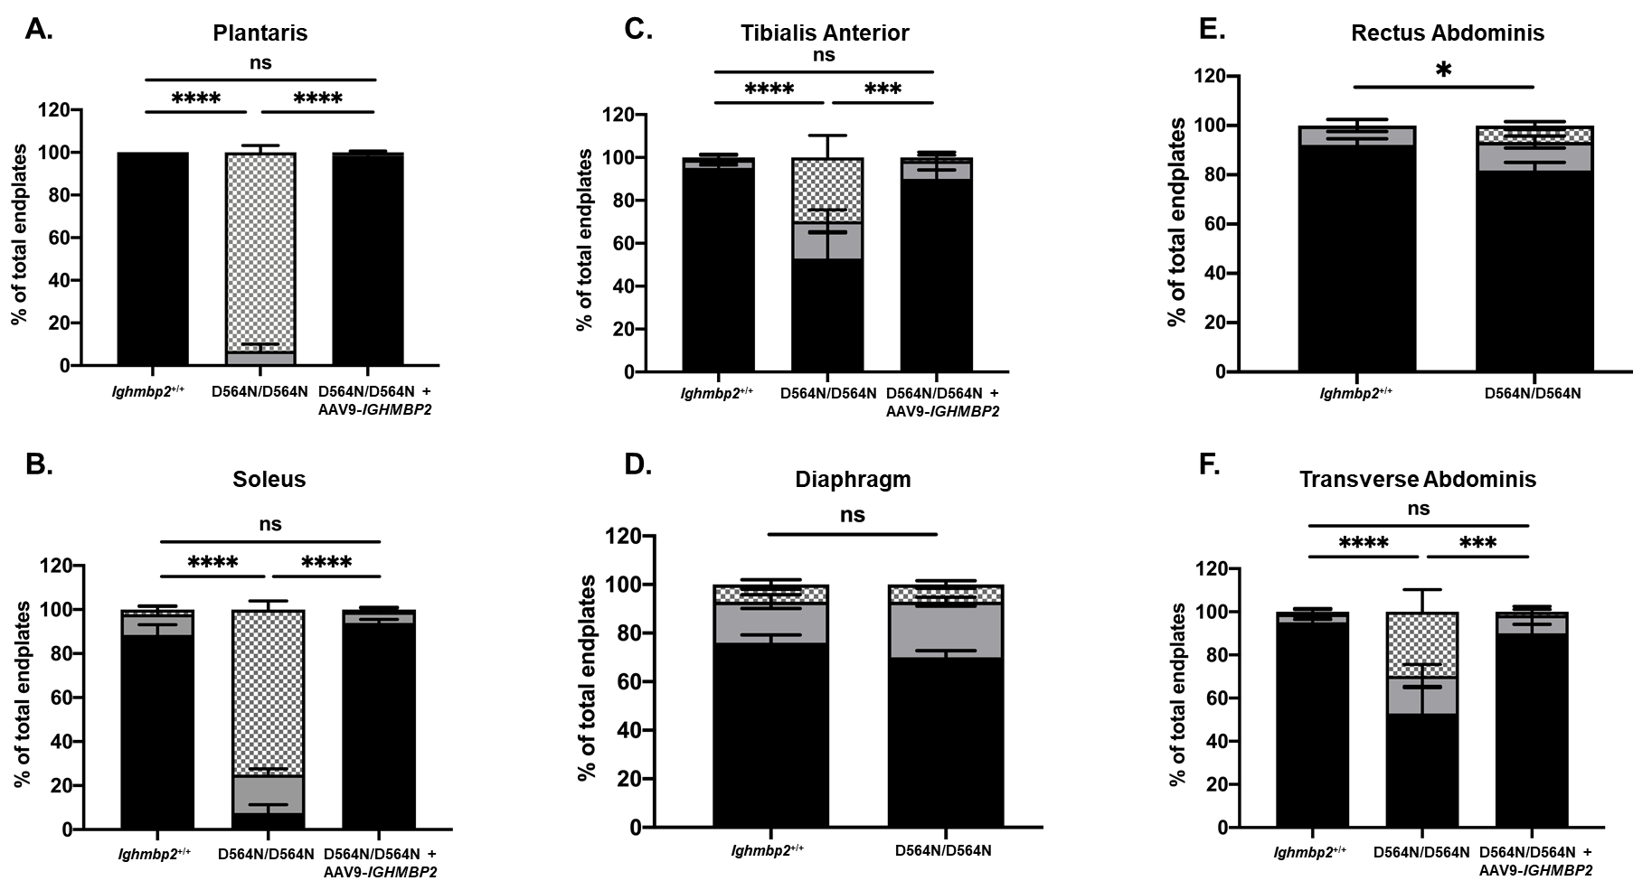
Supplemental Figure 3: D564N mutants demonstrate selective vulnerability to end plate denervation. PND15 Ighmbp2^{+/+} mice, Ighmbp2^{D564N/D564N} mice and Ighmbp2^{D564N/D564N} ssAAV9-IGHMBP2 injected mice. Muscles were labeled with anti-neurofilament heavy polypeptide (NF-H) antibody, anti-synaptic vesicle 2 (SV2) antibody, and α-bungarotoxin (α-BTX) that labels the acetylcholine receptors (AChRs). Fluorescent images were taken at 40x magnification. Quantification of fully innervated, partially innervated, and fully denervated NMJs in the plantaris muscle (A), soleus muscle (B) and tibialis anterior muscle (C). Quantification of fully innervated, partially innervated, and full denervated NMJs in the diaphragm muscle (D), rectus abdominis muscle (E), and transverse abdominis muscle (F). Data analyzed by a Two-way ANOVA with Tukey’s post-hoc test for multiple comparisons. Data bars expressed as mean + SEM. ****p<0.0001, ***p<0.001, *p=0.0071, n=3 animals per cohort (n>100 end plates analyzed per cohort), ns=not significant.
Notes:
Figure 6. NMJs
*P5 Gastroc in supplemental

