Slide 1
Figure 4D
Vehicle
DQ
Fisetin
α-Klotho (α-Klotho antibody ;R&D Systems, AF1819

Slide 2
Figure 4D
Vehicle
DQ
Fisetin
GAPDH antibody (Cell Signaling Technology, 97166)

Slide 3
Supplemental Figure 3a
Young (3-month)
Old (32-month)
α-Klotho (α-Klotho antibody ;R&D Systems, AF1819

Slide 4
Supplemental Figure 3a
Young (3-month)
Old (32-month)
GAPDH antibody (Cell Signaling Technology, 97166)

Slide 5
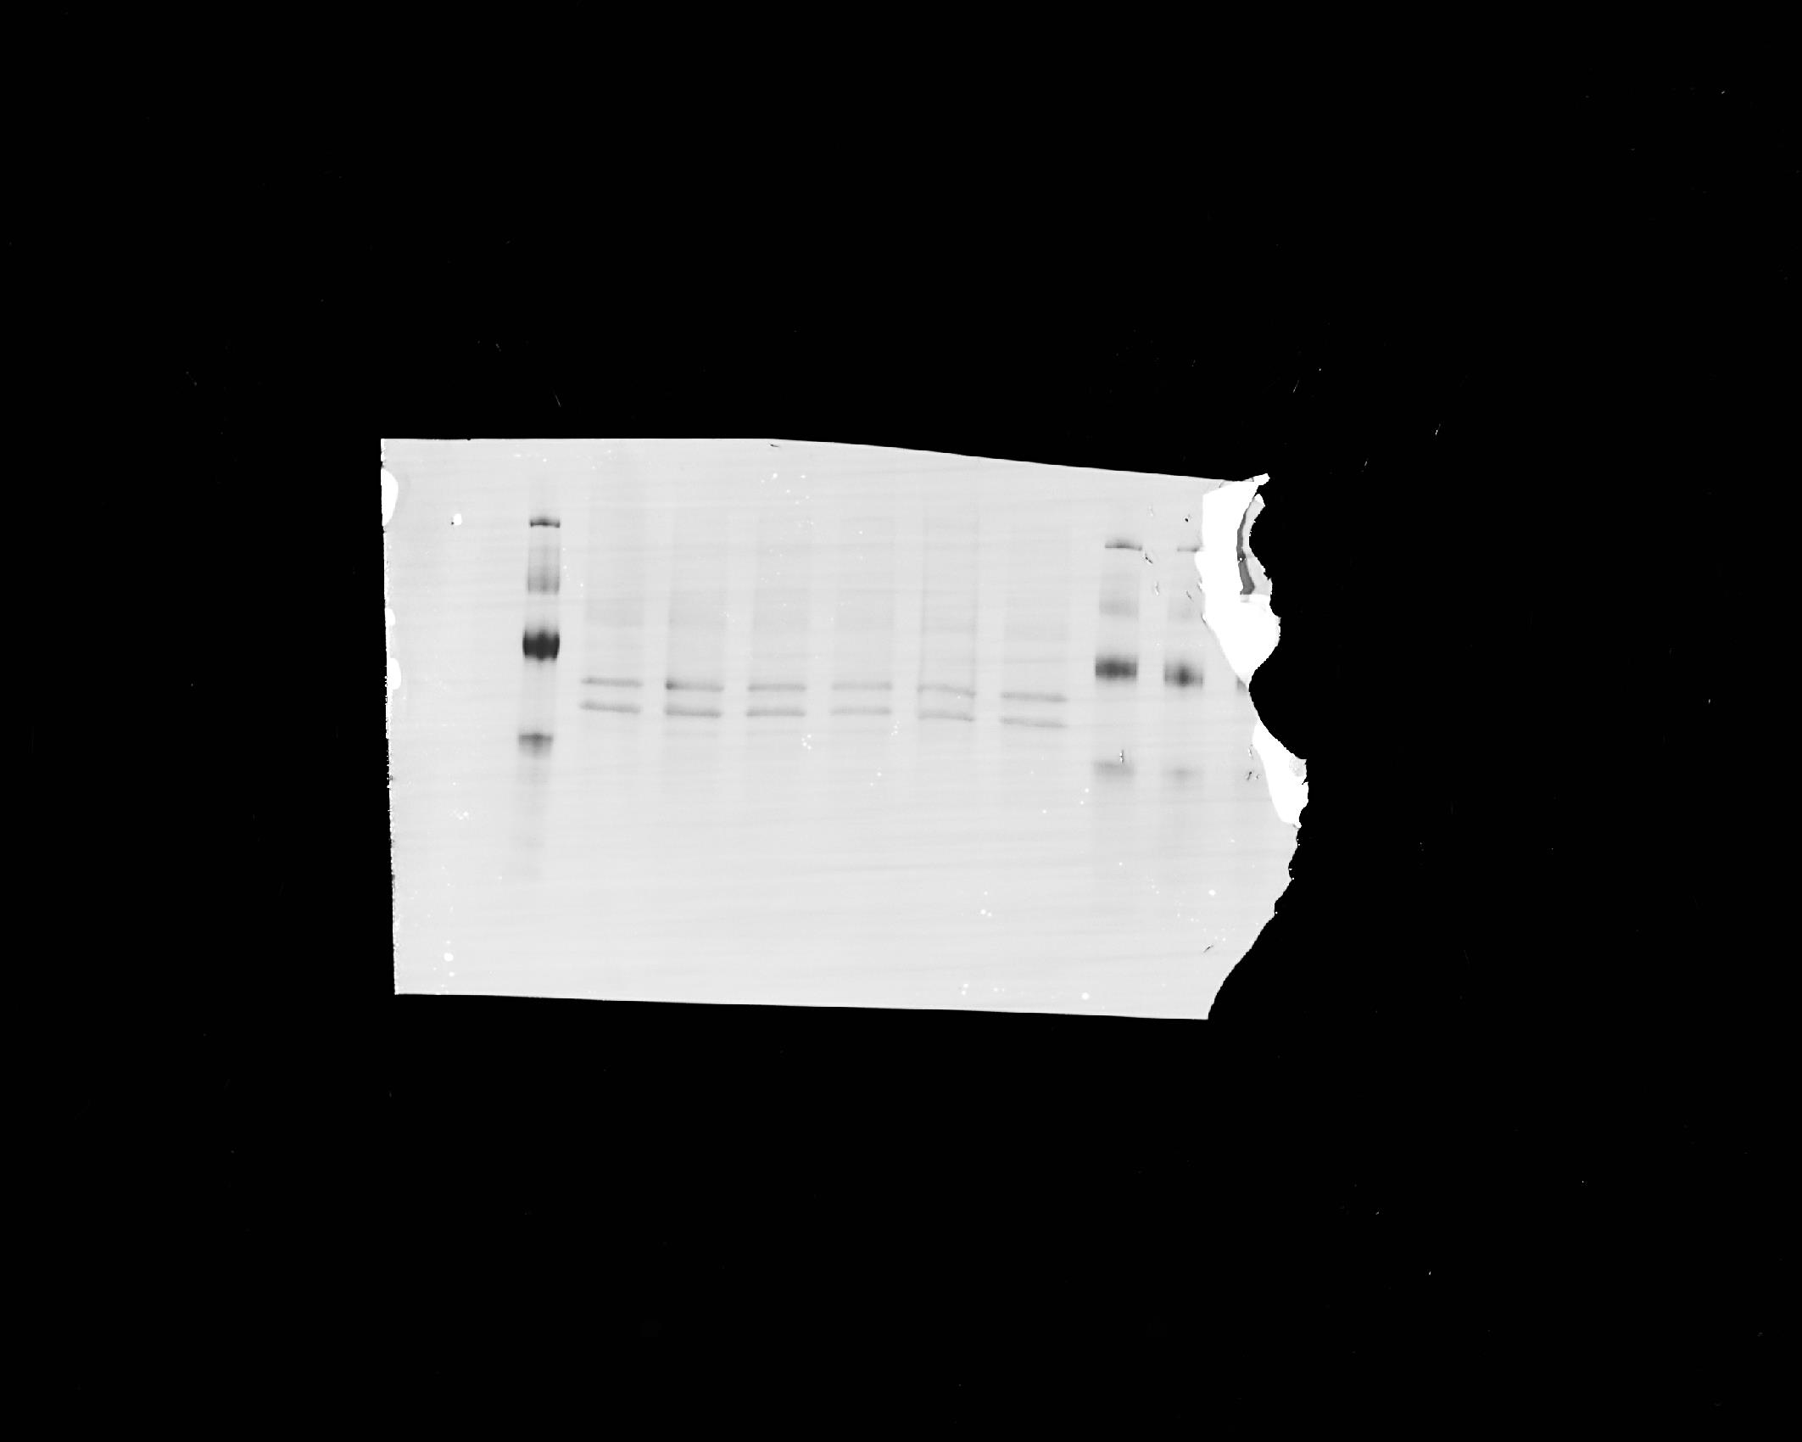
Supplemental Figure 5a
α-Klotho (α-Klotho antibody ;R&D Systems, AF1819

Slide 6
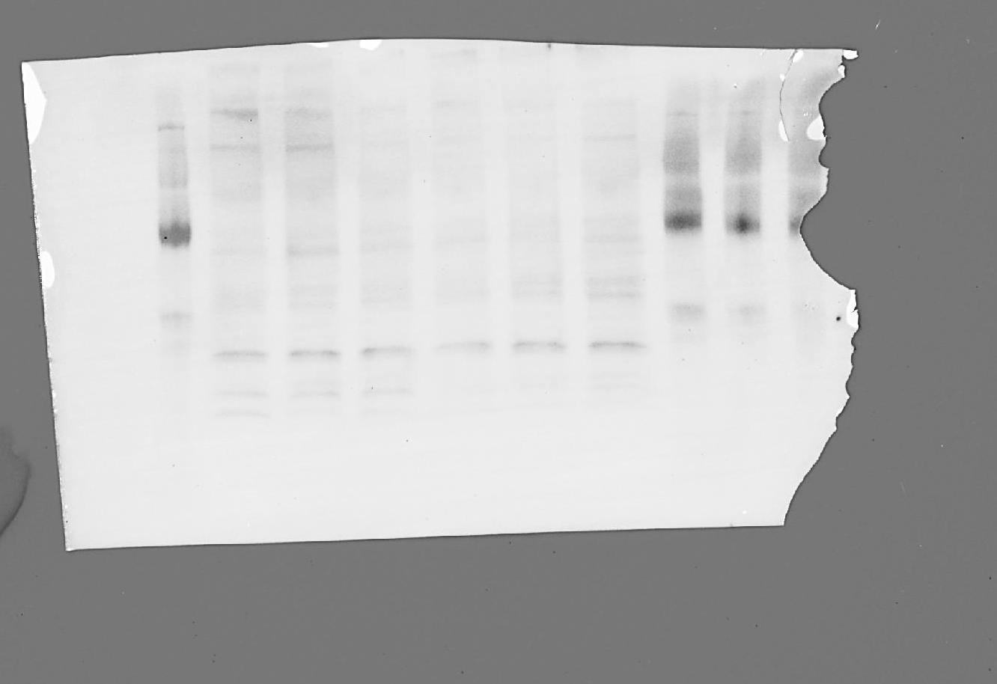
Supplemental Figure 5a
Vehicle
DQ
Fisetin
GAPDH antibody (Cell Signaling Technology, 97166)

Slide 7
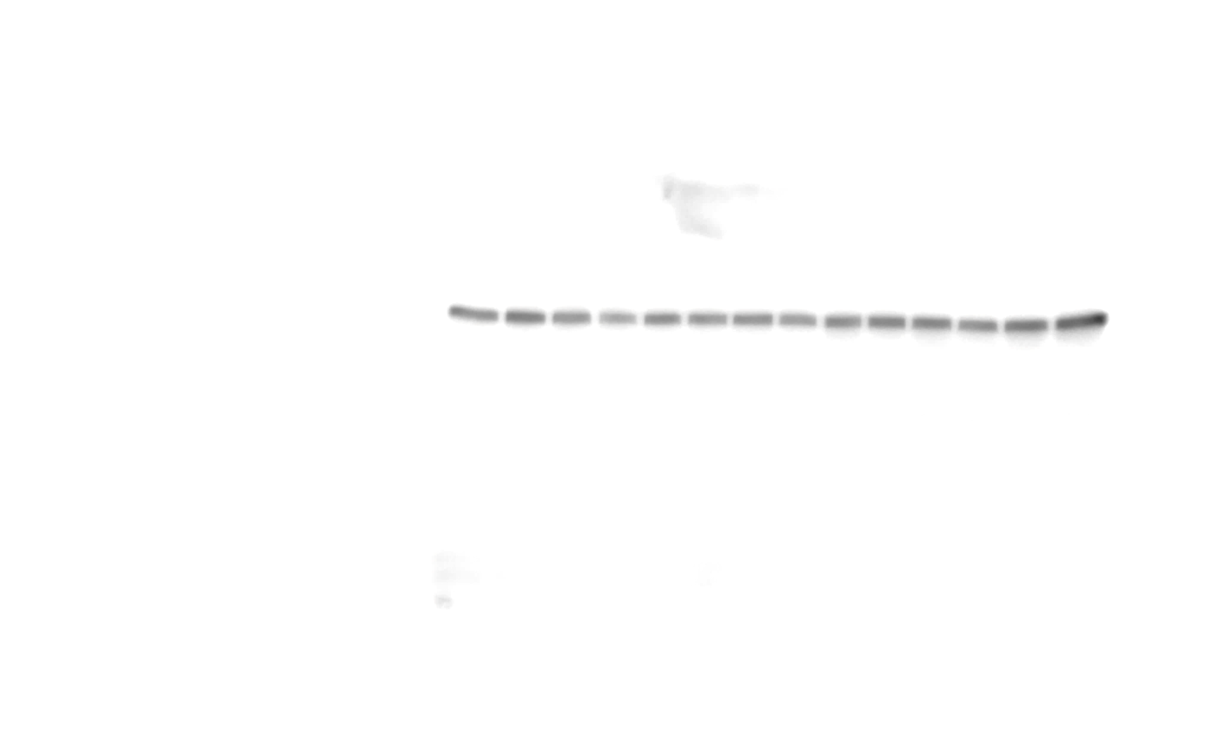
Supplemental Figure 6A
Vehicle
DQ
AP
α-Klotho (α-Klotho antibody ;R&D Systems, AF1819

Slide 8
Supplemental Figure 6A
Vehicle
DQ
AP
GAPDH antibody (Cell Signaling Technology, 97166)

Slide 9
Supplemental Figure 5
Young
Old -veh
Old -AP
α-Klotho (α-Klotho antibody ;R&D Systems, AF1819

Slide 10
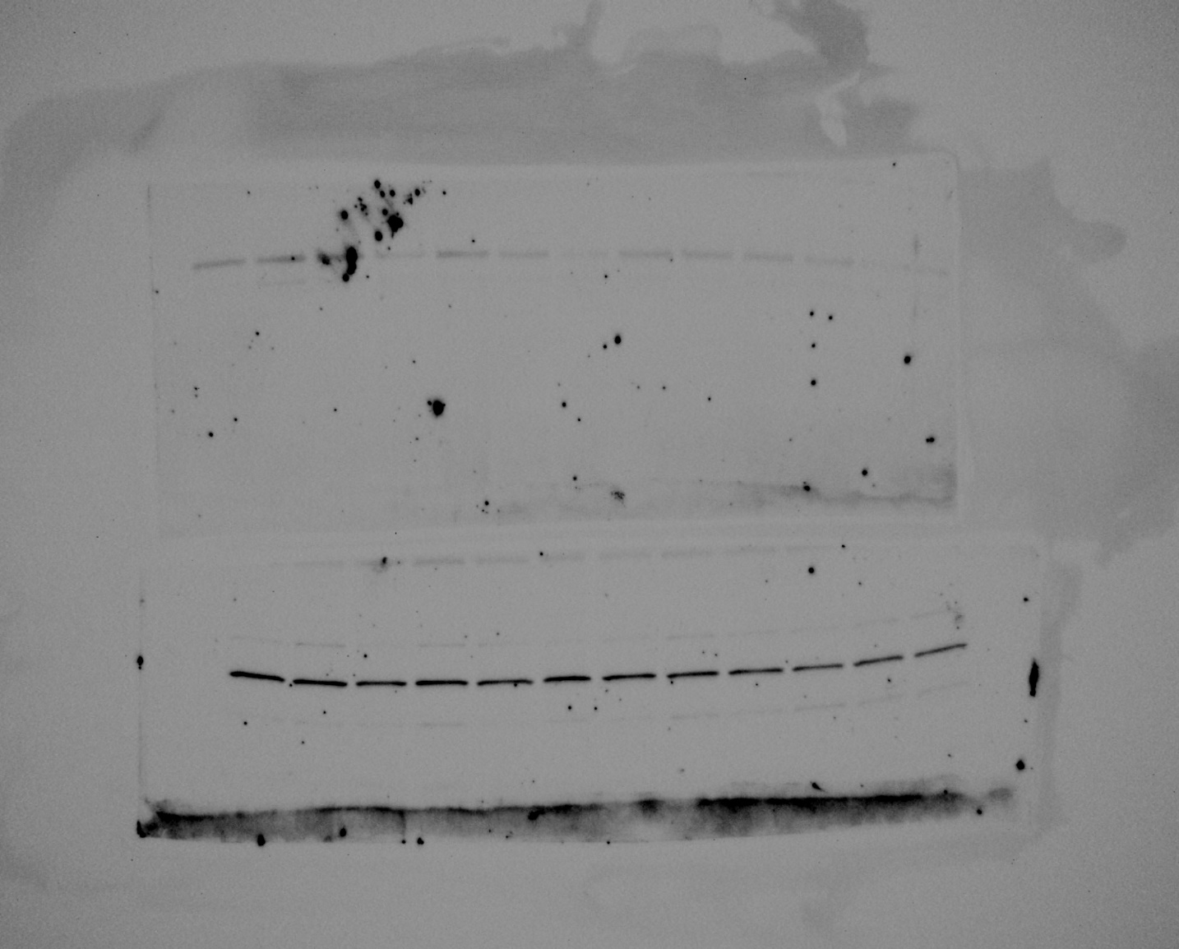
Supplemental Figure 7
Young
Old -veh
Old -AP
GAPDH antibody (Cell Signaling Technology, 97166)

Slide 11
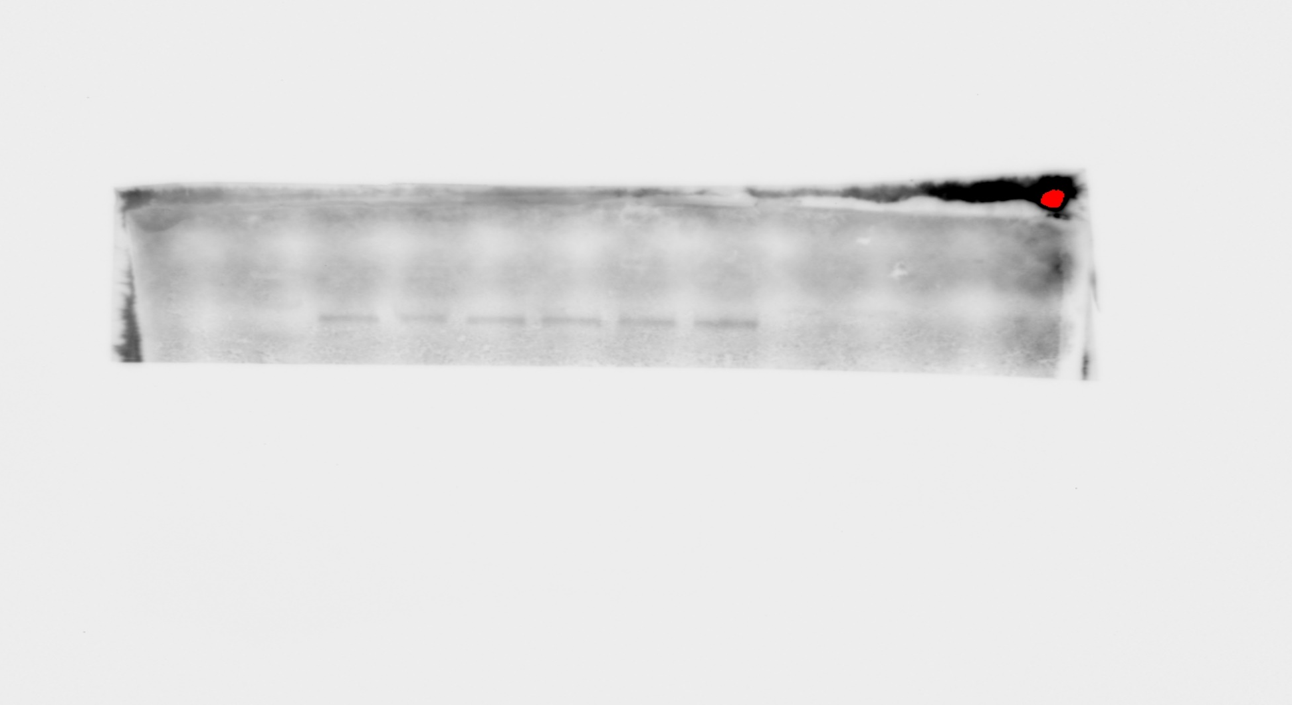
Supplemental Figure 7
Old -veh
Old -AP
α-Klotho (α-Klotho antibody ;R&D Systems, AF1819

Slide 12
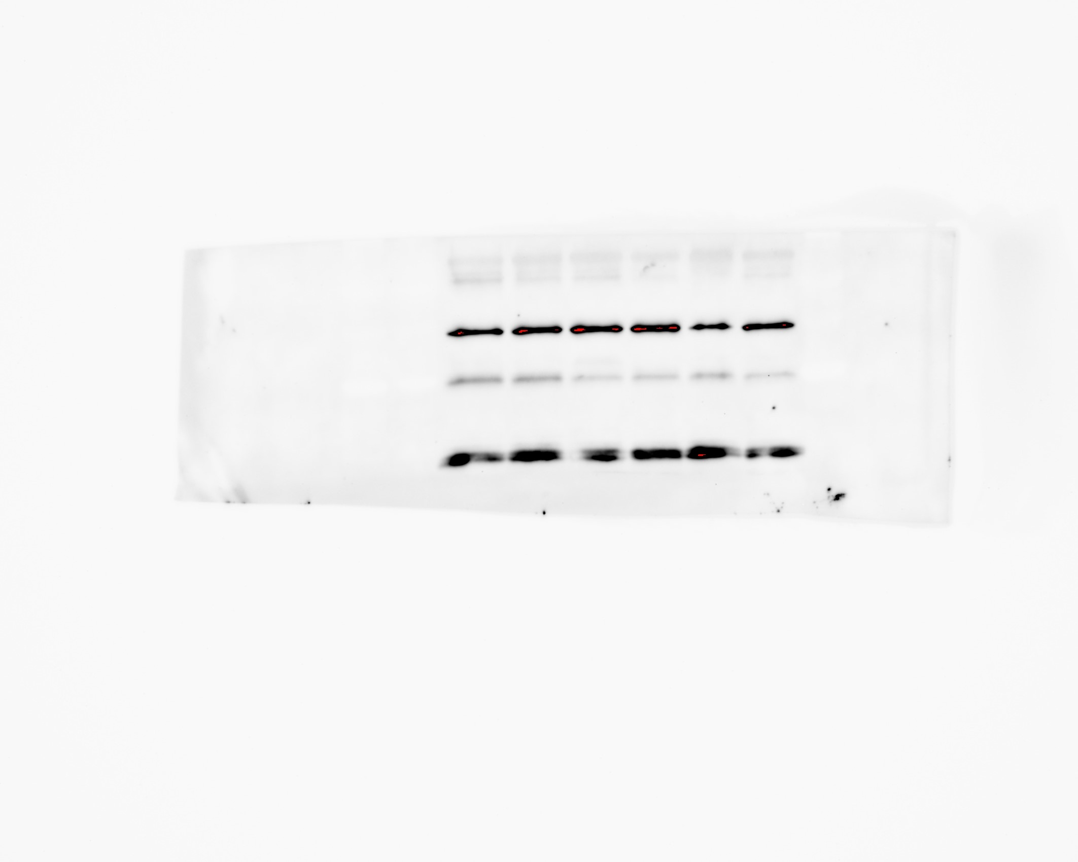
Supplemental Figure 7
Old -veh
Old -AP
GAPDH antibody (Cell Signaling Technology, 97166)

