Slide 1
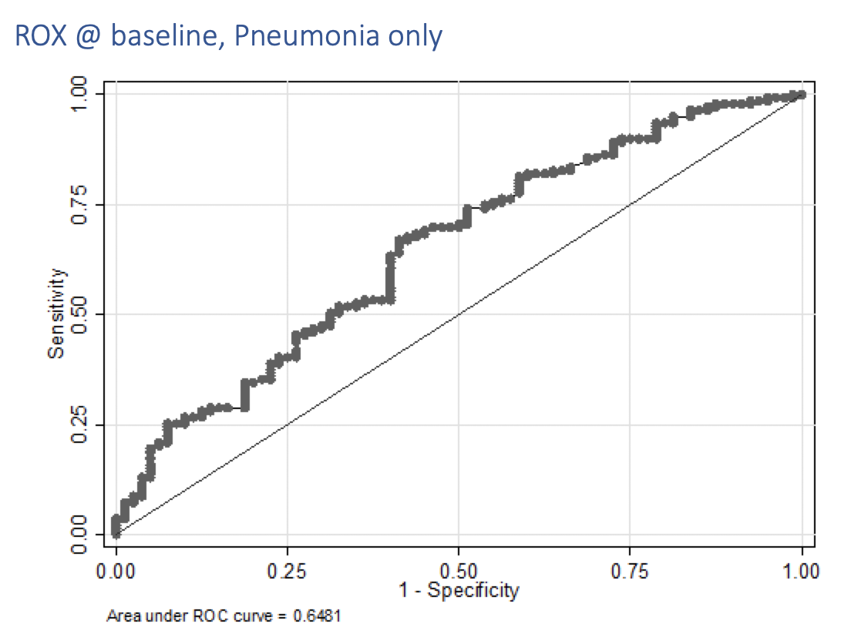
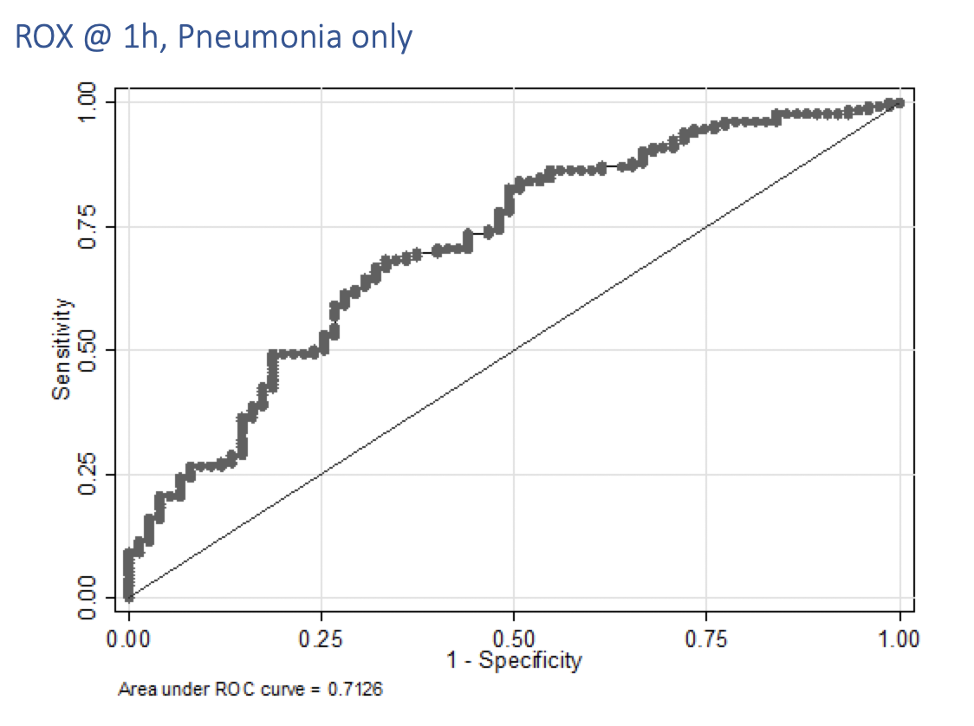
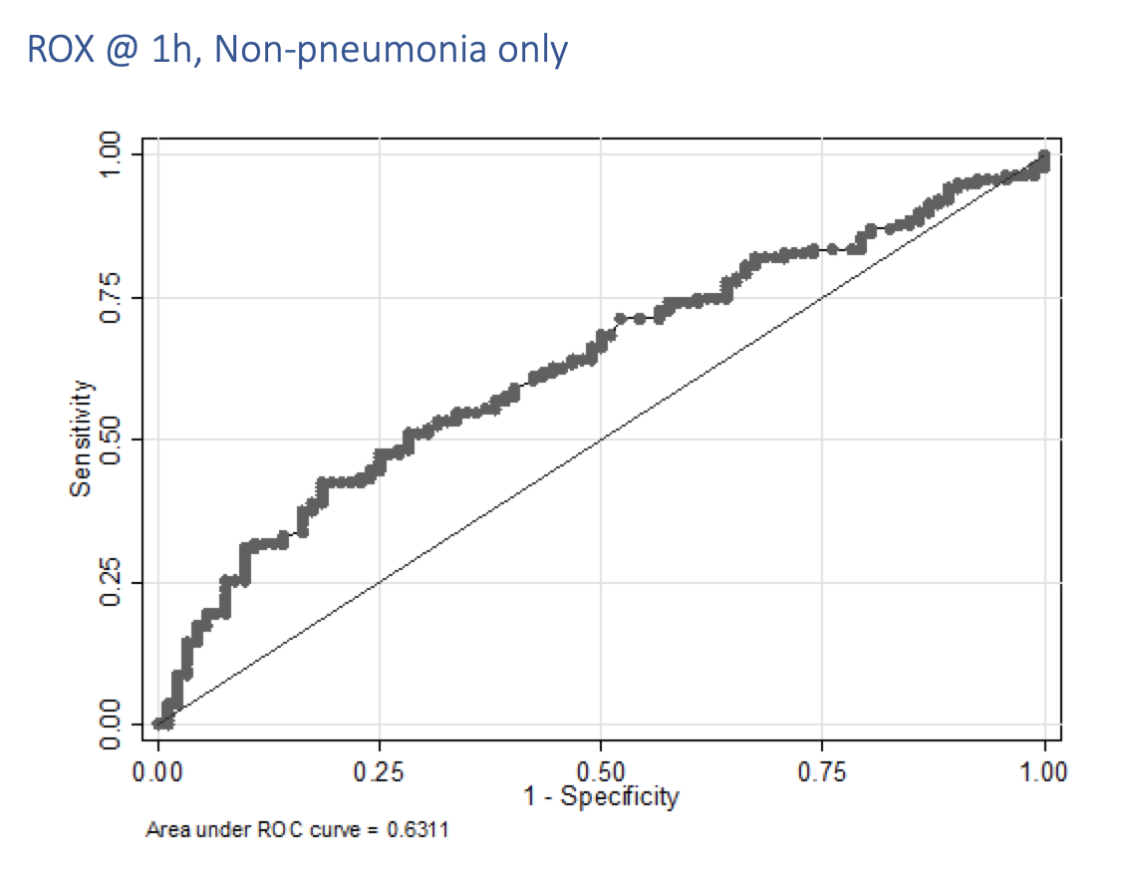
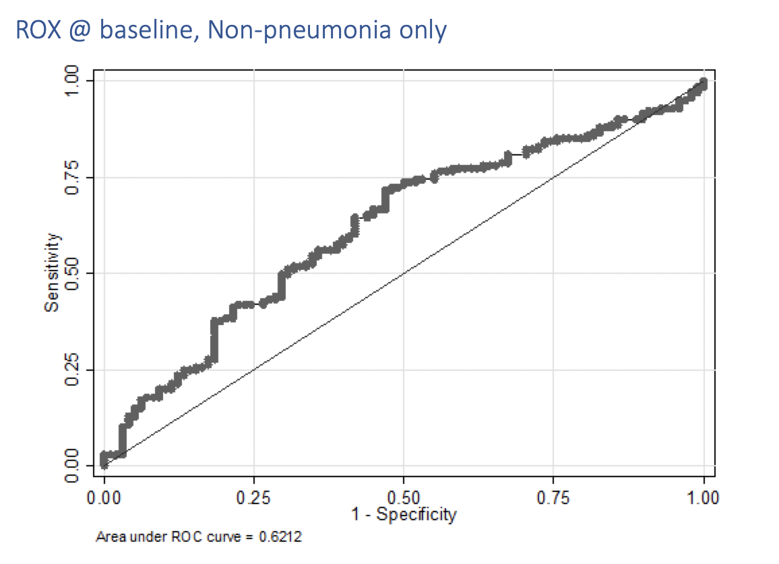
A: ROX index prior to HFNC initiation among pneumonia patients
B: ROX index one—hour post-HFNC initiation among pneumonia patients
C: ROX index prior to HFNC initiation among non-pneumonia patients
D: ROX index one—hour post-HFNC initiation among non-pneumonia patients

