Slide 1
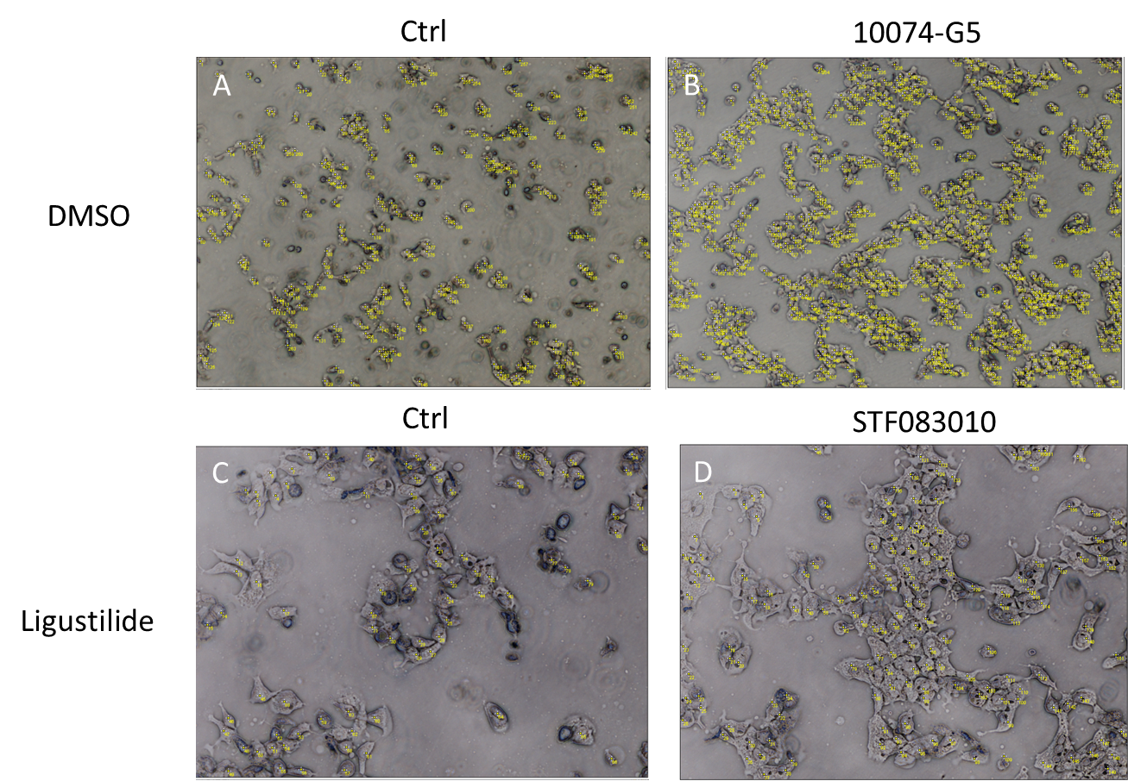
A
B
B
Supplementary Figure 1. We used Image J to count the number of cells.
(A) The number of cells was 263 when ligustilide was use alone. (B) When 10074-G5 was co-treated with ligustilide, the number of cells was 781.
(C) When ligustilide was used alone, the number of cells was 88. (D) When STF083010 was co-treated with ligustilide, the number of cells was 165. The yellow mark (number) in the figure is the number of each individual cell.

