Slide 1
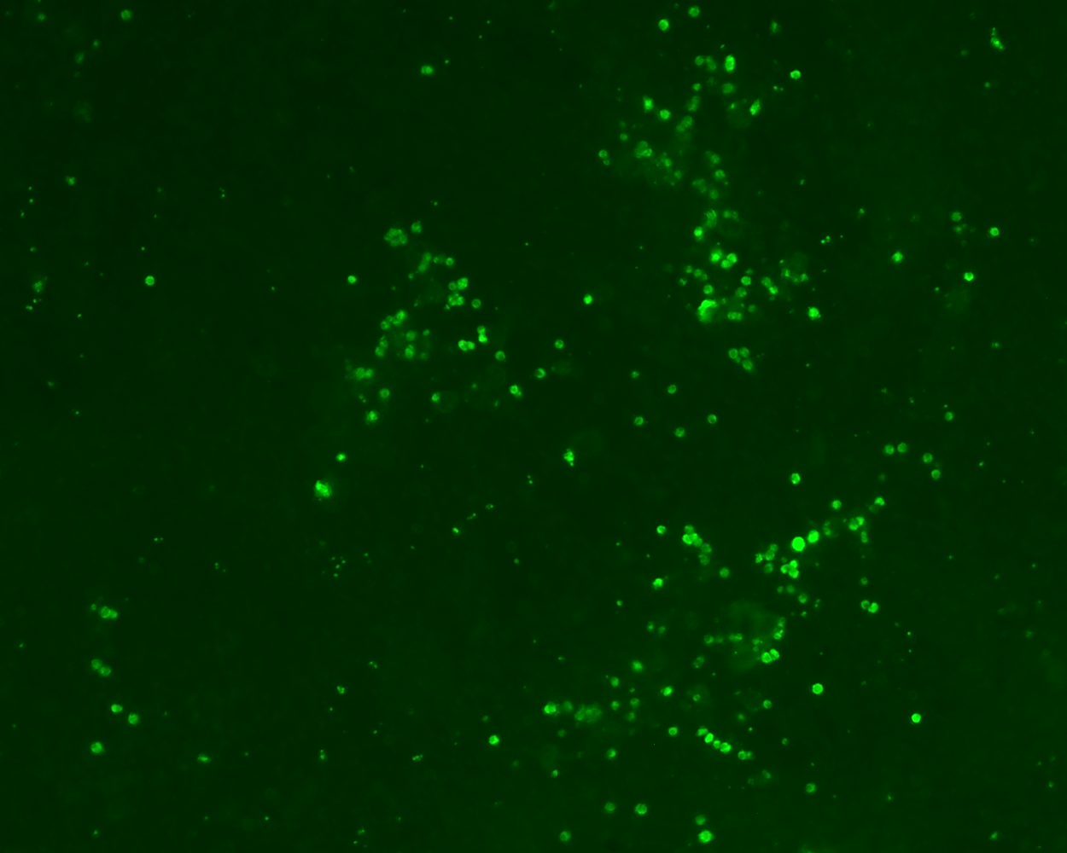
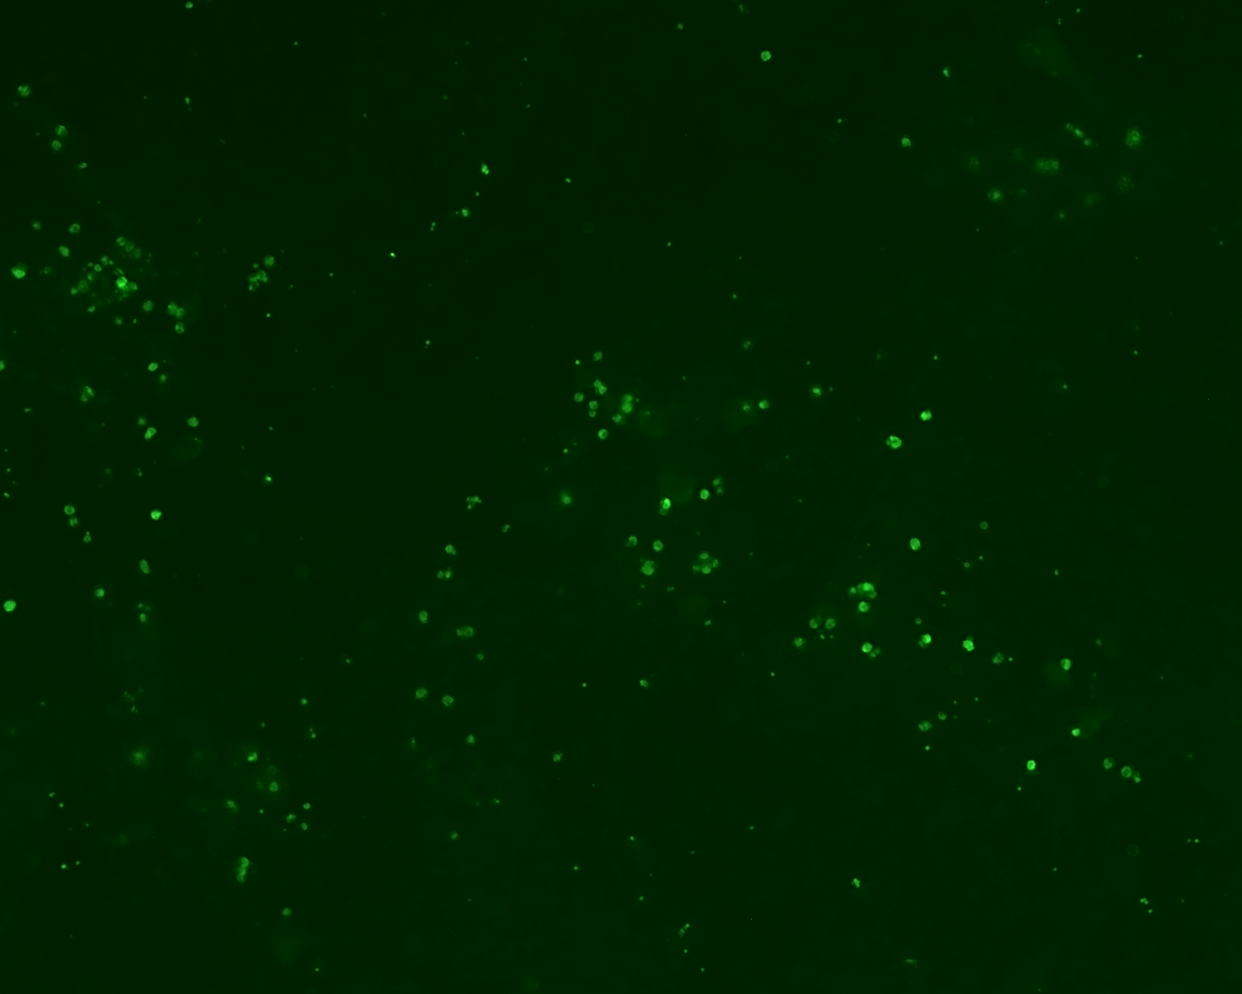
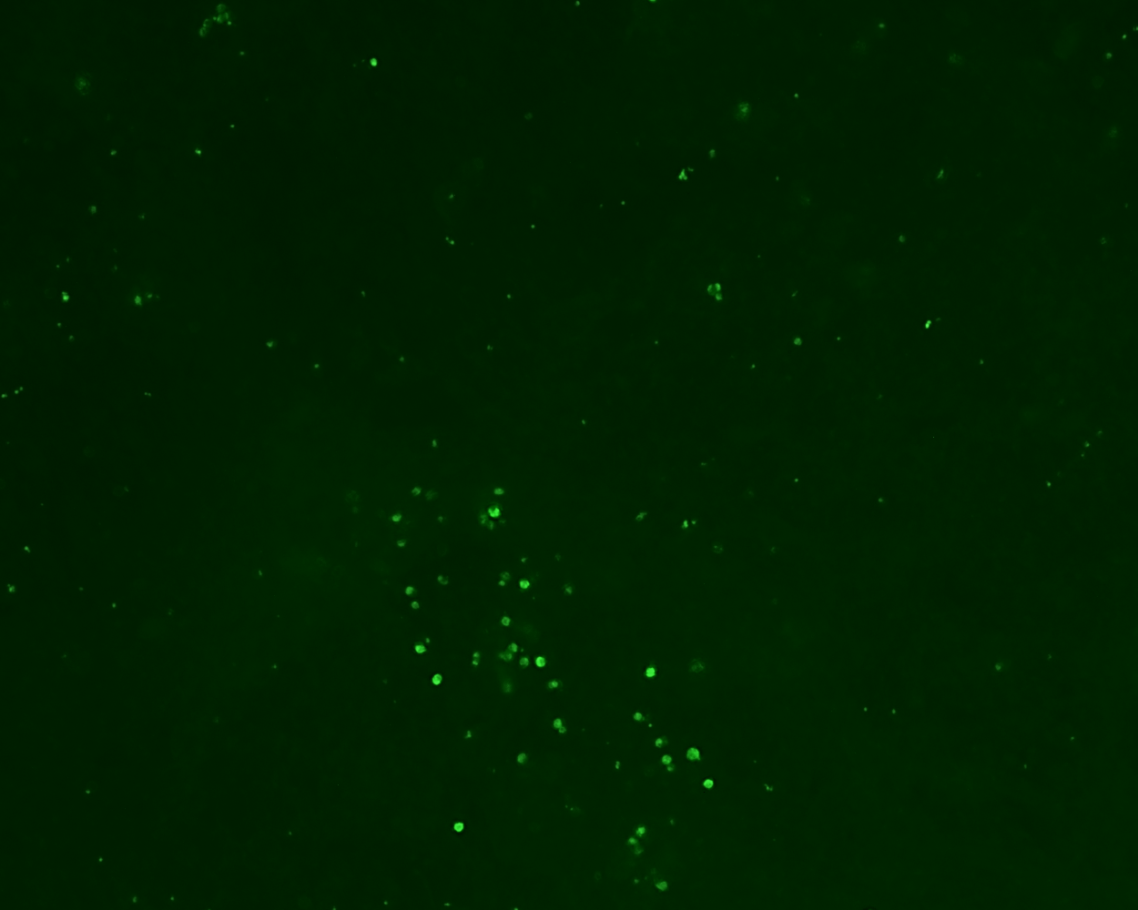
Control (1% DMSO)
JS-2-30 (5 μM)
JS-2-30 (10 μM)

