Slide 1
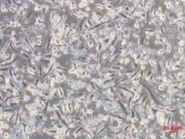
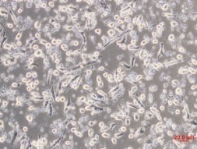
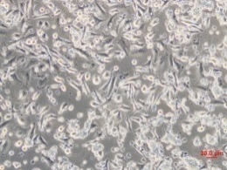
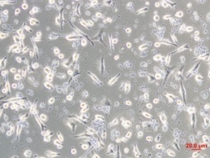
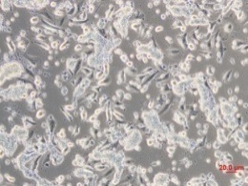
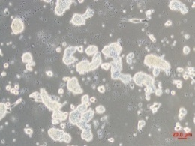
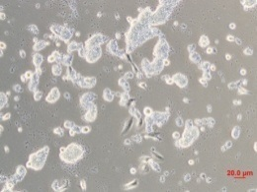
Figure S1
40:1 40:1 10:1 Tumor cell alone
anti-PD-L1 500 ng / ml
A
TL1 TL4
B
Cytotoxic activity (%) | TL1 | TL4
Tumor cell alone | 2.65 % | 2.11 %
E:T = 10:1 | 11.22 % | 15.11 %
E:T = 40:1 | 16.31 % | 48.78 %
E:T = 40:1 Anti-PD-L1 | 46.14 %

