Slide 1
Supplementary information
Rare and misincorporated DNA N⁶-methyladenine is a hallmark of cytotoxic stresses for selectively stimulating the stemness and proliferation of human glioblastoma cells
Cong Lyu^{1,6,#}, Yamei Niu^{2,#}, Weiyi Lai¹, Yu Wang³, Yaning Wang³, Peibin Dai^{4,7}, Chunhui Ma², Shaokun Chen^{1,6}, Yao Li^{1,6}, Chun Luo⁴, Guibin Jiang^{1,6}, Zhiyong Liang⁵, Wenbin Ma³, Zhenliang Gao^{4,7,*}, Wei-Min Tong^{2,*}, Hailin Wang^{1,6,*}

Slide 2
a
y = 28.28 x
R² = 0.9999
b
[¹⁵N₅]-6mA
m/z 271-155
60000
Standard 1 amol
40000
20000
Standard 2 amol
Signal integrals
Standard 5 amol
3000
2000
400
Standard 10 amol
1000
CPS
Standard 20 amol
0
0
0
20
40
60
80
100
500
1500
2500
4.0
4.5
5.0
6mA (amol)
Retention time/min
Supplementary Fig. S1. Linearity and LOD of 6mA by UHPLC-MS/MS Analysis.
(a) The obtained calibration curve (correlation coefficient R² ≥ 0.999).
(b) UHPLC-MS/MS chromatograms of [¹⁵N₅]-6mA with [¹⁵N₅]-6mA standard spiked with genomic DNA of glioma cell. The LOD (S/N = 3) of [¹⁵N₅]-6mA was estimated about 10 amol (Eqv: ~0.98 [¹⁵N₅]-6mA per 10⁸ dC for spiking with 1.1 μg genomic DNA).

Slide 3
a
dC (1:30)
m/z 228-112
6mA
m/z 266-150
25
Standard
Standard
20
A-10#
A-10#
15
6mA/10⁸ dC
A-11#
A-11#
10
30k
A-18#
3k
A-18#
5
CPS
Blank
CPS
Blank
0
0
0
A-10#
A-11#
A-18#
0.4
0.8
1.2
3.5
4.0
4.5
5.0
Time/min
Time/min
b
dC (1:30)
m/z 228-112
6mA
m/z 266-150
25
Standard
Standard
15
AA-13#
AA-13#
6
6mA/10⁸ dC
6mA/10⁸ dC
AA-17#
AA-17#
4
30k
AA-20#
3k
AA-20#
2
CPS
Blank
CPS
Blank
0
0
0
AA-13#
AA-13#
AA-17#
AA-17#
AA-20#
0.4
0.8
1.2
3.5
4.0
4.5
5.0
AA-20#
Time/min
Time/min
Supplementary Fig. S2. Characterization of DNA N⁶-methyladenine (6mA) in Human Astrocytomas and Anaplastic Astrocytomas.
(a-b) UHPLC-MS/MS chromatograms and quantification of dC and 6mA in Astrocytomas (A) (a), and Anaplastic Astrocytomas (AA) (b).

Slide 4
a
b
Unlabeled dA (1:100)
m/z 252-136
[¹⁵N₄]-dA (1:100)
m/z 256-140
Unlabeled 6mA
m/z 266-150
[¹⁵N₄]-6mA
m/z 270-154
Standard
Standard
A172
A172
U118-MG
U118-MG
U251
U251
70k
T98G
3k
T98G
CPS
Blank
CPS
Blank
0
0
1.0
1.5
2.0
1.0
1.5
2.0
4.0
4.5
5.0
4.0
4.5
5.0
Time/min
Time/min
Time/min
Time/min
Supplementary Fig. S3. UHPLC-MS/MS chromatograms of the labeled dA (a), and 6mA (b) in the genomic DNA of glioma cell lines (A172, U118-MG, U251, T98G). The cells were treated with [¹⁵N₅]-dA stable isotope tracer.

Slide 5

a
[D₃]-L-methionine
6mA
[D₃]-6mA
CPS
Cell culture and treatment
DNA/RNA extraction
RT/min
UHPLC-MS/MS analysis
b
2.0
Unlabled 5mC
c
6
Unlabled 6mA
1.5
[D₃]-5mC
[D₃]-6mA
4
1.0
6mA/10⁸ dC
5mC/10² dC
2
0.5
0.0
0
ND
ND
ND
GSC-12#
GSC-13#
GSC-17#
GSC-12#
GSC-13#
GSC-17#
d
2.5
Unlabled 5mC
e
15
Unlabled 6mA
2.0
[D₃]-5mC
[D₃]-6mA
1.5
10
5mC/10² dC
6mA/10⁸ dC
1.0
5
0.5
0.0
0
ND
ND
ND
ND
ND
T98G
U118 MG
SVG p12
A172
U251
T98G
U118 MG
SVG p12
A172
U251
Supplementary Fig. S4. Characterization of DNA 6mA by a stable isotope tracer [D₃]-L-methionine.
(a) Flow diagram of tracing DNA 6mA in glioma cells by [D₃]-L-methionine.
(b, d) Quantification of [D₃]-5mC in the genomic DNA of glioblastoma stem cells (GSCs) (b) and glioblastoma cell lines (d).
(c, e) Quantification of [D₃]-6mA in the genomic DNA of glioblastoma stem cells (GSCs) (c) and glioblastoma cell lines (e).
[D₃]- L-methionine was used for tracing stable isotope-labeled methyl group.

Slide 6
a
b
25
5
15
4
5
3
6mA/10⁸ dC
5mC/10² dC
4
2
3
2
1
1
0
0
A-
16#
GBM-
6#
A-
16#
GBM-
6#
Supplementary Fig. S5. The frequency of DNA 6mA (a) and 5mC (b) in A-16# and GBM-6# from the same patient. The DNA 6mA and 5mC contents were quantified by UHPLC-MS/MS analysis

Slide 7
a
P < 0.0001
b
P < 0.0001
P = 0.09
P < 0.05
6
P = 0.22
P < 0.0001
6
P = 0.19
P < 0.01
P = 0.18
P < 0.05
P = 0.21
P = 0.55
4.3
4.3
4.1
4.3
4.1
3.8
3.9
4
3.8
3.4
4
3.5
5mC/10² dC
3.4
5mC/10² dC
3.4
n = 13
n = 13
n = 20
2
n = 20
2
n = 13
n = 7
n = 40
n = 18
n = 40
n = 39
n = 18
n = 8
0
0
Normal Brain
A
AA
GBM
Normal Brain
A
AA
GBM
Supplementary Fig. S6. DNA 5mC Content significantly decreases in human Anaplastic Astrocytomas and glioblastomas.
(a) DNA 5mC content in glioma tissues and normal brain tissues. Normal brain tissues:, n = 13; Astrocytoma (A) tissues: n = 20; Anaplastic Astrocytoma (AA) tissues: n = 18; Glioblastoma (GBM) tissues: n = 40.
(b) DNA 5mC content in glioma tissues (with IDH1^{mut} excluded) and normal brain tissues. Normal brain tissues: n = 13; A tissues: n = 7; AA tissues, n = 8; GBM tissues, n = 39.
Statistical significance was determined by Student‘s unpaired t test.

Slide 8
a
b
1.5
NC
6
NC
siALKBH1-1

siALKBH1-1
1.0
siALKBH1-2
4

siALKBH1-2
ALKBH1 relative mRNA levels

6mA/10⁸ dC
0.5

2
ns
ns








0.0


0
A172
U118 MG
U251
T98G
A172
U118 MG
U251
T98G
Supplementary Fig. S7. DNA 6mA in ALKBH1-Knockdown Glioblastoma Cell Lines.
(a) RT-PCR analysis of ALKBH1 expression in ALKBH1- knockdown glioblastoma cell lines.
(b) Quantification of 6mA in the genome of ALKBH1- knockdown glioma cell lines.
Statistical significance was determined by Student‘s unpaired t test. ns, no significance; *P < 0.05; **P < 0.01; ***P < 0.001; ****P < 0.0001.

Slide 9
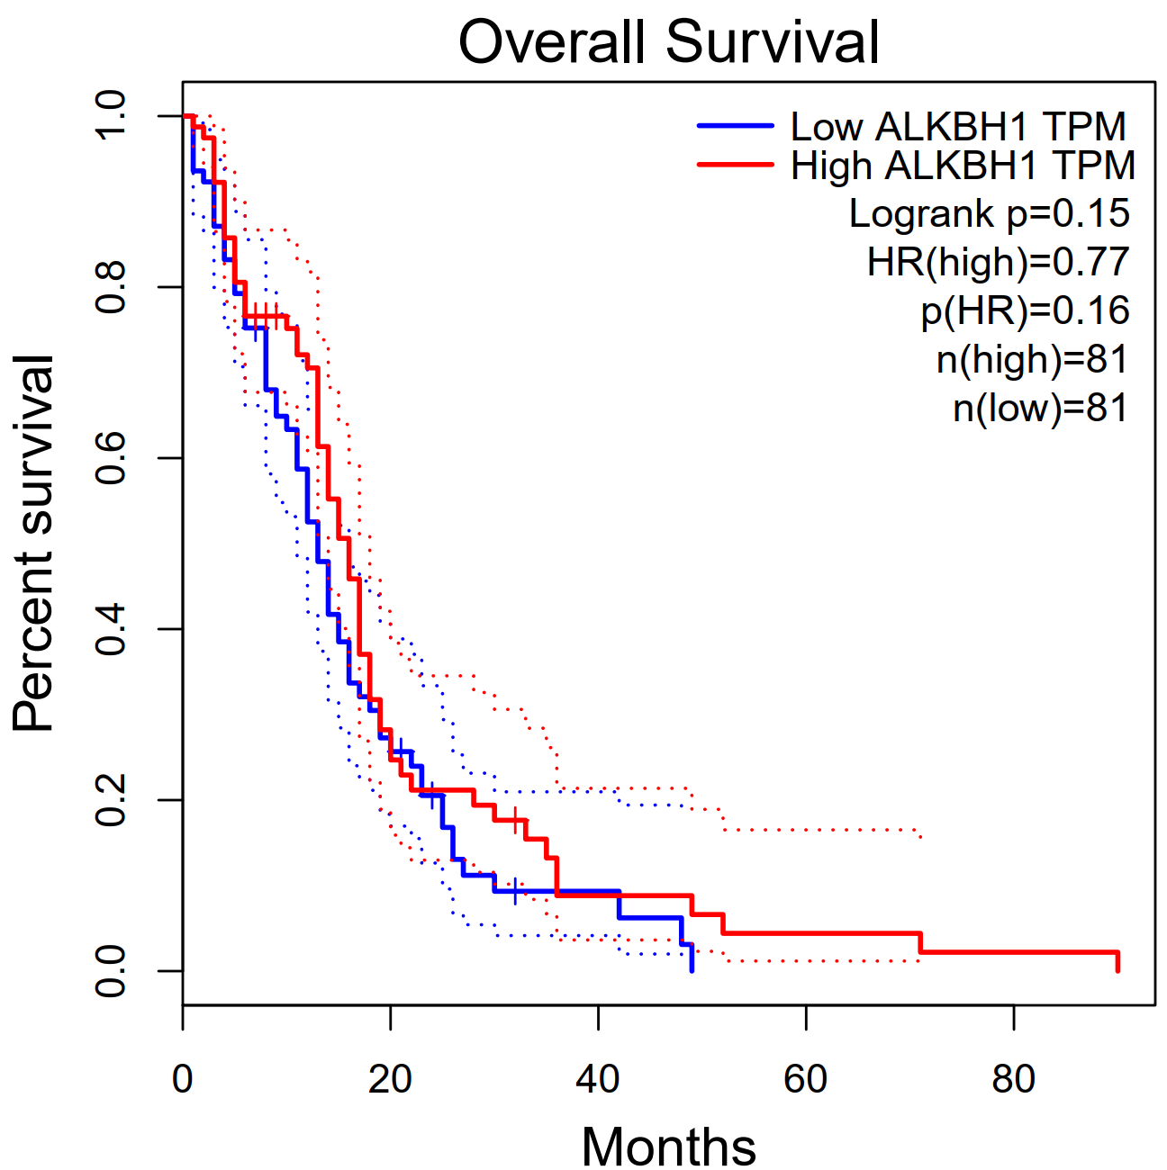
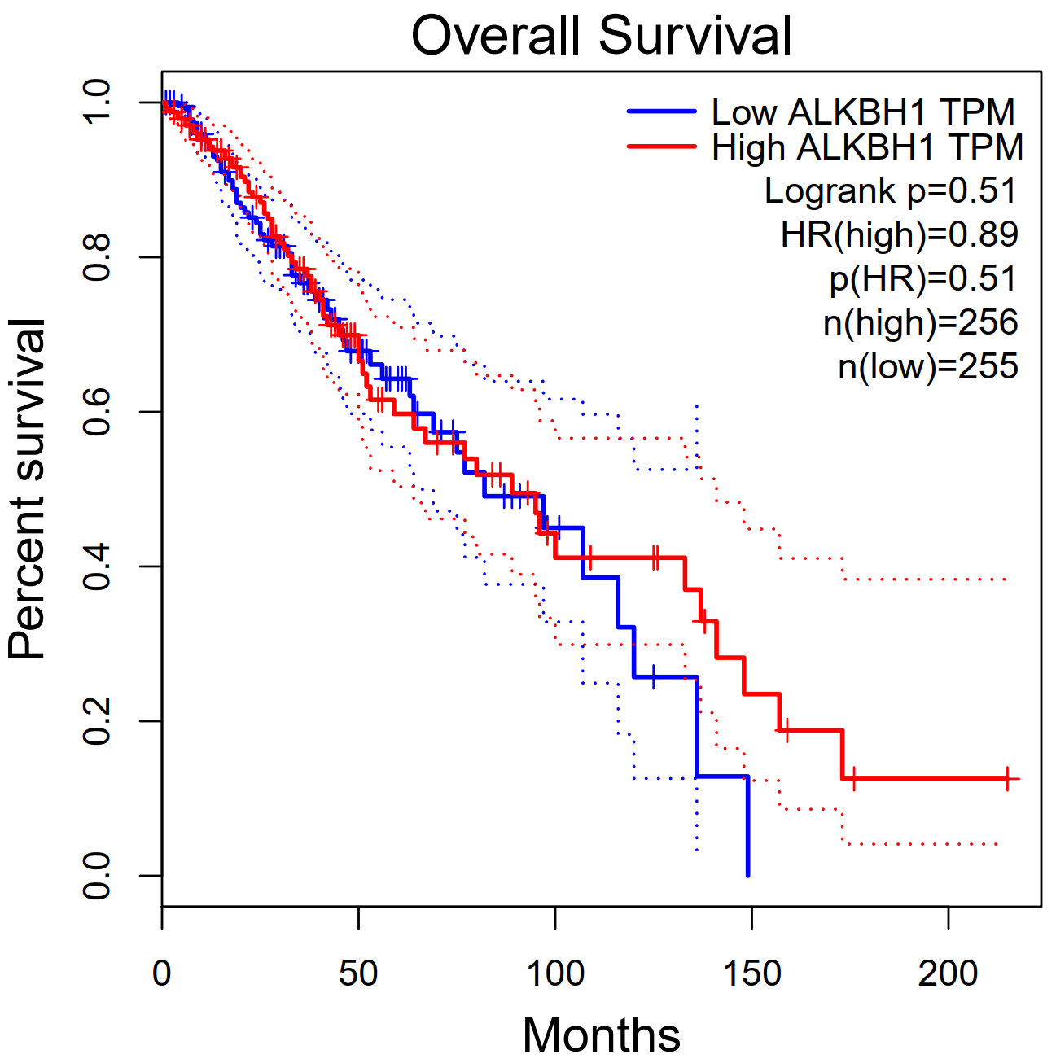
a
b
Supplementary Fig. S8. Expression of ALKBH1 Is Not Associated with Clinical Prognosis in Human Gliomas.
(a) Kaplan-Meier curve of GBM patients’ survival. Patients were stratified into the ‘‘High ALKBH1’’ group (n = 81) and the ‘‘Low ALKBH1 ’’ group (n = 81) by the median value of ALKBH1 expression. p = 0.15.
(b) Kaplan-Meier curve of LGG patients’ survival. Patients were stratified into the ‘‘High ALKBH1’’ group (n = 256) and the ‘‘Low ALKBH1 ’’ group (n = 256) by the median value of ALKBH1 expression status. p = 0.51.
Significance was determined by log rank analysis. The data obtained from The Cancer Genome Atlas clinical dataset

Slide 10
a
r = -0.1096
P = 0.5307
b
r = -0.1243
P = 0.4769
80
80
60
60
Overall Survival (months)
Overall Survival (months)
40
40
20
20
0
0
0
3
60
0
1
2
4
5
0
20
40
80
100
5mC/10² dC
5hmC/10⁴ dC
Supplementary Fig. S9. No correlation of the levels of 5mC and 5hmC with overall survival time of GBM patients
(a) Pearson correlations between 5mC level and overall survival time of GBM patients (n = 35).
(b) Pearson correlations between 5hmC level and overall survival time of GBM patients (n = 35).
Statistical significance was determined by Student‘s unpaired t test.

Slide 11
a
r = -0.0493
P = 0.6682
b
r = -0.0154
P = 0.9250
100
50
80
40
60
30
6mA/10⁸ dC
6mA/10⁸ dC
40
20
20
10
0
60
0
0
20
40
80
0
20
40
60
80
c
age
d
age
100
P = 0.56
50
P = 0.19
80
40
60
30
40
20
6mA/10⁸ dC
6mA/10⁸ dC
9.8
20
9.1
10.9
10
5.5
0
n = 41
n = 35
0
n = 19
n = 19
-20
Male
Female
-10
Male
Female
e
f
100
P = 0.66
60
P = 0.41
80
40
60
20
40
6mA/10⁸ dC
6mA/10⁸ dC
20
0
0
-20
-20
Methylated
Unmethylated
Methylated
Unmethylated
g
P = 0.87
h
P = 0.62
100
P = 0.27
60
P = 0.90
80
P = 0.17
40
P = 0.41
60
20
40
6mA/10⁸ dC
6mA/10⁸ dC
20
0
0
-20
-20
WT
C228T
C250T
WT
C228T
C250T
Supplementary Fig. S10. The questioned association of DNA 6mA with MGMT promoter methylation and TERT promoter mutation.
(a, b) Pearson analysis for the correlation of age of diagnosis with the DNA 6mA level of all glioma patients (n = 78) (a) and GBM patients (n = 40) (b).
(c, d) DNA 6mA contents in male and female glioma patient tissues. For all gliomas, Male, n = 41; Female, n = 35. For only GBM patients, Male: n = 19; Female: n = 19.
(e, f) DNA 6mA contents in MGMT promoter-methylated and MGMT promoter-unmethylated glioma tissues. For all giomas (e), MGMT promoter-methylated: n = 38; MGMT promoter-unmethylated: n = 38. For glioblastomas (f), MGMT promoter-methylated: n = 11; MGMT promoter-unmethylated: n = 29.
(g, h) DNA 6mA contents in TERT promoter-WT, TERT promoter-C228T mutated and TERT promoter-C250T mutated glioma tissues. For all giomas (g), TERT promoter-WT: n = 32; TERT promoter-C228T mutated: n = 33; TERT promoter-C250T mutated: n = 11. For only gioblastomas (h), TERT promoter-WT: n = 10; TERT promoter-C228T mutated: n = 25; TERT promoter-C250T mutated: n = 5.
Statistical significance was determined by Student‘s unpaired t test.

Slide 12
Supplementary Table S1. siRNA oligonucleotides sequences (5'-3').
Non-targeting control | sense: UUCUCCGAACGUGUCACGUTT
Non-targeting control | antisense: ACGUGACACGUUCGGAGAATT
siALKBH-1 | sense: GGUAUAAAGAAGCGACUAATT
 | antisense: UUAGUCGCUUCUUUAUACCTT
siALKBH-2 | sense: GGAAUCCACGUAGACAGAUTT
 | antisense: AUCUGUCUACGUGGAUUCCTT
Supplementary Table S2. RT-PCR primer sequences for GAPDH and ALKBH1 (5'-3’).
GAPDH | forward: GGGAAGGAAATGAATGGGCAG
Non-targeting control | reverse: TCTAGGAAAAGCATCACCCGG
ALKBH1 | forward: ATGGACTCAAAGGCTATCCTGG
 | reverse: GTCTCCGTTTAGTCGCTTCTTTA

Slide 13
a
b
Variable | HR (95% CI) | P value
Age | 1.0 (0.98-1.02) | 0.91
TERT promoter mutation
Wild-type | 1.0 (referent)
Mutated | 0.96 (0.40-2.3) | 0.92
MGMT promoter methylation
Unmethylated | 1.0 (referent)
Methylated | 0.43 (0.16-1.2) | 0.10
6mA Level
Low | 1.0 (referent)
High | 2.4 (1.03-5.5) | 0.04
Variable | HR (95% CI) | P value
Age | 1.0 (0.98-1.03) | 0.66
Gender
Female | 1.0 (referent)
Male | 0.88 (0.39-2.0) | 0.76
6mA Level
Low | 1.0 (referent)
High | 2.6 (1.2-5.6) | 0.02
Supplementary Table S3. Multivariate survival analysis for 6mA using Cox proportional hazards regression model.
(a) Multivariate Cox proportional hazards ratios for survival based on 6mA level adjusted for age at diagnosis and gender of patient.
(b) Multivariate Cox proportional hazards ratios for survival based on 6mA level adjusted for age at diagnosis, TERT promoter mutation and MGMT promoter methylation of patient.

Slide 14
a
b
Variable | HR (95% CI) | P value
Age | 1.0 (0.98-1.03) | 0.50
Gender
Female | 1.0 (referent)
Male | 0.89 (0.41-2.0) | 0.78
5mC Level
Low | 1.0 (referent)
High | 0.89 (0.41-2.0) | 0.79
Variable | HR (95% CI) | P value
Age | 1.0 (0.99-1.03) | 0.48
Gender
Female | 1.0 (referent)
Male | 0.89 (0.41-1.9) | 0.76
5hmC Level
Low | 1.0 (referent)
High | 1.2 (0.55-2.5) | 0.67
Supplementary Table S4. Multivariate survival analysis using Cox proportional hazards regression model.
(a) Multivariate Cox proportional hazards ratios for survival based on 5mC level adjusted for age at diagnosis and gender of patient.
(b) Multivariate Cox proportional hazards ratios for survival based on 5hmC level adjusted for age at diagnosis and gender of patient.

