Slide 1
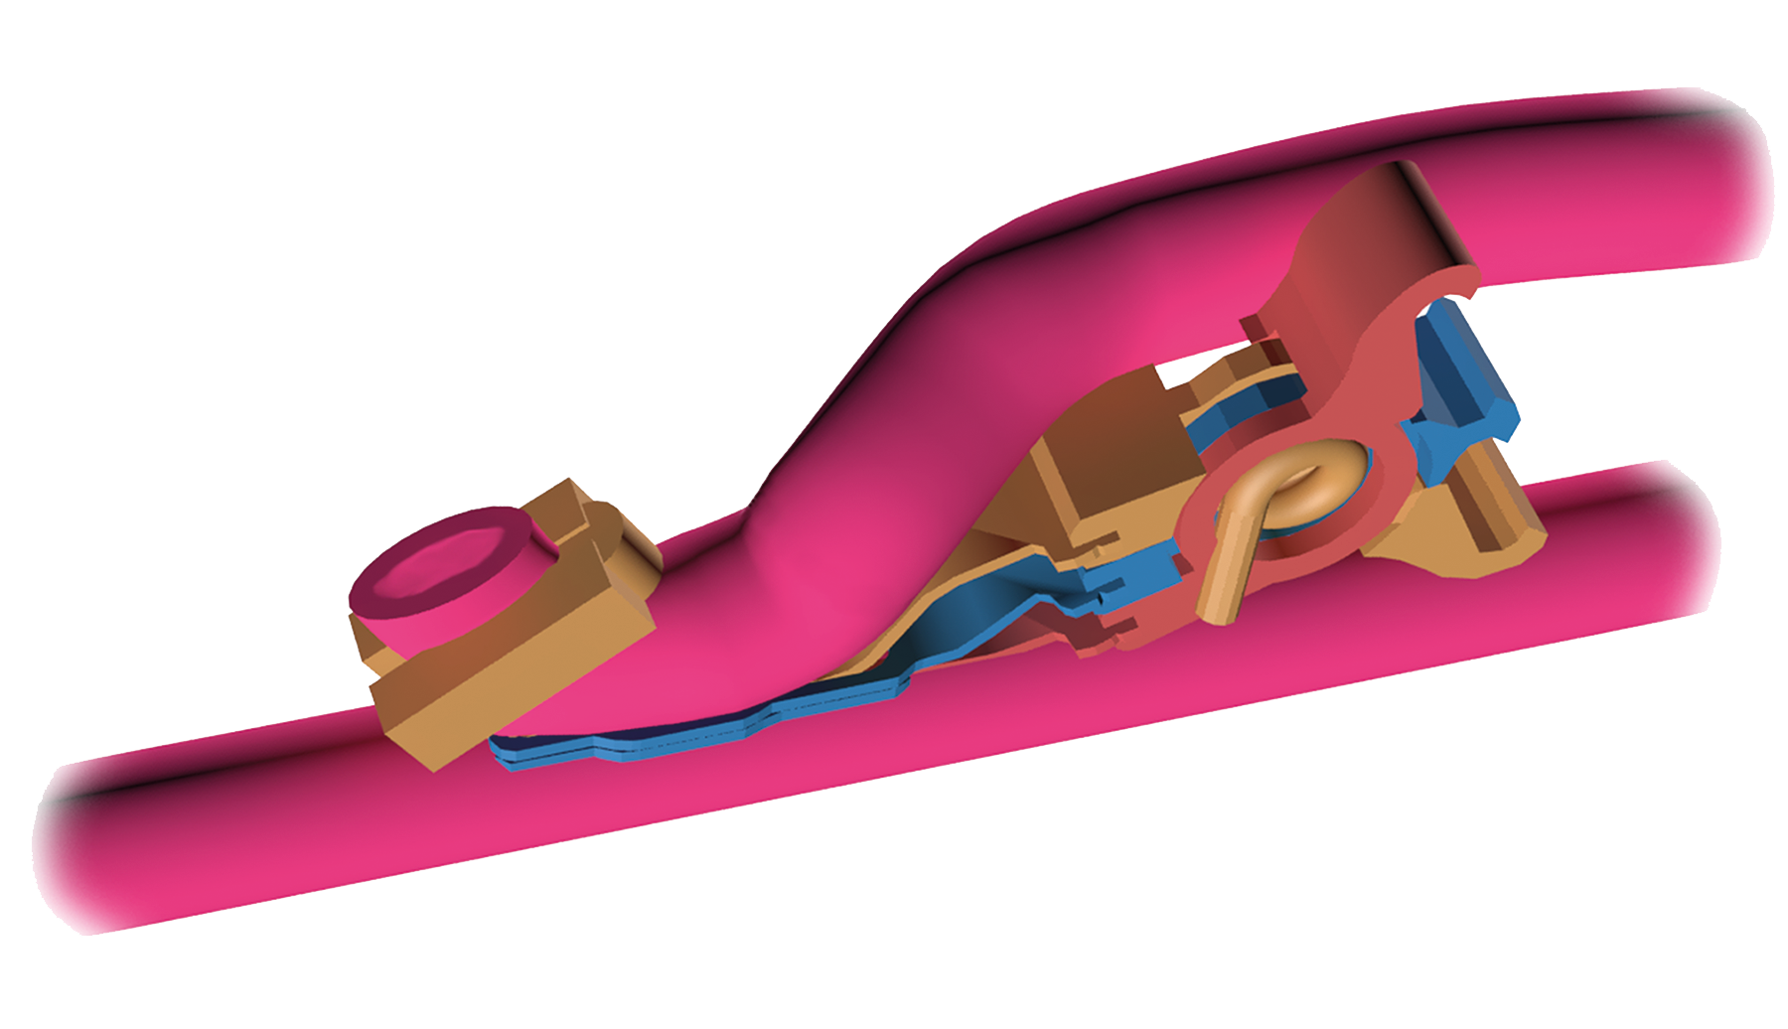



Preclinical Comparison of Distal Off-Pump Anastomotic Remodeling:
Hand-Sewn Versus ELANA Heart Bypass
STUDY POPULATION
Porcine off-pump CABG,
LIMA-LAD
ELANA Heart Bypass (n=24)
Hand-sewn control (n=18)
INTERVENTION
ELANA Heart Bypass ®
0–90 days of follow-up
OUTCOME
Neo-intima coverage from
14 days
ELANA < hand-sewn on
intima hyperplasia,
anastomotic opening, and patency (79% vs 100%)
Stecher et al. Innovations. March/April 2022.
@Innovationsjour | Copyright © The Author(s) 2022. All rights reserved. Published by SAGE Publishing Inc.

