Slide 1
Additional result
Result and analysis
Effect and mechanism of naringin on P2Y₁₄ receptor in superior cervical ganglion in diabetic cardiac autonomic neuropathy.

Slide 2
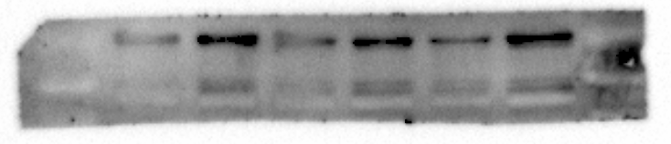
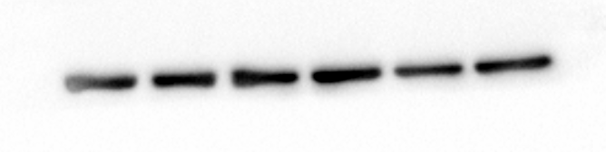
Fig. 1
result and analysis
1. original gel image of protein P2Y₁₄ and β-actin
P2Y₁₄ (55kD)
β-actin (43kD)

Slide 3
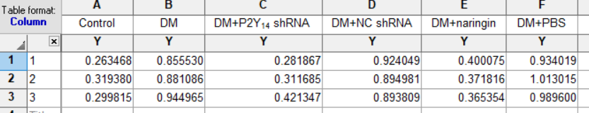
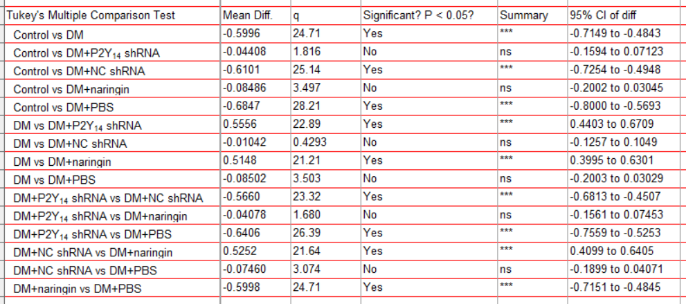
Fig. 1
result and analysis
2. IOD values analysis
(Note: all the detailed IOD values were shown in the Excel file titled “data sheet 1”)

Slide 4
Fig. 1
result and analysis
3. GraphPad prism histogram

Slide 5
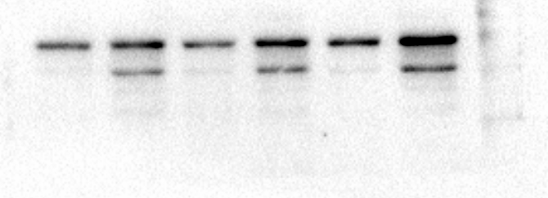
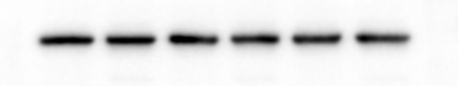
Fig. 1
result and analysis
1. original gel image of protein GFAP and β-actin
GFAP (50kD)
β-actin (43kD)

Slide 6
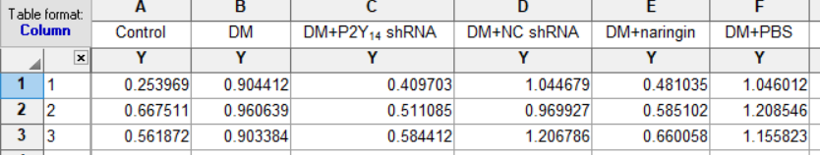
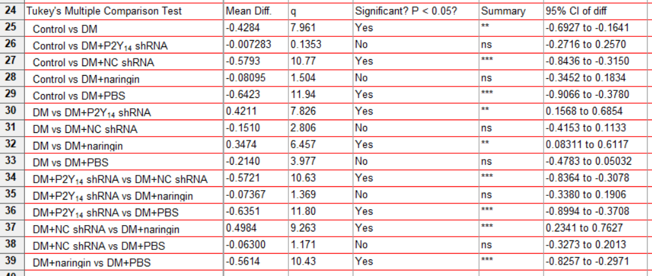
Fig. 1
result and analysis
2. IOD values analysis
(Note: all the detailed IOD values were shown in the Excel file titled “additional data”)

Slide 7
Fig. 1
result and analysis
3. GraphPad prism histogram

Slide 8
Fig. 1
result and analysis
4. Original Immunofluorescent images (aiming to testify the co-localization)
P2Y14
GFAP

Slide 9
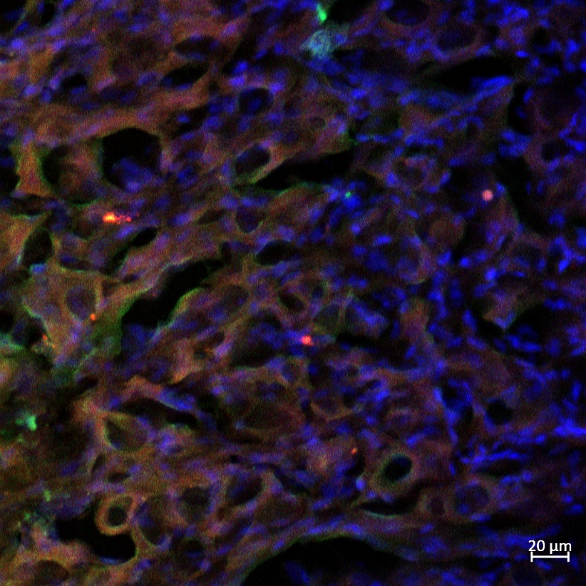
Fig. 1
result and analysis
4. Original Immunofluorescent images (aiming to testify the co-localization)
DAPI
Merge

Slide 10
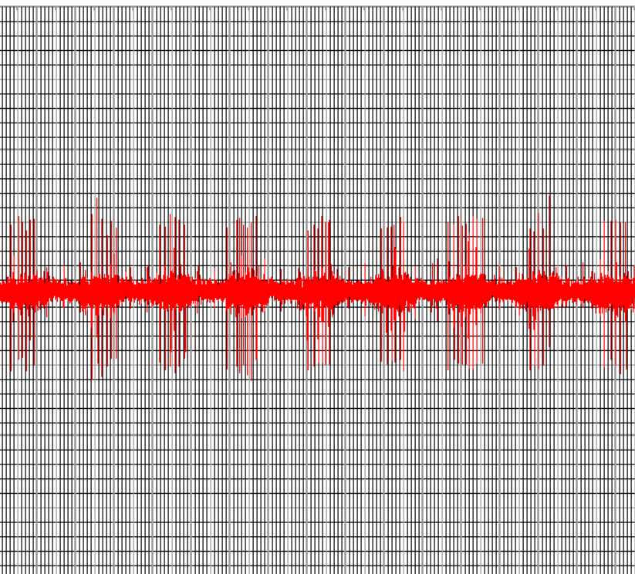
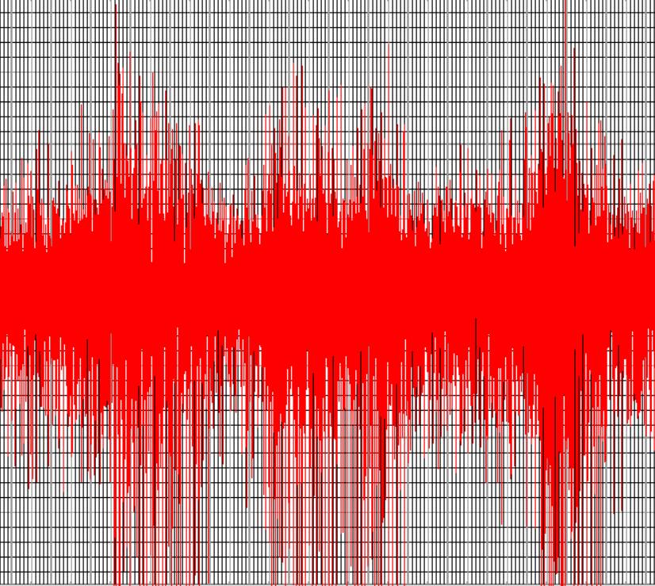
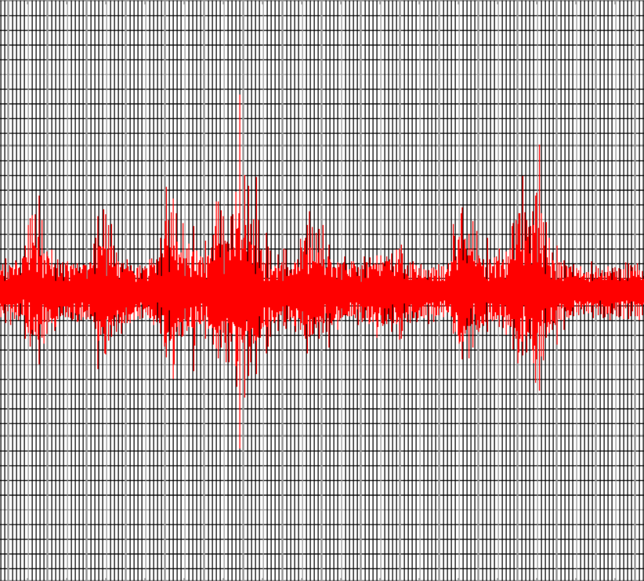
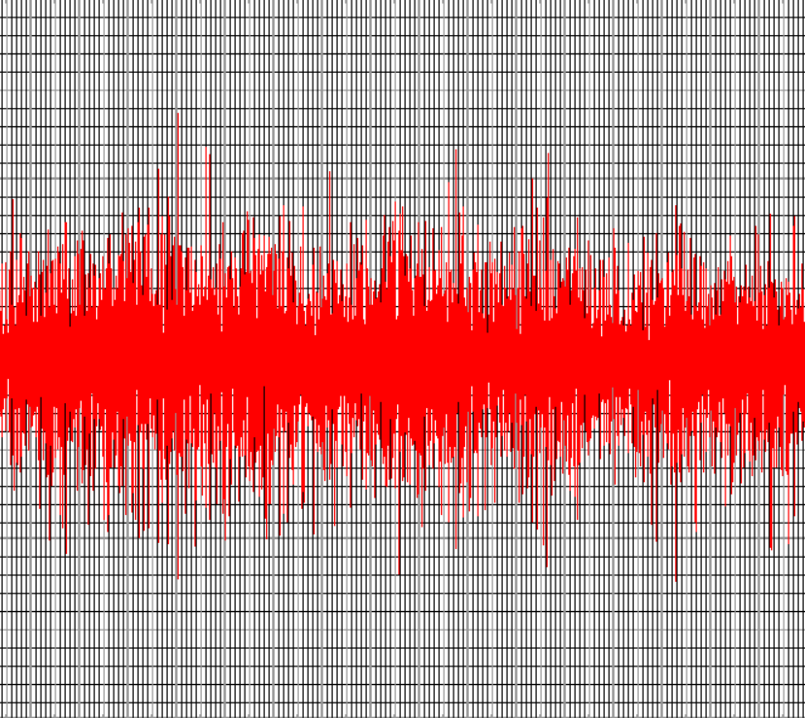
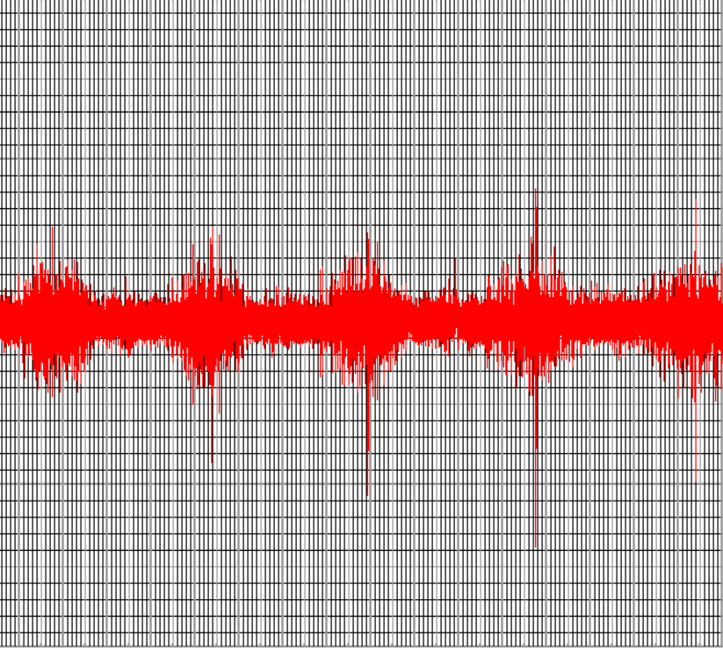
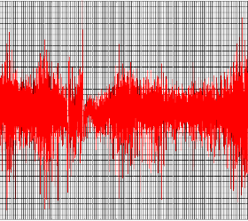
Fig. 2
result and analysis
1. Original pictures: Representative images of the postganglionic cervical sympathetic nerve discharge of SG.
100 mV
100 mV
Control
0 mV
DM
0 mV
-100 mV
1 s
-100 mV
100 mV
100 mV
DM+P2Y₁₄ shRNA
DM+NC shRNA
0 mV
0 mV
-100 mV
-100 mV
100 mV
100 mV
DM+Naringin
0 mV
DM+PBS
0 mV
-100 mV
-100 mV

Slide 11
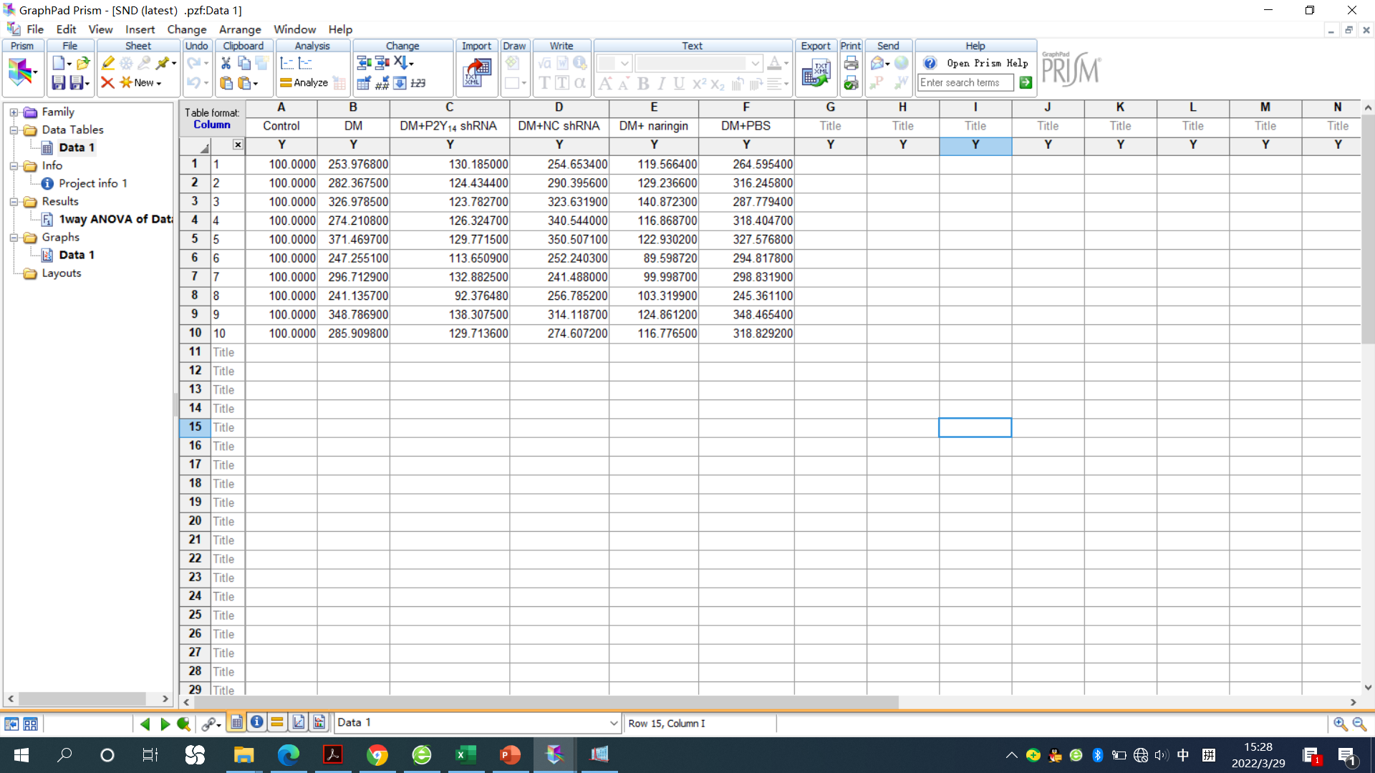
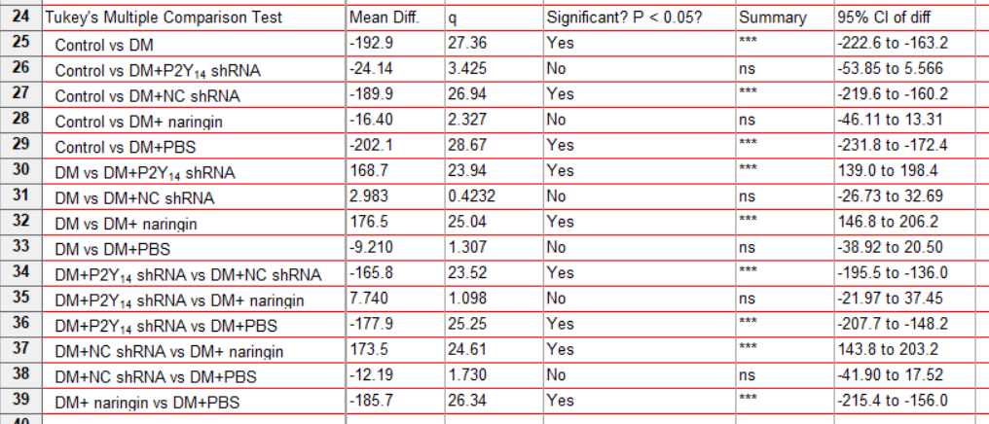
Fig. 2
result and analysis
2. The Δ cervical SND analysis
Note: The detailed Δ cervical SND data were shown in the Excel file titled “data sheet 1”

Slide 12
Fig. 1
result and analysis
3. GraphPad prism histogram

Slide 13
Fig. 2
result and analysis
Fig.2:

Slide 14
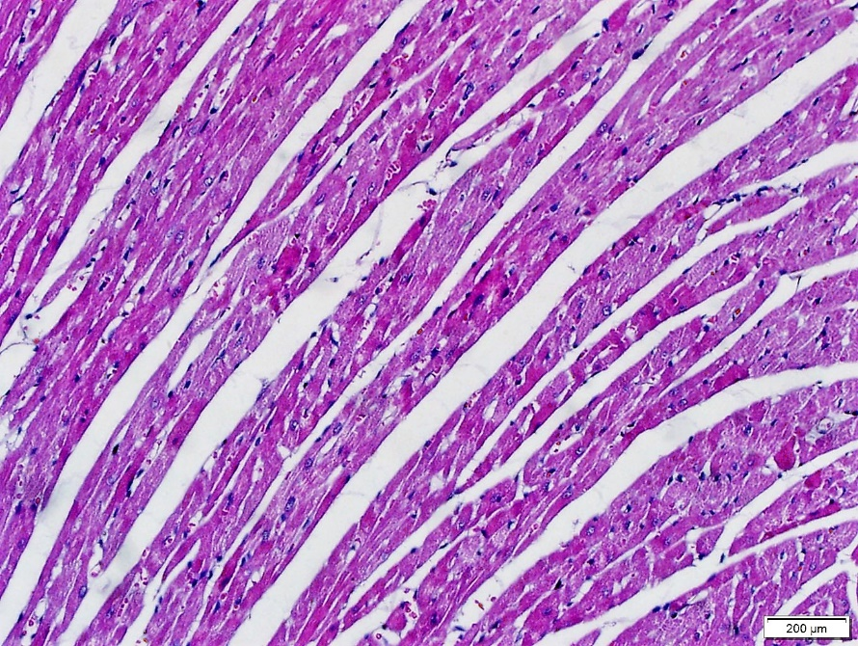
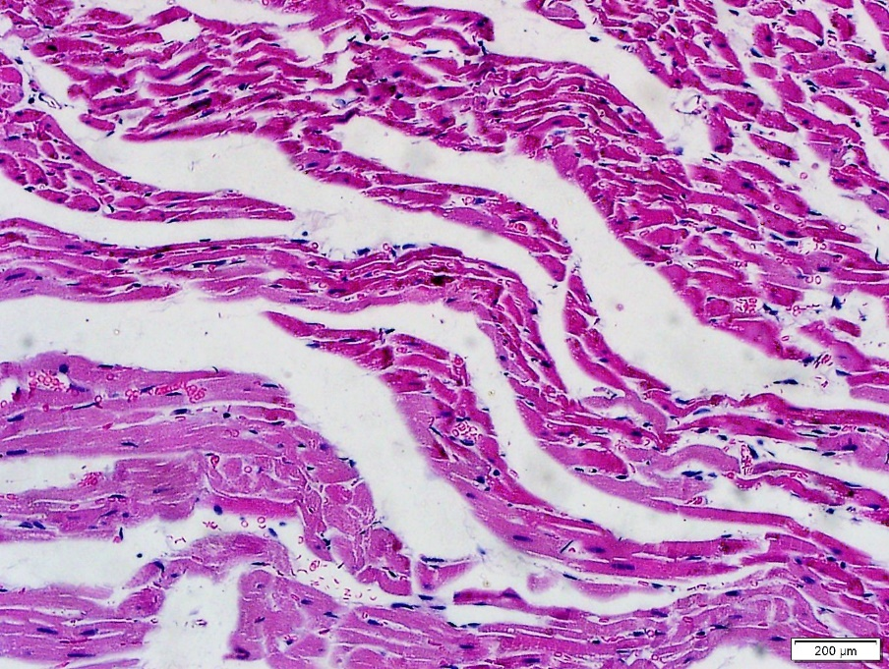
Fig. 3
result and analysis
1. original pictures of microscopy:
Control
DM

Slide 15
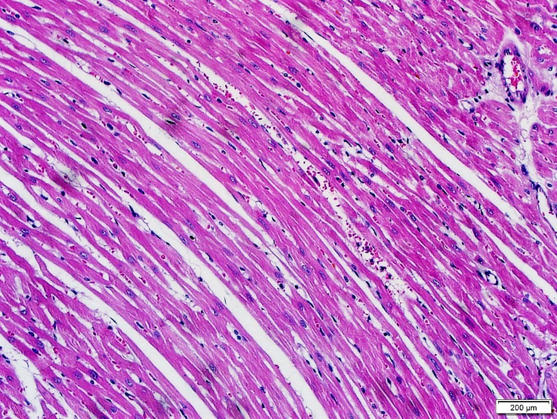
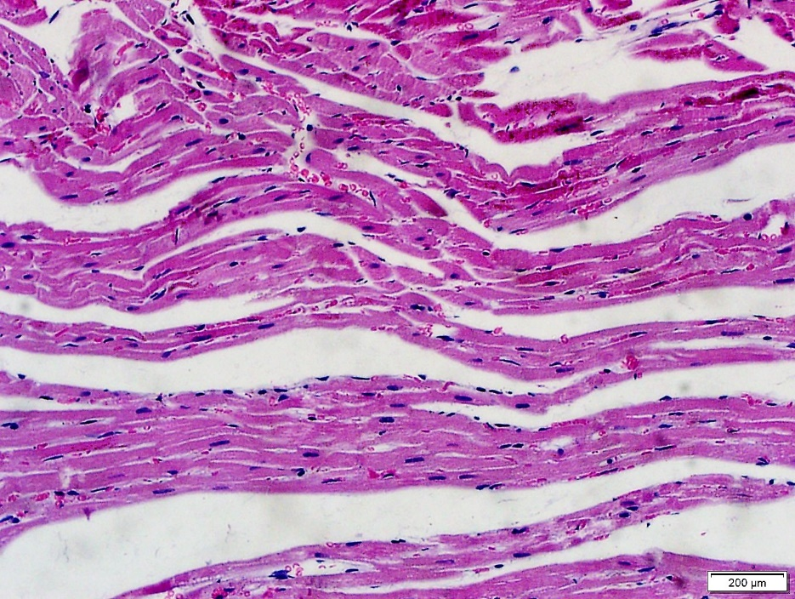
Fig. 3
result and analysis
1. original pictures of microscopy:
DM+P2Y₁₄ shRNA
DM+NC shRNA

Slide 16
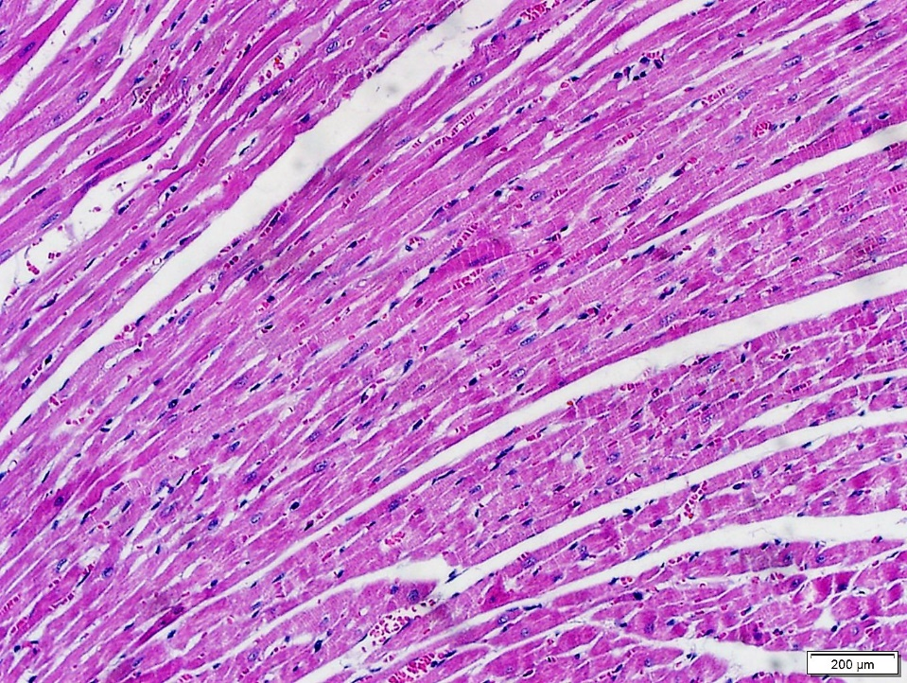
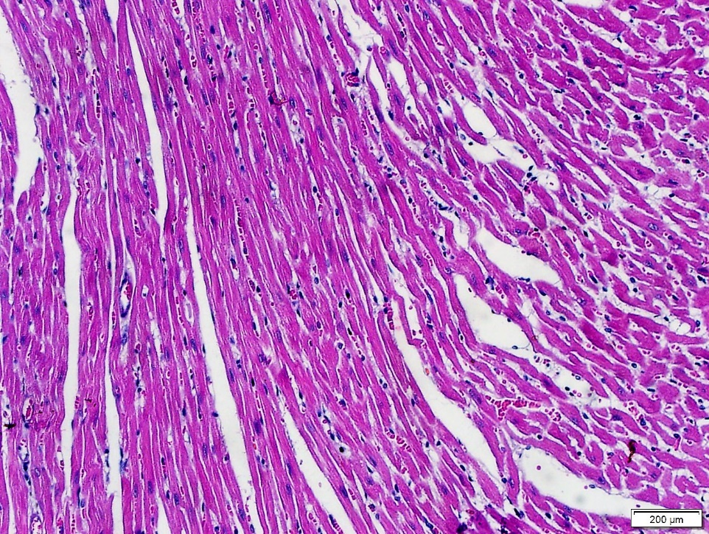
Fig. 3
result and analysis
1. original pictures of microscopy:
DM+naringin
DM+PBS

Slide 17
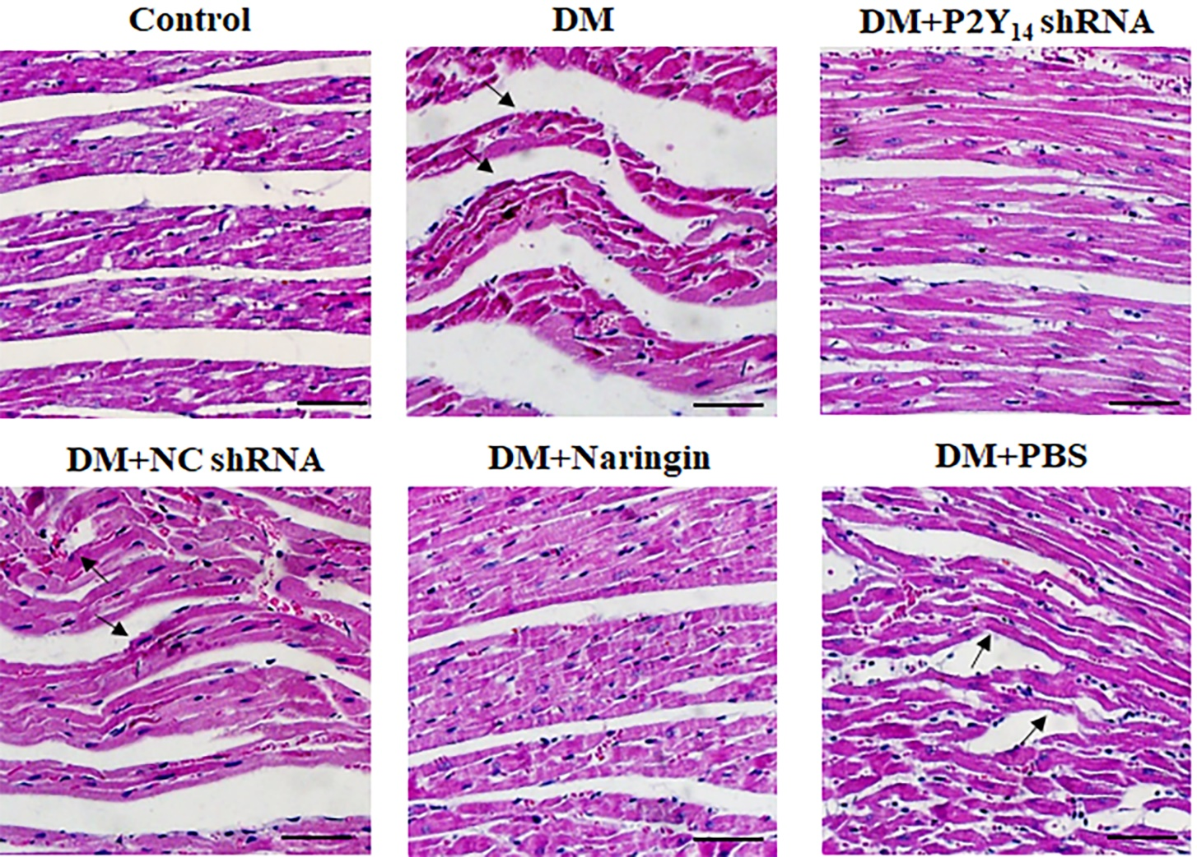
Fig. 3
result and analysis
Fig.3:

Slide 18
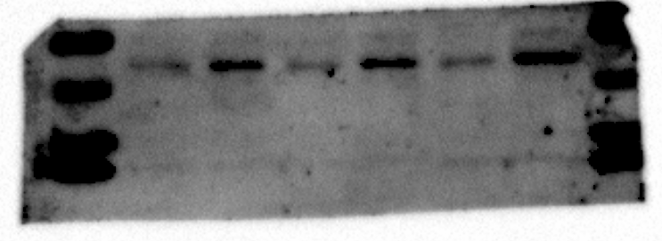
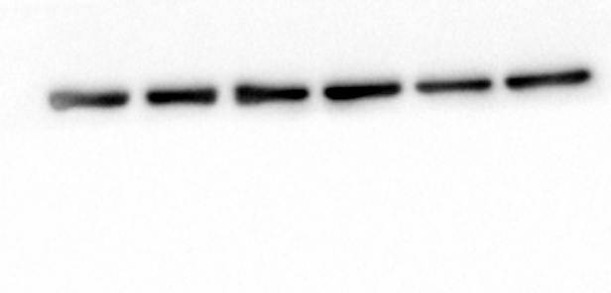
Fig. 4
result and analysis
1. original gel image of protein IL-1β and β-actin
IL-1β (31kD)
β-actin (43kD)

Slide 19
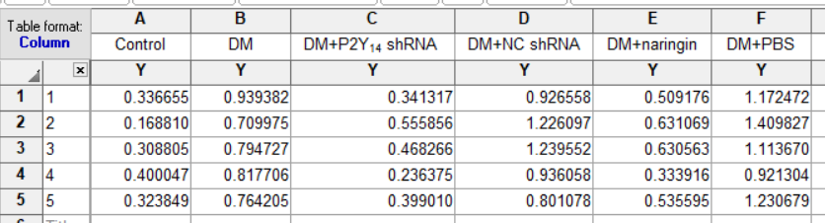
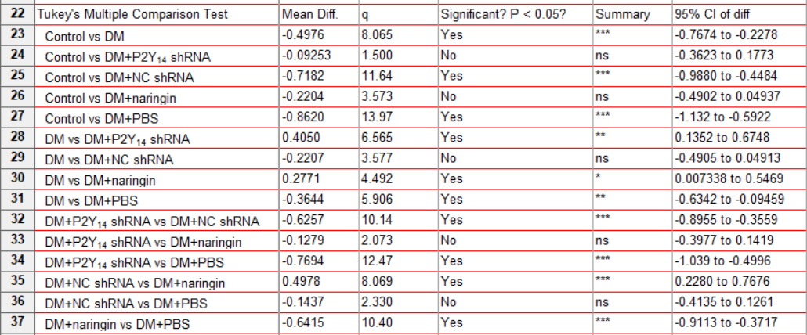
Fig. 4
result and analysis
2. IOD values analysis
(Note: all the detailed IOD values were shown in the Excel file titled “data sheet 1”)

Slide 20
Fig. 4
result and analysis
3. GraphPad prism histogram

Slide 21
Fig. 4
result and analysis
Fig. 4:

Slide 22
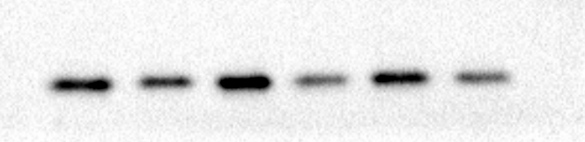
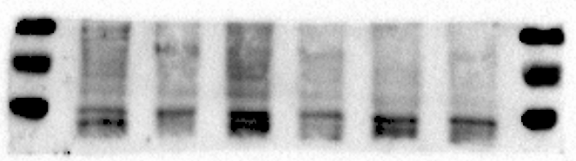
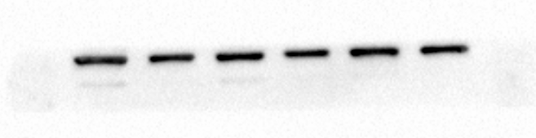
Fig. 5
result and analysis
1. original gel image of protein GPX4, NRF2 and β-actin
GPX4 (25kD)
NRF2 (70kD)
β-actin (43kD)

Slide 23
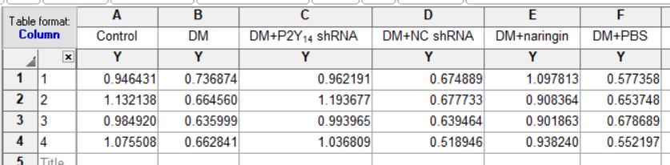
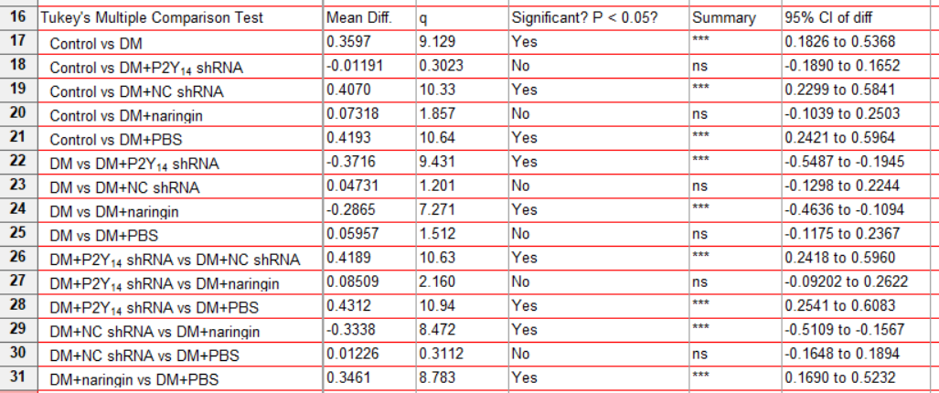
Fig. 5
result and analysis
2. IOD values analysis (GPX4)
(Note: all the detailed IOD values were shown in the Excel file titled “data sheet 1”)

Slide 24
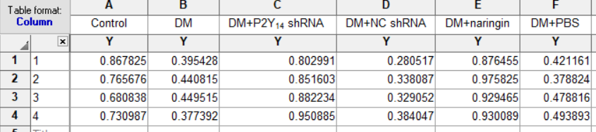
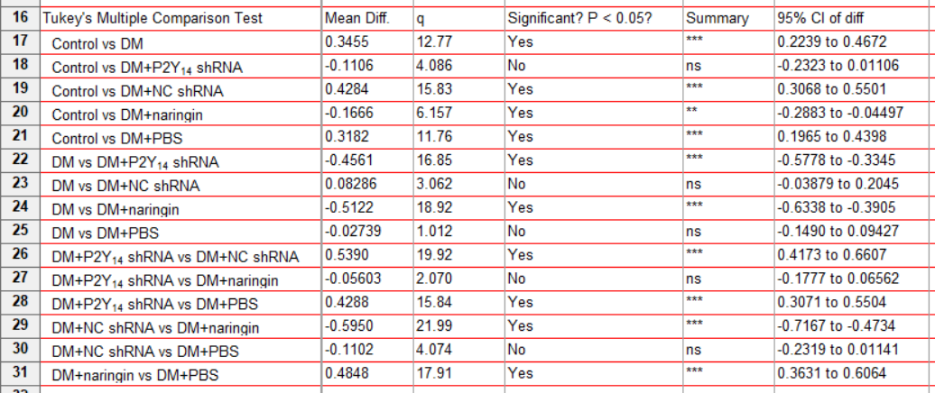
Fig. 5
result and analysis
2. IOD values analysis (NRF2)
(Note: all the detailed IOD values were shown in the Excel file titled “data sheet 1”)

Slide 25
Fig. 5
result and analysis
3. GraphPad prism histogram

Slide 26
Fig. 5
result and analysis
Fig. 5:

Slide 27
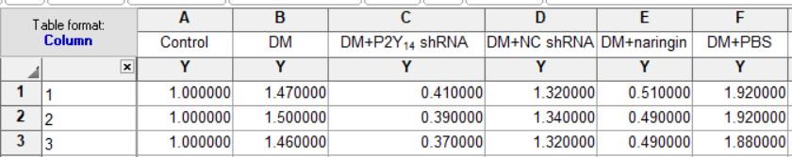
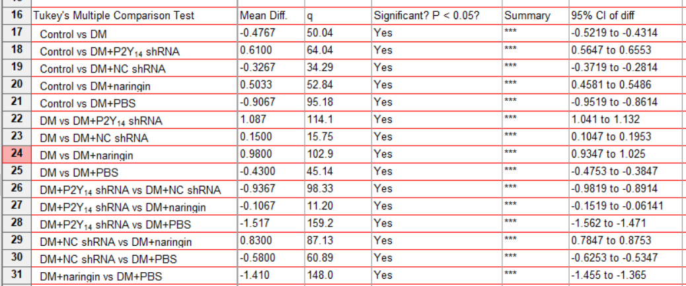
Fig. 6
result and analysis
1. The detailed ROS data were shown in the Excel file titled “data sheet 1”

Slide 28
Fig. 6
result and analysis
2. Fig.6

Slide 29
Fig. 7
result and analysis
1. The detailed data were shown in the Table 3
Fig.7:

Slide 30
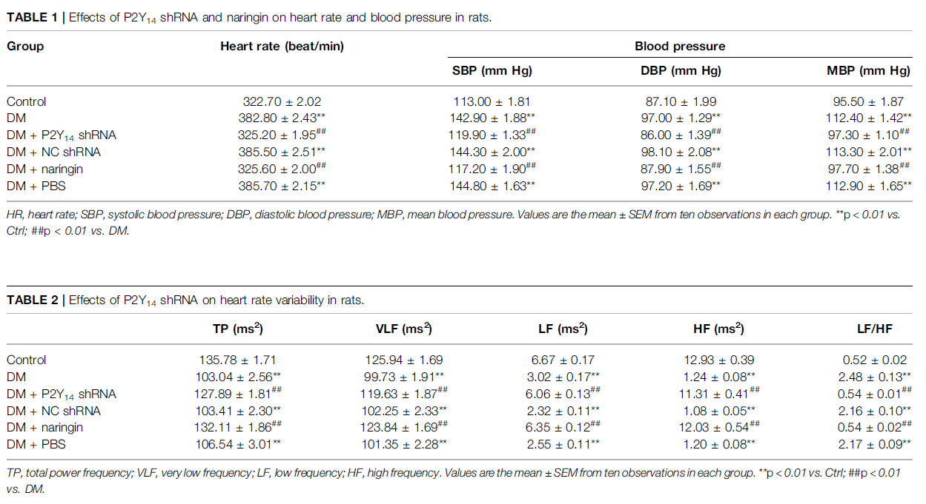
Table 1,2
result and analysis
1. The detailed data were shown in the Excel file titled “data sheet 1”

Slide 31
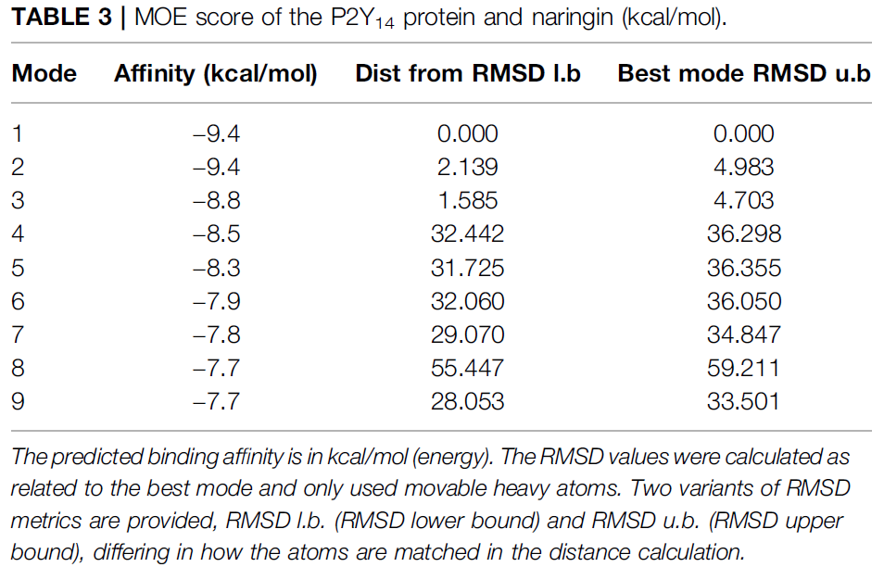
Table 3
result and analysis

Slide 32
Ending
Thanks for your viewing

