Slide 1
S1
Emergency Department (ED) Encounters
July 1st to December 5th
4th Generation
2017
N = 40,175
High-sensitivity
2018
N = 39,898
Troponin resulted
4th Generation
N = 6,319
High-sensitivity
N = 6,678
Complaint of ‘chest pain’
(primary study population)
4th Generation
N = 3,641
High-sensitivity
N = 4,203
Supplemental Figure 1: Consort diagram of patient encounters

Slide 2
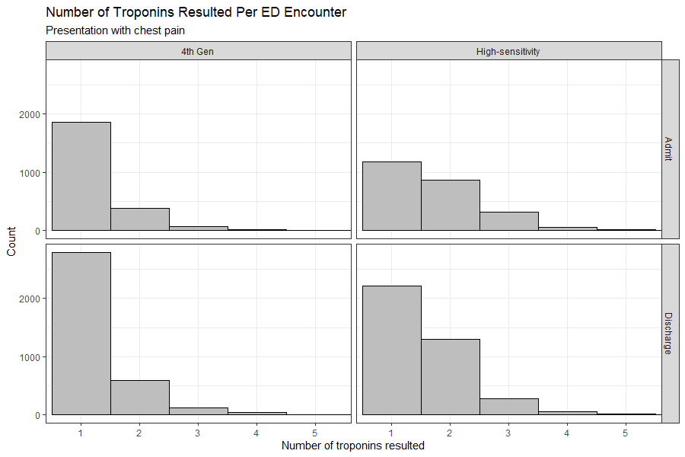
S2
Supplemental Figure 2: Histograms showing number of troponin results in ED for encounters during the 4th generation phase (left column) or High-sensitivity phase (right column) stratified by encounters leading to admission (top row) or discharge (bottom row).

Slide 3
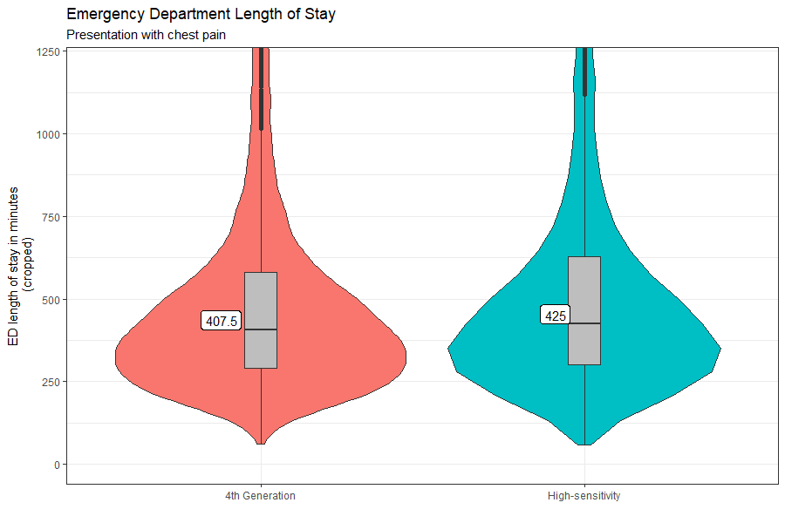
S3
P<0.0001
Supplemental Figure 3: Violin plot showing distribution of ED length of stay for all encounters for 4th generation phase (left) and high-sensitivity phase (right). Box plot shows median and interquartile range (IQR). Whisker is 1.5 IQR. Median value is shown in box. P value derived from Wilcoxon test.

Slide 4
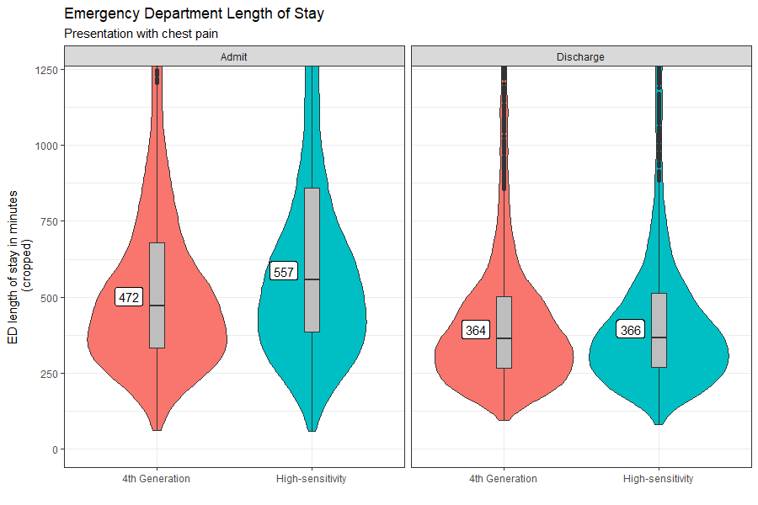
S4
P<0.0001
P=0.4
N = 1,295
N = 1,407
N = 2,346
N = 2,796
Supplemental Figure 4: Violin plot showing distribution of ED length of stay for encounters leading to hospital admission (left panel) and hospital discharge (right panel). Box plot shows median and interquartile range (IQR). Whisker is 1.5 IQR. Median value is shown in box. Within each panel data is shown for 4th generation phase (left) and high-sensitivity phase (right). P values derived from Wilcoxon test.

Slide 5
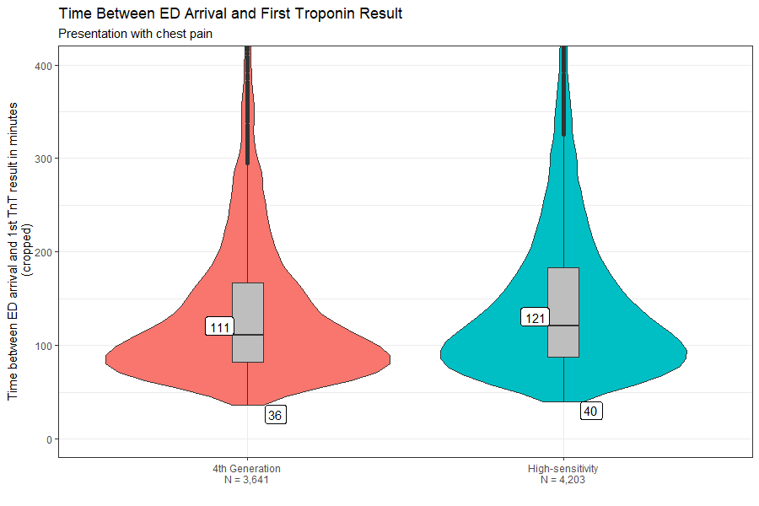
S5
P<0.0001
Supplemental Figure 5: Violin plot showing distribution of time elapsed between patient arrival to the ED and first troponin result for all encounters for 4th generation phase (left) and high-sensitivity phase (right). Box plot shows median and interquartile range (IQR). Whisker is 1.5 IQR. Median value is shown in box to the left of boxplot. Minimum value is shown in box below violin. P value derived from Wilcoxon test.

Slide 6
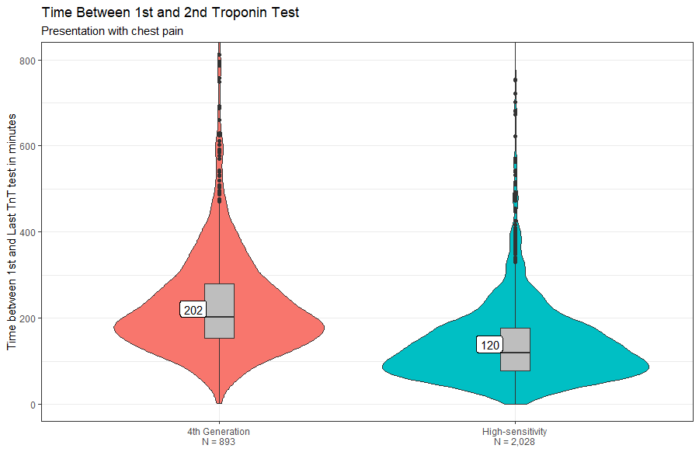
S6
P<0.0001
Supplemental Figure 6: Violin plot showing distribution time between first and second troponin result for all encounters with 2 or more results: 4th generation phase (left) and high-sensitivity phase (right). Box plot shows median and interquartile range (IQR). Whisker is 1.5 IQR. Median value is shown in box. P value derived from Wilcoxon test.

Slide 7
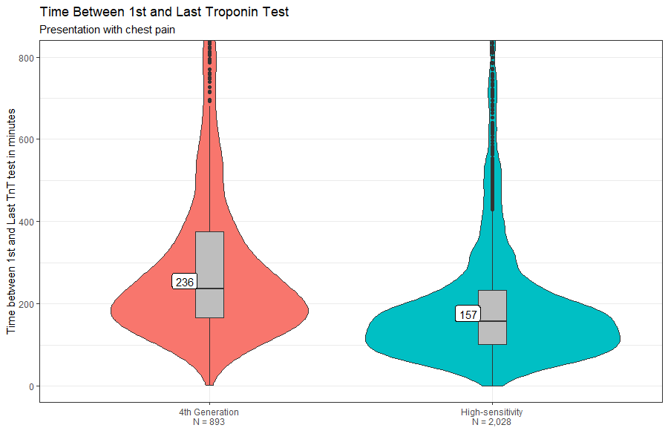
S7
P<0.0001
Supplemental Figure 7: Violin plot showing distribution time between first and last troponin result for all encounters with 2 or more results: 4th generation phase (left) and high-sensitivity phase (right). Box plot shows median and interquartile range (IQR). Whisker is 1.5 IQR. Median value is shown in box. P value derived from Wilcoxon test.

Slide 8
Supplementary Table 1
 | 4th gen | 5th gen
Duration of assay | 9 minutes | 9 minutes
Specimen types | Serum Plasma (Li heparin) | Plasma (Li heparin)
Analytical measurement range | 0.010 – 25.0 ng/mL | 6 – 10,000 ng/L
Max dilution | 1:10 | None
Limit of detectionª | 0.01 ng/mL | 5 ng/L
Reference intervalª | <0.01 ng/mL | See diagnostic pathway Male < 22 ng/L Female < 14 ng/L
%CV at 99th %ª | 18 % | <8.0 %
10% CVª | 0.03 ng/mL | 13 ng/mL
ªAs stated by manufacturer.

Slide 9
Supplementary Table 2
 | Phase 1: 4th gen TnT Mean (standard deviation) | Phase 2: hs-TnT Mean (standard deviation) | P value*
Collection -> Lab Received (minutes) | 20 (42.8) | 23 (51.4) | <0.0001
Lab Received -> Resulted (minutes) | 57 (249.0) | 57 (92.0) | 0.96
Collection -> Resulted (minutes) | 77 (252.8) | 80 (105.7) | 0.17
*two-tailed t-test

