Slide 1
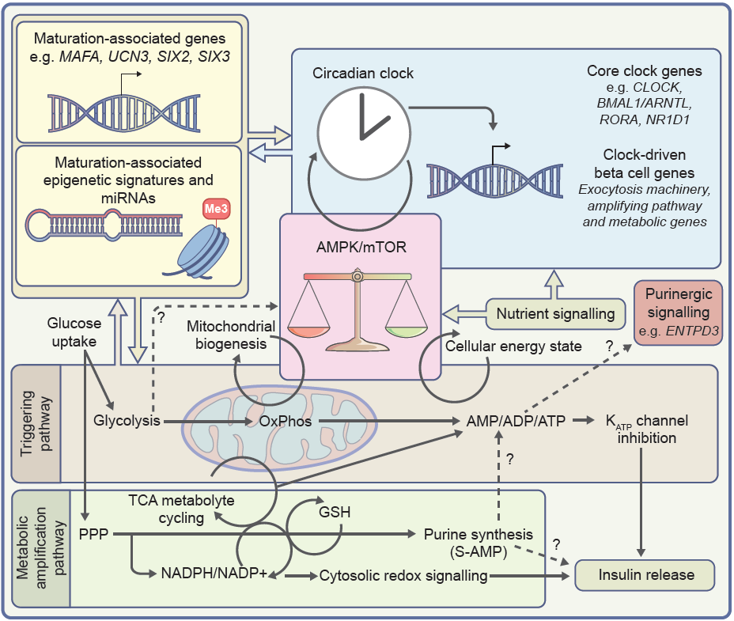
Overlapping transcriptomic, metabolic and energy-sensing machinery that enables the functional maturation of beta cells
Barsby and Otonkoski (2022) Diabetologia DOI 10.1007/s00125-022-05672-y
© The Authors 2022. Distributed under the terms of the CC BY 4.0 Attribution License (http://creativecommons.org/licenses/by/4.0/)

Slide 2
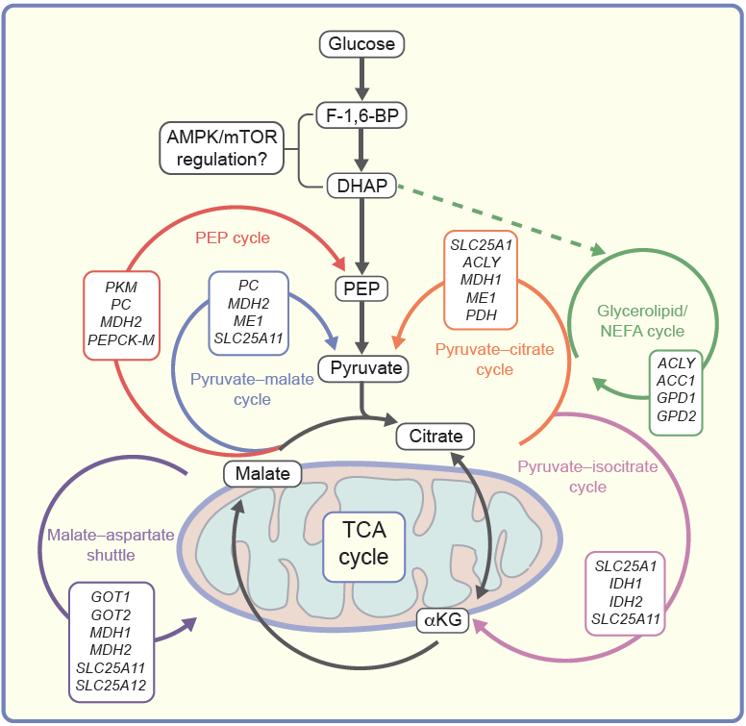
Proposed glucose-sensitive metabolic cycles in functionally mature beta cells
Barsby and Otonkoski (2022) Diabetologia DOI 10.1007/s00125-022-05672-y
© The Authors 2022. Distributed under the terms of the CC BY 4.0 Attribution License (http://creativecommons.org/licenses/by/4.0/)

