Slide 1
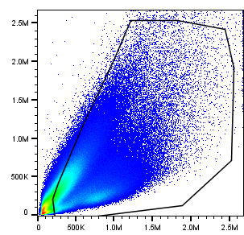
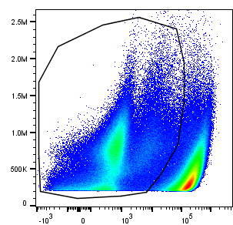
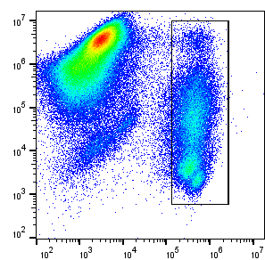
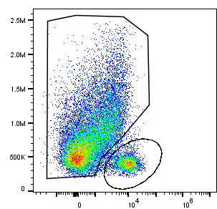
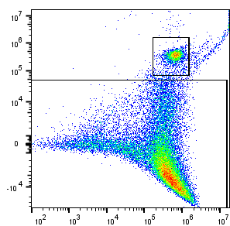
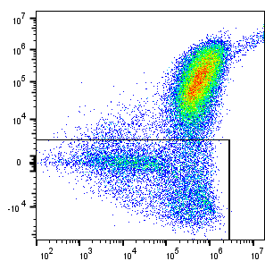
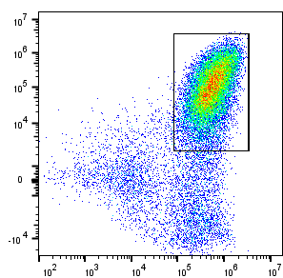
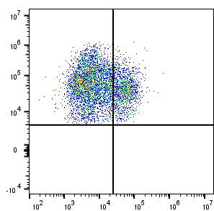
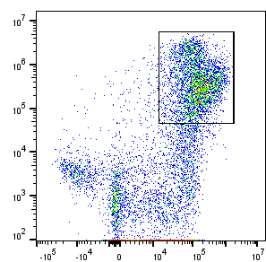
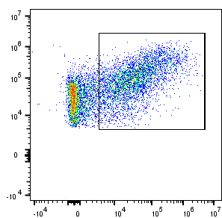
  Supplementary Figure S1
Total mouse leukocytes
SSC-A
FSC-A
GFP
FSC-A
Viability dye (FVS620)
Mouse CD45
NK cells
(CD45⁺CD11b^{-/+}Ly6G⁻NKp46⁺)
G-MDSC
(CD45⁺CD11b⁺Ly6G⁺)
FSC-A
Ly6G
F4/80
NKp46 (CD335)
CD11b
CD11b
(CD45⁺CD11b⁺Ly6G⁻NKp46⁻F4/80⁺ Ly6C⁻ or ⁺)
Dendritic cells
(CD45⁺CD11b^{+/-}F4/80⁻CD11c⁺MHCII⁺)
TAMs
Monocytes
F4/80
F4/80
MHCII
CD11b
Ly6C
CD11c
MHCII⁺ TAMs
F4/80
MHC II

Slide 2
Supplementary Figure S1: Gating strategy for identification of tumor-infiltrating myeloid-lineage populations and NK cells in Raji GFP^{hi} tumors. Starting from the upper left, arrows indicate strategy of subpopulation gating. Identified populations are displayed at top of the quadrants.

Slide 3
  Supplementary Figure S2
a
b
c
Dendritic cells
phagocytosis

Slide 4
Supplementary Figure S2: a. Immunodeficient NOD SCID mice were implanted with Raji GFP^{hi} lymphoma tumor cells and treatment was started when tumor volume reached about 100mm3. Tumors were excised 7 days later to evaluate impact of treatment on the tumor microenvironment Analysis by flow cytometry of tumor-infiltrating total mouse leukocytes, myeloid subpopulations (TAMs, monocytes, G-MDSCs, dendritic cells), NK cells and b. MHCII⁺ TAMs (gated on CD11b⁺, Ly6G⁻, NKp46⁻, F4/80⁺, Ly6C⁻ cells). Gating strategy to identify subpopulations is displayed in supplementary figure S1. c. Phagocytosis of tumor cells by dendritic cells (i.e. GFP⁺ DC) assessed at D14 after hIgG1 or NI-1701 treatment initiation. Data are presented as mean ± SD. Significance was determined by unpaired t test. *p<0.05

Slide 5
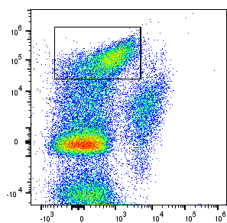
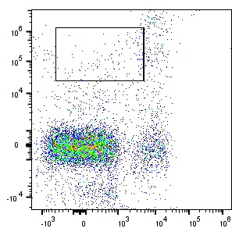
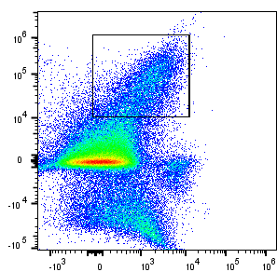
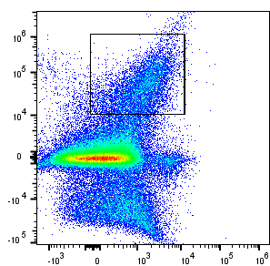
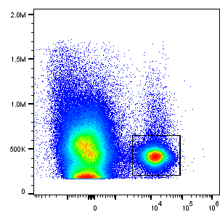
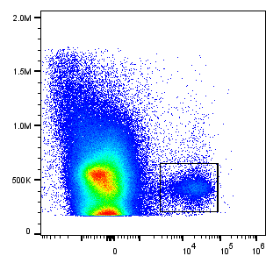
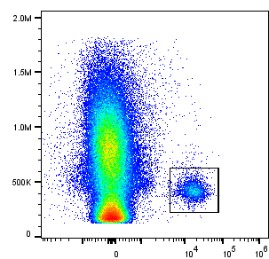
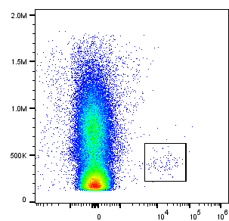
  Supplementary Figure S3
a
PBS lip.+ NI-1701
Clodronate lip. + NI-1701
20.4
1.6
Spleen
F4/80
NKp46
PBS lip.+
NI-1701
Clodronate lip. + NI-1701
Tumor
7.7
7.6
F4/80
NKp46
b
Anti-asialo GM1
+ NI-1701
PBS + NI-1701
19.8
2
Spleen
FSC-A
NKp46
PBS + NI-1701
Anti-asialo GM1
+ NI-1701
Tumor
FSC-A
2.4
0.15
NKp46

Slide 6
Supplementary Figure S3: Analysis of macrophage and NK cell content in spleen and tumor of NI-1701-treated mice, with or without macrophage or NK cell depletion, was performed by flow cytometry. Representative flow cytometry plots and analysis of macrophage (a) or NK cell (b) proportion in live cells in tumor and spleen, at study termination, with or without cell depletion. Graphs represent the percentage of F4/80⁺ macrophages (a) or NKp46⁺ NK cells (b) in live cells in spleens or tumors. Data are presented as mean ± SD, with n=3-4 mice per group. Significance was determined by unpaired t test. ***p<0.001, ****p<0.0001

Slide 7
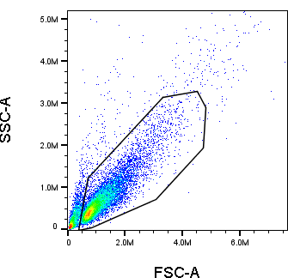
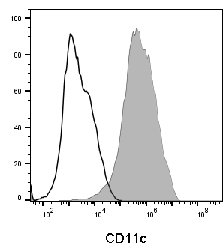
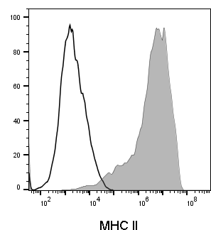
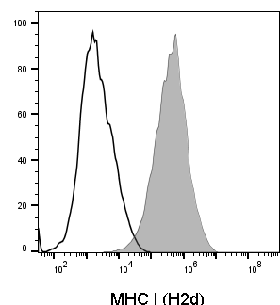
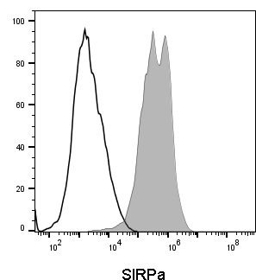
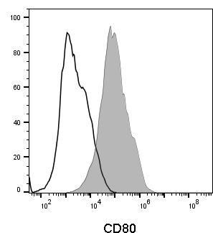
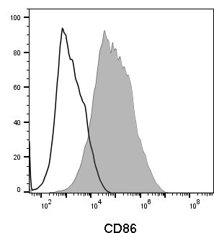
  Supplementary Figure S4

Slide 8
Supplementary figure S4: Phenotypic characterization of GM-CSF BALB/c bone-marrow-derived dendritic cells (BMDCs) by flow cytometry. BMDCs were stained with anti-CD11c, anti-MHCII (IA/IE), anti-MHC I (H2d), anti-SIRPα, anti-CD80 or anti-CD86 Abs (filled grey histograms) or matching isotype controls (empty histograms).

