Slide 1
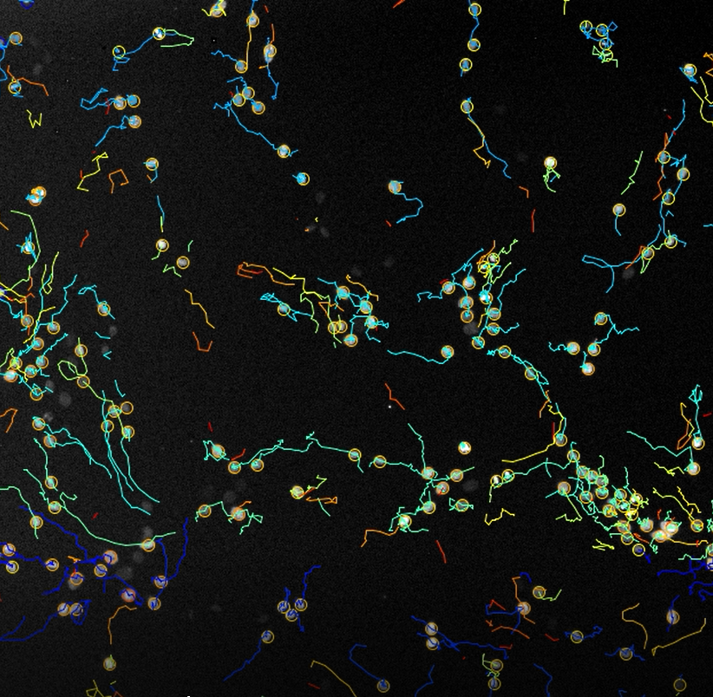
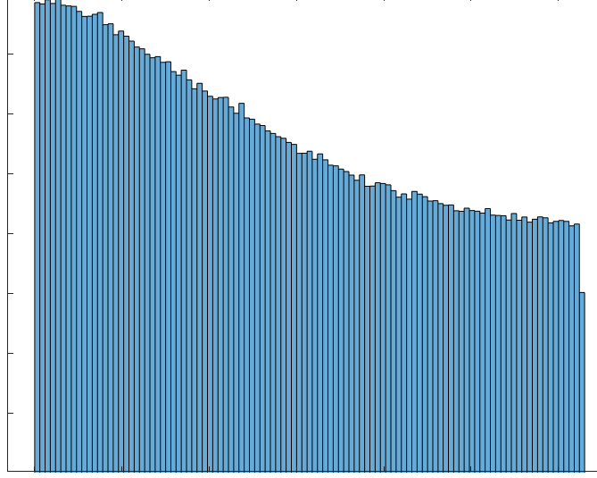
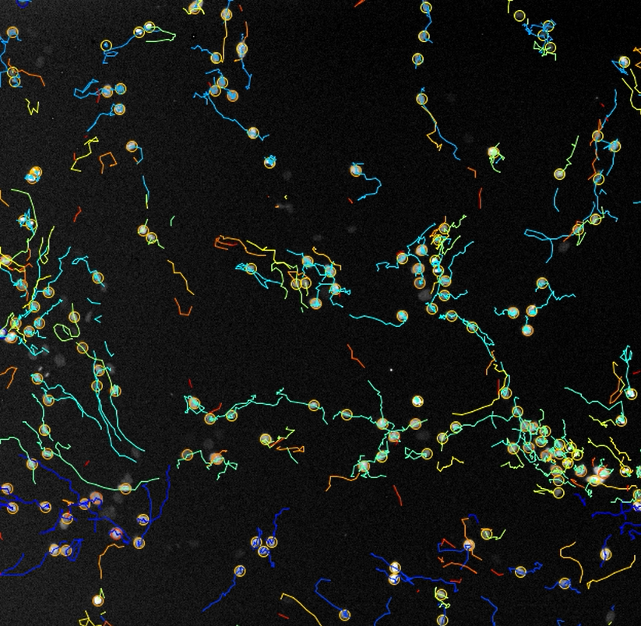
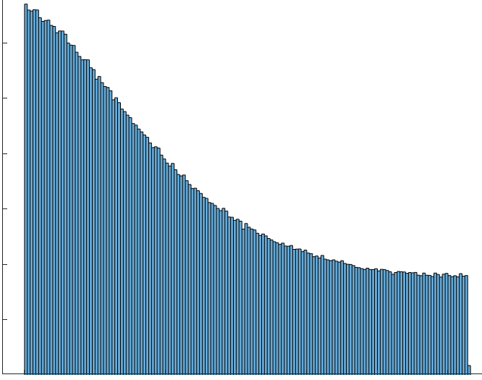


A)
B)
time T_{k}
16000
Normal cells
PO
$$CI=\frac{PO}{BO}≈2$$
cell C_{i}
12000
Occurence (# of pairwise displacement angles)
BO
8000
cell C_{j}
4000
0
0.03π
0.95π
0.98π
0
0.5
1.0
1.5
2.0
2.5
3.0
Displacement angle (radians)
time T_{k+1}
Cancer cells
PO
30000
$$CI=\frac{PO}{BO}≈3.7$$
D_{i,k}
Occurence (# of pairwise displacement angles)
20000
θ_{i-j,k}
10000
D_{j,k}
BO
0
0.03π
0.95π
0.98π
0
0.5
1.0
1.5
2.0
2.5
3.0
Displacement angle (radians)

