Slide 1
Fig. 1C
PD-L1
Repeat 1
Repeat 1
HLF
Hep3B
IFN-γ
IL-1β
-
-
-
+
+
-
+
+
-
-
-
+
+
-
+
+
75
PD-L1
40-50 kDa
100
100
75
75
γActin
42 kDa
50
50
37.5
37.5

Slide 2
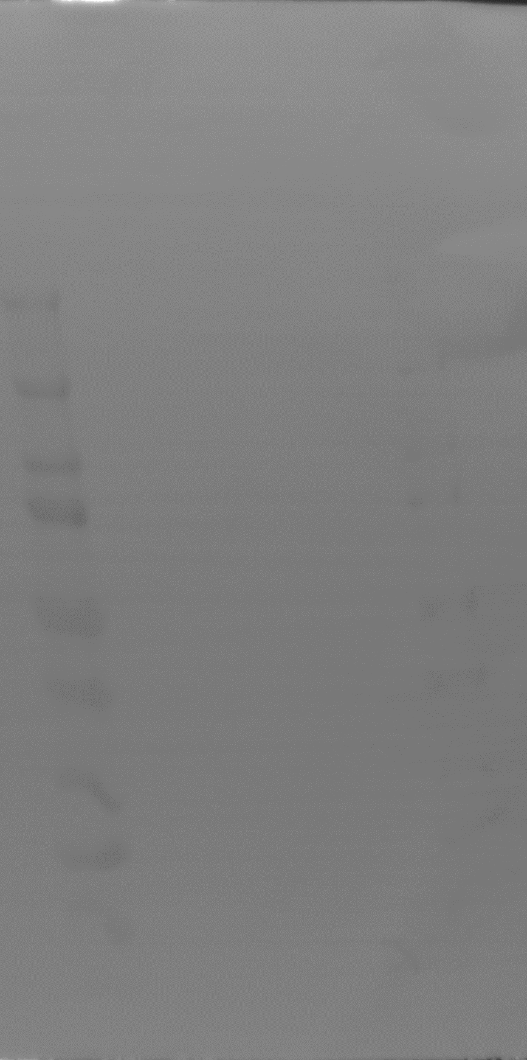
Repeat 2
Repeat 2
Hep3B
- - + +
- + - +
HLF
- - + +
- + - +
100
100
75
PD-L1
75
50
PD-L1
50
37.5
40-50 kDa
40-50 kDa
37.5
(kDa)
(kDa)
100
100
100
γActin
75
100
75
75
50
75
γActin
50
50
42 kDa
50
42 kDa
37.5
37.5
37.5
(kDa)
37.5
(kDa)
(kDa)
(kDa)

Slide 3
Repeat 3
Repeat 3
HLF
Hep3B
IFN-γ
IL-1β
+ - + -
- - + +
The order is different form Repeat 1 and 2.
- + - +
- - + +
100
75
PD-L1
40-50 kDa
50
37.5
(kDa)
100
100
γActin
75
75
42 kDa
50
50
37.5
37.5
(kDa)
(kDa)

