Slide 1
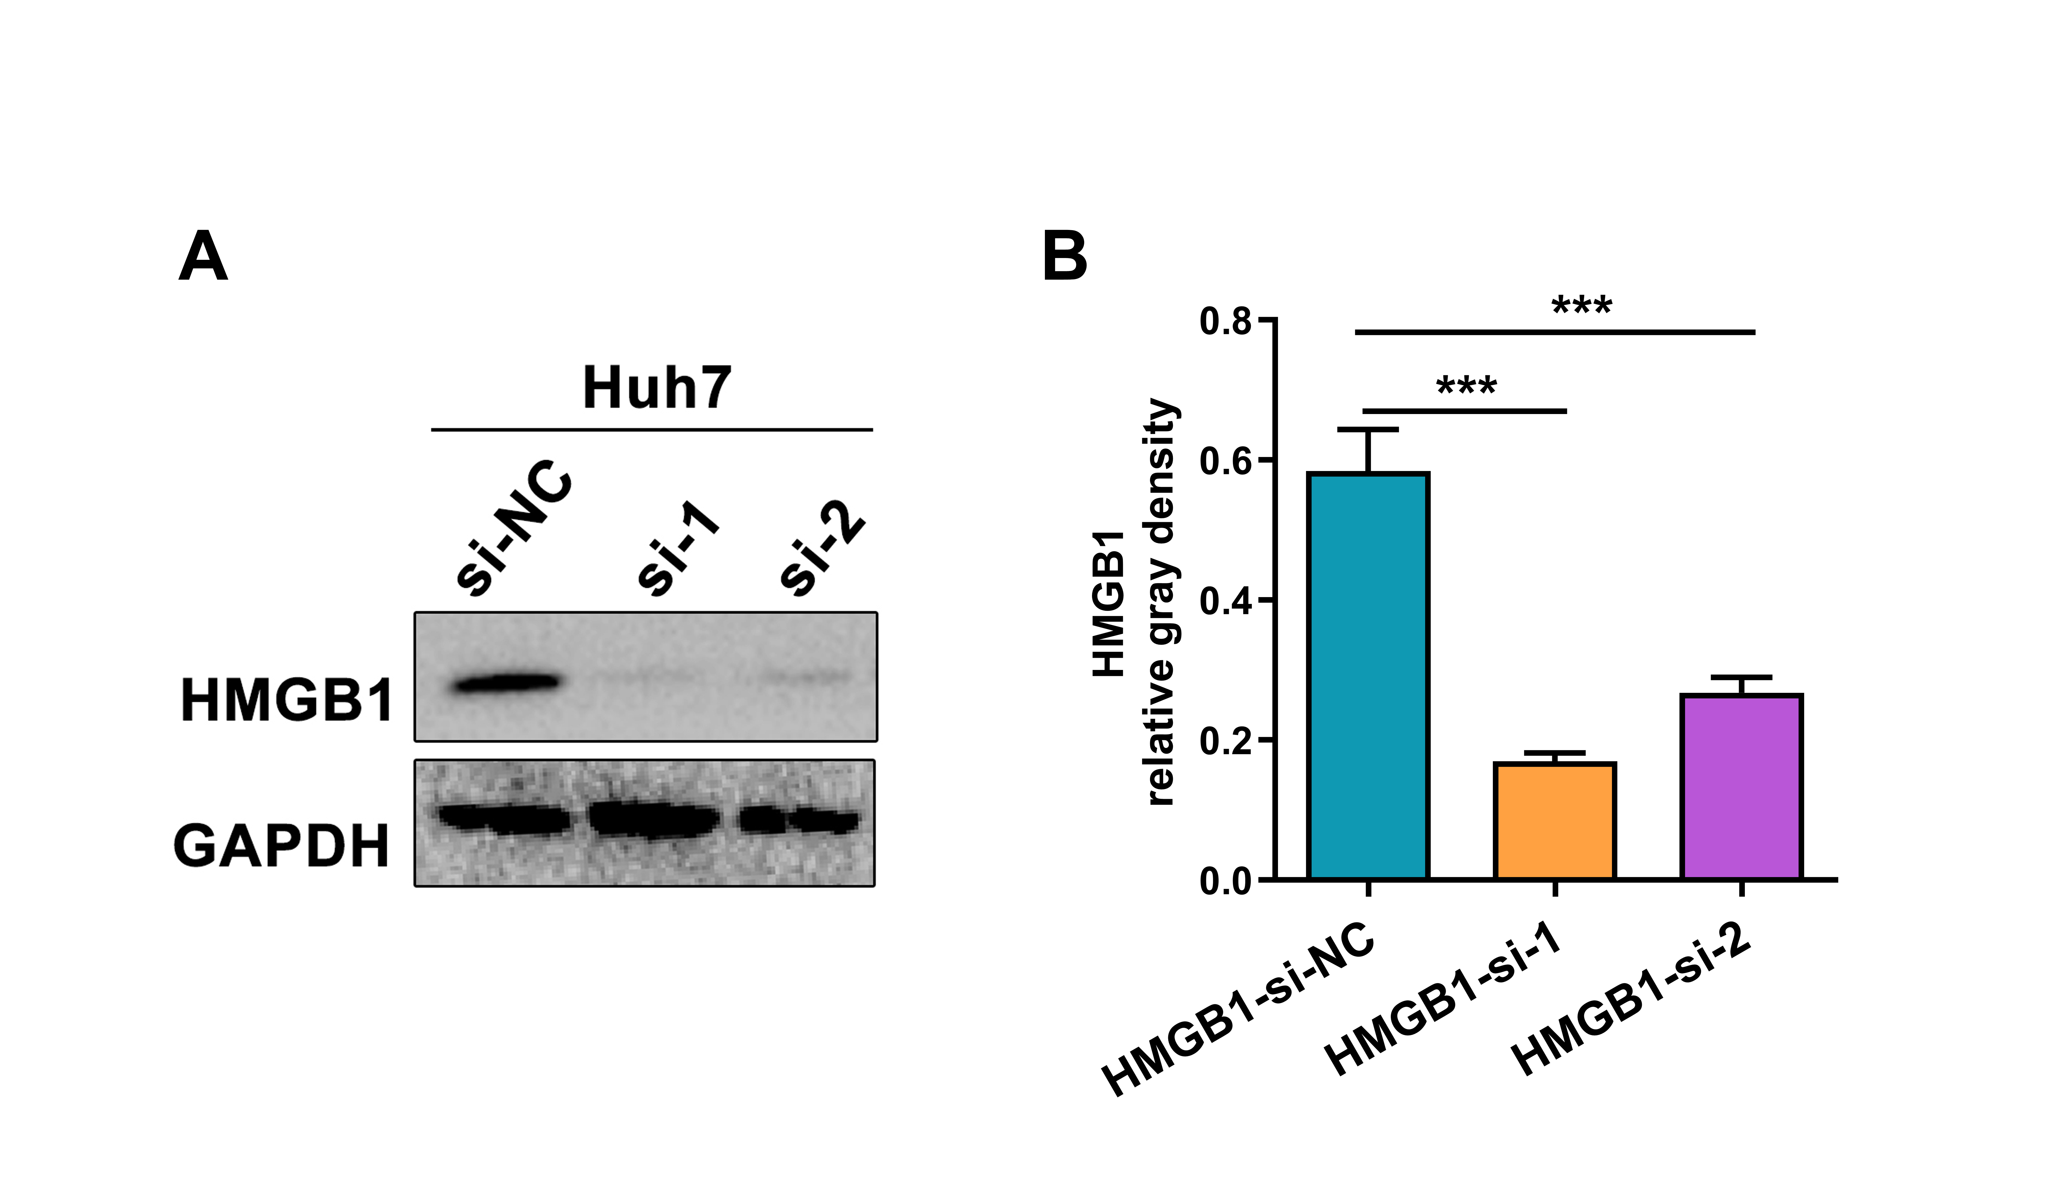
Figure S5. The efficacy verification of HMGB1-siRNA in HCC cells. A The protein expression of HMGB1 was determined by western blot. B the relative gray density of HMGB1 protein was analyzed by Image J software. *** P ＜0.001.

