Slide 1



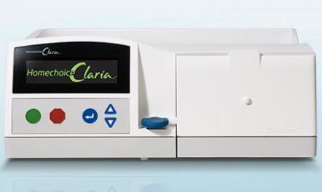

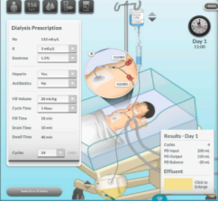




Evaluation of the Claria Sharesource System from the Perspectives of Patient/Caregiver, Physician, and Nurse in Children Undergoing Automated Peritoneal Dialysis (APD)
HYPOTHESIS: This study aimed to evaluate patient/caregiver, nurse and physician perceptions on the advantages and disadvantages of the APD remote monitoring platform, the Claria sharesource system (CSS)
Multicenter study in Turkey
Questionnaires were answered by…
CSS helps detect PD technique-related problems (according to all physicians and most nurses (87%)
CSS improves patient monitoring (according to 87% of PD nurses and 73% of physicians)
Over 1 year experience with Claria
30 patient/caregivers
73% of nurses thought that CSS is not as well known by physicians compared to nurses
22
physicians
15
PD nurses
Although 68% of physicians accept CSS as saving time by reducing hospital visits, only 20% of patients/caregivers reported decreased hospital visits.
3 different
web-based questionnaires
CONCLUSION: CSS can be successfully applied to children for increased adherence to dialysis prescription, and can improve recognition of problems with APD
Uzun Kenan et al. 2022

