Slide 1
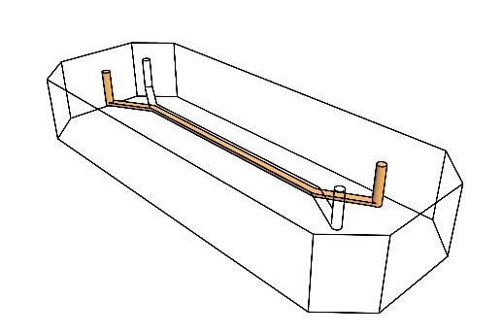
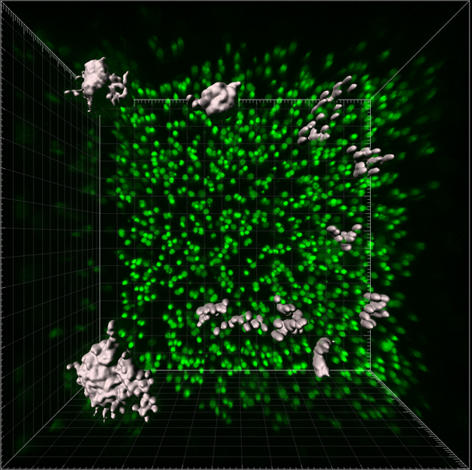

a
b
B-cells T-cells
Day 0
c
Day 4
d
d
e
Follicle #
2D
μm
Chip
f
0
4
7
2D
Day
Static
Flow
CXCL13 fg/10⁴ cells
Supplementary Fig. 1
4
8
Day
Notes:
Add cluster quantification surfaces

Slide 2
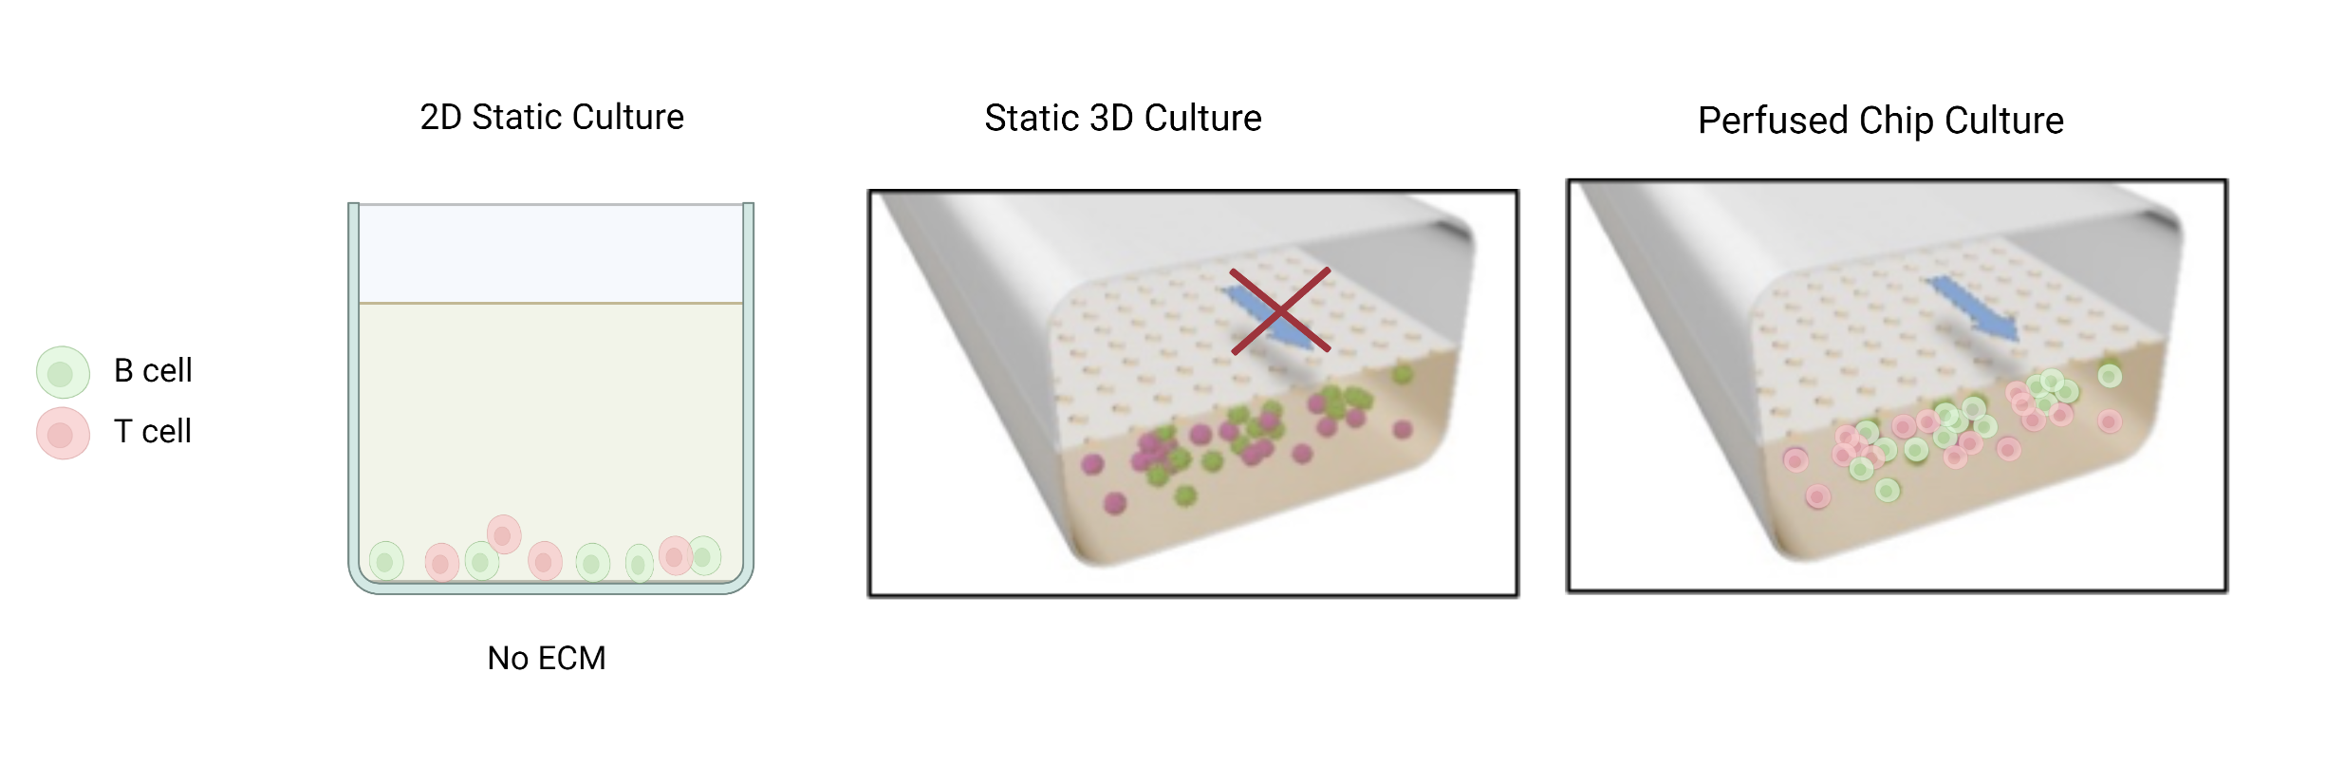
Supplementary Fig. 2

Slide 3
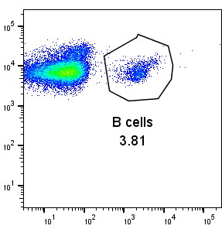
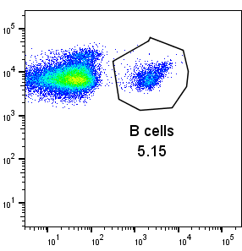
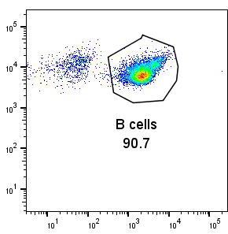
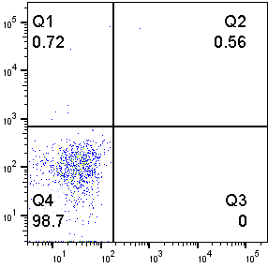
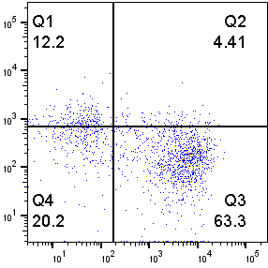
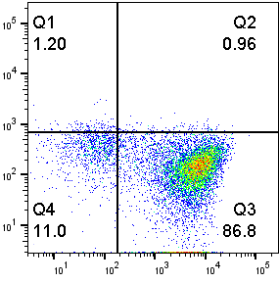
a
Isotype Control
PBMC
Sorted B Cells
SSC-A
CD19
CD27
IgD
b
IgM
ng/ml
Static
Flow
Supplementary Fig. 3

Slide 4
a
b
Nuclei
CD3
AID
Donor 1
Donor 2
Staining con
c
d
r=0.3290 p=0.0024
AID (% area)
Follicle size (μm²)
Supplementary Fig. 4

Slide 5
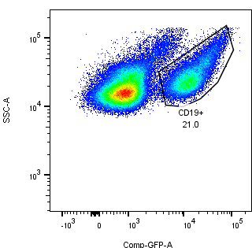
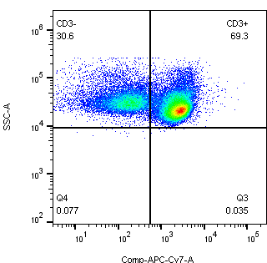
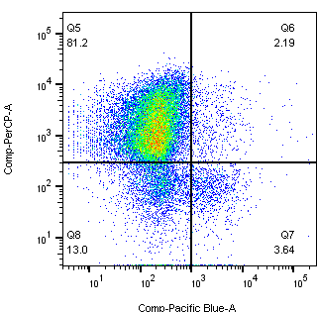
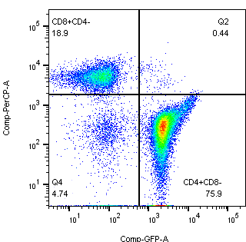
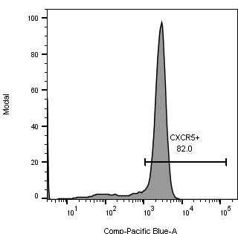
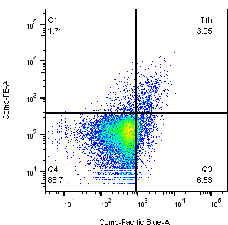
a
B cell panel
T cell panel
SSC
SSC
CD19
CD3
IgM
CD8
IgG
CD4
Count
PD-1
CXCR5+
82%
CXCR5
CXCR5
b
Supplementary Fig. 5

Slide 6
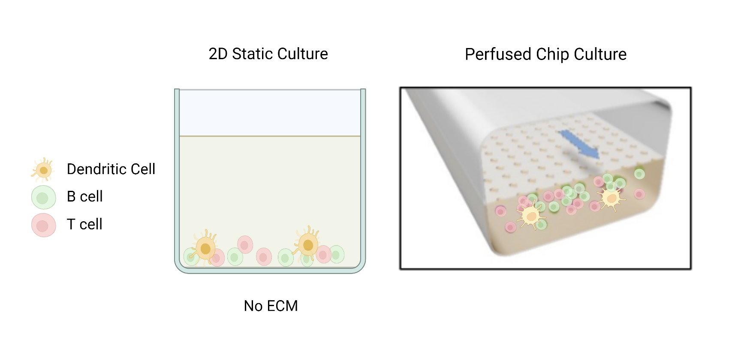
a
b
In-house SiMoa assay for anti-HA IgG
AEB
Dilution factor
c
Supplementary Fig. 6

Slide 7
Follicle #
Follicle Vol. (μm³)
H5N1
+SWE
H5N1
+SWE
------Chip------
------Chip------
Supplementary Fig. 7

