Slide 1
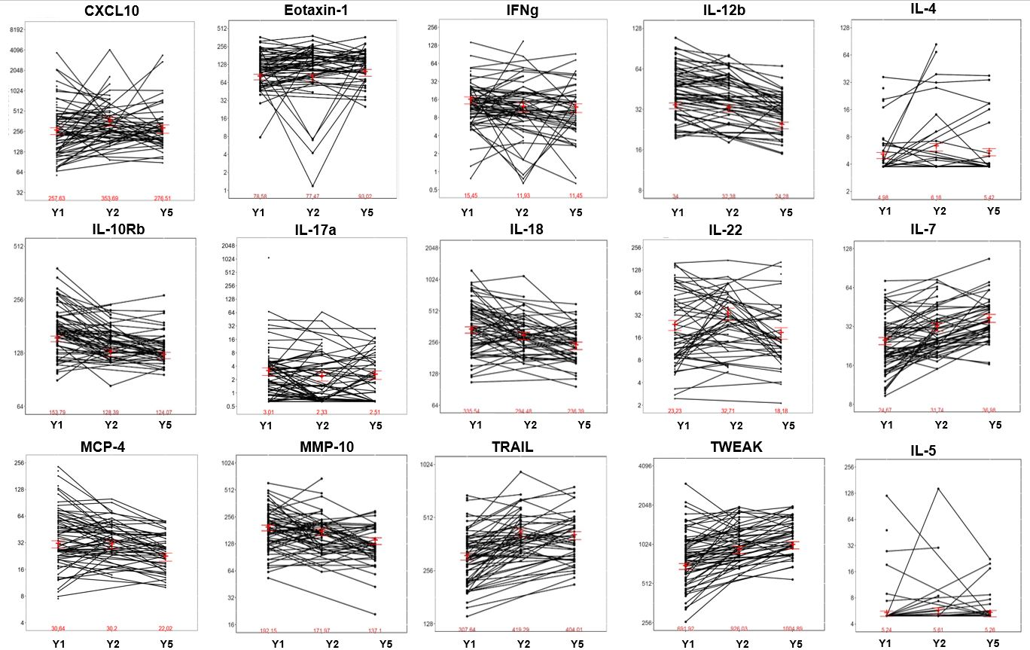
Supplemental Figure 1
Log2 (relative concentration)
Year

