Slide 1
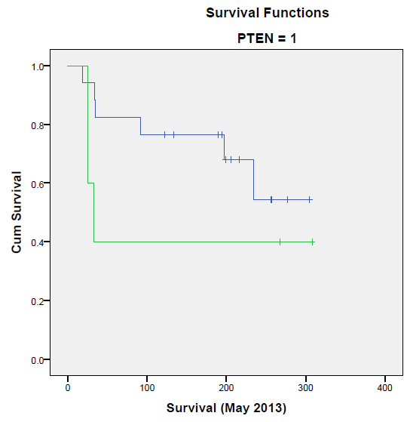
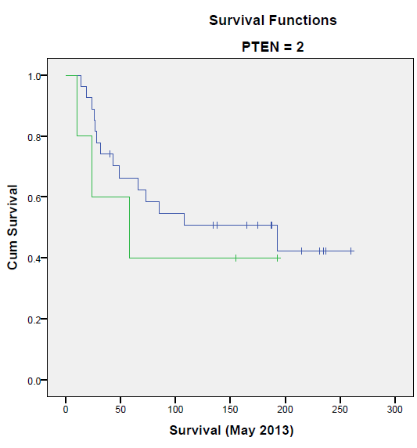
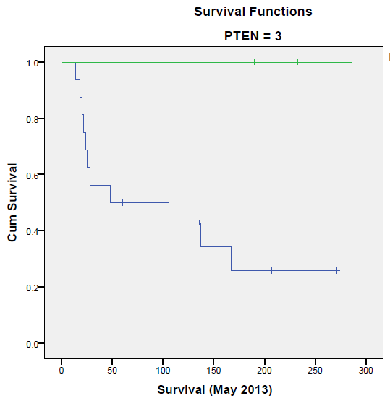
A.
B.
C.
Notch-1 Nuclear
PTEN Status (Low)
Notch-1 Nuclear
PTEN Status (Moderate)
High
(Notch1)
Notch-1 Nuclear
PTEN Status (High)
Low
(Notch1)
Low
(Notch1)
High
(Notch1)
High
(Notch1)
Low
(Notch1)
Censored
Supplementary Figure 10. Kaplan-Meier Survival Outcome Based on Notch-1 Nuclear and PTEN Protein Expression. Kaplan-Meier Survival Outcome for women with stage II-III primary invasive, HER2+ breast cancer-expressing high (1.00) or low (0.00) Notch-1 nuclear protein and low (A.), moderate (B.), or high (C.) PTEN expression. D. Table showing case processing summary results from Notch-1 protein expression scores in 75 cases of HER2+ breast tumor tissue arrays from the Nottingham cohort. Total number of events (deaths) and censored patients from tissue scored for Notch-1 nuclear staining and PTEN low to high staining (1-3). Overall comparisons were statistically tested using Chi-Squares and Log Rank by Mantel-Cox analysis.
D.
PTEN Notch1_nuc_lowhigh | Total N | N of Events | N | Percent
0 .00 Overall | 1 1 | 0 0 | 1 1 | 100.0% 100.0%
.00 1.00 Overall | 17 5 22 | 6 3 9 | 11 2 13 | 64.7% 40.0% 59.1%
.00 1.00 Overall | 27 5 32 | 14 3 17 | 13 2 15 | 48.1% 40.0% 46.9%
.00 1.00 Overall | 16 4 20 | 11 0 11 | 5 4 9 | 31.3% 100.0% 45.0%
Overall Overall | 75 | 38 | 38 | 50.7%

