Slide 1
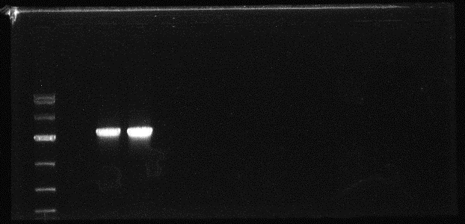
VrCCA1L26-1
VrCCA1L26-2
Marker
Col
Additional file 6: PCR fragment analysis of VrCCA1L26 in transgenic lines and wild-type Arabidopsis (Col) plants. The electrophoretic bands in the Marker from above to below is 10,000, 7,000, 4,000, 2,000, 1,000, 500, and 250 bp, respectively. The fragment length of VrCCA1L26 is 2,250 bp.

