Slide 1
JAMA Ophthalmology Journal Club Slides:
Thyroid Eye Disease and Cumulative Incidence of Strabismus and Surgical Interventions
Boulakh L, Nygaard B, Bek T, et al. Nationwide incidence of thyroid eye disease and cumulative incidence of strabismus and surgical interventions in Denmark. JAMA Ophthalmol. Published online April 28, 2022. doi:10.1001/jamaophthalmol.2022.1002

Slide 2
Introduction
Importance:
  In thyroid eye disease (TED), orbital content (primarily the eye muscles but also fat tissue) expands because of edema and inflammation.
  TED is a serious condition that can cause proptosis and strabismus and, in rare cases, lead to blindness.
  Incidence data for TED and strabismus and surgical interventions after TED are sparce.
Objective:
  To investigate the nationwide incidence of TED, strabismus, and surgical interventions associated with TED.

Slide 3
Methods
Study Design, Setting, and Participants:
  A nationwide registry-based cohort study using all Danish inhabitants aged 18 to 100 years between 2000 and 2018.
Main Outcomes:
  The incidence of TED and subsequent strabismus and surgical interventions were classified using the Danish National Patient Registry and the National Register of Medicinal Product Statistics (including prescriptions from all Danish pharmacies).
  Strabismus, strabismus surgery, and orbital decompression surgery were studied independently.
  Thyroid status was determined from prescriptions redeemed within the 5 years preceding TED diagnosis.

Slide 4
Methods
Limitations:
  Our results can only be generalized to populations with similar ethnicity, iodine intake status, and health care access.
Strengths:
  This study had an unbiased nationwide registry-based design that includes all diagnoses and surgical interventions from all hospitals in Denmark and all prescriptions from Danish pharmacies.

Slide 5
Results
The sampling frame each year consisted of a mean of 4.3 million participants.
The population was examined for a total of 8.22 × 10⁷ person-years overall.
  Women: 4.18 × 10⁷ person-years
  Men: 4.04 × 10⁷ person-years
Of the 4106 patients with incident cases recorded in that period, 3344 (81.4%) were women and 762 (18.6%) were men.
The mean (SD) age at onset was 51.3 (14.5) years overall, 51.1 (14.5) years in women, and 52.2 (14.5) years in men.

Slide 6
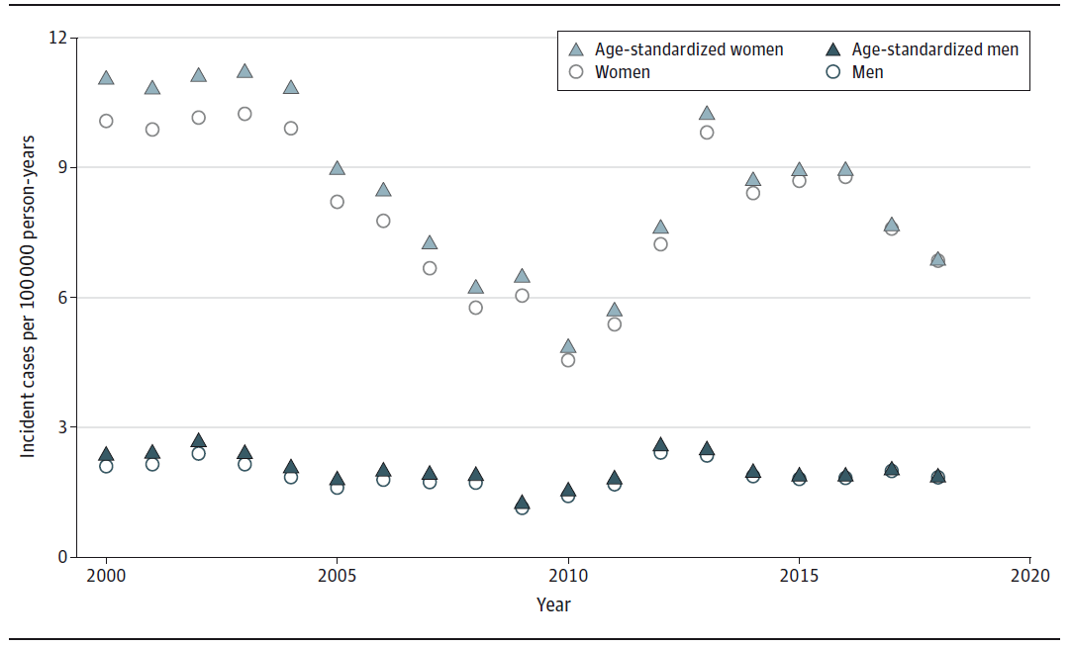
Results
Incidence of Thyroid Eye Disease in Denmark (2000-2018)
The mean numerical incidence rate and age-standardized incidence rate were similar. The incidence in both sexes gradually decreased from 2005, with the lowest incidence rate in 2010, and then increased until reaching a steady level between 2014 and 2018. Women had a higher incidence of thyroid eye disease than men. Information on date of birth, sex, demographics, and vital status of the Danish population was obtained from the Danish Civil Registration System and linked to the Danish National Patient Registry via encrypted unique identifiers in Statistics Denmark.
The mean annual nationwide incidence (per 100 000 per year):
Overall: 5.0
Female: 8.0
Male: 1.9
Female:male ratio: 4:1

Slide 7
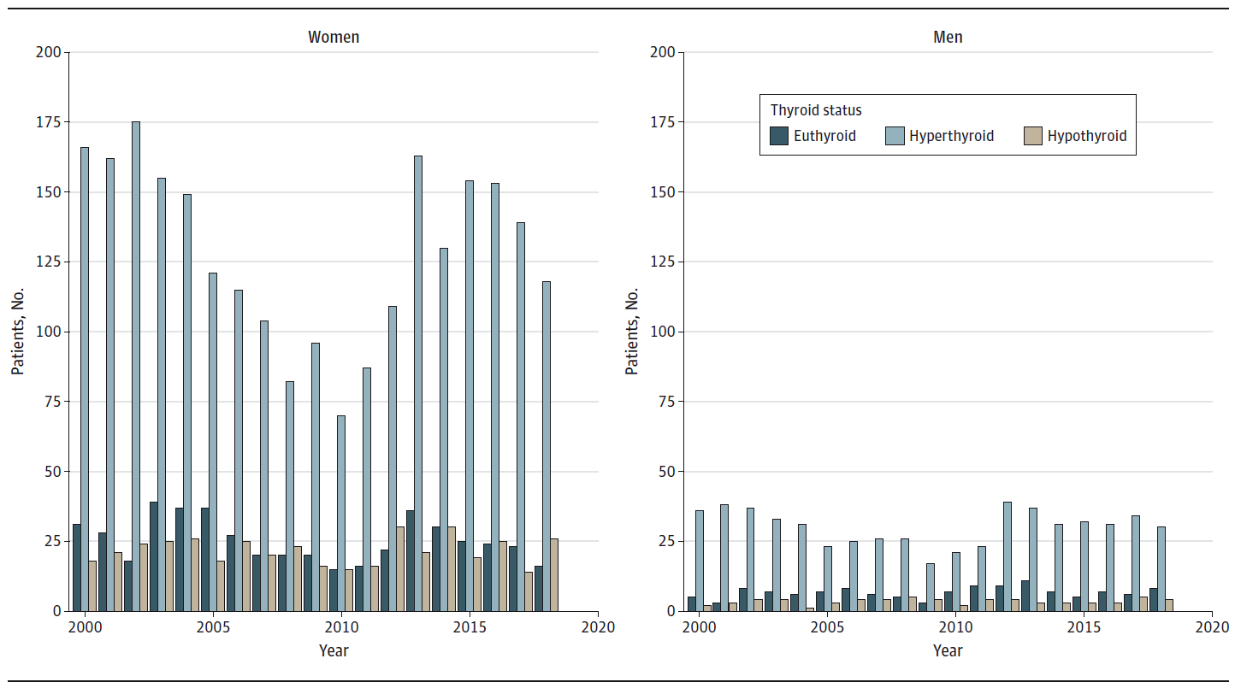
Results
Thyroid Status at Time of Thyroid Eye Disease Diagnosis in Denmark (2000-2018)
The majority of the patients diagnosed with thyroid eye disease were hyperthyroid. The thyroid status proportions did not change over the time studied in either men or women.
At the time of TED diagnosis:
14.9 % Were euthyroid
73.5 % Were hyperthyroid
11.6 % Were hypothyroid

Slide 8
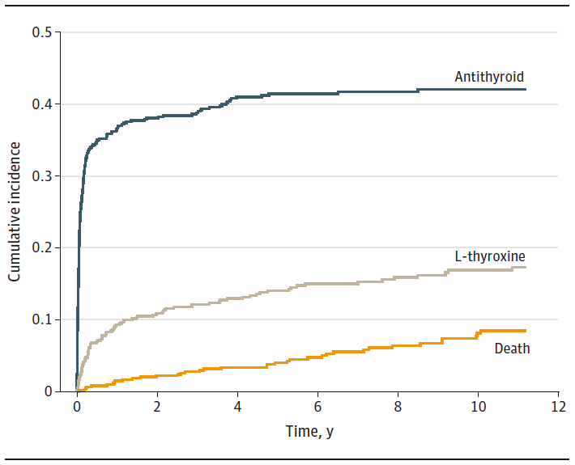
Results
Cumulative Incidence of Patients Who Were Euthyroid
Being Prescribed Thyroid Medication After Thyroid Eye Disease Diagnosis
In this group of patients, there was an increase in prescriptions over the first 2 years after diagnosis, which then stabilized. The 4-year cumulative incidence for redeeming a prescription was 41% for antithyroid medication and 13% for L-thyroxine.

Slide 9
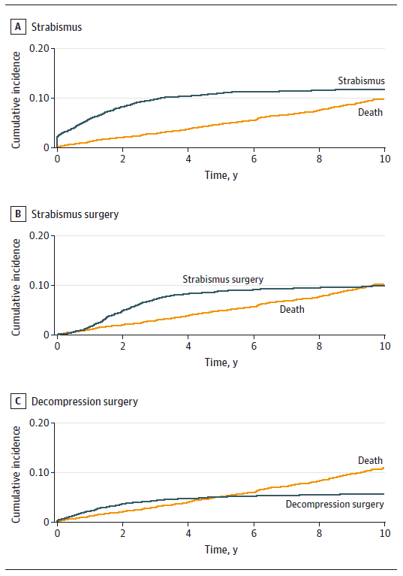
Results
Cumulative Incidence of Strabismus, Strabismus Surgery,
or Orbital Decompression Surgery After Diagnosis of Thyroid Eye Disease
The cumulative incidence of strabismus as an outcome of thyroid eye disease increased to 10% during the first 4 years after diagnosis and then became stable at 12%. The cumulative incidence of strabismus surgery was 8% after 4 years and reached a maximum incidence of 10% after 8 years. The cumulative incidence of decompression surgery was steady at 5% after 4 years.

Slide 10
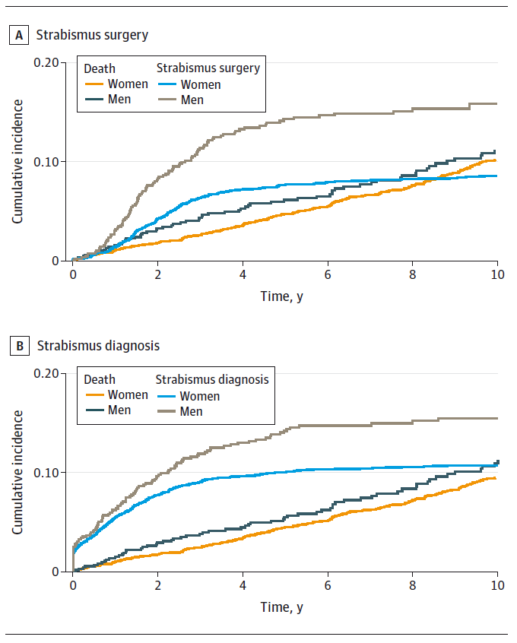
Results
Cumulative Incidence by Sex of Strabismus Surgery or Being Diagnosed
With Strabismus After Thyroid Eye Disease Diagnosis
There was a difference between the sexes in cumulative incidence of strabismus or strabismus surgery, with men having a higher incidence of either (men: 13.3%; 95% CI, 10.75-15.86 vs women: 7.2%; 95% CI, 6.24-8.08; absolute difference: 6.1% [95% CI, 3.42-8.14; P < .001]).

Slide 11
Comment
The national mean annual TED incidence in our study was higher for both women and men than previously reported in other single and multicenter Scandinavian studies (2.7-3.3 per 100 000 person-years for women, 0.5-0.9 per 100 000 person-years for men).
In contrast, it was lower than in a previous study from Minnesota (16/100 000 person-years in women and 2.9/100 000 person-years in men). The Minnesota study had a 4-year cumulative incidence for decompression surgery of 4.3%, which was comparable with our result of 5%.
The cyclical fluctuation of TED over 19 years could be explained by several factors:
  Changes in smoking habits
  Structural changes in the Danish health care system, which led to raised clinical awareness of thyroid eye disease such as implementation of new clinical guidelines, centralization of treatment, and introduction of intravenous treatment with weekly methylprednisolone
This Danish study provides nationwide empirical incidence of TED and strabismus and surgical interventions after TED that required in- or out-patient hospital treatment, which might be used for patient information and health care planning.

Slide 12
Contact Information
If you have questions, please contact the corresponding author:
  Christina Ellervik, MD, PhD, DMSci, MMSci, Harvard Medical School, Department of Laboratory Medicine, Boston Children’s Hospital, Boston, MA 02115 (christina.ellervik@childrens.harvard.edu).
  Funding/Support
This study was funded by the Synoptik Foundation, Ole Kirk’s Fond, Helsefonden, and Mikael Bondum.
Conflict of Interest Disclosures
None reported.

