Slide 1
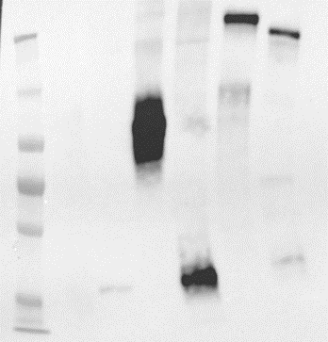
Supplementary images
Figure S1- Western for pp65, IE-1 and gB using LAMP-specific antibody
1
2
3
4
5
6
7
kDa
250
Lanes
1, Molecular weight Marker
2, 293T untransfected, non-deglycosylated
3, 293T untransfected, deglycosylated
4, Human LAMP non-deglycosylated
5, Human LAMP deglycosylated
6, ITI-1001 transfected, non-deglycosylated
7, ITI-1001 transfected, deglycosylated
130
100
70
55
35
25

Slide 2
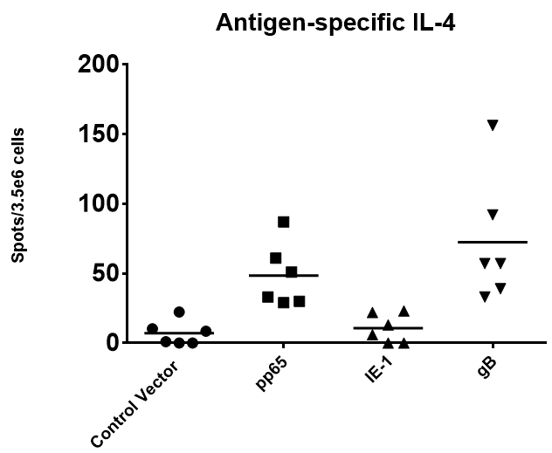
Figure S2- ELISpot data for IL-4
Antigens

Slide 3
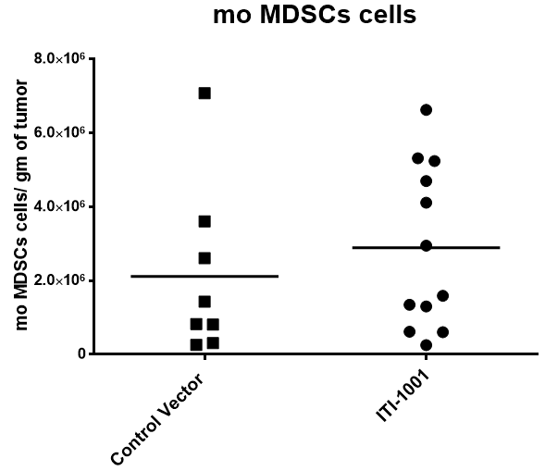
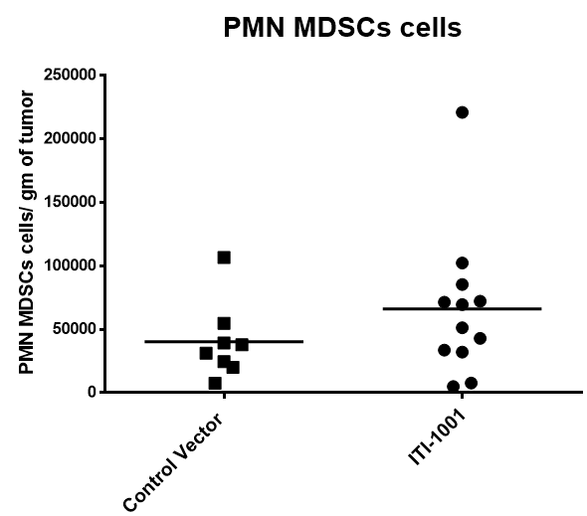
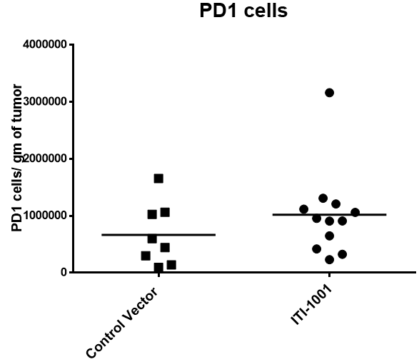
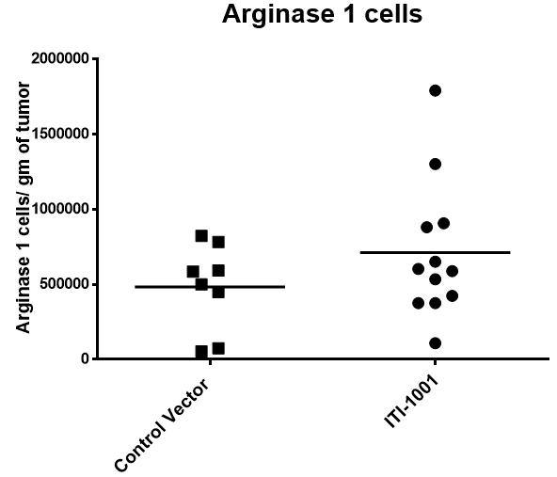
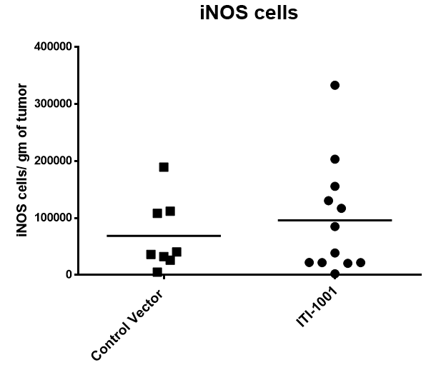
Figure S3- Investigating other immune cells in TME upon ITI-1001 vaccination
A
B
ns
ns
ns
C
ns
ns

Slide 4
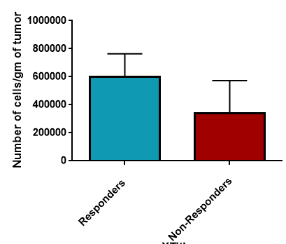
Figure S4- T-reg frequency in responders and non-responders upon ITI-1001 vaccination
p-0.05

Slide 5
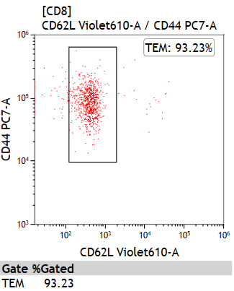
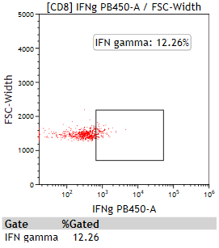
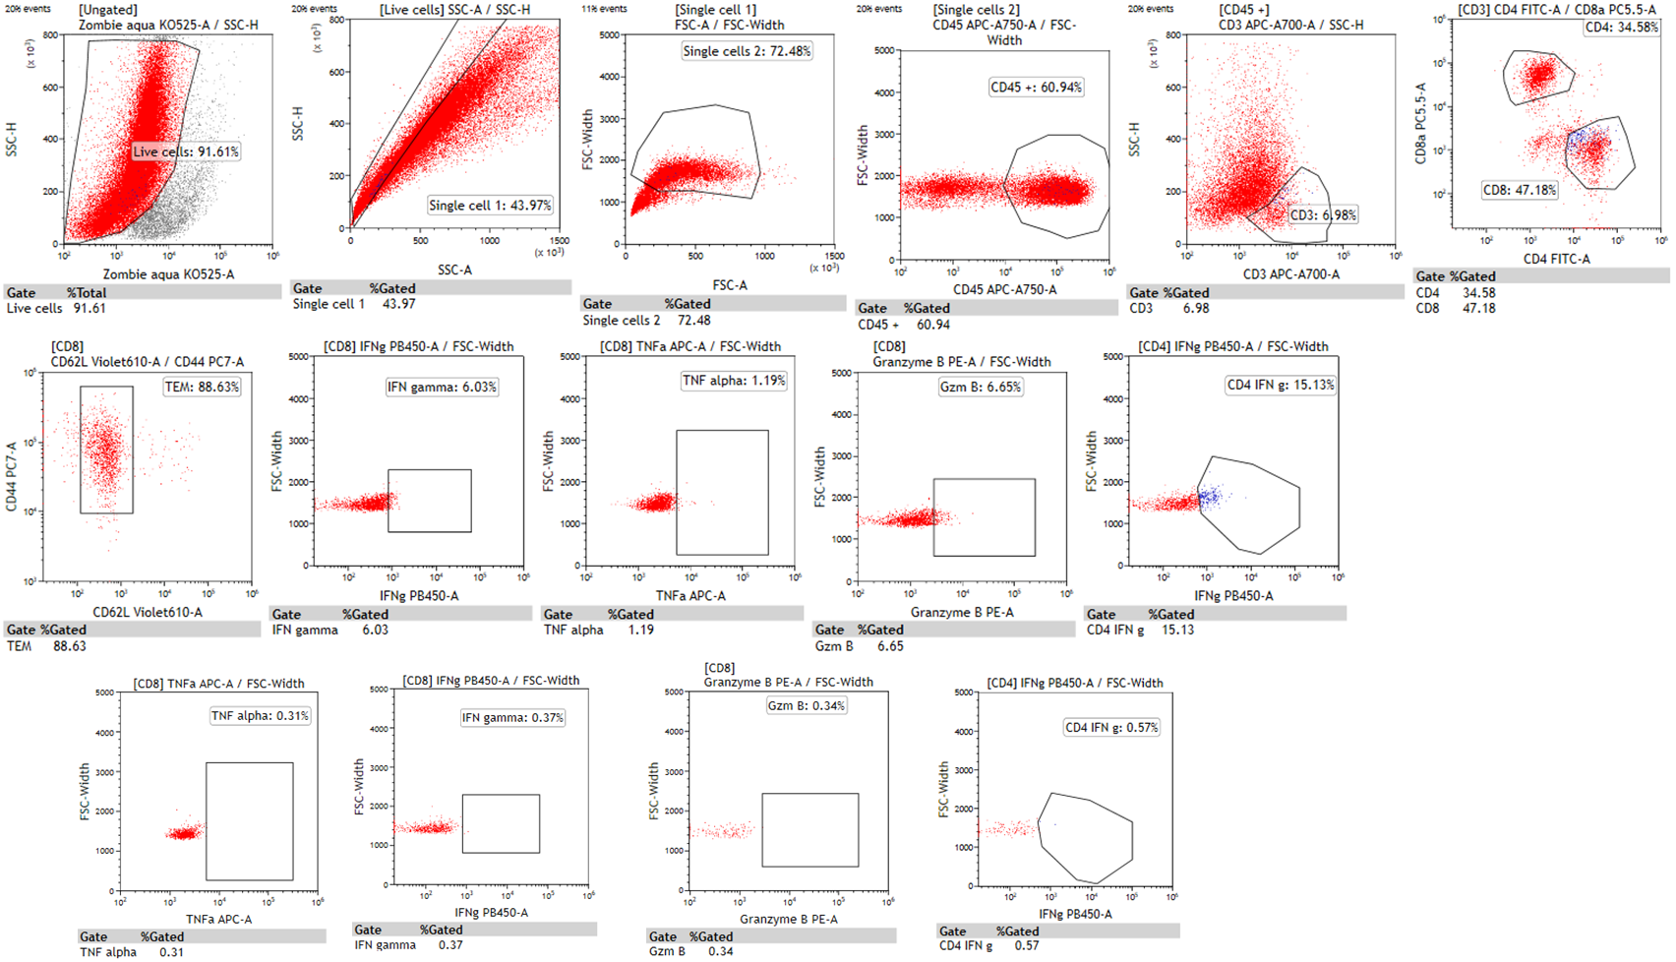
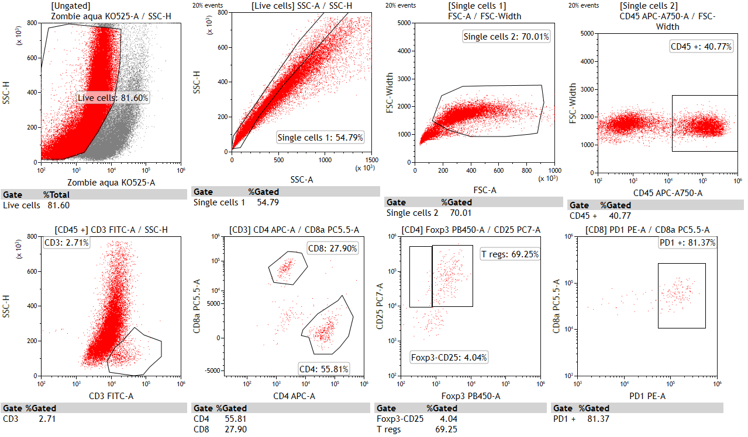
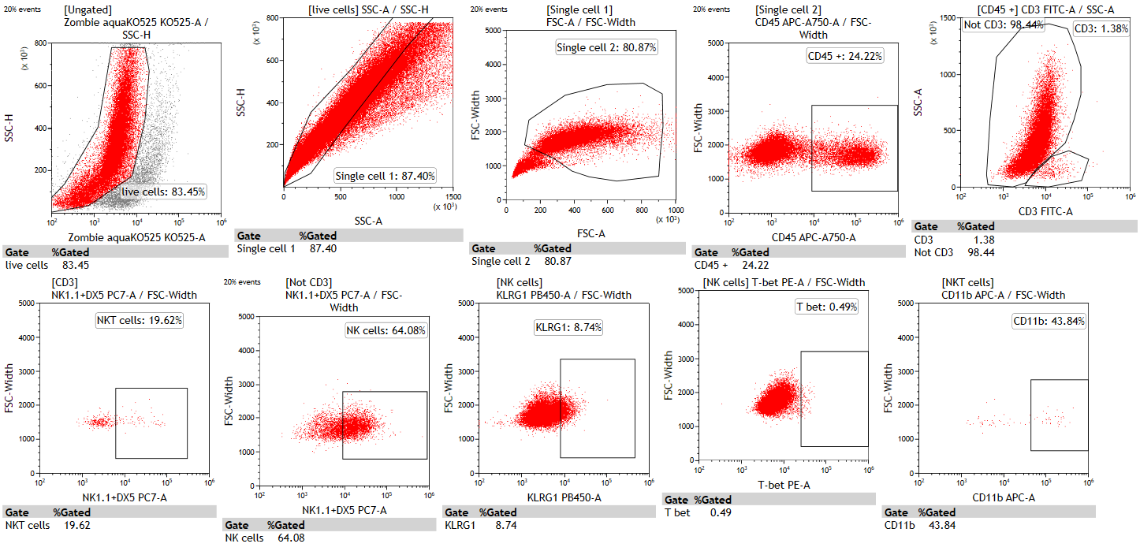
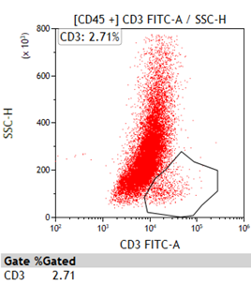
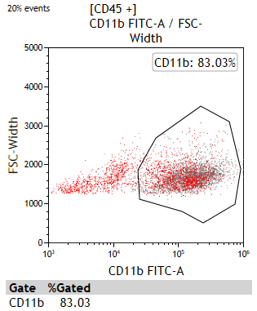
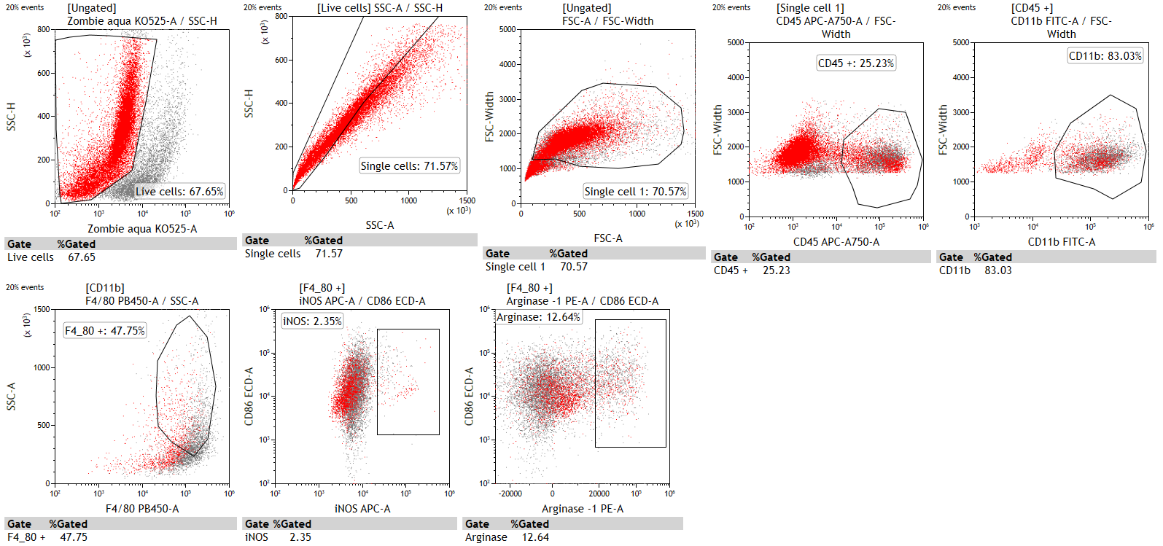
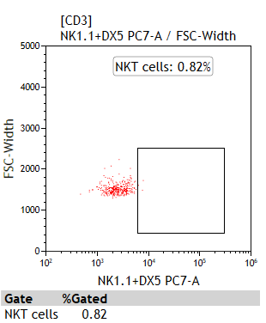
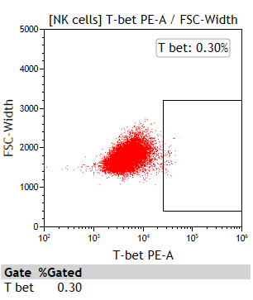
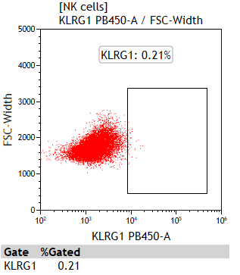
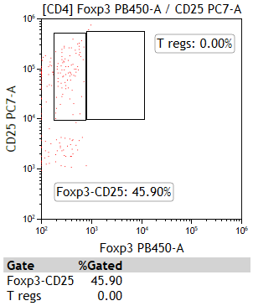
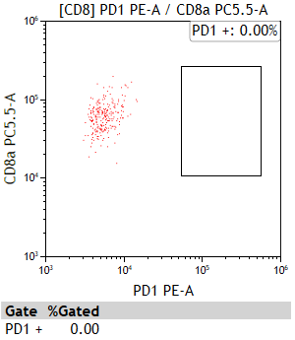
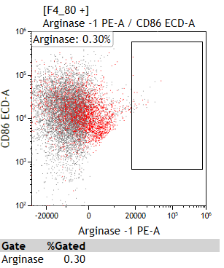
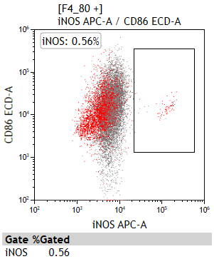
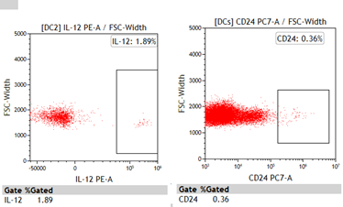
Figure S5- Gating strategy for TME immune cells and FMO control
A Gating strategy
B FMO controls

Slide 6
Table S1. Details of antibodies used in TME Flow cytometry

