Slide 1
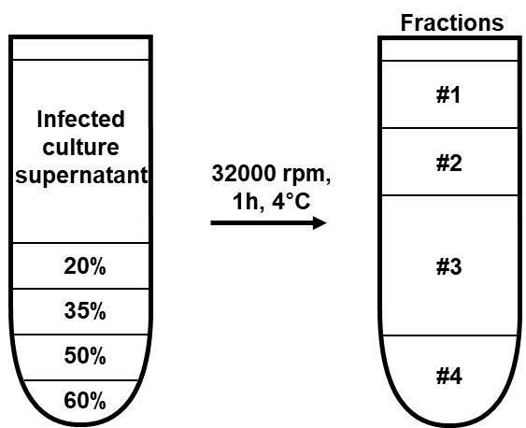
Supplementary Figure 1
a
b
d
c
e
Supplementary Figure 1. Release of viral proteins were detected in cell culture supernatant and influenza virus-infected BALF
MDCK cells were infected with the PR8 virus (103TCID/ml) for 3 days, and then a, cell culture supernatant was separated using sucrose gradient ultracentrifugation. b, Viruses in each fraction were detected by TCID50 assay. c, Viral proteins (HA, NP, M1, PA, PB1, PB2, NS1, NS2, and PB1-F2) were detected in fraction #1 and #4 by ELISA. d, The concentration of NP was determined in #1 and #4. e, Influenza viral proteins (M1, PA, PB1, PB2, NS1, NS2, and PB1-F2) in BALF were detected by ELISA. Data in b-e are presented as the mean ± SD from triplicate culture wells, and data in f are presented as the mean ± SEM. ***p < 0.001, ** p < 0.01, * p < 0.05.

Slide 2
Supplementary Figure 2
a
Supplementary Figure 2. Immune cell recruitment into the lungs following influenza viral infection.
a, Mice (n = 4) were infected with the PR8 virus (32 PFU) and lung cells were collected on days 0, 1, 3, 5, 7, and 9. Neutrophils, monocytes, dendritic cells, CD4+ T cells, CD8+ T cells, and B cells were evaluated by flow cytometry analysis. Data are presented as the mean ± SEM. ***p < 0.001, ** p < 0.01, * p < 0.05.

Slide 3
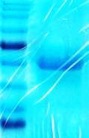


Supplementary Figure 3
a
b
c
d
75 kDa
75 kDa
56 kDa
75 kDa
56 kDa
55 kDa
55 kDa
55 kDa
50ug
SDS PAGE staining
Anti-strep tag
detection
Anti-NP
detection
Supplementary Figure 3. Purification of rNP protein.
rNP was purified from expiCHO cells and it was quality controlled by a, SDS-PAGE, b-c, western blot, and d, endotoxin test.

Slide 4
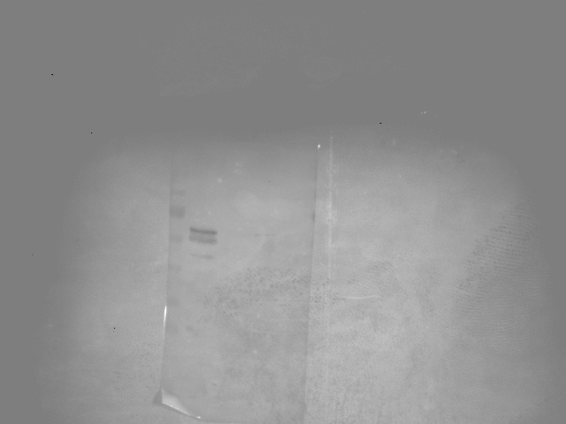

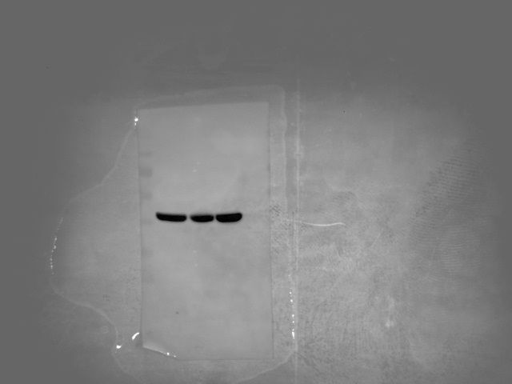
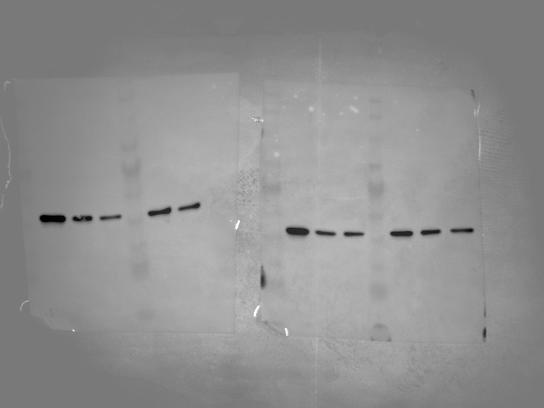
Supplementary Figure 4
b
WT
TLR2 KO
(NP 100 μg/ml)
0 15 30 45 60 120
0 15 30 45 60 120
(min)
pNF-κB (p65)
WT
TLR4 KO
β-actin
TLR2/4 DKO
TLR2/4 DKO
a
TLR2 KO
TLR4 KO
0 15 30 45 60 120
0 15 30 45 60 120
WT
TLR2
WT
TLR4
pNF-κB (p65)
β-actin
β-actin
WT
TLR2/4 DKO
β-actin
0 15 30 45 60 120
0 15 30 45 60 120
pNF-κB (p65)
β-actin
c
Supplementary Figure 4. Extracellular NP induce proinflammatory cytokines in a TLR2 and TLR4 dependent manner.
a, TLR2 or TLR4 were detected by western blotting in WT, TLR2 KO, TLR4 KO, TLR2/4 DKO BMDM. b, WT, TLR2 KO, TLR4 KO, and TLR2/4 double KO (DKO) BMDMs were treated with rNP (100 μg/ml) for 0–120 min, followed by the detection of NF-κB activation by western blotting. c, TLR2 KO, TLR4 KO, and TLR2/4 DKO BMDMs were treated with rNP (12.5–100 μg/ml) for 20 h. After incubation, the cytokine and chemokine levels in the cell culture supernatant were determined by ELISA. Data are presented as the mean ± SD from triplicate culture wells. ***p < 0.001, ** p < 0.01, * p < 0.05.

Slide 5
Supplementary Figure 5
a
b
c
d
THP-1
NP (100 μg/ml)
e
0 15 30 45 60 120 (min)
pNF-κB (p-p65)
pERK
pJNK
pp38MAPK
β-actin
A549
NP (100 μg/ml)
f
0 15 30 45 60 120 (min)
g
pNF-κB (p-p65)
pERK
pJNK
pp38MAPK
β-actin
h
i
Supplementary Figure 5. Internal viral proteins were released from infected cells and extracellular NP induce proinflammatory cytokines through the activation of TLR4 and the NLRP3 inflammasome in human cell lines
THP-1 and A549 cells were infected with the PR8 virus (0.01MOI), and the culture supernatant was filtered using a 50 nm syringe filter. a,b, Viral proteins (HA, NP, M1, PA, PB1, PB2, NS1, NS2, and PB1-F2) were detected in the unfiltered and the filtered supernatant. c, The concentration of NP was determined in the unfiltered and the filtered supernatant. d,f, THP-1 and A549 cells were treated with rNP (100 μg/ml) for 0–120 min and the activation of NF-κB and MAPK family was assessed by western blotting. e,g, THP-1 and A549 cells were treated with rNP (12.5–100 μg/ml) for 20 h. IL-1β and IL-6 levels in the cell culture supernatant were determined by ELISA. h, i, THP-1 cells were treated with a NLRP3 inhibitor (10 μM) or a TLR4 inhibitor (10 μM) for 1 h, and then treated with rNP (100 μg/ml) for 20h. IL-1β or IL-6 levels in the cell culture supernatant were determined by ELISA. Data are presented as the mean ± SD from triplicate culture wells. ***p < 0.001, ** p < 0.01, * p < 0.05, NS, not significant.

Slide 6
Supplementary Figure 6
a
b
c
d
e
Supplementary Figure 6. Increase in viral pathogenicity by pre-treatment of IL-β and IL-6, or co-treatment with trypsin.
a, BMDMs were treated with IL-1β or IL-6 (0.01–10 ng/ml) for 20 h, before ELISA was used to detect trypsin in the cell culture supernatant. b-e, Mice (n = 6) were pretreated intranasally with IL-1β and IL-6 (1–10 ng/mouse), followed by PR8 (32 PFU) infection at day 3 (b, c). Mice were inoculated intranasally with a mixture of PR8 virus (32 PFU) and trypsin (10 μg/ml) (d, e). The body weight and survival rate were monitored for two weeks.

Slide 7
Supplementary Figure 7
a
b
c
d
Supplementary Figure 7. Involvement of TLR4 and the NLRP3 inflammasome in NP-induced pathogenicity.
a-d, WT, TLR2 KO, TLR4 KO, and NLRP3 KO mice (n = 6) were treated intranasally with rNP (10 μg/ml). Three days later, the mice were infected with PR8 virus (32 PFU) and body weight and survival rate were monitored for two weeks.

Slide 8
Supplementary Figure 8
a
b
c
Supplementary Figure 8. Anti-NP serum treatment decreases influenza pathogenesis.
a, PR8 virus was incubated with anti-NP serum for 1 h. MDCK cells were infected with the incubated virus for 72 h, and the virus titer (TCID50) was determined. b, Mice (n = 6) were infected with the PR8 virus (96 PFU), and then anti-NP serum (200 μl/mouse) was administered intraperitoneally daily for three days; the body weight and survival rates were monitored for two weeks. c, Mice (n = 6) were infected with PR8 virus (32 PFU) and then purified IgG, from either naïve or NP-immunized mice (15–240 μg/mouse), was administered daily for three days. The body weight and survival rate were monitored for two weeks. Data are presented as the mean ± SEM.

Slide 9
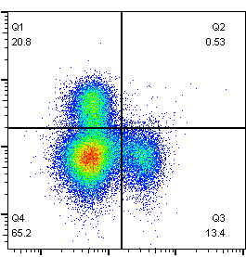
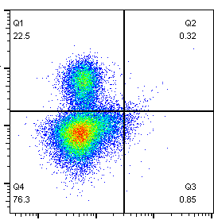
Supplementary Figure 9
Lung
a
10⁵
Isotype
10⁵
Anti-NK 1.1
10⁴
10⁴
CD3
CD3
10³
10³
10²
10²
10²
10³
10⁴
10⁵
10²
10³
10⁴
10⁵
NK 1.1
NK 1.1
b
Supplementary Figure 9. Effect of anti-NP antibodies during influenza viral infection in NK cell-depleted mice
a, NK cells were depleted by intraperitoneal injection of anti-NK1.1 antibody (100 μg). Two days later, NK cell population in the spleen and lung were assessed by flow cytometry. Data are presented as the mean ± SD from triplicate culture wells. b, Two days later, mice (n=16) were infected with PR8 virus (32 PFU) and then intraperitoneally treated with anti-NP serum (200 μl/mouse) daily for three days; body weight was monitored for two weeks. ***p < 0.001 and *p < 0.05.

