Slide 1
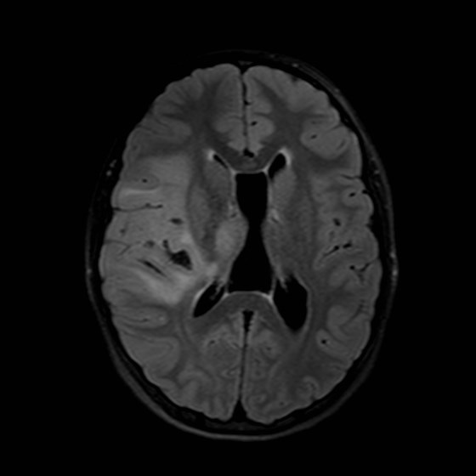
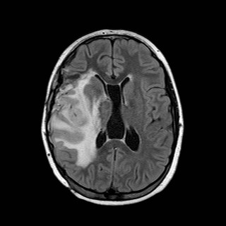
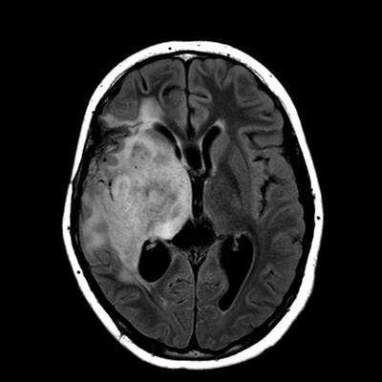
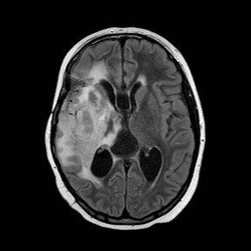
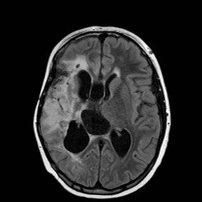
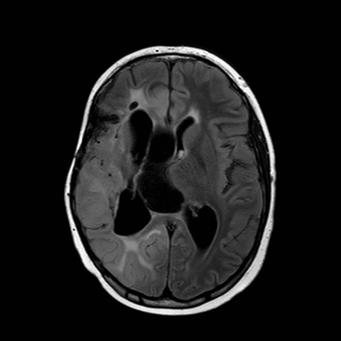
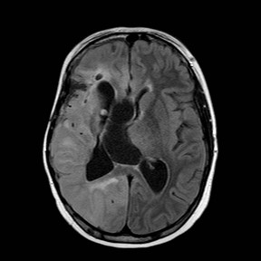
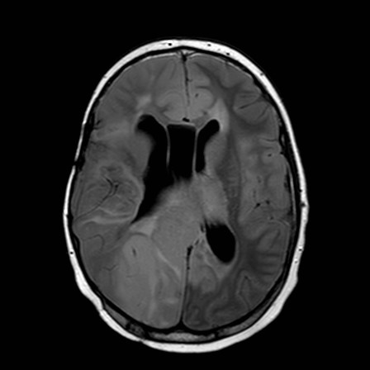
Supplemental Figure 1: Radiographic FLAIR changes in the tumor over the entire treatment course
Diagnosis
4 months after diagnosis, post radiation, radiographic progression, started on bevacizumab /irinotecan/ temozolomide
11 months after diagnosis, radiographic progression
started procarbazine,
lomustine, vincristine (PCV)
15 months after diagnosis
Further radiographic progression,
started erlotinib/ rapamycin
38 months after diagnosis, decreased tumor bulk, still on erlotinib/rapamycin
48 months after diagnosis, further decreased tumor bulk, still on erlotinib/ rapamycin
51 months after diagnosis, radiographic progression, stopped erlotinib, surgical re-biopsy started trametinib with rapamycin
61 months after diagnosis, last MRI obtained prior to death, showing additional radiographic progression

