Slide 1

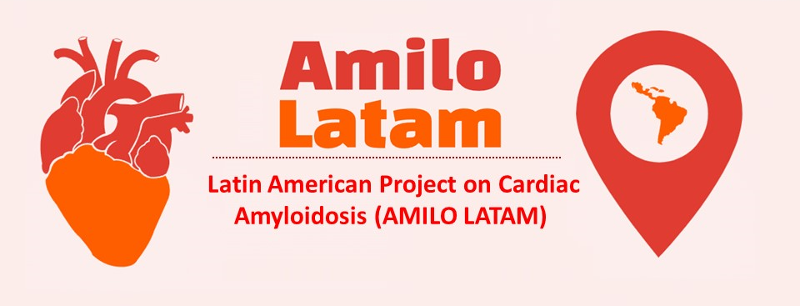


Cardiac amyloidosis in Latin America: Gaps and opportunities to increase awareness of the disease.
Findings from the AMILO-LATAM research group
Journal of Nuclear Cardiology | Official Journal of the American Society of Nuclear Cardiology
Fernando Mutª, Isabel Carvajal^{b,c}, Jorge Camilletti^{d}, Juan Erriest^{d},
Erick Alexanderson^{b,e,f}, Gabriel Grossman^{g,h}
a) Nuclear Medicine Service, Italian Hospital, Montevideo, Uruguay. b) National Institute of Cardiology Ignacio Chavez, Mexico City, Mexico. c) Hospital de Cardiologia, Centro Medico Nacional SXXI, Mexico City, Mexico. d) Nuclear Medicine Service, Italian Hospital, La Plata, Argentina. e) Universidad Nacional Autonoma de Mexico, PET/CT Unit, Faculty of Medicine, Mexico City, Mexico. f) Universidad Nacional Autonoma de Mexico, Department of Physiology, Faculty of Medicine, Mexico City, Mexico. g) Nuclear Medicine Department, Moinhos de Vento Hospital, Porto Alegre, Brazil. h) Cardionuclear Clinic, Porto Alegre, Brazil
Copyright American Society of Nuclear Cardiology

Slide 2
BACKGROUND
Journal of Nuclear Cardiology | Official Journal of the American Society of Nuclear Cardiology
1-Cardiac amyloidosis (CA) is an under-diagnosed disease presenting as a restrictive cardiomyopathy with high morbidity and mortality.
2- Wild-type transthyretin amyloid cardiomyopathy (ATTR-CM) is mostly seen in elderly patients, with increasing prevalence as life expectancy is growing.
3- New diagnostic imaging techniques and novel treatments allow for a better prognosis, but lack of clinical awareness and timely diagnosis is still common and delays appropriate management.
4. In this regard, we have recently created an international working group on CA (AMILO-LATAM) composed by cardiac imaging specialists from different Latin American countries, aiming to identify potential needs in technical resources, training and education.
Copyright American Society of Nuclear Cardiology

Slide 3
METHODS
Journal of Nuclear Cardiology | Official Journal of the American Society of Nuclear Cardiology
Study type: Cross-sectional/observational study.
  Anonymous questionnaires were managed via Google Forms.
  Links to the surveys were distributed by E-mail, Whatsapp, Facebook, and Twitter.
Study subjects:
  Two on-line surveys were distributed among clinicians and cardiac imaging professionals, respectively; one asking about awareness of CA and in different clinical scenarios (10 questions), the other about the availability of diagnostic techniques and studies performed (5 questions).
Study endpoints:
  Our purpose was to investigate the knowledge of clinicians regarding
  ATTR-CM and to assess the availability of imaging resources in the Latin
  American region.
Copyright American Society of Nuclear Cardiology

Slide 4
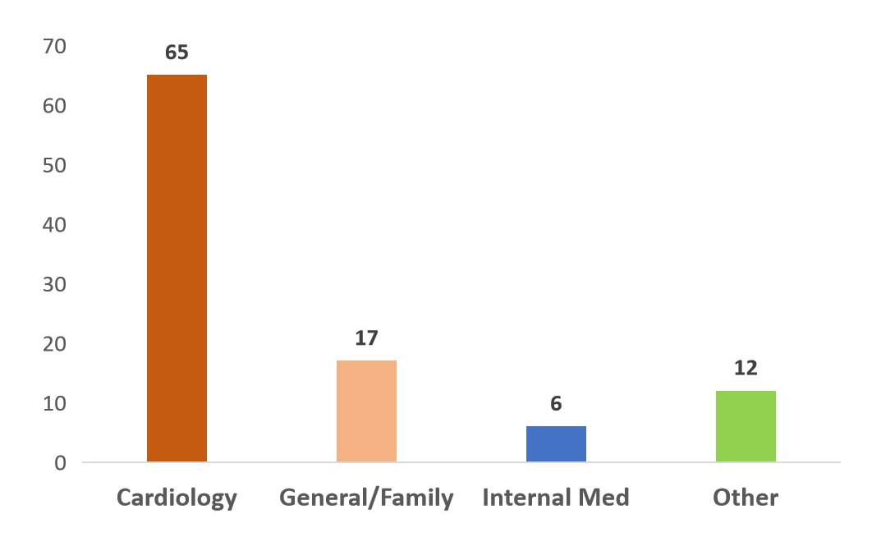
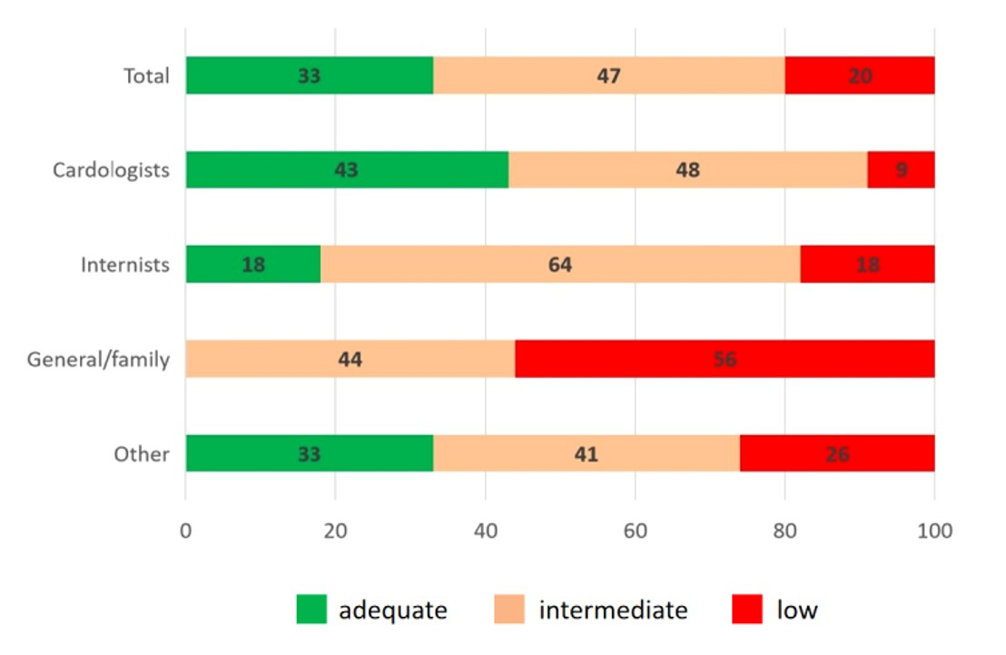
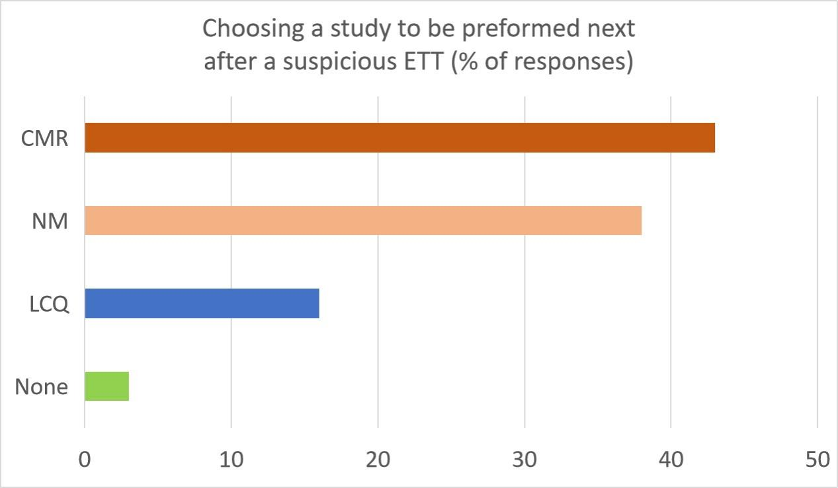
RESULTS
Journal of Nuclear Cardiology | Official Journal of the American Society of Nuclear Cardiology
1
2
3
Fig. 1. Percentage of responders according to medical specialty (n=406).
Fig. 2. Degree of knowledge about CA considering total responses and by specialty (expressed in % of total for each category).
Fig. 3. Distribution of responses for the single most appropriate test to be performed after CA is suspected by ETT results.
Copyright American Society of Nuclear Cardiology

Slide 5
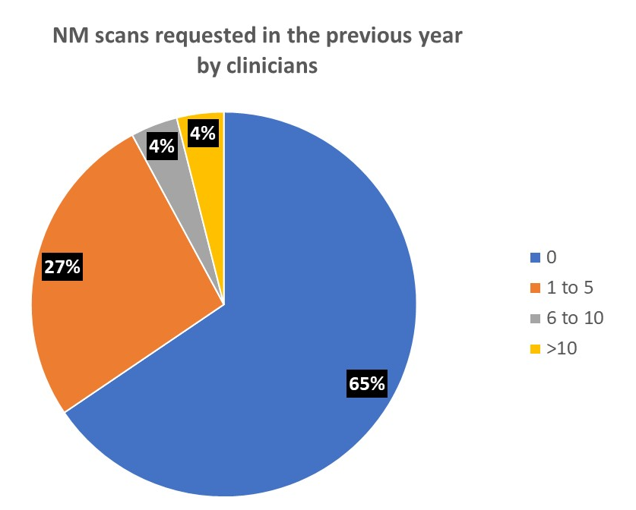
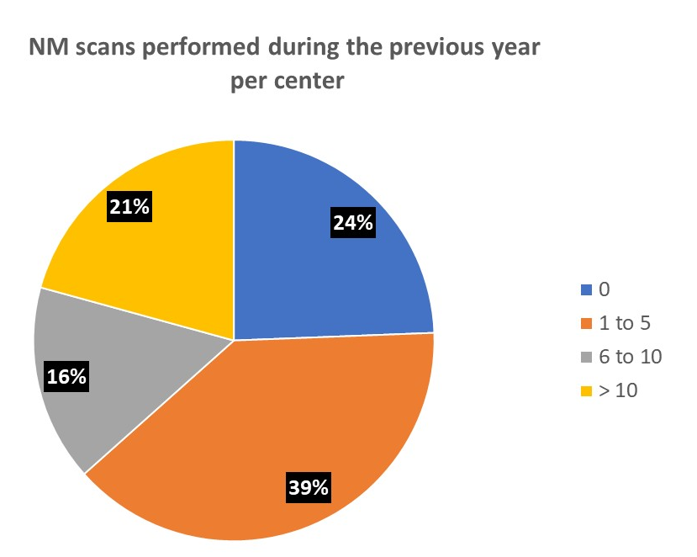
RESULTS
Journal of Nuclear Cardiology | Official Journal of the American Society of Nuclear Cardiology
Fig. 4 NM scans requested during the previous year, expressed as percentage of total responding physicians accross all categories
Fig. 5 NM scans performed during the previous year, expressed as percentage of total responding centers
Copyright American Society of Nuclear Cardiology

Slide 6
CONCLUSIONS
Journal of Nuclear Cardiology | Official Journal of the American Society of Nuclear Cardiology
The surveys demonstrated the need for educational programs and other measures to increase clinical awareness and early detection of CA, so patients receive timely treatment and management of the disease.
Copyright American Society of Nuclear Cardiology

