Slide 1
A single allele of the hsa-miR-302/367 cluster maintains human pluripotent stem cells
Tohru Sugawara, Yuki Kawamoto, Tomoyuki Kawasaki, Akihiro Umezawa, Hidenori Akutsu*
Center for Regenerative Medicine, National Center for Child Health and Development (NCCHD), Tokyo, 157-8535, Japan
*Correspondence:
H Akutsu, Department of Reproductive Medicine, Center for Regenerative Medicine, National Center for Child Health and Development (NCCHD), Okura 2-10-1, Setagaya, Tokyo, 157-8535, Japan, Tel: +81-3-5494-7047, Fax: +81-3-5494-7048, E-mail: akutsu-h@ncchd.go.jp

Slide 2
Supplemental table
List of primer sequences

Slide 3

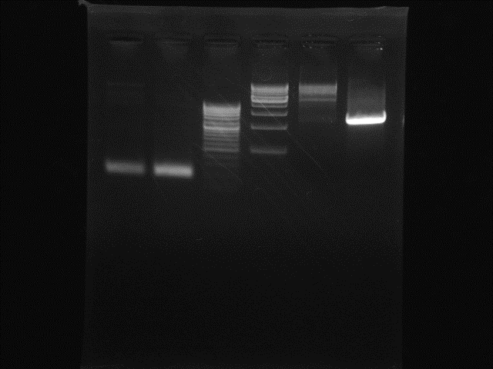
Supplemental figure 1
GTCCCTGCCTTTTACCCTTCTGG
PAM
GAAGCTCTCCGTTAAGACATGGG
PAM
302/367
promoter
302c
302d
c
a
302b
302a
b
367
LHA
EGFP
d
Poly(A) signal
RHA
Donor Vector
Primer a/b
Primer c/d
1500 bp
500 bp
wt-type
hetKO
wt-type
hetKO

Slide 4
Supplemental figure 2
■ wild-type
■ hetKO
Relative expression to wild-type

Slide 5
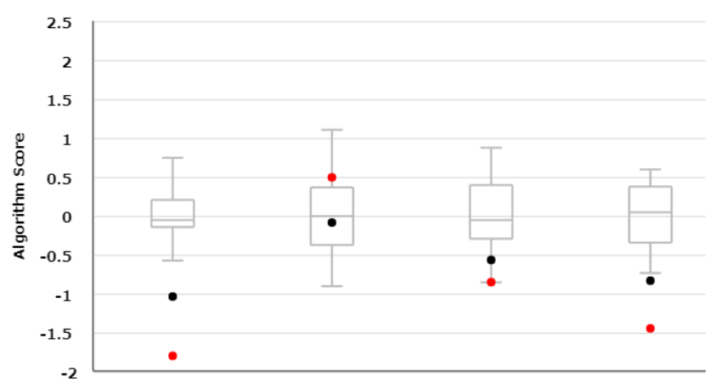
Supplemental figure 3
A
Classification
Gene
EBs
wild-type
hetKO
Classification
Gene
EBs
wild-type
hetKO
B
●wild-type
●hetKO
Self-renewal
Ectoderm
Mesoderm
Endoderm

