Slide 1
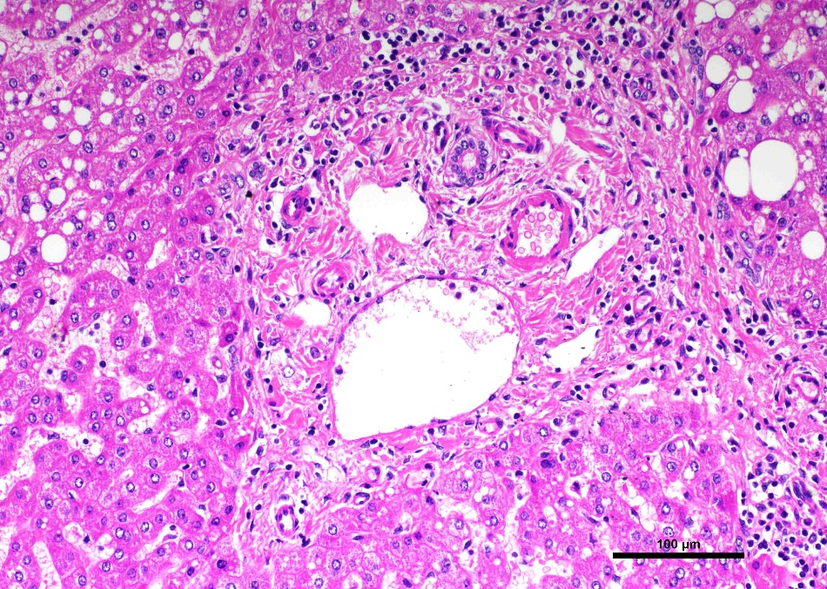
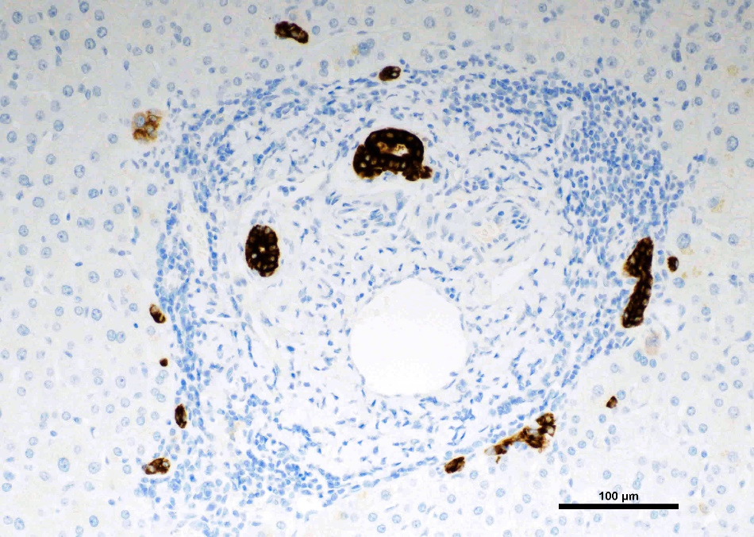
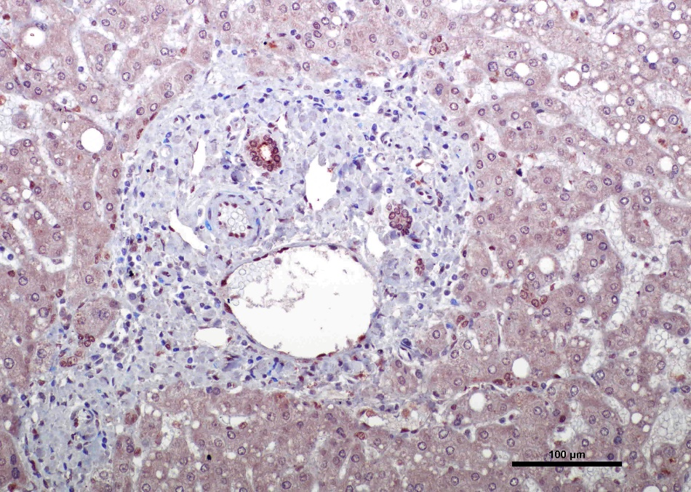
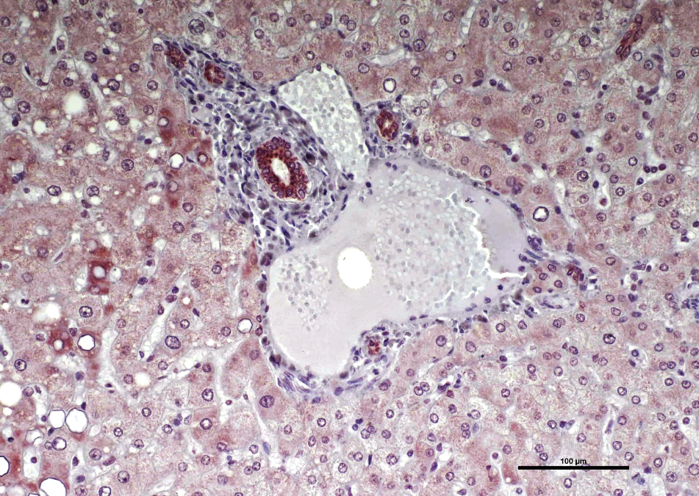
H&E
CK19
TAZ
p-TAZ

Slide 2
Supplementary Figure 11. TAZ immunolocalization in the normal liver. Representative immunohistochemical patterns of TAZ and phosphorylated/inactivated (p)-TAZ in the normal liver. Robust nuclear and/or cytoplasmic TAZ and p-TAZ immunoreactivity characterizes normal biliary cells (indicated by arrows), whereas weak/medium cytoplasmic staining occurs in hepatocytes for the same proteins. CK19 was used as a biliary marker. Identical patterns were detected in non-tumorous surrounding livers. Original magnification: 200x; scale bar: 100 μm. Abbreviations: H&E, hematoxylin and eosin staining.

