Slide 1
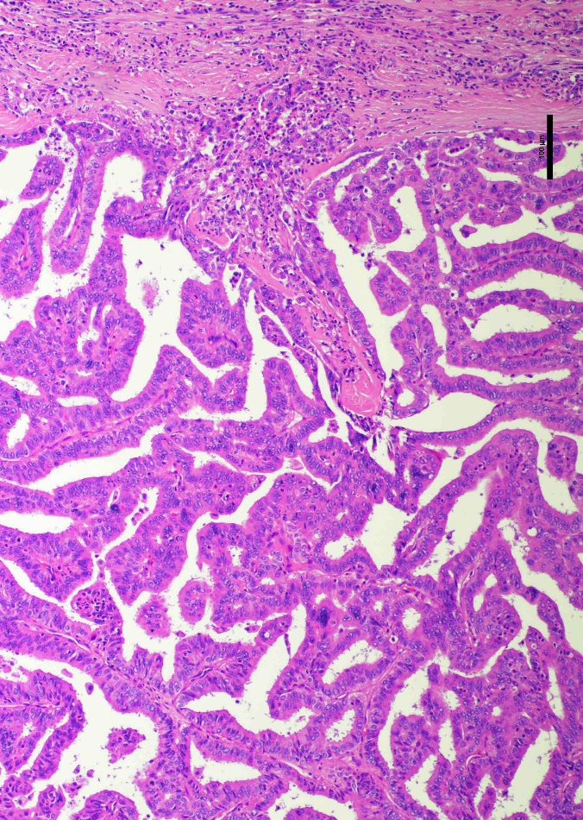
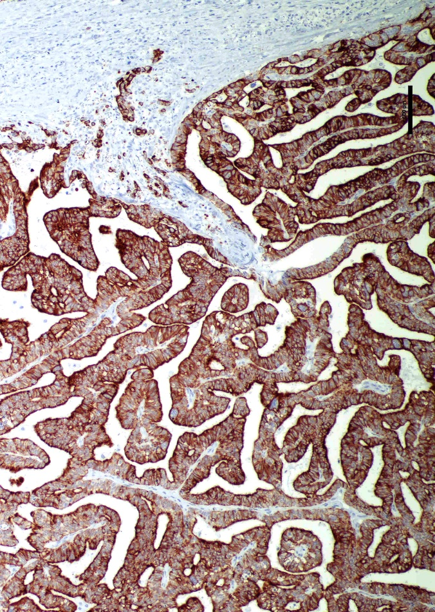
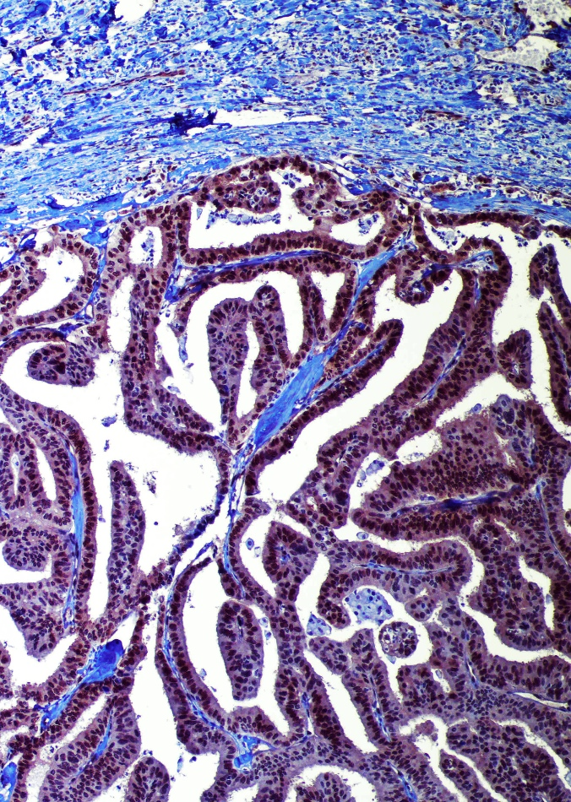
H&E
CK19
TAZ

Slide 2
Supplementary Figure 12. TAZ activation in human intrahepatic cholangiocellular preinvasive lesions. Representative immunohistochemical patterns of TAZ protein in a cholangiocellular preinvasive lesion (an intra-ductal papillary biliary neoplasms or IPBN is depicted here). The lesion displays a strong nuclear and cytoplasmic TAZ immunoreactivity. CK19 was used as a biliary marker. Original magnification: 200x; scale bar: 100 μm. Abbreviations: H&E, hematoxylin and eosin staining.

