Slide 1
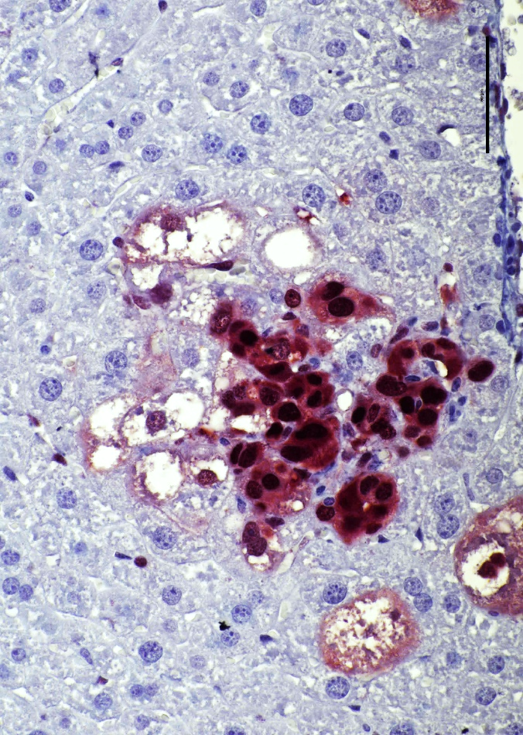
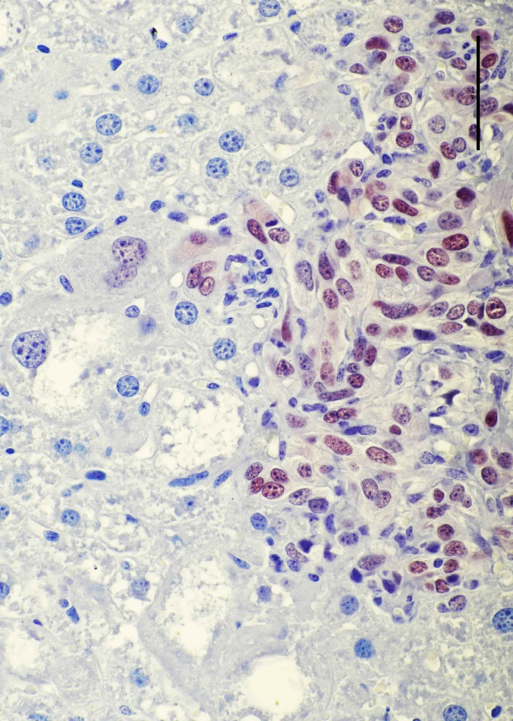
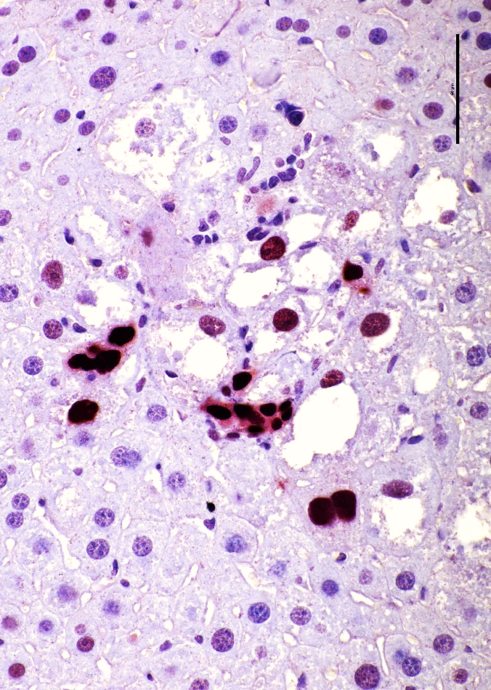
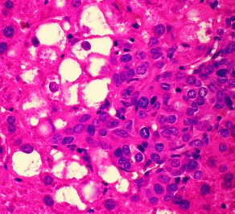
TAZ 1:200
TAZ 1:2000
SOX9
A
B
C
Supplementary Figure 1. Molecular characterization of AKT/TAZ focal lesions. (A) Representative immunohistochemical features of an AKT/TAZ focal lesion displaying stronger nuclear TAZ immunoreactivity in the small cells (indicated by black arrows) compared with lipid-rich large cells (red arrows). (B) Staining differences for nuclear TAZ in the small and large cell clusters are even more evident by diluting the anti-TAZ antibody up to 1:2000). (C) The small cell cluster also shows the most pronounced nuclear immunoreactivity for the NOTCH effector SOX9, a pivotal player in hepatocyte conversion into biliary cells. The inset in (A) shows the hematoxylin and eosin staining of the focal lesion. Original magnification: 400x; scale bar: 50 µm.

