Slide 1
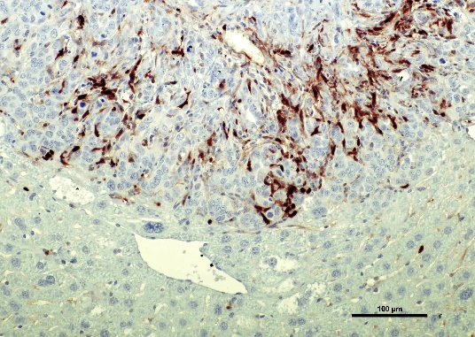
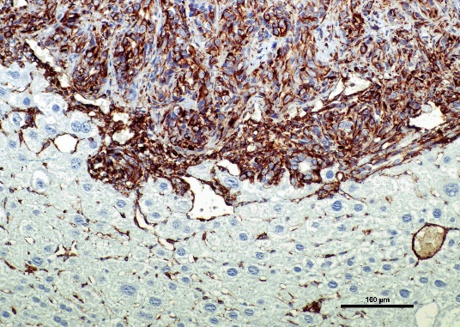
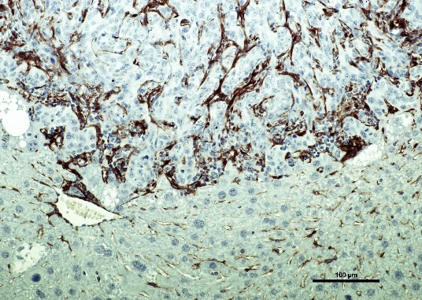
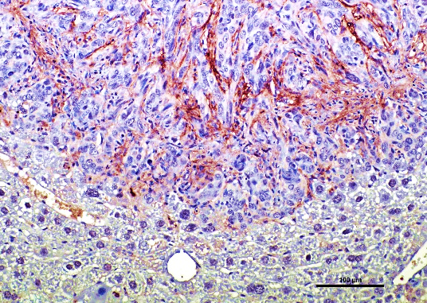
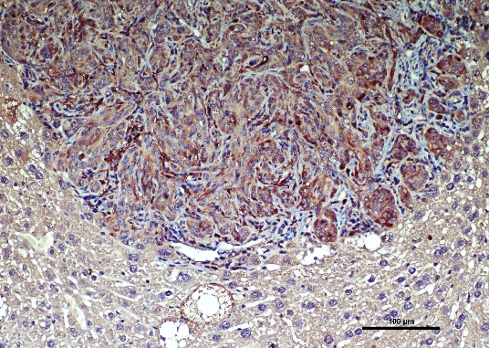
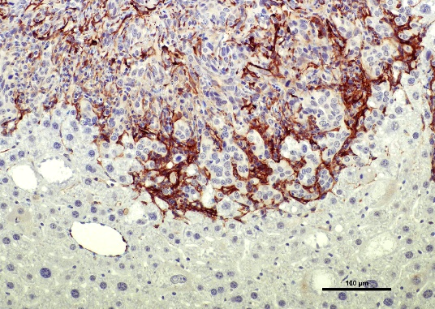
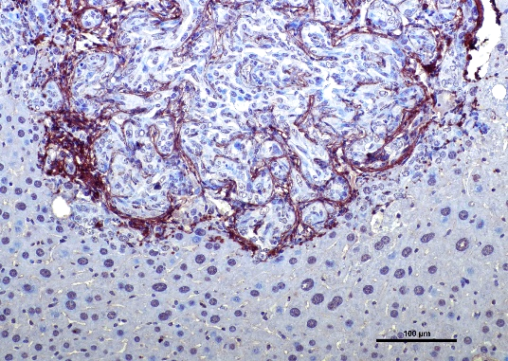
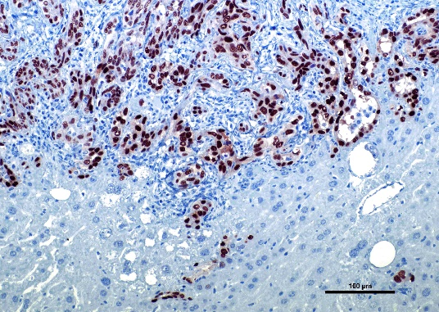
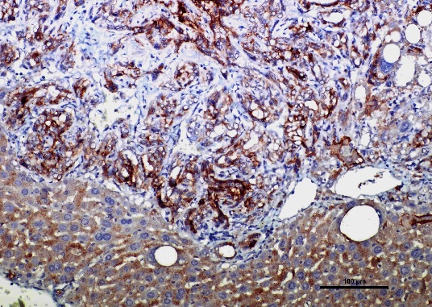
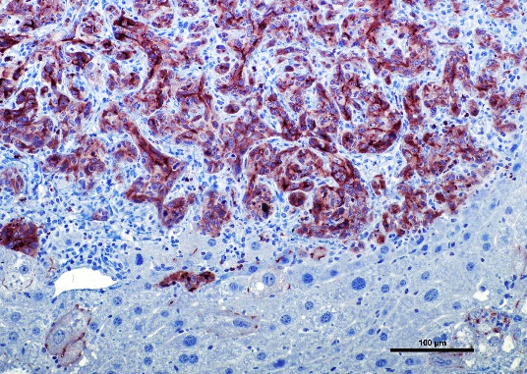
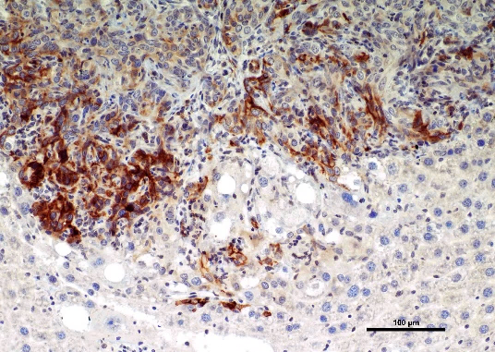
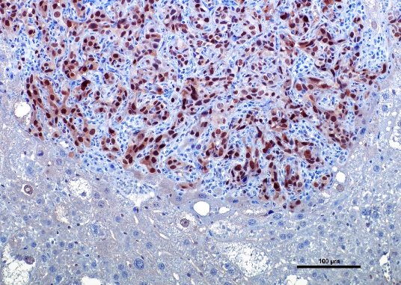
S100A4
VIM
PDGFR-β
POSTN
OPN
α-SMA
HYP
SOX9
CD44v6
CD133
EPCAM
YAP

Slide 2
Supplementary Figure 2. Molecular characterization of AKT/TAZ advanced cholangiocellular lesions. Representative immunohistochemical features of an AKT/TAZ intrahepatic cholangiocarcinoma (same tumor as in Figures 4 and 5) showing robust immunoreactivity for markers of desmoplasia and collagen deposition (S100A4, VIM, PDGFR-β, POSTN, OPN, α-SMA, hydroxyproline or HYP) and stemness (SOX9, CD133, and EPCAM). In addition, strong nuclear immunolabeling for the TAZ paralog YAP was detected in the same lesions. Original magnification: 200x; scale bar: 100 µm.

