Slide 1
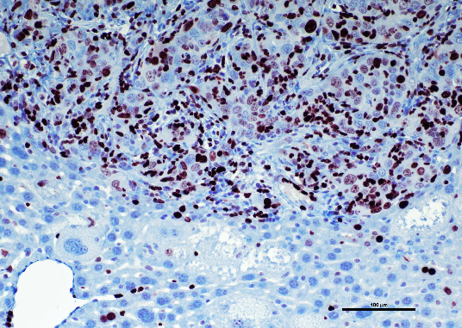
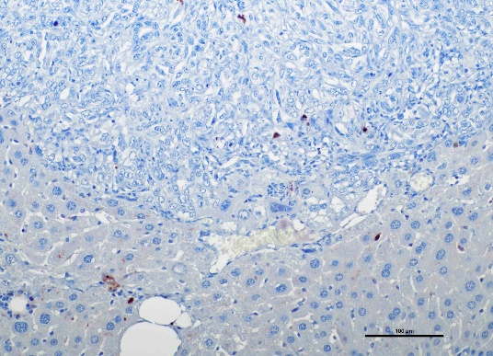
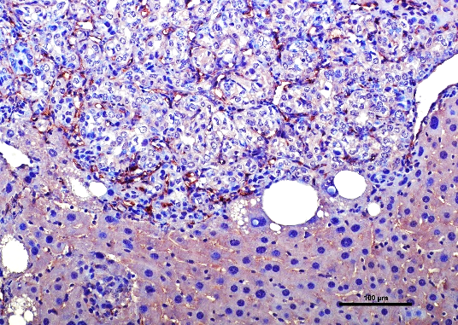
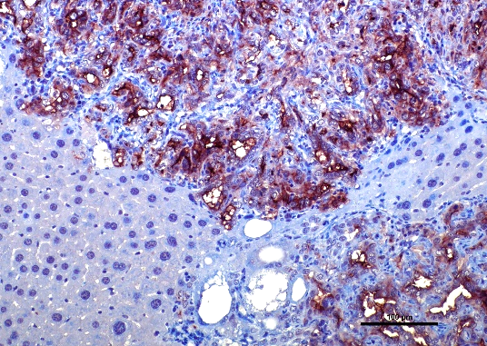
Ki67
Cl. Casp. 3
CD34
PDPN
Supplementary Figure 3. Molecular characterization of advanced AKT/TAZ cholangiocellular lesions. Representative immunohistochemical features of an AKT/TAZ intrahepatic cholangiocarcinoma (same tumor as in Figures 4 and 5) showing robust immunoreactivity for markers of proliferation (Ki67), angiogenesis (CD34), and lymphangiogenesis (PDPN). Intratumoral immunolabeling for cleaved caspase 3 was low (arrows indicate apoptotic cells within the neoplasm), indicating low levels of apoptosis. Original magnification: 200x; scale bar: 100 µm.

