Slide 1





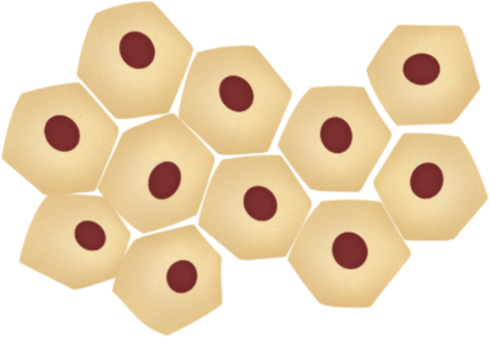






















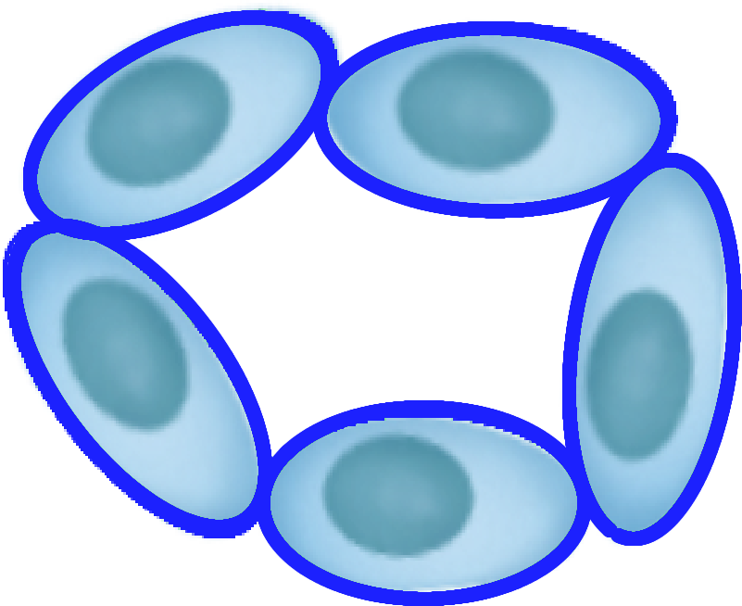
R26R-EYFP liver
AAV-TBG-Cre injection
iCCA formation
and progression
Early stage iCCA lesions
HTVi of AKT-HA / TAZ
Malignant transdifferetiation
iCCA development
HNF4a (+), CK19 (-) hepatocytes
Hepatocytes are marked with EYFP (red fluorescence), while the normal cholangiocytes remain unmarked.
HTVi transfects AKT and TAZ plasmids into some of the EYFP (+) hepatocytes (yellow stars). Normal cholangiocytes do not receive the plasmids.
AKT/TAZ transfection into EYPF (+) mature hepatocytes results in CK19 induction (CK19 +) in these cells, which aquire various malignant properties. Normal cholangiocytes
are unaffected.
The EYFP (+), CK19 (+) malignant hepatocytes evolve into iCCA. Normal cholangiocytes are unaffected.
HNF4a (-), CK19 (+) cholangiocytes
Normal cholangiocytes
Normal cholangiocytes
Normal cholangiocytes
Normal cholangiocytes
Normal cholangiocytes
Supplementary Figure 6. Schematic representation of the lineage tracing method used in the study. Abbreviation: HTVi, hydrodynamic tail vein injection.

