Slide 1
A.
B.
Proportion Alive
Proportion Progression-Free
Overall Survival (Months)
N Event Censored Median OS (95% CI) 1-Year OS (90% CI)
45 36 (80%) 9 (20%) 11.47 (7.86, 15.22)) 0.46 (0.33, 0.58)
Progression-free Survival (Months)
N Event Censored Median PFS (95% CI) 1-Year PFS (90% CI)
45 39 (87%) 6 (13%) 3.35 (2.56, 7.13) 0.19 (0.10, 0.29)
Supplementary Figure 2. A) one-year progression free survival (PFS) and B) one-year overall survival (OS) estimate using Kaplan-Meier Method for patients in Cohort A only. C) one-year PFS and D) one-year OS estimate using Kaplan-Meier Method for patients in Cohort B only. E) PFS and F) OS comparison between p16-positive and p16-negative patients (N=43) in Cohort B only. G) PFS and H) OS comparison between patients with programed cell death ligand 1 (PD-L1) combined positive score (CPS) <1, 1-19, and ≥20 (N=40) in Cohort B only.

Slide 2
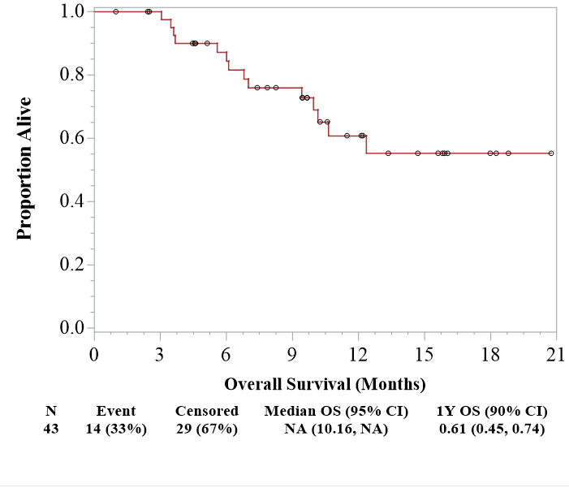
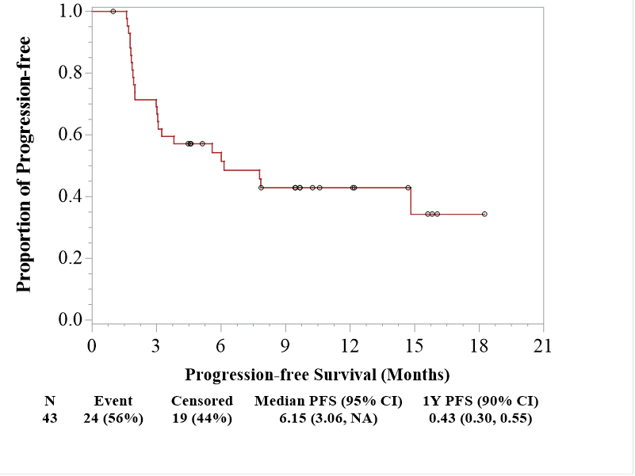
Supplementary Figure 2.
Chung, et al.
C.
D.
Proportion Alive
Proportion Progression-Free
Overall Survival (Months)
N Event Censored Median OS (95% CI) 1-Year OS (90% CI)
43 14 (33%) 29 (67%) NA (10.16, NA) 0.61 (0.45, 0.74)
Progression-free Survival (Months)
N Event Censored Median PFS (95% CI) 1-Year PFS (90% CI)
43 24 (56%) 19 (44%) 6.15 (3.06, NA) 0.43 (0.30, 0.55)

Slide 3
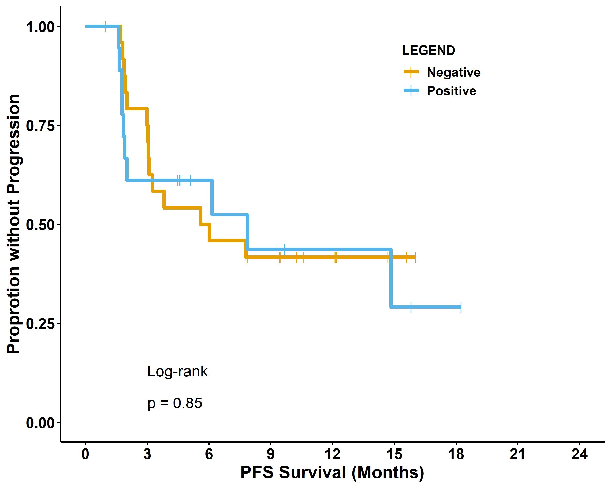
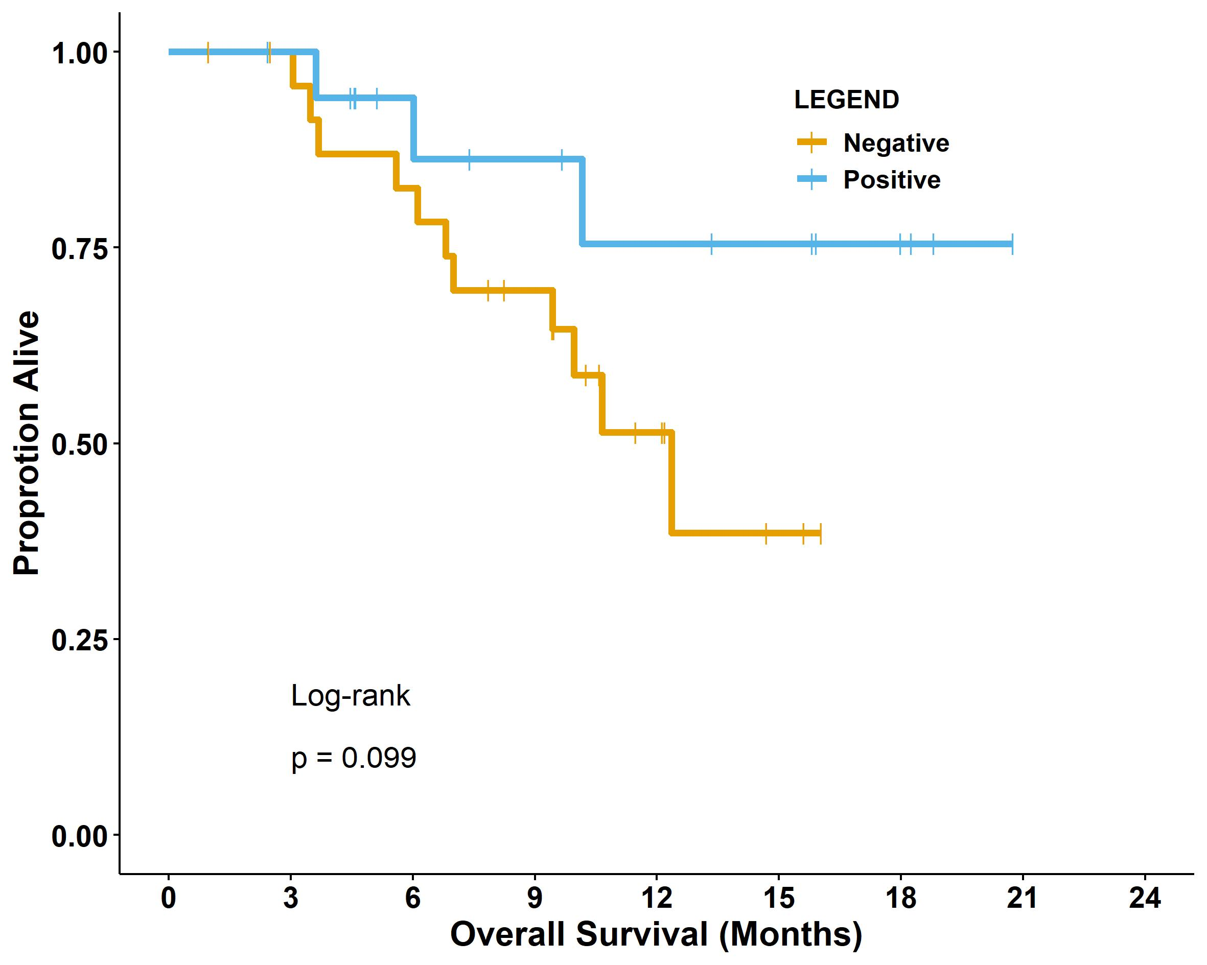
Supplementary Figure 2.
Chung, et al.
E.
F.

Slide 4
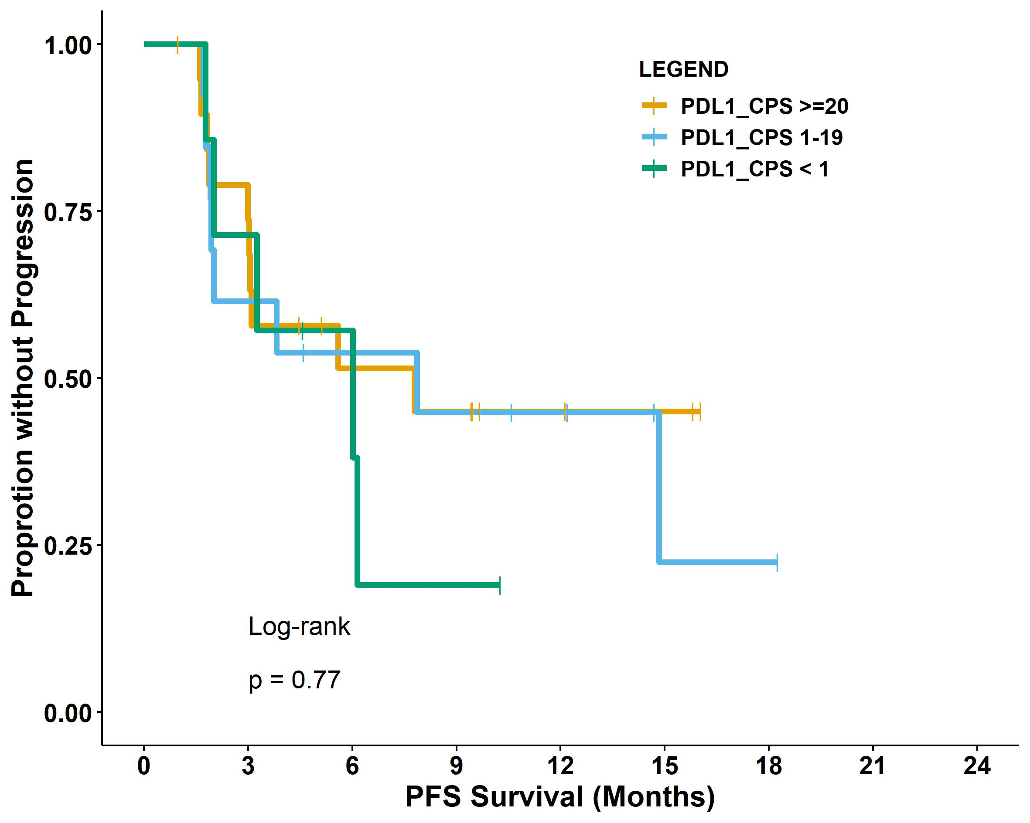
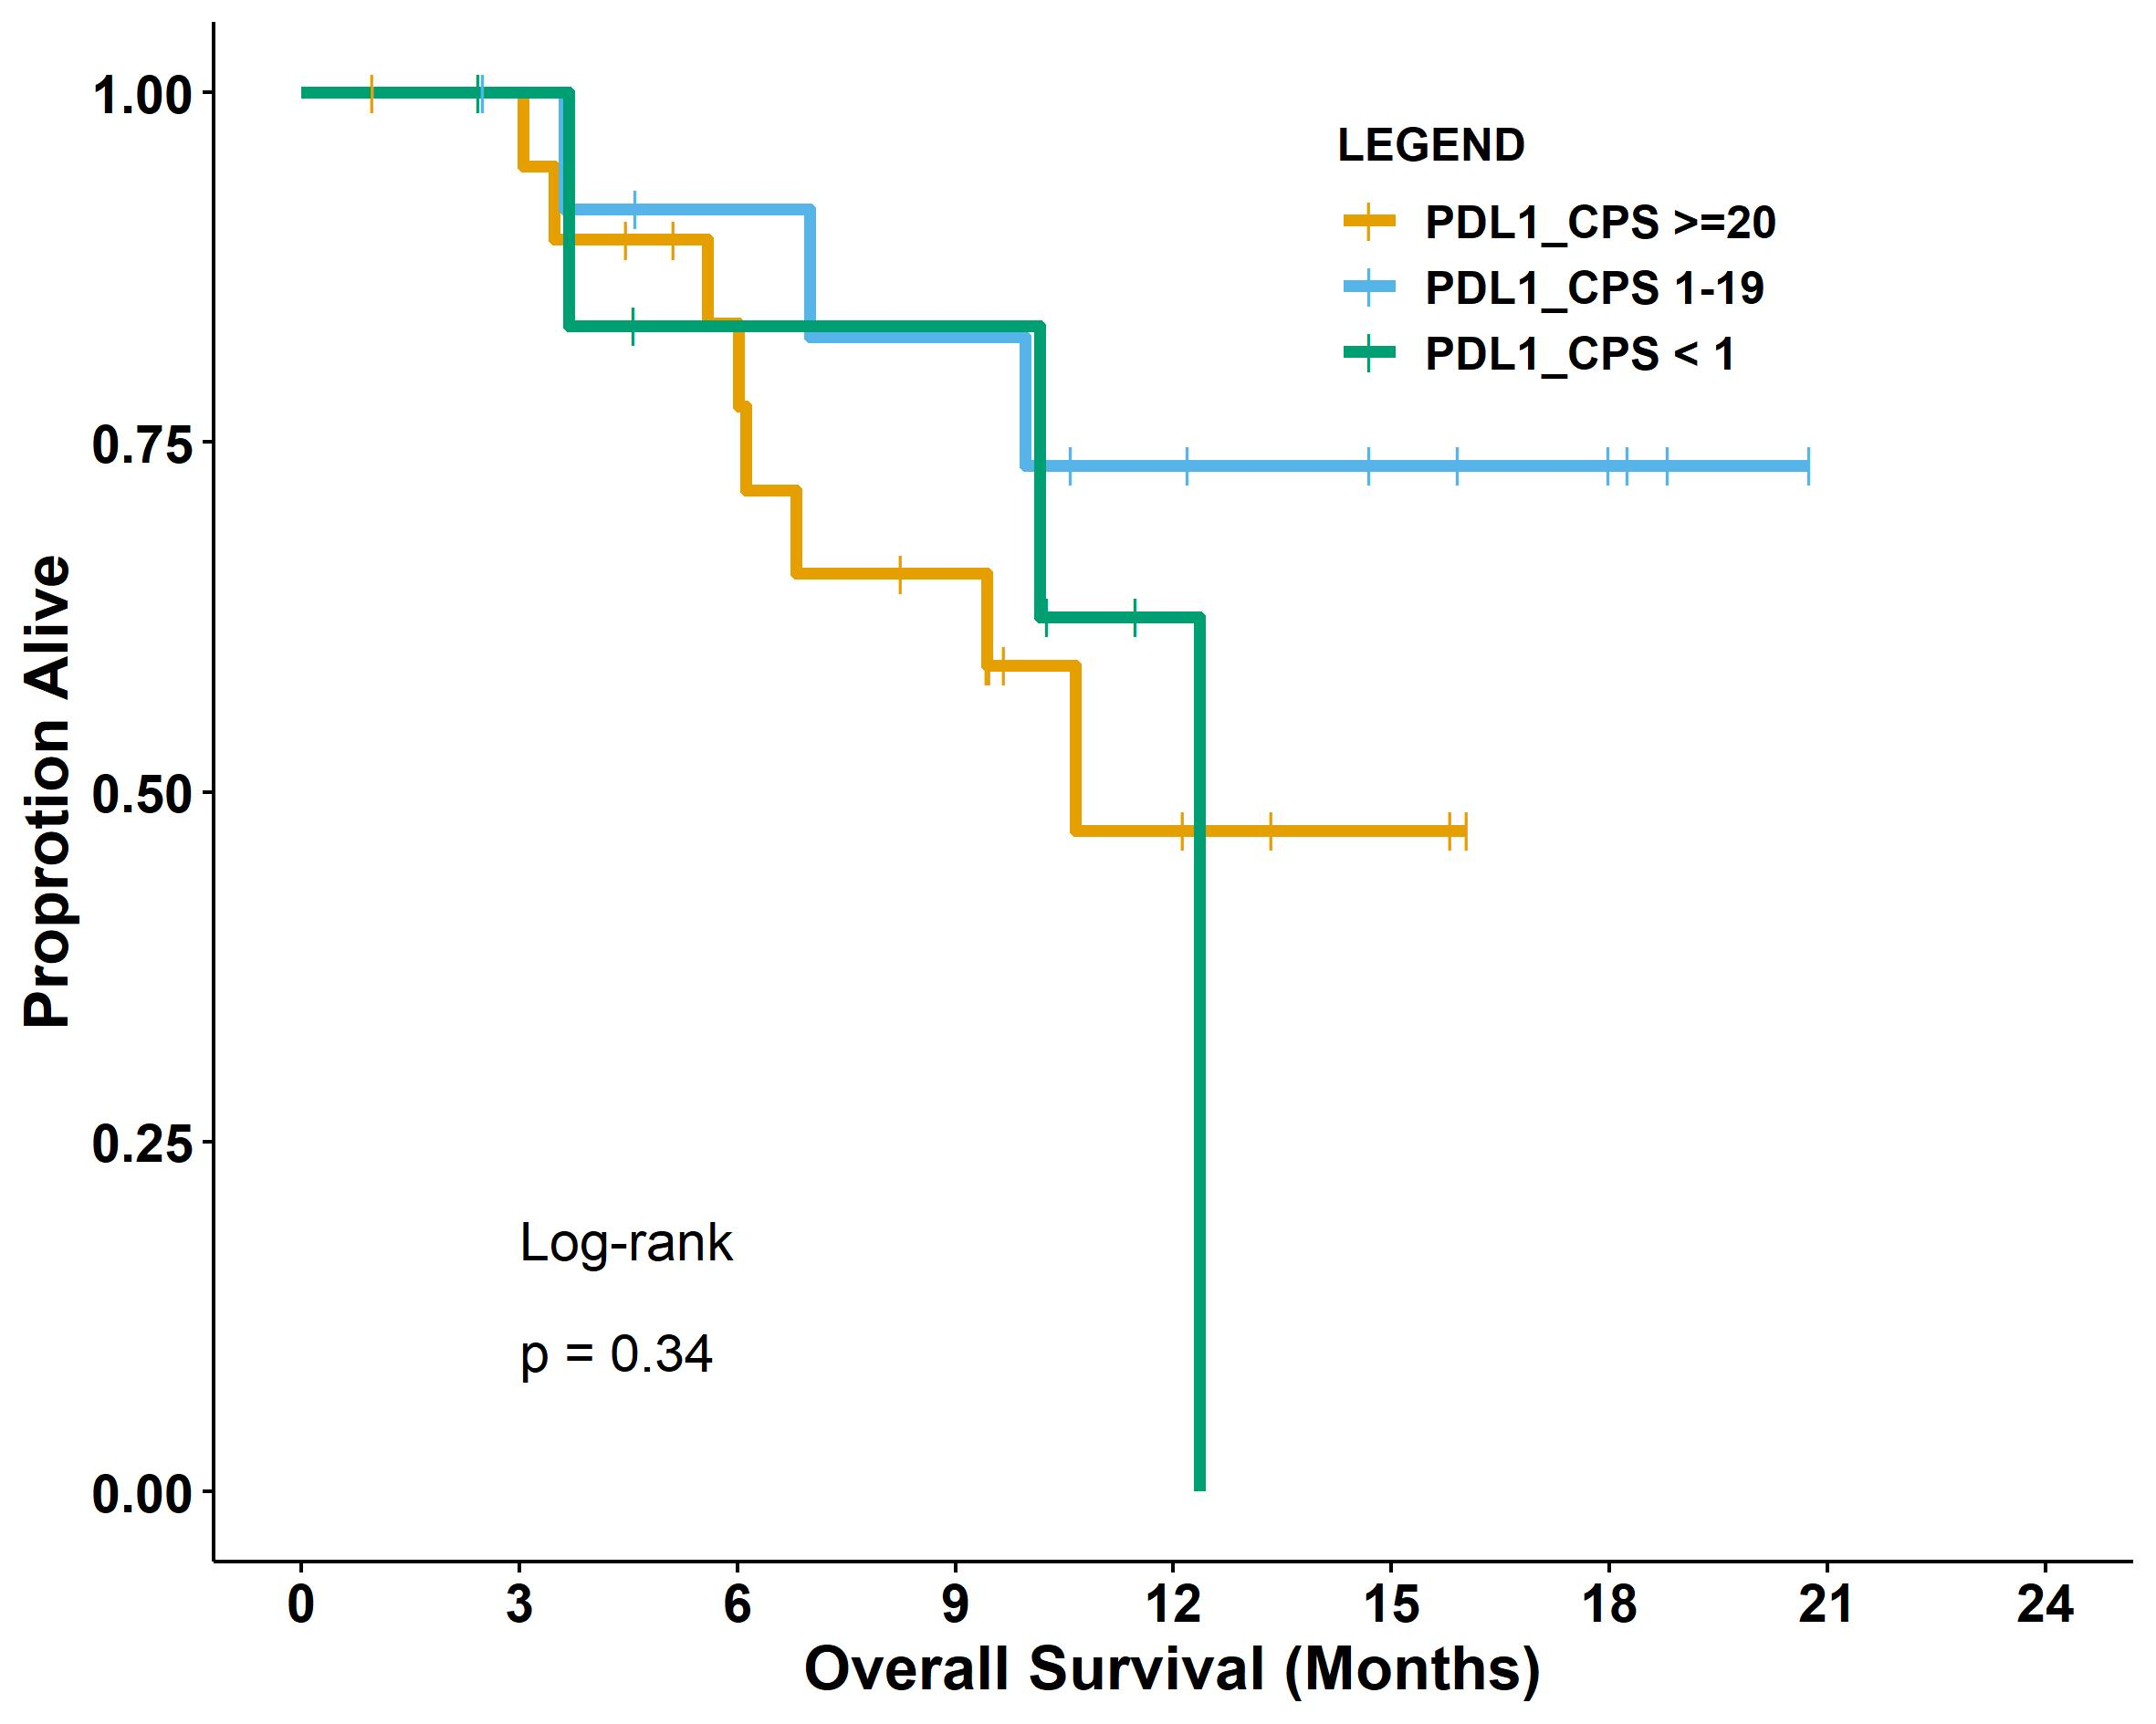
Supplementary Figure 2.
Chung, et al.
G.
H.

