Slide 1
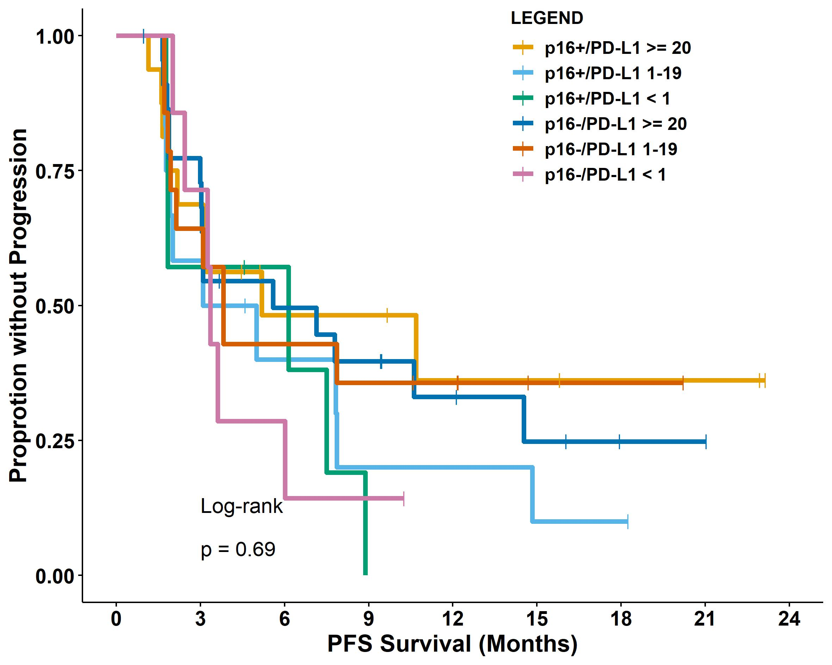
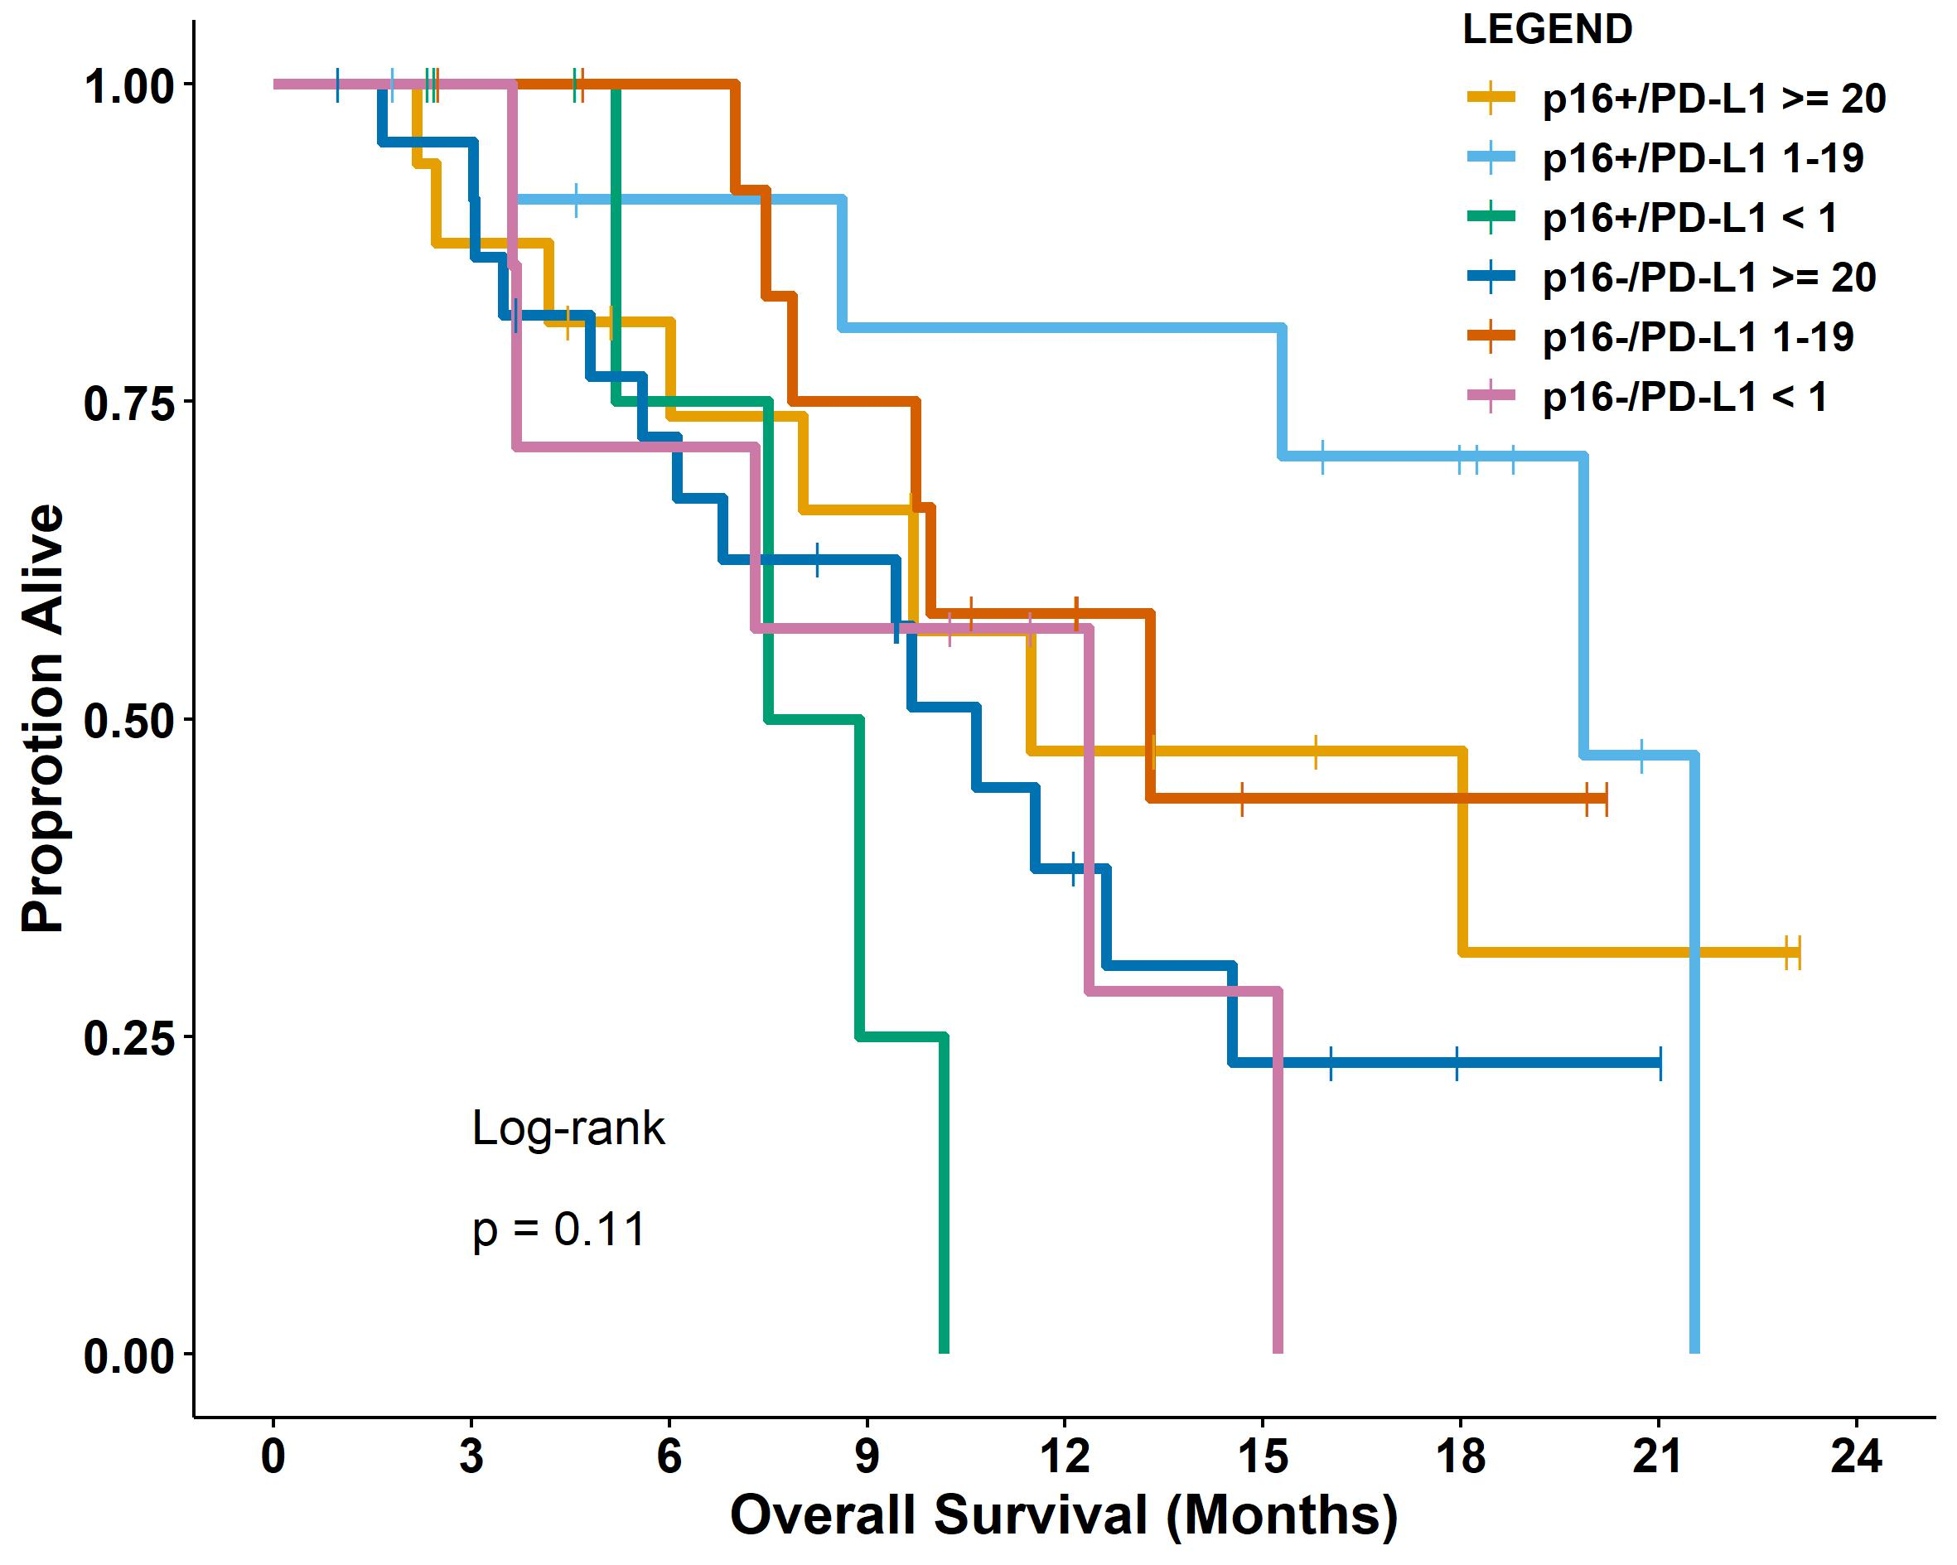
A.
B.
Supplementary Figure 3. A) Progression free survival (PFS) and B) overall survival (OS) comparison based on both p16 immunohistochemistry staining and programmed cell death ligand 1 (PD-L1) combined positive score (CPS) in both Cohort A and B. C) PFS and D) OS comparison based on both the tumor-tissue-modified human papillomavirus (TTMV) DNA levels and PD-L1 CPS in only p16-positive patients in both Cohort A and B.TTMV high – higher than the median TTMV DNA level in plasma; TTMV low – lower than the median TTMV DNA level in plasma.

Slide 2
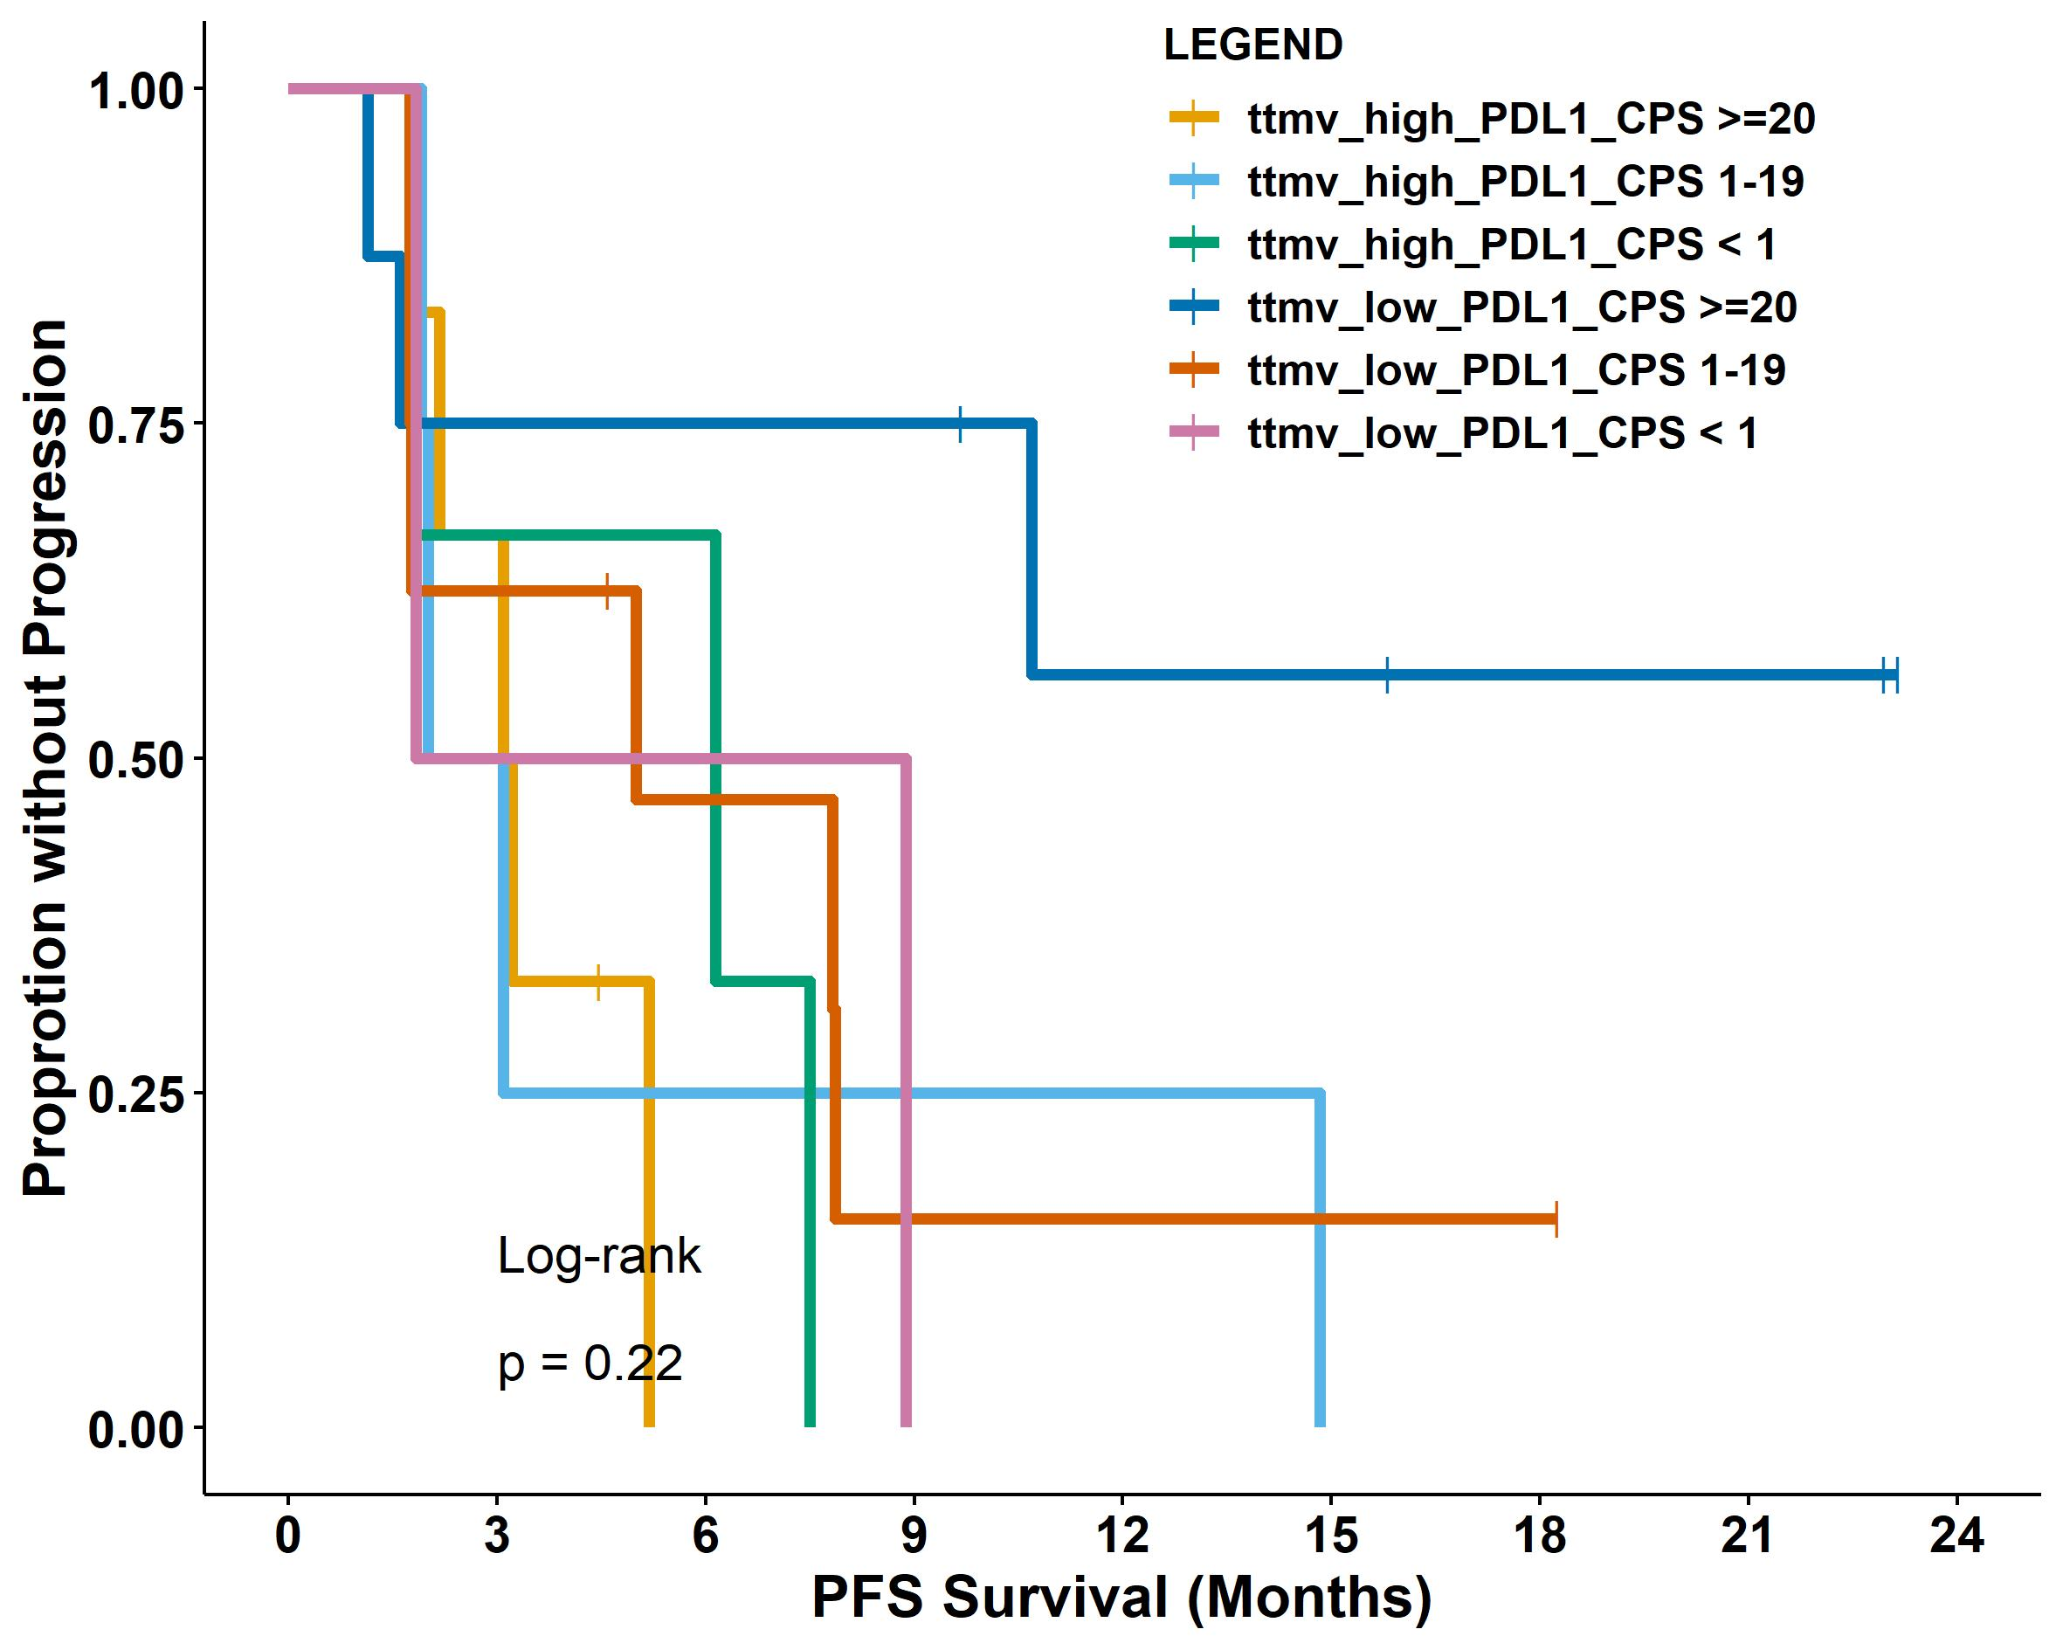
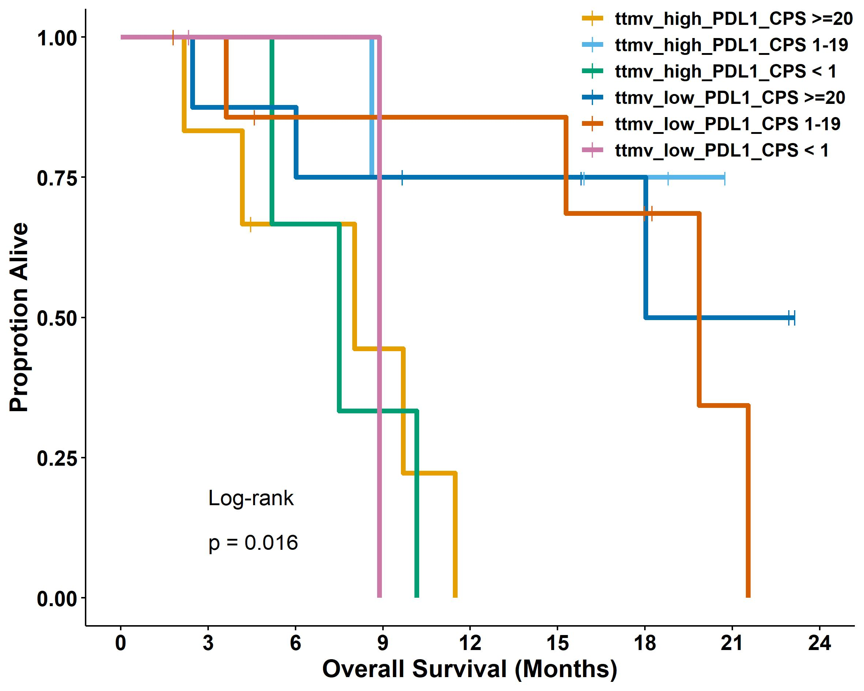
Supplementary Figure 3.
Chung, et al.
C.
D.

