Slide 1
Figure 1. Physicochemical characterization of silver nanoparticles
A

Slide 2
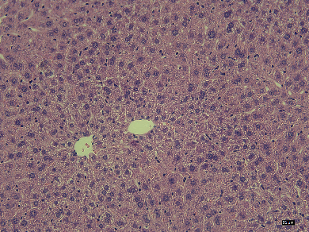
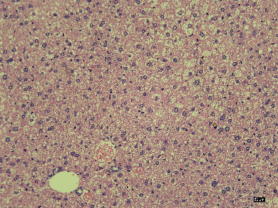
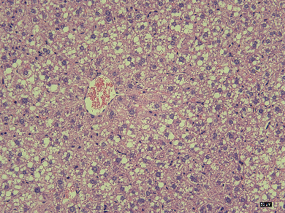
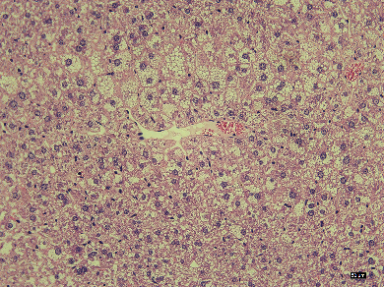
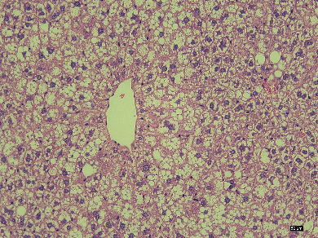
Figure 2. AgNPs aggravated HFD-induced hepatic dysfunction in mice
L
Control
NAFLD
NAFLD + AgNPs-0.5
NAFLD + AgNPs-2.5
NAFLD + AgNPs-12.5
Notes:
8*6.68
5*7.32

Slide 3
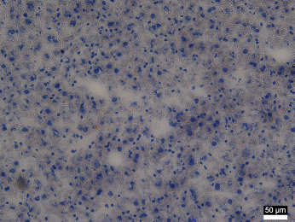
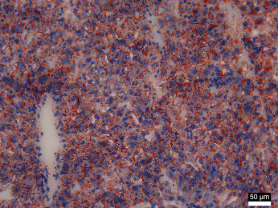
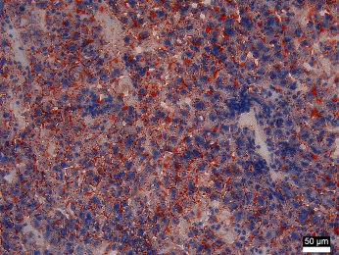
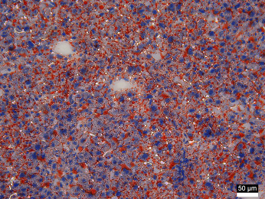
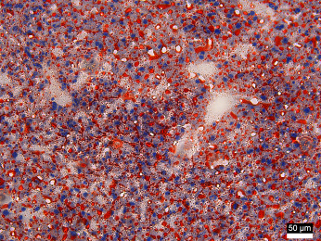
Figure 3. AgNPs exacerbated HFD-induced hepatic steatosis in a manner involving altered expression of genes for de novo lipogenesis in mice
A
Control
NAFLD
NAFLD + AgNPs-0.5
NAFLD + AgNPs-2.5
NAFLD + AgNPs-12.5

