Slide 1
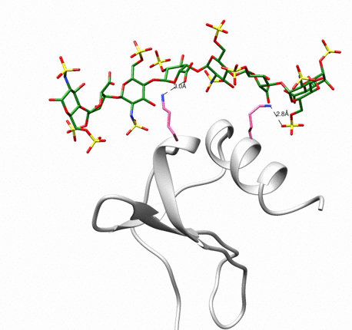
Movie S1. Highly Selective Binding. MD simulations of HS08 (green stick) binding to KC. Simulations were performed for 100 ns and a snap shot of trajectory is shown. KC is shown in grey ribbon diagram and interacting residues, Lys22 and Lys66, are shown in hot pink color. What to look for in the video: Note HS08 interacts consistently in the same binding site. Refer to the original publication for details: https://doi.org/10.1074/jbc.RA118.004866

