Slide 1
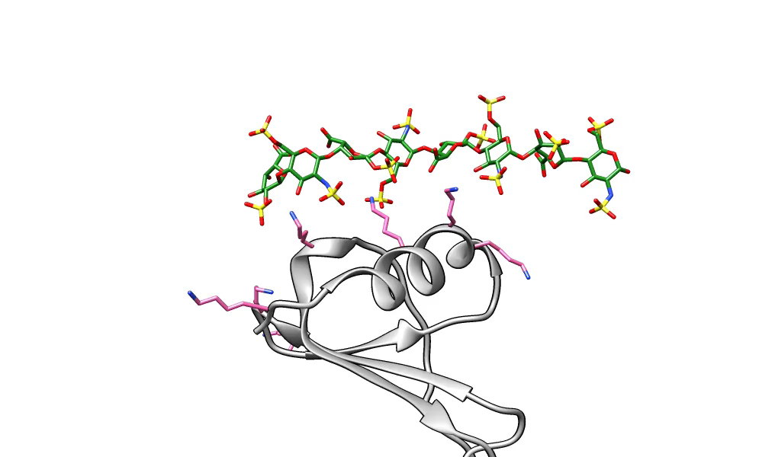
Movie S3. Plastic Binding. MD simulations of HS08 (grey sticks) binding to CXCL5. Simulations were performed for 50 ns and a snap shot of trajectory is shown. CXCL5 is shown in grey ribbon diagram and interacting residues, Lys25, Lys65, and Lys69, are shown in hot pink color. What to look for in the video: Note how HS08 moves along the binding site. In this movement, initially residues lysines interact with sulfates and carboxylates of HS08; as the simulation proceeds, the protein slides along the HS08 chain, a movement of 11 – 12 Å. Refer to the original publication for details: https://doi.org/10.1074/jbc.M116.745265

